Slide 1
gSpan: graph-based Substructure pattern
Paper by: Xifeng Yan and Jiawei Han
Report by: Gaurav Ghosh and Harold Austin
Notes:
Introduce ourselves . . . Hope that we have the presentation pulled together enough to make this work.

Slide 2
Introduction
Definitions (Labeled Graph, BFS, DFS)
The Problem – Organizing Data
Data Structures can grow exponentially
Depth First Search Tree
Forward Edge Set and Backward Edge Set
Canonical Labelling and Minimum DFS Code
gSpan Algorithm
gSpan Comparisons

Slide 3
Definition: Labeled Graph
Basically – Each vertex + edge is assigned a label
Canonical expression
G=(V,E, L, l)
V = Vertex (Node)
E = Edge (Connects to vertices)
L = Label Set
l = function for assigning labels (in case there are no Labels)
Notes:
Labels are assigned to each Vertex (Node) and Edge – this labelling procedure

Slide 4
Definitions: Breadth First Search
Select Node
Notes:
Selecting a Node, we traverse all edges to their adjoining nodes

Slide 5
Definitions: Breadth First Search
Select Node
Traverse all Edges connected to the Node
Add Adjoining Nodes
Notes:
Then we repeat by following all the edges for the nodes discovered . . .

Slide 6
Definitions: Breadth First Search
Select Node
Traverse all Edges connected to the Node
Add Adjoining Nodes
Repeat for each Node Added, until Graph is complete
Notes:
Until the process is complete – the problem with the process, is that traversing all edges to their respective nodes, can be very expensive (time and effort) with a large graph. (Especially one that is mislabelled)

Slide 7
Definition: Depth First Search
Select a Node
Notes:
Depth First Search has a lot of weaknesses compared to the Breadth First Search . . .

Slide 8
Definition: Depth First Search
Select a Node
Follow down the longest Path
Add adjoining Edge + Node
Notes:
By traversing the longest path first we automatically generate a deeper tree

Slide 9
Definition: Depth First Search
Select a Node
Follow down the longest Path
Add adjoining Edge + Node
Repeat ad Nauseam
Notes:
The advantage of using depth First search is a smaller graph to traverse. The depth first search generated duplicate entries (

Slide 10
Search Space: Depth First Search Code Tree
DFS Tree problems:
Deeper Tree
Duplicate Entries
Quickly Expands
(X-c-Z) is removed
(X-c-Z) == (X-c-Z)
(Y-d-Z) is NOT removed
(Y-d-Z) != (Z-b-Y)
Notes:
The idea is that we create a search space of the graph (like an index for a database). In order to make the graph faster to traverse duplicate sub-graphs are removed. Note the highlighted Vertix

Slide 11
DFS Code for Generating DFS Tree
Edge No | Tree (iv)
0 | (V0, V1, X, a, X)
1 | (V1, V2, X, a, Y)
2 | (V2, V0, Y, b, X)
3 | (V2, V3, Y, b, Z)
4 | (V3, V0, Z, c, X)
5 | (V2, V4, Y, d, Z)

Slide 12
Labelling DFS Tree
A vertex is selected
A middle vertex is selected to better illustrate the process
This vertex is labelled V0

Slide 13
Labelling and DFS Tree, Cont.
A Forward Edge is added
can only be added to the rightmost path
A Backwards Edge connects a node to another existing non-parent node
can only be added to the rightmost vertex (closest to the root)

Slide 14
DFS Code for Graph iv
Edge No | Tree (iv)
0 (V0’s Edge) | (V0, V1, X, a, X)
1 | (V1, V2, X, a, Y)
2 | (V2, V0, Y, b, X)
3 | (V2, V3, Y, b, Z)
4 | (V3, V0, Z, c, X)
5 | (V2, V4, Y, d, Z)

Slide 15
Labelling and DFS Tree
A Forward Edge is added
can only be added to the rightmost path
A Backwards Edge connects a node to another existing non-parent node
can only be added to the rightmost vertex (closest to the root)

Slide 16
DFS Code for Graph iv
Edge No | Tree (iv)
0 | (V0, V1, X, a, X)
1 | (V1, V2, X, a, Y)
2 | (V2, V0, Y, b, X)
3 | (V2, V3, Y, b, Z)
4 | (V3, V0, Z, c, X)
5 | (V2, V4, Y, d, Z)

Slide 17
DFS Code for Graph iv
Edge No | Tree (iv)
0 | (V0, V1, X, a, X)
1 | (V1, V2, X, a, Y)
2 | (V2, V0, Y, b, X)
3 | (V2, V3, Y, b, Z)
4 | (V3, V0, Z, c, X)
5 | (V2, V4, Y, d, Z)

Slide 18
DFS Code for Graph iv
Edge No | Tree (iv)
0 | (V0, V1, X, a, X)
1 | (V1, V2, X, a, Y)
2 | (V2, V0, Y, b, X)
3 | (V2, V3, Y, b, Z)
4 | (V3, V0, Z, c, X)
5 | (V2, V4, Y, d, Z)

Slide 19
Step One: Pick a Node and traverse the graph, depth first search
Notes:
Graph 1 is the original graph we are working with. Combining the labelling and selecting any node, we should notice that the graph structure is retained.
In Graph 2-3, a node is selected, and the Vertex + Edge is labeled with V and a Number
The solid lines represents a forward Edge set, while the dashed lines represents a backward edge set . . .reminder that the Vertex + Edge = a label (V#) . . . The label number increases as we traverse down the right most path, then any branches increment after that – Note that the Z vertex at the branch by itself is always V4
For the original Graph – there exists tens of possibilities of generating DFS Codes.

Slide 20
DFS Code for Graph ii
Edge No | Tree (ii)
0 | (V0, V1, X, a, Y)
1 | (V1, V2, Y, b, X)
2 | (V2, V0, X, a, X)
3 | (V2, V3, X, c, Z)
4 | (V3, V1, Z, b, Y)
5 | (V1, V4, Y, d, Z)

Slide 21
DFS Code for Graph iii
Edge No | Tree (iii)
0 | (V0, V1, Y, a, X)
1 | (V1, V2, X, a, X)
2 | (V2, V0, X, b, Y)
3 | (V2, V3, X, c, Z)
4 | (V3, V0, Z, b, Y)
5 | (V0, V4, Y, d, Z)

Slide 22
G-Span Algorithm (Pruning the DFS Tree)
Rule 1: In the DFS Tree, no potential child can contain an edge less than e0 (No negative edge counts)
Rule 2: Backward Edges must be smaller edge than the parents edge
Rule 3: Do not prune from the Rightmost path
Rule 4: Post-pruning is applied to the remaining un-pruned nodes
Notes:
Finally, at the content of the paper . .. Yes, majority of the paper is about how to setup the DFS Tree in order to use the G-Span algorithm. G-span does a pre-order search of he DFS Code tree, covering the entire graph.

Slide 23
Pruning Examples
Notes:
The Sample G-Span Tree, compared to the Grown G-Span Tree . . .
Rule 1: X-a-X is pruned because this would be a child duplicate node . . . .
Rule 2: X-a-Z is larger than X-c-Y, therefore the back edge is removed.
Rule 3: (According to the Paper: W-a-Z is pruned fore not being on the right most path . . . ) Do they mean X-b-Y?
Rule 4: Z-e-Y is pruned . . ..

Slide 24
Comparisons
FSG by Kuramochi and Karypis
Apriori based
Candidate set generation
Multiple scans of database
Harder to scale
Tests
Synthetic data by Kuramochi and Karypis
Real data is a chemical compound dataset

Slide 25
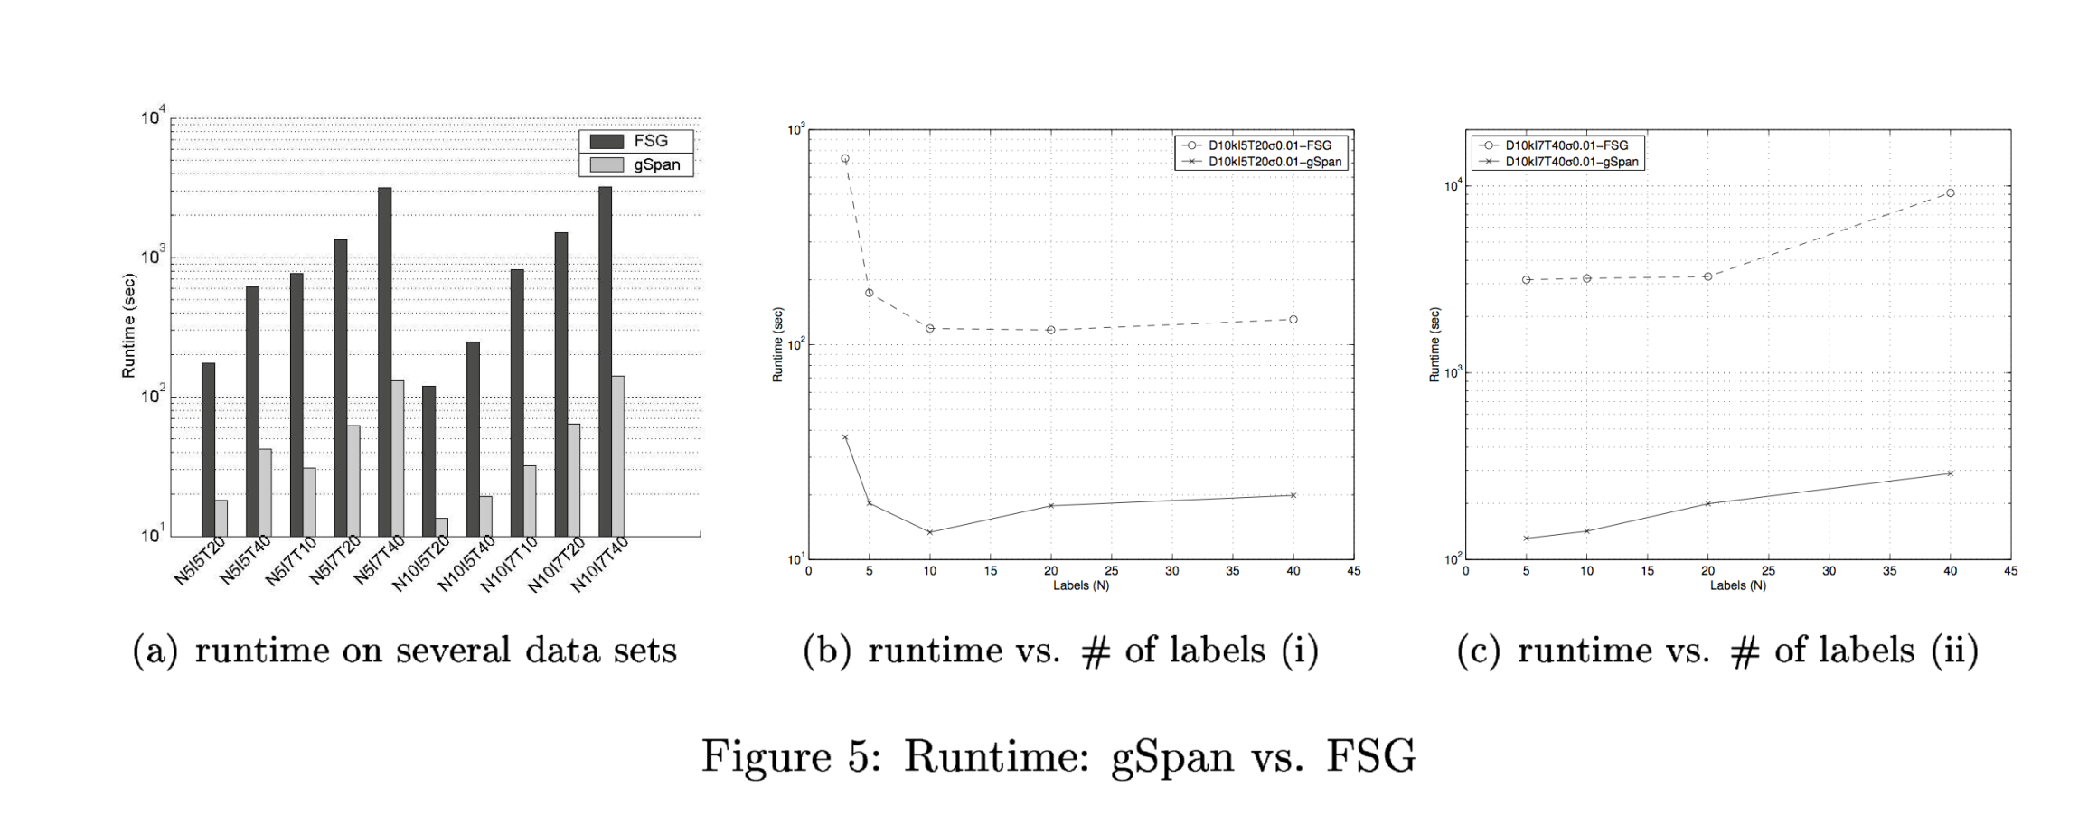
Performance
N: Number of possible Labels, T: Average size of graphs in terms of edges
(b) Average Size of graphs 20, Average size of potential frequent subgraph: 5
(c) Average Size of graphs 40, Average size of potential frequent subgraph: 7

Slide 26
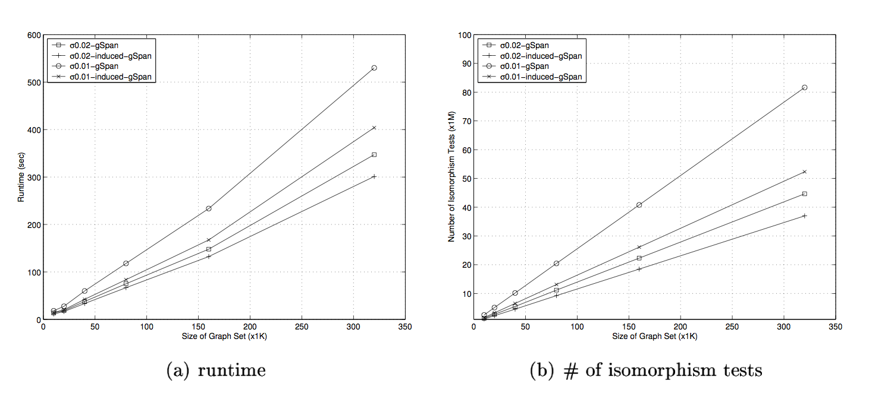
Performance
Scalability of gSpan and Induced gSpan

Slide 27
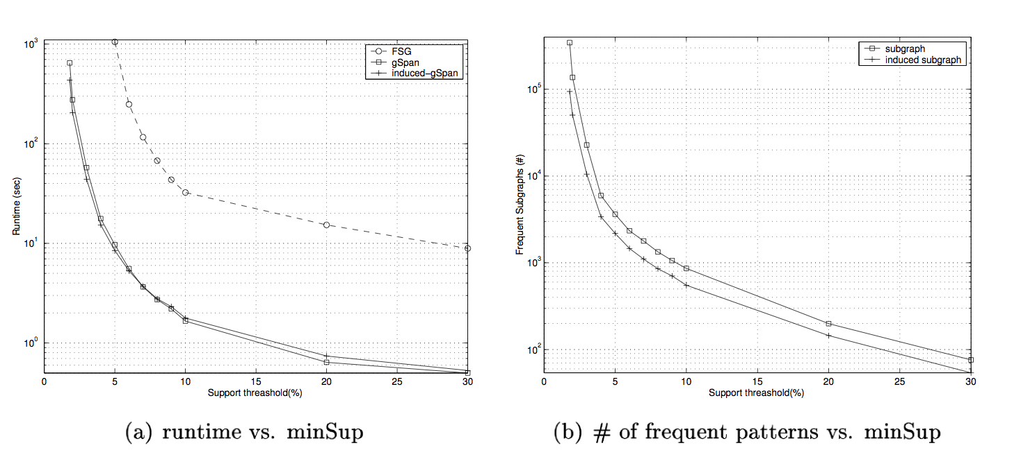
Performance
Chemical Compound Datasets
Chemical compounds have lots of tree like structures

Slide 28
Recent Developments
Test Machine: 500 Mhz Intel Pentium III PC with 488 MB
A survey of Frequent Subgraph Mining Algorithms by Chuntau Jiang, Frans Coenen and Michel Zato II
ADI-Mine (Wang et al. 2004b) Use general index structure. Can mine graphs sets off up to 1 million while gSpan can only do 300K
FFSM (Huan et al. 2003). Large and dense graphs with number of labels.
SPIN (Huan et al. 2004) is a spanning tree based frequent subgraph mining algorithm. SPIN displayed significantly better performance than gSpan and FFSM with respects to both synthetic and chemical data
Closegraph (Yan & Han, 2003) improvement on gSpan uses an equivalent based early termination to prune the search space.

Slide 29
Conclusion
Thank you . . .

Slide 30
Hidden Slide
Edge No/ Depth | Tree (ii) | Tree (iii) | Tree (iv)
0 | (V0, V1, X, a, Y) | (V0, V1, Y, a, X) | (V0, V1, X, a, X)
1 | (V1, V2, Y, b, X) | (V1, V2, X, a, X) | (V1, V2, X, a, Y)
2 | (V2, V0, X, a, X) | (V2, V0, X, b, Y) | (V2, V0, Y, b, X)
3 | (V2, V3, X, c, Z) | (V2, V3, X, c, Z) | (V2, V3, Y, b, Z)
4 | (V3, V1, Z, b, Y) | (V3, V0, Z, b, Y) | (V3, V0, Z, c, X)
5 | (V1, V4, Y, d, Z) | (V0, V4, Y, d, Z) | (V2, V4, Y, d, Z)

Slide 31
Hidden Pruning the DFS Tree
Notes:
In order to make the DFS tree smaller, pruning duplicate graph patterns is done.

Slide 32
Background Information
Substructure Mining
Graphs isomorphism
Lexicographic order
Depth First

