Slide 1
Learning Patterns in the Dynamics of Biological Networks
Speaker : Jeel Patel & Lin Zhang
Professor : Petko Bogdanov

Slide 2
Overview
Motivation
Current Work
Problem Definition
Approach
Experiments & Results
Conclusion

Slide 3
Motivation
Biological network directly connected to
our own biological system.
Advancement in the understanding of
this system could lead to better health
conditions.
So let’s learn about the Dynamics of the
Biological Network and the patterns associated
with it.!

Slide 4
Current Work
Analysis of the trends in the amount of molecules and flux of biochemical reactions.
Temporal data mining attempts to learn temporal patterns in sequencial data, which is ordered with respect to some index like time-stamps.
Discover communities and detect changes in dynamic graphs that is represented as matrix and encoding schemes.
Several detection measures of abnormal changes in the sequence of graphs and graph distance measures between two graphs.
Predict the future structure in a dynamic network and mine periodic patterns using frequent subgraphs.

Slide 5
Problem Definition
The approach:
First learn how one graph is structurally transformed
into another using graph rewriting rules, and then
abstract patterns that represent the dynamics of a
sequence of graphs using the transformation rules.

Slide 6
Learning graph rewriting rules from two sequential graphs

Slide 7
Learning entire set of graph rewriting rules

Slide 8
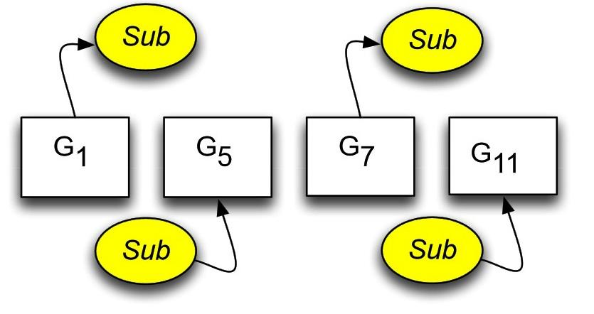
Learning a transformation rule to abstract the learned graph rewriting rules
Above Example: Sub is removed from Gi and then added back in Gi+4

Slide 10
4. Approach
1.Compressing minimization
2.Learning Graph Rewriting Rules
3.Learning Transformation Rule
4.Complexity Issue
5.Evaluation Metric

Slide 11
4.1Compressing minimization
Definition the best-compressing subgraphs:
These can minimize the description length of the input graph after being compressed by the subgraphs based on the Minimum Description Length (MDL) principle.

Slide 12
4.1Compressing minimization
The approach finds a substructure S that minimizes the Compression of the graph defined as:

Slide 13
4.1Compressing minimization
Explaination
The description length of the substructure S
The description length of the input graph after compression
The description length of the input graph

Slide 14
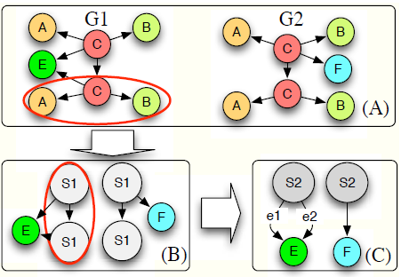
4.1Compressing minimization
Example:

Slide 15
4.2Learning Graph Rewriting Rule
Purpose: The leanring graph rewriting rule is used to describe the difference between two sequential graph.
Result: Through repeated application of this method allows us to find the set of all subgraphs common to a pair of consecutive graphs.

Slide 16
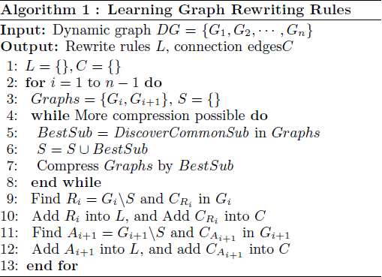
4.2Learning Graph Rewriting Rule
The L C is used to store and removal subgraph and connection edges

Slide 17
4.2Learning Graph Rewriting Rule
prepare two sequential graph

Slide 18
4.2Learning Graph Rewriting Rule
while loop:
Discovery the common subgraph by compressed-based approach

Slide 19
4.2Learning Graph Rewriting Rule
line 9~11:
After compressing the two graphs by the maximum common subgraph, the algorithm identifies removal (or addition) sub-graphs and connection edges (lines 9 and 11) using a modified Breadth First Search (mBFS), which adds each edge as well as each vertex into the queues as visited or to be visited.

Slide 20
4.2Learning Graph Rewriting Rule
output:
A will be the input of the Algorithm and C will be use to visualize the relation between learned subgraphs and original graphs.

Slide 21
4.3 Learning Transformation Rule
Purpose: Describe how the graph changes over time. A sequence of revised graphs are used to represent the changes.
Result: This allows us to find the subgraphs repeatedly added and removed in the dynamic graph

Slide 22
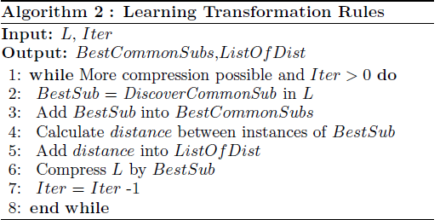
4.3 Learning Transformation Rule
We then use DiscoverCommonSub again to find common subgraphs in L

Slide 23
4.3 Learning Transformation Rule
We calculate the temporal distance between two consecutive instances of the best-compressing
subgraphs to describe the time at which the removal (or addition) occurs after the previous addition (or removal)

Slide 24
4.3 Learning Transformation Rule
After the discovery of the common subgraph, L is
compressed by this subgraph, and the discovery process is iterated until no more compression is achieved or we reach a user-defined limit Iter on the number of iterations.

Slide 25
4.4 Complexity Issue
The problem addressed in this paper is a NP-complete. Specifically, the chanllenge is to discover the maximum common subgraph between two sequential graphs.

Slide 26
4.4 Complexity Issue
Algorithm 1’s total runtime: N1 = NDCS(T − 1), where NDCS is the runtime of Discover CommonSub and it runs for T-1 times.
Algorithm 2’s running time is dominated by NDCS. NDCS is restricted by limit that is calculated based on input data, specifically, the number of unique vertex and edge labels.

Slide 27
4.4 Complexity Issue
Two reasons make sure the proposed algorithm’s complexity is not high:
1: Biological networks are usually sparse graphs and there are not many instances due to plenty of unique labels
2: The algorithm does not try to discover the entire set of maximum common substructures at once.

Slide 28
4.4 Complexity Issue
There will be a tradeoff between exactness and computation time when analyzing very large graphs. So, how to balance them is a ctritical issue.

Slide 29
4.5 Evaluation Metrics
Two metrics are applied to evaluate the leaned transformation rules.
1.Coverage: Evaluate how well the rule describes the change in the graphs.
2Prediction: Evaluate the prediction capability of the learned transformation rule.

Slide 30
4.5 Evaluation Metrics
4.5.1 Coverage
The definition of coverage:
where,
As and Rs are the addition and removal subgraphs in L that contain BestSub.
size(G) = |V | + |E| calculate the size of graph G

Slide 31
4.5 Evaluation Metrics
4.5.1 Coverage
The meaning of Coverage: Higher Coverage indicates the subgraph can describe more significant (larger portions of) changes.
Drawback: Coverage ignores the size of connection edges (|C|).

Slide 32
4.5 Evaluation Metrics
4.5.2 Prediction
The definition of Prediction:
P is the set of positions where we predict the PredictedSubi will show up, RealSubi is the actual subgraph found at position i,

Slide 33
4.5 Evaluation Metrics
4.5.2 Prediction
The meaning of Prediction: Prediction represents how much the predicted subgraph covers the sub-graphs in the testing experiments.
Drawback: It’s not for a temporal prediction, i.e., the exact time
the subgraph appears, but for a sequential prediction,

Slide 34
5 Example and Results
Four experiments are designed to evaluate the proposed method using three ways: artificial generation, combination with two real world data sets.
In the artificial generation, we use a real biological network, but we remove and add some subgraphs manually to generate the dynamic graphs.
In the real world data, we use the KEGG data in combination with additional data to generate dynamic graphs.

Slide 35
5 Example and Results
Artificial Generation: The goal of the artificial generation experiment is to identify the strengths and weaknesses of our approach.
Prediction Experiment: Processing this experiment is because of the research is focused on patterns in graph rewriting rules (patterns in structural changes), we can predict which graph rewriting rules appear.
Mathematical Modeling: Applying the approach to a dynamic graph based on the mathematical modeling data.
Microarray Data: Showing the result of the dynamic graphs based on
microarray data.

Slide 36
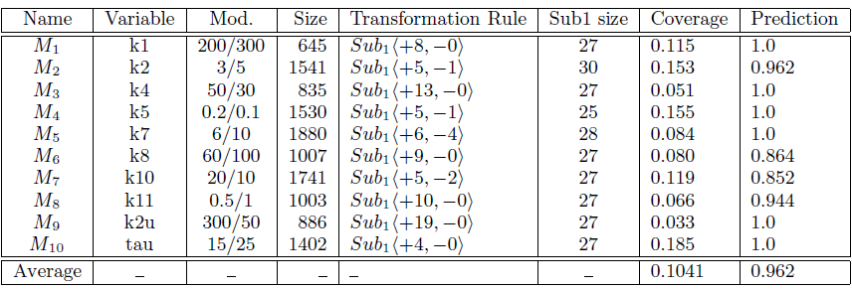
5 Example and Results
Mathematical Modeling:

Slide 37
6 Conclusion
1.Two basic algorithms are proposed:
1.Learning Graph Rewriting Rules
2.Learning Transformation Rule
2.Two evlauation metrics are provided:
1.Coverage: Evaluate how well the rule describes the change in the graphs.
2Prediction: Evaluate the prediction capability of the learned transformation rule.
3.Complexity issue addressed , it’s a NP complete
4.Four erxperiments are conducted to prove the proposed algorithms.

Slide 38
6 Conclusion
Future works:
Find a more general standard compress graph;
The algorithm can compare more than two graph everytime, this will reduce the itertion.
Evaluation metric shoud be updated, make it more universal, not too much restriction.
In the expriment part, more comparision work should be presented.

