Slide 1
CSI 660: Sep 26 Flash Team Presentations
CSI 660 – Networks Mining
Instructor: Petko Bogdanov
U at Albany, SUNY
Website:
http://www.cs.albany.edu/~petko/classes/FALL14.CSI660/

Slide 2
Teams
Priya and Navita
Yu and Lin
Dhiraj and Bilal
Darshana and Sushant
Aditi and Shibani
Samarth and Jeel
Jinal and Saurabh
Ananya, Rohith and Bhavana
Gaurav
Trey and Ziqiang
Akhil and Tejas
Shashwat and Vaibhav

Slide 3
Klustering Your Friends
Navita Jain
Priya Balachandran Mary

Slide 4
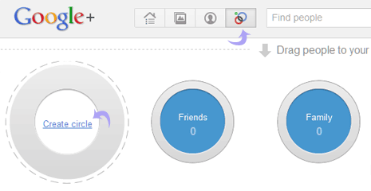
Problem Description
What is ego-network?

Slide 5
Related Work
Learning to Discover Social Circles in Ego Networks - by Julian McAuley and Jure Leskovec
Notes:
There were many papers that tried to address this issue
While some considered network structure of an ego network others considered profile information
But this particular paper stood out and used both network structure and profile information.
Their approach involved calculating a parameter which was a indicator of similarity between 2 alters of a ego network. We felt there was a lot of computation involved since the parameter is calculated for every pair in the ego’s network.

Slide 6
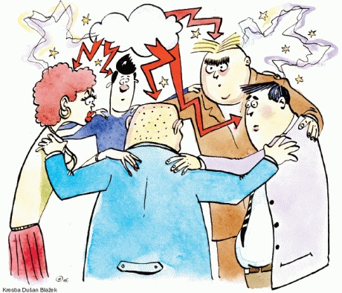
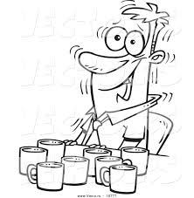
Our Approach
Multilevel K way partitioning approach for Irregular graphs
Notes:
So after much brainstorming and conversing and coffees!!!
We think the multilevel k way partitioning approach for irregular graphs would be a good way to address this problem.
We have a few ideas and are still figuring out the details.

Slide 7
Output Result
Image taken from “Learning to Discover Social Circles in Ego Networks" by Julian McAuley and Jure Leskovec from the Neural Information Processing Systems (NIPS) conference

Slide 8
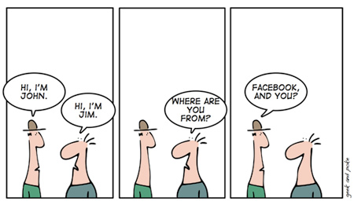

Slide 9
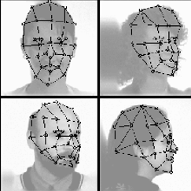
Face Expression Recognition by Improved Elastic Bunch Graph Matching--- Yu Zhang & Lin Zhang
We will employ the Gabor wavelet feature to describe the face expression and then classify the face expression via elastic graph matching.

Slide 10
Data set
The Japanese Female Facial Expression(JAFFE)
It contains 213 images of 7 facial expressions (6 basic facial expressions + 1 neutral)
s
e B e Face Database B

Slide 11
Collaborative Filtering with Multi-component Rating for Recommender Systems
by Dhiraj Tanwar and Bilal Khan

Slide 12
INTRODUCTION
Collaborative filtering based recommender system focuses on predicting new items of interest for a user based on correlations computed between that user and other users. We are going to use the concept of collaborative filtering using multi component rating to recommend movies to the users.
There are two variables to characterize user behavior and items characteristics separately while most of the collaborative filtering use single component that is overall rating of the movies or of the items.
The multi components attributes like stories, acting, scripts, directions ,age ,gender etc. to be rated which is brought into generation of movie recommendation.

Slide 13
MOTIVATION
Currently the multi component rating recommender system uses the techniques and models like Flexible Mixture Model(FMM) and Expectation Maximization Algo with an assumption that allow them to factorize joint distribution and finally make predication and recommendation.
However, there is catch point in this method that while working with the less training data they got a better prediction and retrieval but working with large training data then it leads to lower prediction.
Secondly, the author assumes that there is no dependency among the variables and also correlation amount the component variable is zero just to avoid the complexity.

Slide 14
Finding social circles in Ego-Networks using network assignments and profile Similarity.
Presenters- Darshana Rane
Sushant Obeja

Slide 15
Introduction
Social network allows users to use and follow streams of data generated by hundreds of their friends and acquaintances.
This in turn generates a large volume of information. There is a need to organize this information overload and create their personal social network .
One of the main organizing principles in real-world networks is that of network communities, where sets of nodes organize into densely linked clusters. Organizing their networks by forming social circles.

Slide 16
Motivation
Currently, users active on any social network like Facebook, Google+ and Twitter identify their circles either manually, or by finding friends who share a common feature.
However, there are issues with these approaches ,the first one is time consuming and does not update automatically as a user adds more friends.
The second one does not take into consideration the individual features of the users communities, and can work poorly when profile information is missing or withheld.

Slide 18
Scope
Circles can be more accurately predicted by exploiting relationships between the circles of multiple users .
Optimization of the algorithm to work consistently for large number of nodes.
The assumption that circles will be made up of groups of friends with common properties works well with less nodes and degrades the performance as the number of nodes increase, hence reconsideration of the assumption can help in optimizing the algorithm.

Slide 19
SOCIAL MEDIA MINING
USING INFORMATION CASCADES
Aditi and Shibani

Slide 20
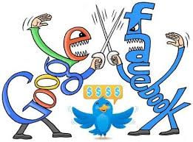
Why Social Media Mining?

Slide 21
EXISTING SYSTEM
Mining approach by considering BURSTY subgraphs.
Use of two algorithms like DIBA for intrinsic graph model and SODA for social burst model.
Time analysis of the BURSTY subgraphs.

Slide 22
PROPOSED SYSTEM
Market Research
Inspection of subgraphs in detail manner.
Categorization of Feedback.

Slide 23
APPLICATIONS
Social media has been increasingly used in a wide range of domains such as:
Political campaigns (e.g., presidential elections).
Market Research
Mass movements (e.g., organizing Occupy Wall Street movements, Arab Spring).
Disaster, crisis response and relief coordination.

Slide 25
Community discovery in social networks
-Samarth Shah
-Jeel Patel
University at Albany

Slide 26
Dynamic Graphs

Slide 27
Communities

Slide 28
Why the fuss?
The data set can be of any period of time, e.g. 1 month, 1 year, or a decade.
We are interested in a particular time-span when a group of nodes (intra-subgraph) interact the most.
For example,
a group of coworkers interact more when their project approaches deadlines.
Deluge of tweets ‘when’ a new product is released.

Slide 29
Thank you

Slide 30
Advertisment Prediction
By:
Jinal Patel
Saurabh Saxena

Slide 31
Motivation
Advertisement industry a multi-billion dollar industry
Internet; The best market to exploit and extract resources

Slide 32
Motivation

Slide 33
Paper’s Referred
Chieh-jen Wang and Hsin-His Chen, “Learning User Behavior for Advertisement click prediction”
Performance of the system has not been analyzed
Only 1 Phase feature selection algorithm has been used

Slide 34
What’s New
Similarity between two user, by common click advertisement.
Deciding on how to display advertisement on website

Slide 35
THANK YOU! ☺

Slide 36
Predicting Movie Popularity Based On Movie Attributes Using Social Media.
Ananya Chinta
Bhavana Bangaru
Rohith Raj Chenna

Slide 37
What is this project?
Easy Guess
It’s in the title
Predicting Movie Popularity Based On Movie Attributes Using Social Media.

Slide 38
Why this project?
The user predictions are generally extracted from comments on various movie websites.
The user reviews however, are more commonly posted on social networking websites like Facebook.
None of the papers that are published researched that domain for more efficiency in prediction of results.
In our paper we are suggesting an algorithm which helps us to predict the popularity of the movie before it is released.
We mine data from various social networking websites like Facebook, Twitter, Google +, Instagram, Foursquare etc.. and use it in the prediction of movie popularity and potential success.

Slide 39
Who gave it a shot?
1. Movie Popularity Classification Based On Inherent Movie Attributes Using C4.5, PART and Correlation Coefficient.
This paper deals with the popularity prediction of a movie pre-release and financial aspects of the movie post-release but does not discuss about intervention of social media.
2. Predicting IMDB movie ratings using social media
This paper deals a little with the social media( only twitter and Youtube) but does not talk about the prediction by taking into the relationship success history of the actors, actresses, directors or budget of the movie.

Slide 40
What do we aim to achieve?
To predict the movie success or failure rate without any error by using social media.
To make sure that the predictions also take the success rate of combination of people working together in the movie.
To completely integrate movies into social media.

Slide 41
Thank You

Slide 42
Location Based Twitter Trend and Event Detection with Network Follower Data
Gaurav Ghosh

Slide 43
Motivation
Twitter
271 million monthly active users
500+ million tweets per day
Major Events
Real-time updates
High frequency + Short time = Burst
Location

Slide 44
Implementation
“Trendy” term list
Timestamp
Location
Location not mandatory for user
User follower network to find location
Random walk

Slide 45
Using Markov Chain to Predict the best treatment for patients
By Trey Huang and Ziqiang Lin

Slide 46
SEER Data
We will use the data from seer.org to do the predict
Data contain the information of patients who has lung cancer in different cancer stage.
We will use the categorical to divide the patient in different group.
E.g. Age: 0-17, 18-24, 25-45, 46-64 and 64+
E.g. Sex: Male and Female.
Combine with cancer stages: Stage 1, Stage 2, Stage 3 and Stage 4.

Slide 47
Categories, Stages and Treatments
What we can learn in general:
We will using Markov Chain to find out the “best” treatment (Surgery or Radiation) for each group on any given stage.
What we can do:
Based on all information we get, we can recommend a “best” treatment for new patient.
For example, a classified type-C patient comes in as stage 1, we may give him radiation, a couple months later, his cancer change from stage 1 to 2, we will recommend him to have a surgery.

Slide 48
But, the reality is … can we really classify everyone in real world?

Slide 49
Basic idea: Feedback from what we have learn
We can do some reverse engineering to do a better job on classification.

Slide 50
Where can we go from here?

Slide 51
Outliners and their potential values
Anomalies are not errors (sometimes)
New discoveries may come from them
For example, if we know type C patient overlaps B,C and E, while a type-C patient who has been following the “best” treatments did not get expected results…

Slide 52
Anomaly Detection in Computer Networks
Akhil Chaturvedi Tejas Bhoir

Slide 53
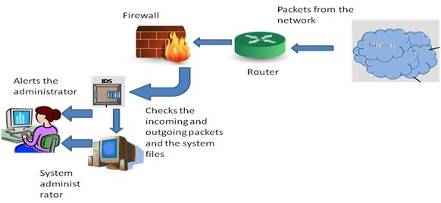
Introduction and Motivation
It deals with an efficient anomaly detection in traffics of computer networks.
In business world, information is the key component.
As the entire business is connected to the Internet there is potential for millions of attacks on the business.

Slide 54
Related Work
Network Traffic Anomaly Detection Based on Packet Bytes by Matthew V. Mahoney.
Novel Attack
Efficient Computer Network Anomaly Detection by Changepoint Detection Methods by Aleksey S. Polunchenko .
Sequential Probability Ratio Test (SPRT), Cumulative Sum (CUSUM) chart, Exponentially Weighted Moving Average (EWMA) and Shiryaev–Roberts (SR) procedure.
INPUT---OUTPUT
I/P→ Computer network system with lot of anomalies that ceases the normal behaviour of system.
O/P→ Computer network system with anomalies removed which allows the system to behave as usual.

Slide 55
Resilient Identitity Crime Detection in Credit Card
Shashwat Parashar
Vaibhav Kapse

Slide 56
Motivation
Detection of Fraud
Saving innocent people
Make the world a safer place to live in

Slide 57
Citation Citation Phua, Clifton, et al. "Resilient identity crime detection." Knowledge and Data Engineering, IEEE Transactions on 24.3 (2012): 533-546.
The Current Paper Detects the Fraud by checking on the data which is similar in certain attributes and is repeating and raises a suspicion on the data. However when the same family members when apply will have similar details which should have certain similar details like address and last name.
The community detection algorithm will organise the data into related community whitelist.
If an attribute is regularly being observed in the data the spike is generated for that attribute and its weightage is altered in the whitelist.
Notes:
Needs/Services, Threats, Mechanisms/Solutions

Slide 58
What we are going to do ?
Introduction of a pre existing list which contains already existing fraud data and is referred to filter out fraud initially.
Business decisions affect the spike in a particular attribute similarity for ex. a business idea asks to give women a special plan in credit card .So the attribute most commonly feature in stream would be “gender”. Introduce factor to observe and introduce business decision in altering the whitelist.
Propose guidelines to check for typographical errors by verifying the fraudulent data to be handled at some other level.

Slide 59
Thank You

