Slide 1
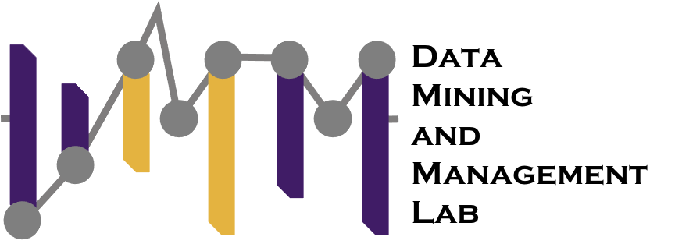
CADENCE Community-aware Detection Of Dynamic Network States
${\text{Maxwell} \text{McNeil}}^{∗†}$ ${\text{Carolina} \text{Mattsson}}^{†}$ ${\text{Frank} \text{W}\text{. }\text{Takes}}^{†}$ ${\text{Petko} \text{Bogdanov}}^{∗}$
* Department of Computer Science, University at Albany— SUNY
† Department of Computer Science (LIACS), Leiden Universit
Computational Network Science Lab

Slide 2
Dynamic Networks
Dynamic networks: interactions (re)occur over time
Social Media
Traffic Networks
Communication networks
STOP
Time
Time
Time

Slide 3
Interaction snapshots
Typically, individual temporal interaction (e.g., one second of interactions) are aggerated into interaction snapshots
t1
t2
t3
t4
t5
t6
t7
t8
S1
Interaction snapshots
S2

Slide 4
Applications
Dependent on these snapshots
Snapshot quality -> model quality
Link prediction
Community detection
Anomaly detection
S1
S2
S3
Link?
S1
S2
S3
Community?
S1
S2
S3
Anomaly?

Slide 5
Typical aggregation
Most often this is done via regular time intervals
e.g., each snapshot represents two hours
t1
t2
t3
t4
t5
t6
t7
t8
1PM:3PM
3PM:6PM
S1
S2

Slide 6
Toy example: Interactions between friends and co-workers
12pm
1pm
2pm
3pm
4pm
5pm
6pm
a
Work
Dinner plan
coordination
b
Lunch break
catch-up
c
d
Message exchange across time
Friends
Communities

Slide 7
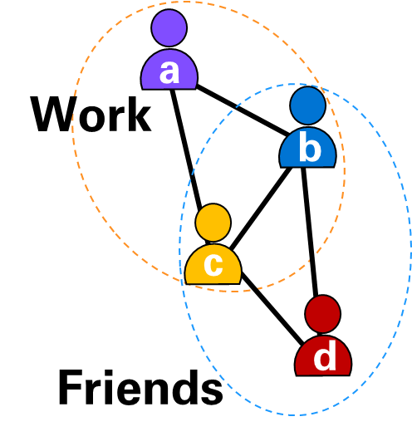
Flawed regular aggregation
12pm
1pm
2pm
3pm
4pm
5pm
6pm
a
2
a
a
1
2
Community structure is not clear
2
2
b
b
b
1
1
1
1
2
c
c
c
2
3
d
d
d

Slide 8
Community aware aggregation
12pm
1pm
2pm
3pm
4pm
5pm
6pm
a
a
3
a
Community structure is clear!
b
4
b
b
1
2
1
1
2
c
c
c
3
2
d
d
d

Slide 9
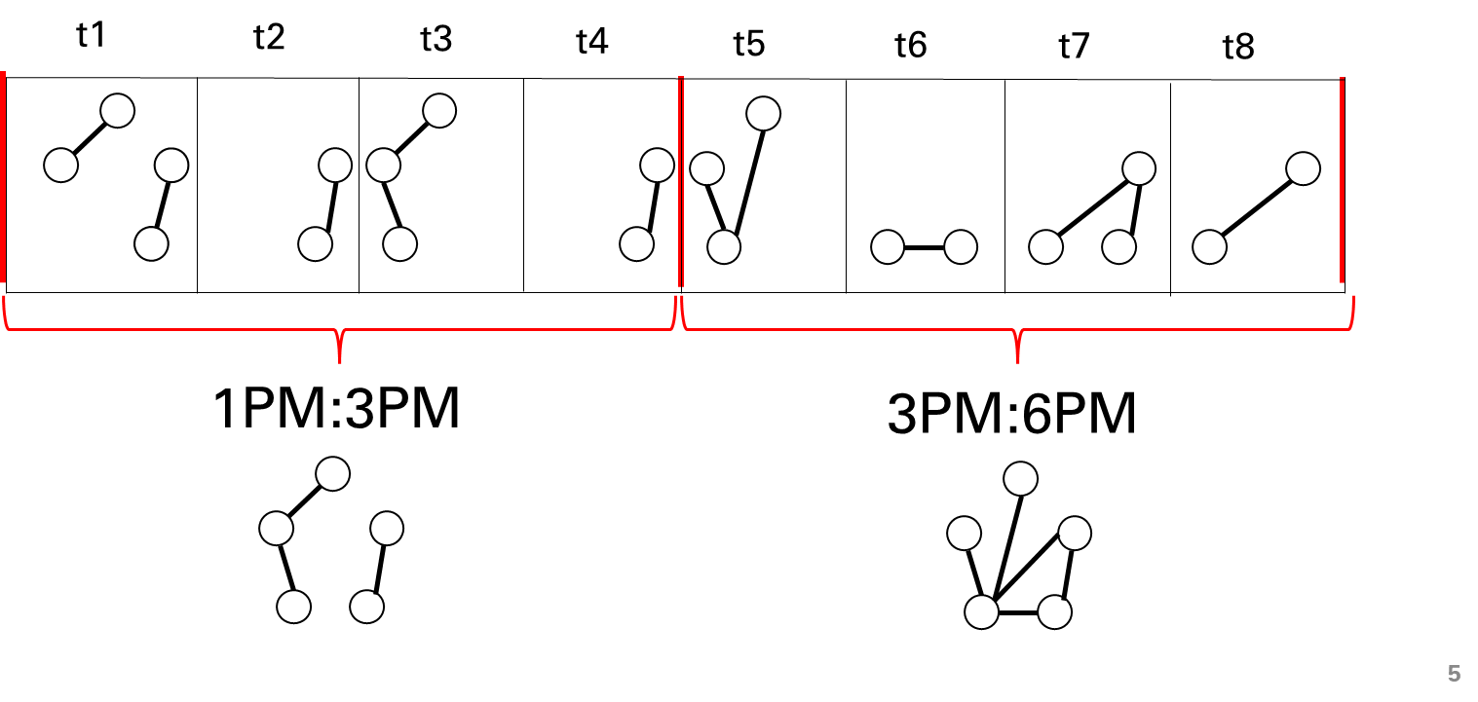
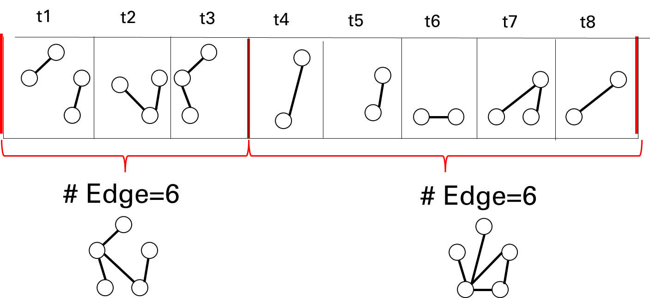
Related workTemporal aggregation
Reg: Regular in time
Completely data agnostic
Cons[WSDM 2022]: Constant number of edges
Edges may come from any community
Not community aware
AGT (Adaptive Granularity in Time Evolving Graphs as
Tensors) [MLG 2020]: Each slice satisfies a heuristic
Dependent on heuristic

Slide 10
Related work
Change point detection
LAD Laplacian change point detection [KDD 2020]:
Looks for changes in Laplacian eigenvalues
Dependent on input resolution
TSP Tensorsplat [PCI 12]: Factorization of an interaction tensor. Exam temporal factor
Looks for changes in temporal factor
Does not look for regimes of stable community activity
Change point

Slide 11
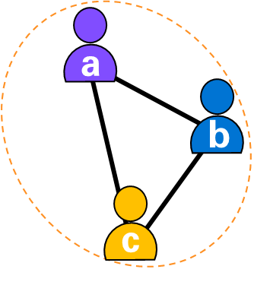
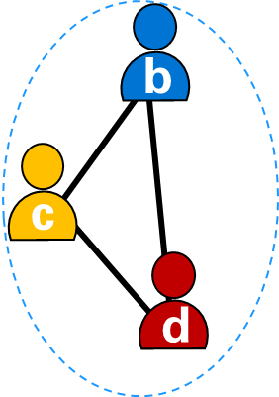
Good snapshots = stable community interactions
b
12pm
1pm
2pm
3pm
4pm
5pm
6pm
c
d
Communities:
Work
Friends

Slide 12
Interactions as a tensor
Input interaction tensor $X ∈R^{n ×n ×t}$
High temporal resolution (e.g., each slice is a second of interactions)
Many timesteps (e.g., t=1,000,000)
Each slice is very sparse
. . .
$n$
$n$
$$t$$
$$t$$
. . .
$n$
$n$
$$X ∈R^{n ×n ×t}$$

Slide 13
Modeling Assumptions
Communities which may overlap
C₁
C₂
Time
$$X$$
Node
Node
S₁
S₂
S₃
S₄
S₅
stable activity as snapshots

Slide 14
Approximate via three-way outer product
C₁
Time
Community factors
Node
$$≅$$
Snapshots
Node
S₁
S₂
S₃
S₄
S₅
Snapshots
$$X$$
$$≅$$
[[$U, V, W$ ]]
$$n ×k$$
$$n ×k$$
$$t ×k$$

Slide 15
W as interpretable snapshots
We want $W$to consist of a set number of snapshots $θ$
Constant within a snapshot
Start and end of snapshots should be the same for all communities
$$W$$
S1
$$1 x k$$
1
1
1
1
0
0
0
0
0
0
0
0
0
$A_{S1}$ community activity
$H_{S1}$ snapshot vector
$$t x k$$
$$t x 1$$

Slide 16
$W$ as interpretable snapshots
Repeat this idea for all snapshots
Snapshot matrix $H_{S}$
Coefficient matrix $A_{S}$
$$W$$
time
$$θ x t$$
. . .
$$t x k$$
$$t x θ$$

Slide 17
Snapshot mega matrix$H$
Consists of submatrices defining all possible snapshots of varying length
Snapshots length=1
. . .
Snapshots length=2
Snapshots length=t
. . .
. . .
. . .
time
. . .
. . .
. . .
$$H_{S}$$
$$H$$

Slide 18
Snapshot mega matrix coefficients
Nonzero rows in encoding matrix A indicate chosen snapshots
$X ≅$[[$U, V, W$ ]] $=\text{[[}U, V, \text{HA} \text{]]}$
. . .
x
time
=
. . .
. . .
. . .
. . .
. . .
. . .
W
H
A

Slide 19
Requirements for snapshots via A
We want to a set number of snapshots = 𝜃
Thus, A must have 𝜃 nonzero rows
. . .
x
time
=
. . .
. . .
. . .
. . .
. . .
. . .
W
H
A

Slide 20
Requirements for snapshots via A
We need snapshots to not overlap
A must select orthogonal snapshots from H
No overlap of red sections
. . .
x
. . .
. . .
. . .
. . .
. . .
. . .
H
A

Slide 21
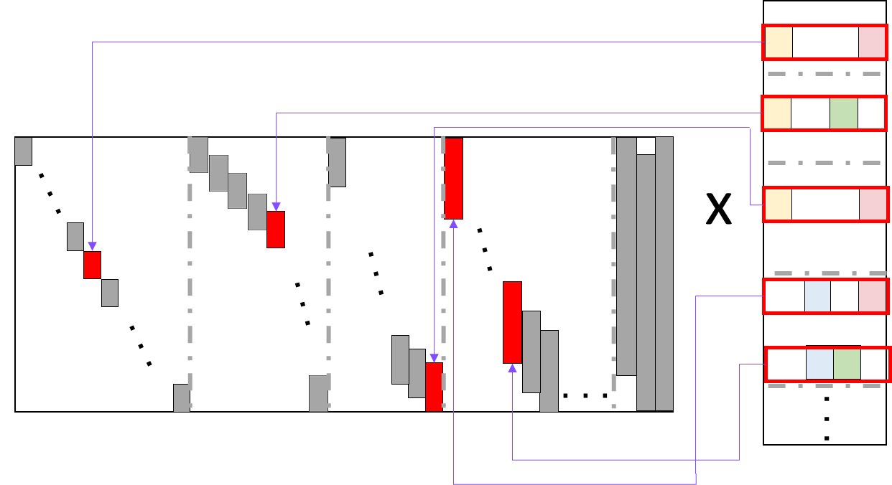
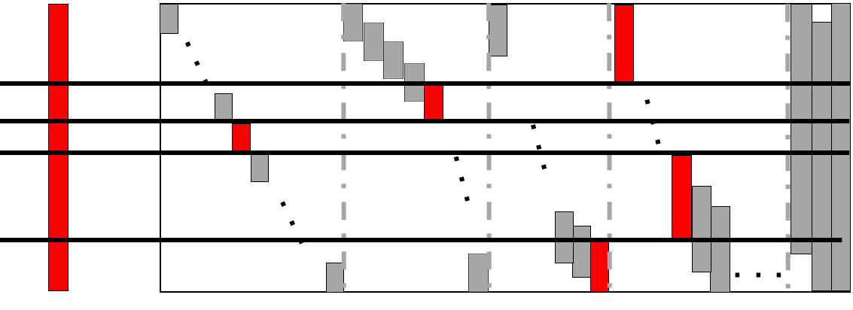
CADENCE Formulation
$$arg {\min_{U,V,A}\left\|X −[[U,V,HA]]\right\|}_{F}^{2}$$
s.t. U,V $>$0 $,{ θ≥\left\|A\right\|}_{2,0}$ , $H_{A_{i}≠0}^{T}H_{A_{i}≠0}=I$

Slide 22
Optimization: High level
$$arg {\min_{U,V,A}\left\|X −[[U,V,HA]]\right\|}_{F}^{2}$$
s.t. U,V $>$0 $,{ θ≥\left\|A\right\|}_{0}$ , $H_{A_{i}≠0}^{T}H_{A_{i}≠0}=I$
Alternating least squares CPD for $U,$ $V$
How can we solve for A?
H is overcomplete dictionary
Thus, to solve for A
Solve for unconstrained W
Orthogonal matching pursuit inspired algorithm to solve W = HA ${ s.t.{ θ≥\left\|A\right\|}_{0}\text{ , }H_{A_{i}≠0}^{T}H_{A_{i}≠0}=I}_{}$

Slide 23
Optimization: A
Top-down approach
Add snapshots 1 at a time until $θ$ is reached
Try to match W as best we can
Details in the paper
$$H_{1}$$
$$H_{2}$$
$$H_{3}$$
$$H_{4}$$
W

Slide 24
Optimization: A
Start with one snapshot spanning all time
Encode via A
Compute residual R
R
W
H
A
Overrepresented activity
=
-
Underrepresented activity

Slide 25
Optimization: A
Split an existing snapshot to best represent R
Best aligned H
Chosen
R
$$H_{1}$$
H
H
H
H
$$H_{2}$$
R
R
VS
. . .
. . .
Candidates
Split point
New H

Slide 26
Optimization: A
Re-encode
Update residual
R
W
$$H_{2}$$
A
-
=

Slide 27
Optimization: A
Repeat until H has $θ$ columns
R
W
$$H_{3}$$
A
R
W
$$H_{4}$$
A
=
-
=
-

Slide 28
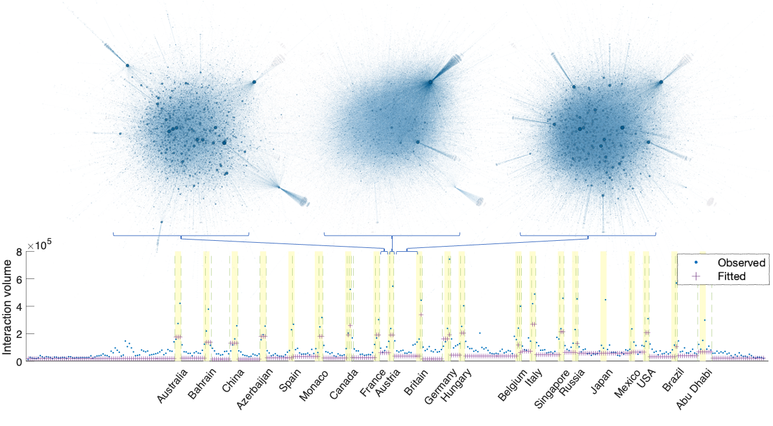
CADENCE applied to r/formula1
Snapshot visualizations represent distinct patterns of interactions
Snapshots = race days

Slide 29
Experiment: Change point (CP) detection
Baselines:
TSP [PCI 12]
LAD [KDD 2020]:
AGT [MLG 2020]
Covering metric (high = good)
Overlap between points defined by pred CP vs ground truth CP
Max score at 1
Change point
t1
t2
t3

Slide 30
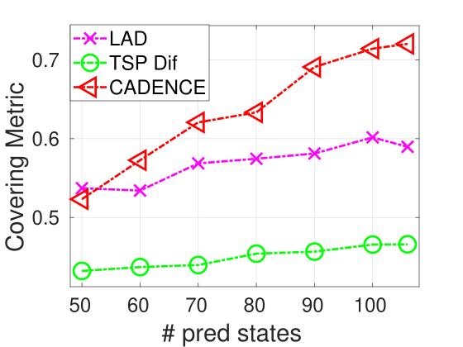
Change point detection
Daily taxi rides in NYC
Change points are working versus non-working days
t1
t2
t3
Change point
Higher = better

Slide 31
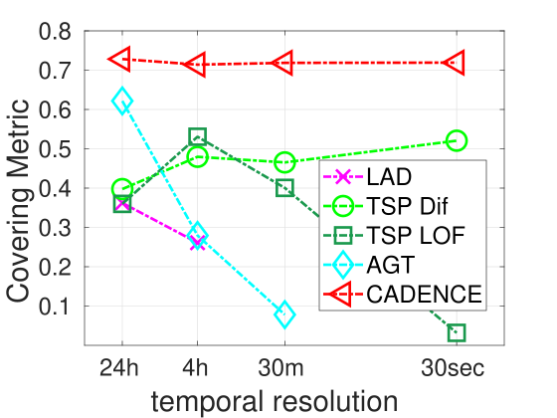
Change point detection
Daily taxi rides in NYC
Change points are working versus non-working days
t1
t2
t3
Change point
Robust across input resolution
Higher = better

Slide 32
Experiments: Downstream tasks
Node classification by AdaNN [ICDM 2019]
via competing aggregations
t2
t3
t1
Class labels
1
1
2
1
2
2
3
G1
AdaNN
S1
S2
. . .
Gt
Competing aggregations
Reg
Cons [WSDM 2022]
AGT [MLG 2020]
Higher accuracy node classification

Slide 33
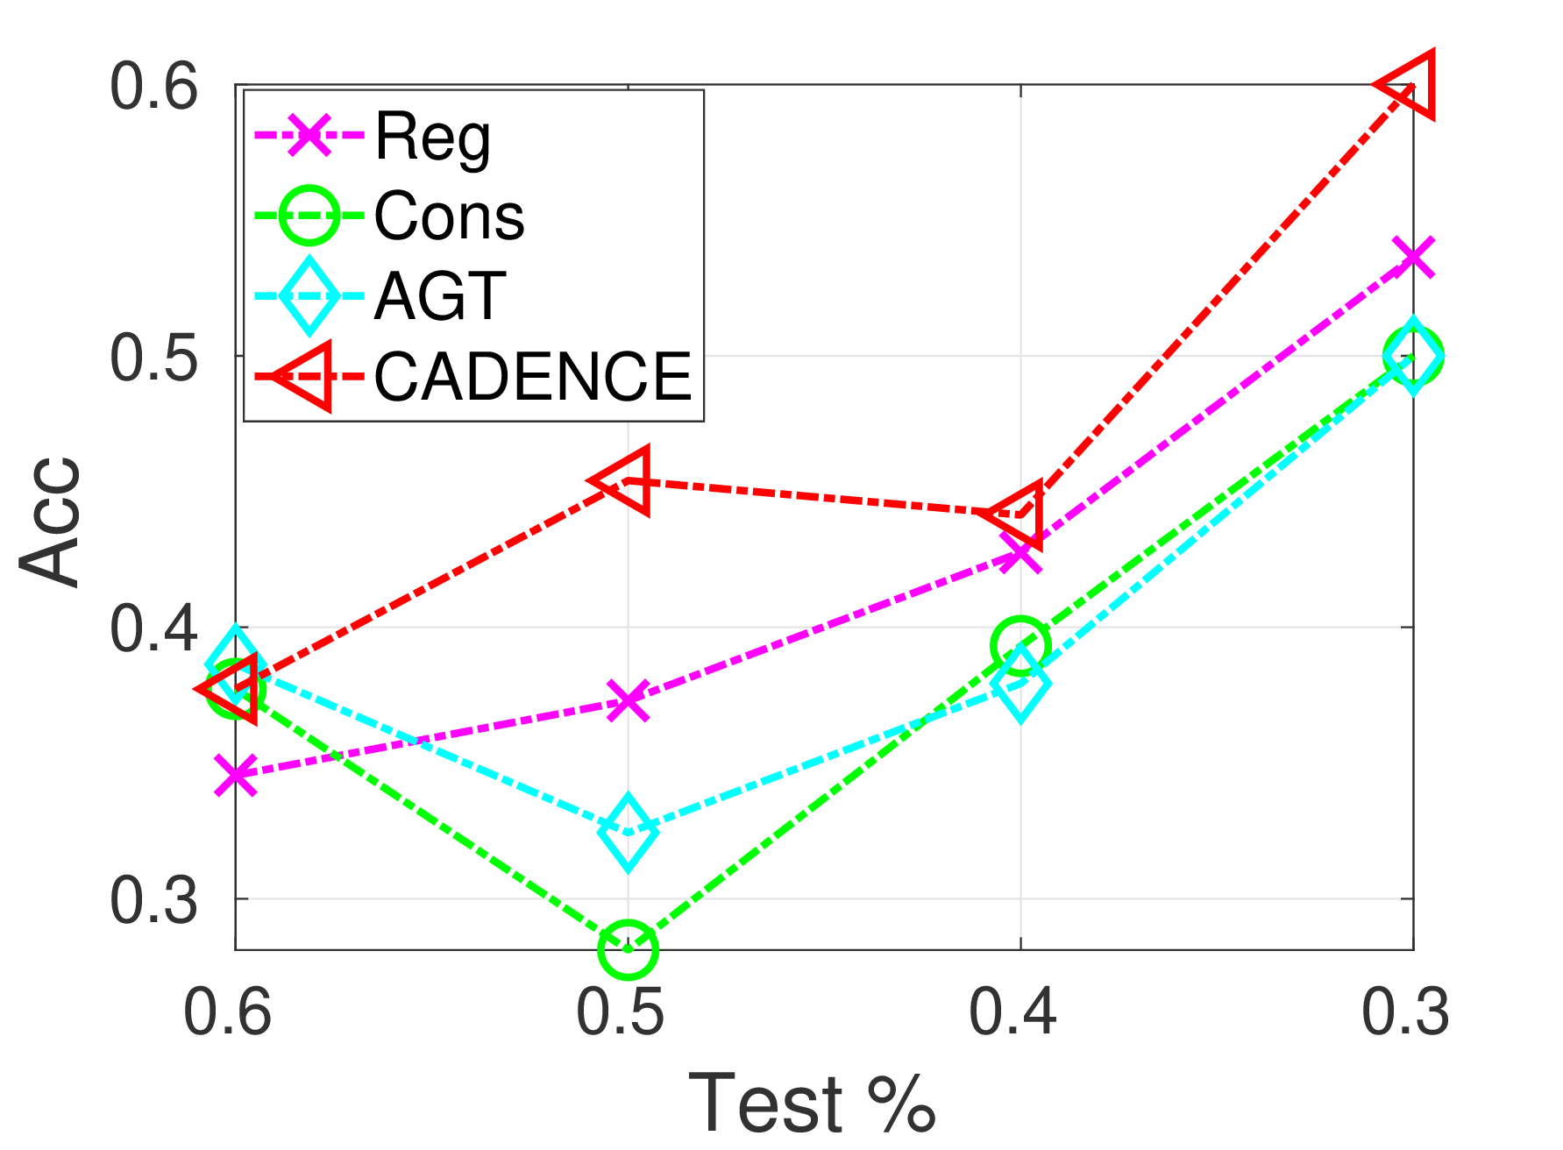
Node classification
Data:
Person to person interactions at a hospital
20 second resolution
Node labels:
doctor
patient
nurse
administrator

Slide 34
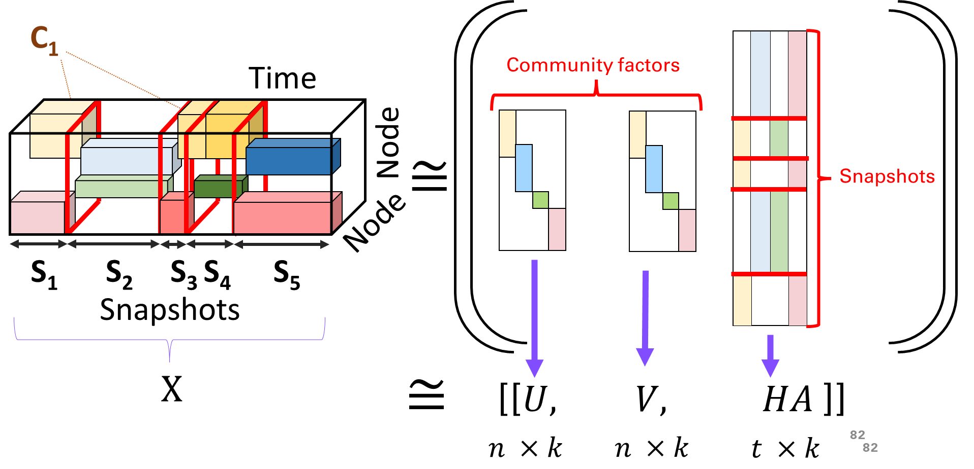
Summary
Key idea: CADENCE
Find regimes of stable community interaction
Use time-frames of regimes to form snapshot
Optimization: Mixed approach
Tensor factorization plus orthogonal matching pursuit
Findings: Community aware snapshots
Correspond to ground truth change points
Increase accuracy in the downstream task of node classification
Many more details in the paper

Slide 35
Thank you!
Special thanks to Leiden University for covering conference expenses
Special thanks to my coauthors for their hard work
Questions?
mmcneil2@albany.edu
Code and paper at
http://www.cs.albany.edu/~petko/lab/code.html\
Or

Slide 36
Citations
[WSDM 2022] D. Jin, S. Kim, R. A. Rossi, and D. Koutra, On generalizing static node embedding to dynamic settings, in Proceedings of the Fifteenth ACM International Conference on Web Search and Data Mining, 2022, pp. 410–420
[MLG 2020] Ekta Gujral Ravdeep Pasricha and Evangelos Papalexakis. 2020. Adaptive Granularity in Time Evolving Graphs as Tensors. In Proceedings of the 16th International Workshop on Mining and Learning with Graphs (Virtual). http:/www.mlgworkshop.org/2020/papers/MLG2020_paper_35.pdf
[KDD 2020] S. Huang, Y. Hitti, G. Rabusseau, and R. Rabbany, Laplacian change point detection for dynamic graphs, in Proceedings of the 26th ACM SIGKDD International Conference on Knowledge Discovery & Data Mining, 2020, pp. 349–358.
[PCI 12] D. Koutra, E. E. Papalexakis, and C. Faloutsos, Tensorsplat: Spotting latent anomalies in time, in 2012 16th Panhellenic Conference on Informatics, IEEE,2012, pp. 144–149
[ICDM 2019] Xu, W. Cheng, D. Luo, Y. Gu, X. Liu, J. Ni, B. Zong, H. Chen, and X. Zhang, Adaptive neural network for node classification in dynamic networks, in 2019 IEEE International Conference on Data Mining(ICDM), IEEE, 2019, pp. 1402–1407.

Slide 37
Constant aggregation
Most often this is done via regular time intervals
e.g., each snapshot represents two hours
t1
t2
t3
t4
t5
t6
t7
t8
# Edge=6
# Edge=6

Slide 38
Finding communities and snapshots
b
12pm
1pm
2pm
3pm
4pm
5pm
6pm
c
d
Communities:
Work
Friends

Slide 39
Motivating assumption: Good snapshots = stable community interactions
t1
t2
t3
t4
t5
t6
t7
t8
C1
C2
C3
Change point
Stable interaction

Slide 40
Finding time-frames of stable community interactions
t1
t2
t3
t4
t5
t6
t7
t8
Find overlapping communities with stable interactions
Find time-frames of stable community interaction

Slide 41
Optimization: A
Break an existing snapshot in two
Encode via A
Get residual R
W
H
A
-
R =

Slide 42
Optimization: A
Initialize
R = W
Residual matrix
$H_{Υ}$ = all ones
Set chosen snapshots to all points
t
$$h_{s}$$
$H_{Υ}$:
$$h_{m}$$
$$h_{\overline{m}}$$

Slide 43
Optimization: A
t
Initialize
R = W
Residual matrix
$H_{Υ}$ = all ones
Set chosen snapshots to all points
Repeat until $θ$
$H_{c}$ = max <R, H>
Pick snapshot that best aligns with R
${ H}_{Υ }= H_{Υ }∪$ $H_{c}$
Add chosen snapshot to set of snapshots
A = ${ inv(H}_{Υ })$W
Update encoding for A
R = W- HA
Update residual
$$h_{s}$$
$H_{Υ}$:
$$h_{m}$$
$$h_{\overline{m}}$$

Slide 44
Orthogonal Matching pursuit
Initialize
R = W
Residual matrix
$H_{Υ}$ = {}
Set chosen snapshots to empty
Repeat until $θ$
$H_{c}$ = max <R, H>
Pick snapshot that best aligns with R
${ H}_{Υ }= H_{Υ }∪$ $H_{c}$
Add chosen snapshot to set of snapshots
A = ${ inv(H}_{Υ })$W
Update encoding for A
R = W- HA
Update residual

Slide 45
$W:$Interpretable snapshots
1
2
3
t-1
t
k
=
x
t
W
H
A

Slide 46
$W:$Interpretable snapshots
1
2
3
t-1
t
k
=
x
t
W
H
A

Slide 47
Snapshots: structuring $W$
First learn unstructured $W$
Enforce that $W=HA$
$H$ is an overcomplete dictionary basis
Contains all possible piece-wise smooth temporal sections
$A$ is an encoding matric which choose which snapshots from $H$ to
Best match $W$
Be orthogonal from other snapshots
Choose $θ$columns from $H$
1
2
3
t-1
t
k
=
x
t
W
H
A

Slide 48
Subproblem 2: Temporal States
$W$ is completely unstructured
We want $W$ to capture time frames of stable community activity we call snapshots
A snapshot is shared by all communities
Time
Node
Node
T₁
T₂
T₃
T₄
T₅
Snapshots

Slide 49
Data assumptions: Snapshots
Assume there exists time-frames where interaction patterns remain stable
Time
Node
Node
T₁
T₂
T₃
T₄
T₅
Snapshots

Slide 50
Snapshots: structuring $W$
Need to structure $W$ such that it contains interpretable valid snapshots
Piece wise constant within snapshots
Snapshots are shared for all communities
Good $W$ = Valid Snapshot
Valid Snapshot
Bad $W$
Bad $W$
No temporal consistency = no place to draw snapshots
Snapshots not shared by all communities

Slide 51
Subproblem 1: Community detection
Assume we have a matrix representation of community interactions
$$D ∈R^{n ×n}$$
Time
Node
Node
Node
Node

Slide 52
Communities: Static representation
We can easily find communities in this using non-negative matrix factorization. Factor matrices $U∈R^{n ×k }$and $V∈R^{n ×k }$
$$D ∈R^{n ×n}$$
$$v_{1}$$
$$v_{k}$$
. . .
Node
Node
$$u_{1}$$
$$u_{k}$$

Slide 53
Communities
Mathematically
$D$ =$\sum_{i=1}^{k}{u_{i}v_{i}^{T}}={UV}_{}^{T}$
As an optimization scheme
$$arg {\min_{U,V}\left\|D −{UV}_{}^{T}\right\|}_{F}^{2}$$
s.t. U,V $≥$0

Slide 54
Communities: Back to tensors
Assume we have $U$ and $V$ we need to go back to $X ∈R^{n ×n ×t}$
$$D ∈R^{n ×n}$$
Time
Node
Node
Node
Node

Slide 55
Temporal pattern
To do this we essentially learn another matrix $W∈R^{t ×k}$
which tells us the degree to which a community is active at each timestep
C₁
temporal activity of C₁
Time
$$W∈R^{k ×t}$$
Node
Node

Slide 56
Factors together
We can express this as a three-way outer product
$$w_{k}$$
$$w_{1}$$
$$X ∈R^{n ×n ×t}$$
$$v_{1}$$
$$v_{k}$$
$$≈$$
. . .
$$u_{1}$$
$$u_{k}$$

Slide 57
Understanding the input
Interaction tensor
$X ∈R^{n ×n ×t}$
Tensor generalize matrices to higher order
A matrix has two modes (rows and cols)
A tensor has an arbitrary number of modes
In our case we have 3 modes
User/Node
User/Node
Time

Slide 58
Input details
Now that we understand what a tensor representation means we can look more specifically at our input
$$t$$
Time
Node
Node
$n$
$n$
$$X ∈R^{n ×n ×t}$$

Slide 59
Optimization: A
Initialization
R = W
Residual matrix
R = W

Slide 60
Motivation: Time-frames which form informative network snapshots
Example:
Corporate email network overtime
Want to understand the network at different timepoints
Not all time points are equal
t1
t2
t3
t4
t5
t6
t7
t8

Slide 61
Motivation: Given high resolution edges how can we form representative snapshots
t1
t2
t3
t4
t5
t6
t7
t8

Slide 62
Related work
$ε$<
. . .
. . .
. . .

Slide 63
Data assumptions
Assume most interactions are within communities of nodes
may overlap
$$t$$
Time
Node
Node
$n$
$n$
$$X ∈R^{n ×n ×t}$$

Slide 64
Understanding the input
Suppose we have a matrix for every time stamp $i$ $X_{i} ∈R^{n ×n}$
1 2 3 4 5 6
1
2
3
4
5
6
0 | 1 | 1 | 0 | 0 | 0
1 | 0 | 1 | 0 | 0 | 0
1 | 1 | 0 | 1 | 0 | 0
0 | 0 | 1 | 0 | 1 | 1
0 | 0 | 0 | 1 | 0 | 1
0 | 0 | 0 | 1 | 1 | 0
$$X_{i} ∈R^{n ×n}$$

Slide 65
Temporal States?
$W$ is completely unstructured
We desire to identify states of consistent levels of community's interactions
We need these states to be reflective of all communities at once

Slide 66
Optimization: U,V
$$arg {\min_{U,V}\left\|X −[[U,V,HA]]\right\|}_{F}^{2}$$
s.t. U,V $≥$0
Standard ALS CPD with nonnegativity

Slide 67
We model this as a tensor decomposition problem
Input:
Interaction tensor
$X ∈R^{n ×n ×t}$
$n$=#nodes
$t$=#temporal samples
$n$
$$t$$
$n$
$$X ∈R^{n ×n ×t}$$

Slide 68
Understanding the input
Connections -> graph
Graph -> adjacency matrix = $X_{i}$
$X_{i} ∈R^{n ×n}$
1 2 3 4 5 6
1
2
3
4
5
6
0 | 1 | 1 | 0 | 0 | 0
1 | 0 | 1 | 0 | 0 | 0
1 | 1 | 0 | 1 | 0 | 0
0 | 0 | 1 | 0 | 1 | 1
0 | 0 | 0 | 1 | 0 | 1
0 | 0 | 0 | 1 | 1 | 0
1
2
3
4
5
6

Slide 69
Similarity to PARAFAC (CPD)
This is known as Canonical Polyadic Decomposition (CPD) or PARAFAC with nonnegative constraints on the first two modes
$$arg {\min_{U,V,W}\left\|X −[[U,V,W]]\right\|}_{F}^{2}$$
s.t. U,V $≥$0
Three-way outer product

Slide 70
Optimization: A
R
W
H
A
=
-

Slide 71
Core idea
Community-aware snapshots
t1
t2
t3
t4
t5
t6
t7
t8

Slide 72
Time
Community factors
Node
$$≅$$
Snapshots
Node
S₁
S₂
S₃
S₄
S₅
Snapshots
$$X$$
$$≅$$
[[$U, V, HA$ ]]
$$n ×k$$
$$n ×k$$
$$t ×k$$

Slide 73
Understanding the input
we stack $t_{}$ $n ×n$ matrices into a tensor
$$X_{2} ∈R^{n ×n}$$
$n$
0 | 1 | 1 | 0 | 0 | 0
1 | 0 | 1 | 0 | 0 | 0
1 | 1 | 0 | 1 | 0 | 0
0 | 0 | 1 | 0 | 1 | 1
0 | 0 | 0 | 1 | 0 | 1
0 | 0 | 0 | 1 | 1 | 0
$$t$$
$n$

Slide 74
Related work
Temporal aggregation
Reg: Regular in time
Cons[4]: Constant number of edges
AGT (Adaptive Granularity in Time Evolving Graphs as
Tensors) [5]: greedily aggerates temporal slices until a heuristic (such as the norm of produced snapshot ) is met
Change point detection
LAD Laplacian change point detection [6]: identifies timepoints where the eigenvalues of the graph Laplacian significantly change as change points
TSP Tensorsplat [7]: Analyses of the temporal factor produced by a factorization of an interaction tensor
[4] D. Jin, S. Kim, R. A. Rossi, and D. Koutra, On generalizing static node embedding to dynamic settings, in Proceedings of the Fifteenth ACM International Conference on Web Search and Data Mining, 2022, pp. 410–420
[5] R. Pasricha, E. Gujral, and E. P. Evangelos, Adaptive granularity in time evolving graphs as tensors, Ratio, 20 (2020), p. 60
[6] S. Huang, Y. Hitti, G. Rabusseau, and R. Rabbany, Laplacian change point detection for dynamic graphs, in Proceedings of the 26th ACM SIGKDD International Conference on Knowledge Discovery & Data Mining, 2020, pp. 349–358.
[7] D. Koutra, E. E. Papalexakis, and C. Faloutsos, Tensorsplat: Spotting latent anomalies in time, in 2012 16th Panhellenic Conference on Informatics, IEEE,2012, pp. 144–149

Slide 75
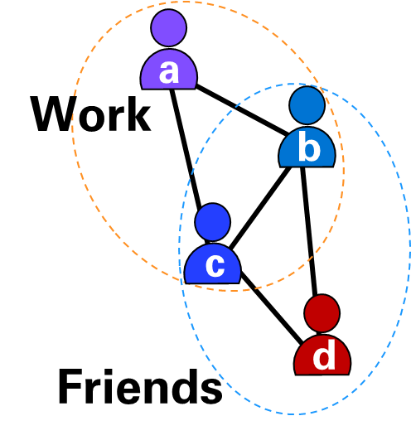
Flawed simple aggregation
12pm
1pm
2pm
3pm
4pm
5pm
6pm

Slide 76
12pm
1pm
2pm
3pm
4pm
5pm
6pm
a
Work
b
c
Lunch break
catch-up
Dinner plan
coordination
Friends
d
(b) Messages exchanges across time
(a) Actual
Communities
10am-2pm
2pm-6pm
6pm-10pm
a
a
a
1
2
1
b
2
b
b
1
1
1
2
c
c
c
2
2
1
d
d
d
(c) Time Scale: 4-hour aggregation

Slide 77
Similarities to tensor factorization
$X$ $≅\text{[[}U, V, W \text{]]}$
Details in the paper
Framework is like CPD\PARAFAC with the following requirements
U,V have nonnegative constraints
W represents interpretable snapshots
How to achieve 2?

Slide 78
12pm
1pm
2pm
3pm
4pm
5pm
6pm
a
Work
b
c
Lunch break
catch-up
Dinner plan
coordination
Friends
d
(b) Messages exchanges across time
(a) Actual
Communities
10am-2pm
2pm-6pm
6pm-10pm
a
a
a
1
2
1
b
2
b
b
1
1
1
2
c
c
c
2
2
1
d
d
d
(c) Time Scale: 4-hour aggregation

Slide 79
Dynamic Networks
Dynamic networks: interactions (re)occur over time
Social Media
Traffic Networks
Communication networks
STOP
Time
Time
Time

Slide 80
$$H$$

Slide 81
Optimization: High level
$$arg {\min_{U,V,A}\left\|X −[[U,V,HA]]\right\|}_{F}^{2}$$
s.t. U,V $>$0 $,{ θ≥\left\|A\right\|}_{2,0}$ , $H_{A_{i}≠0}^{T}H_{A_{i}≠0}=I$

Slide 82
Optimization: High level
C₁
Time
Community factors
Node
$$≅$$
Snapshots
Node
S₁
S₂
S₃
S₄
S₅
Snapshots
$$X$$
$$≅$$
[[$U, V, HA$ ]]
$$n ×k$$
$$n ×k$$
$$t ×k$$
82

Slide 83
. . .
=
. . .
x
. . .
. . .
. . .
. . .
HA
H
. . .
A

Slide 84
Experiments: Community quality
Baselines:
Reg
Cons [WSDM 2022]
AGT [MLG 2020]
Conductance (low = good)
Measures how disconnected a community is from rest of graph
Minimized at 0
t1
t2
t3
S1
S3
Strong community
Higher accuracy node classification

Slide 85
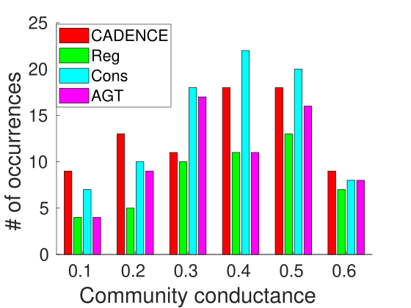
Community quality
S1
S3
Strong community
Data:
Person to person interactions at a hospital
GT communities (e.g., doctors, admins, etc.)
Snapshot conductance distribution
More examples of well separated communities
Lower = better

Slide 86
Flawed regular aggregation
12pm
1pm
2pm
3pm
4pm
5pm
6pm
a
2
a
a
1
2
Community structure is not clear
2
2
b
b
b
1
1
1
1
2
c
c
c
2
3
d
d
d

Slide 87
Community aware aggregation
12pm
1pm
2pm
3pm
4pm
5pm
6pm
a
a
3
a
Community structure is clear!
b
4
b
b
1
2
1
1
2
c
c
c
3
2
d
d
d

