Slide 1



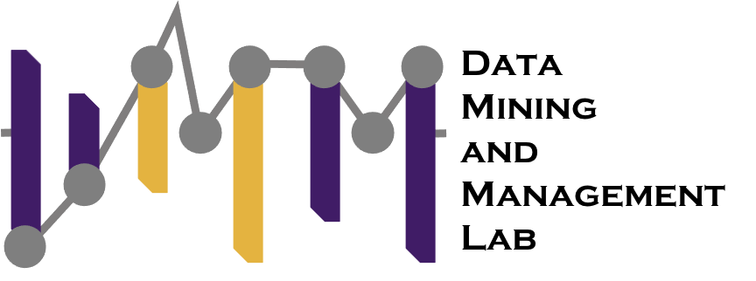

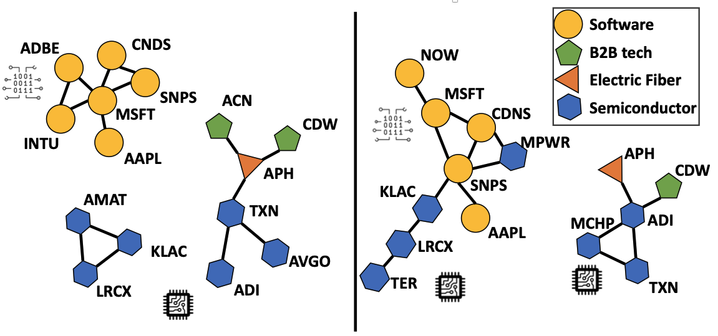
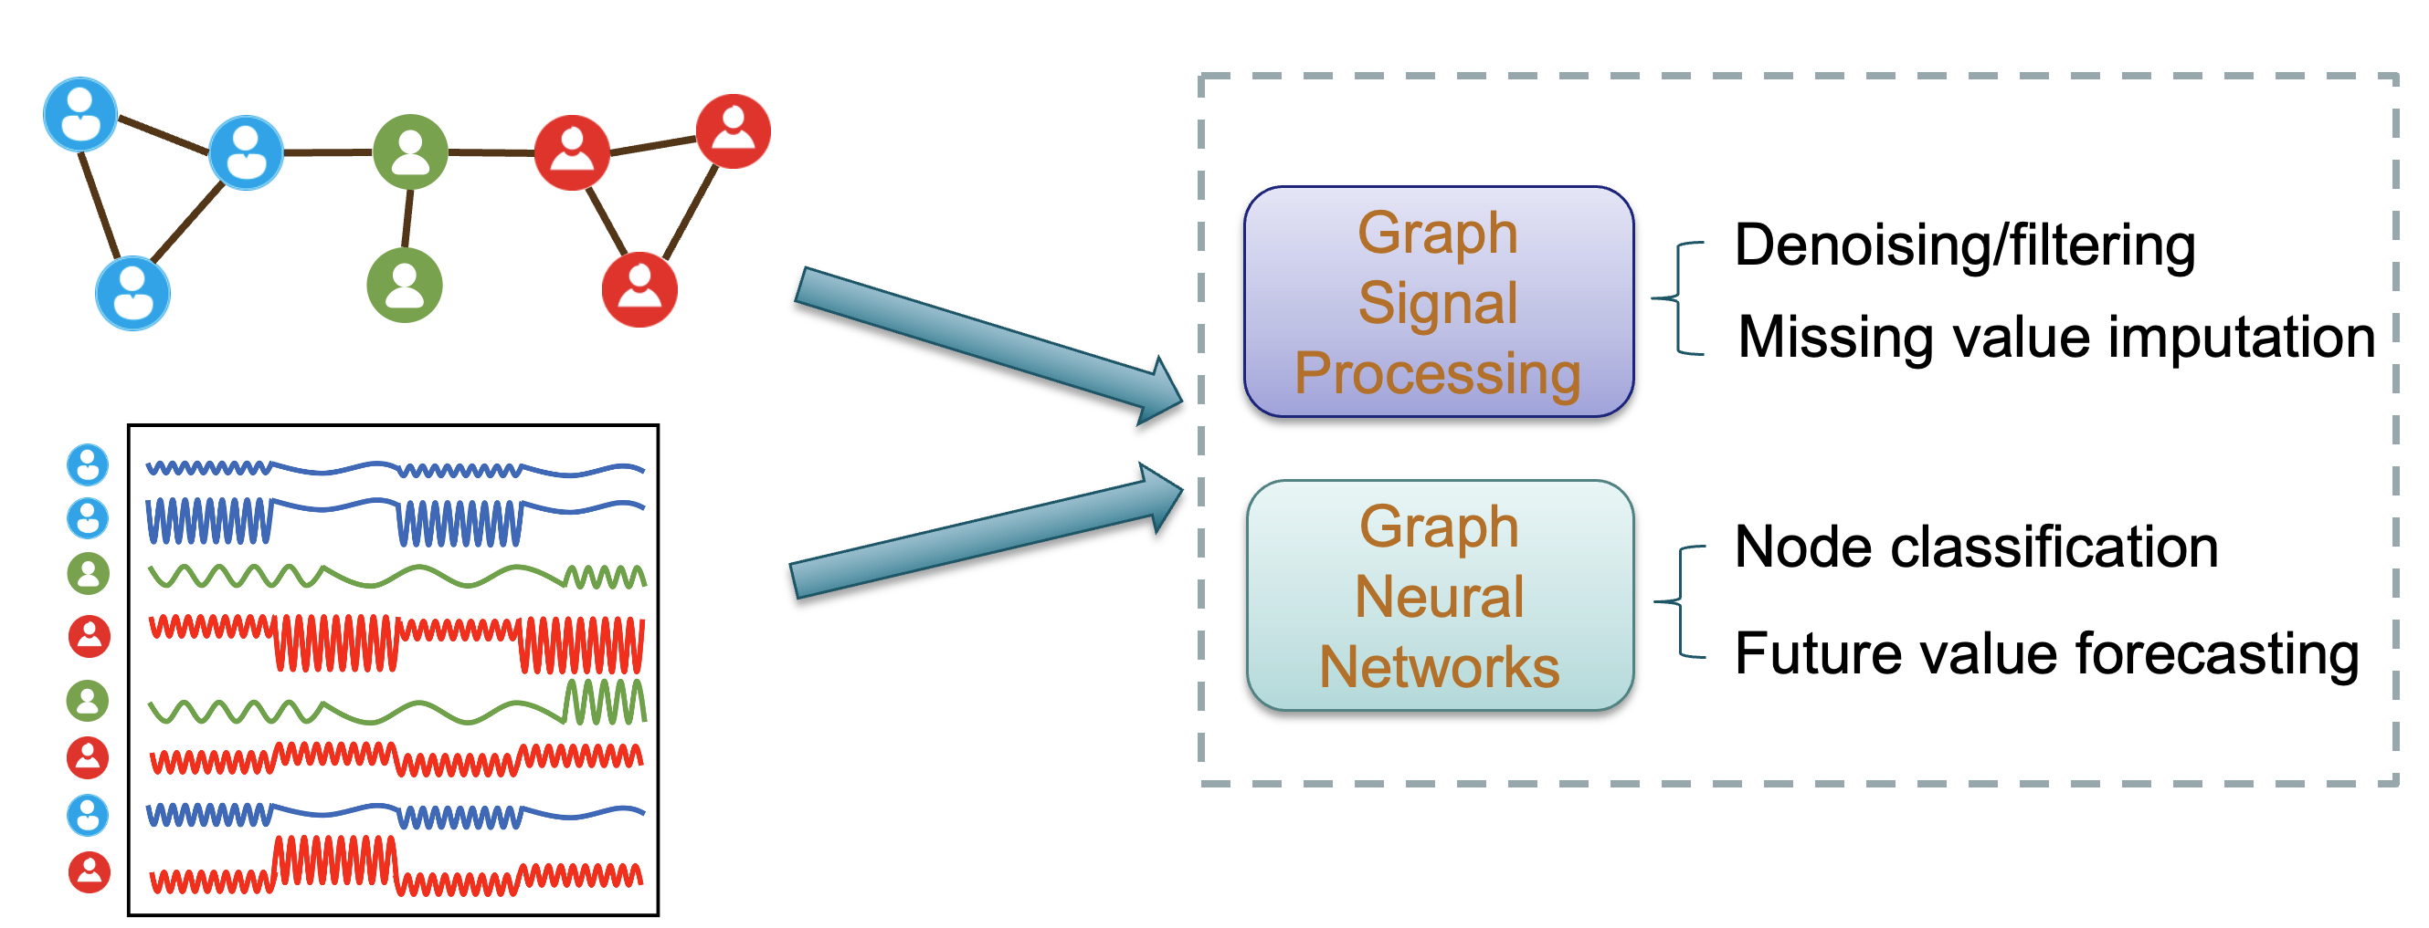
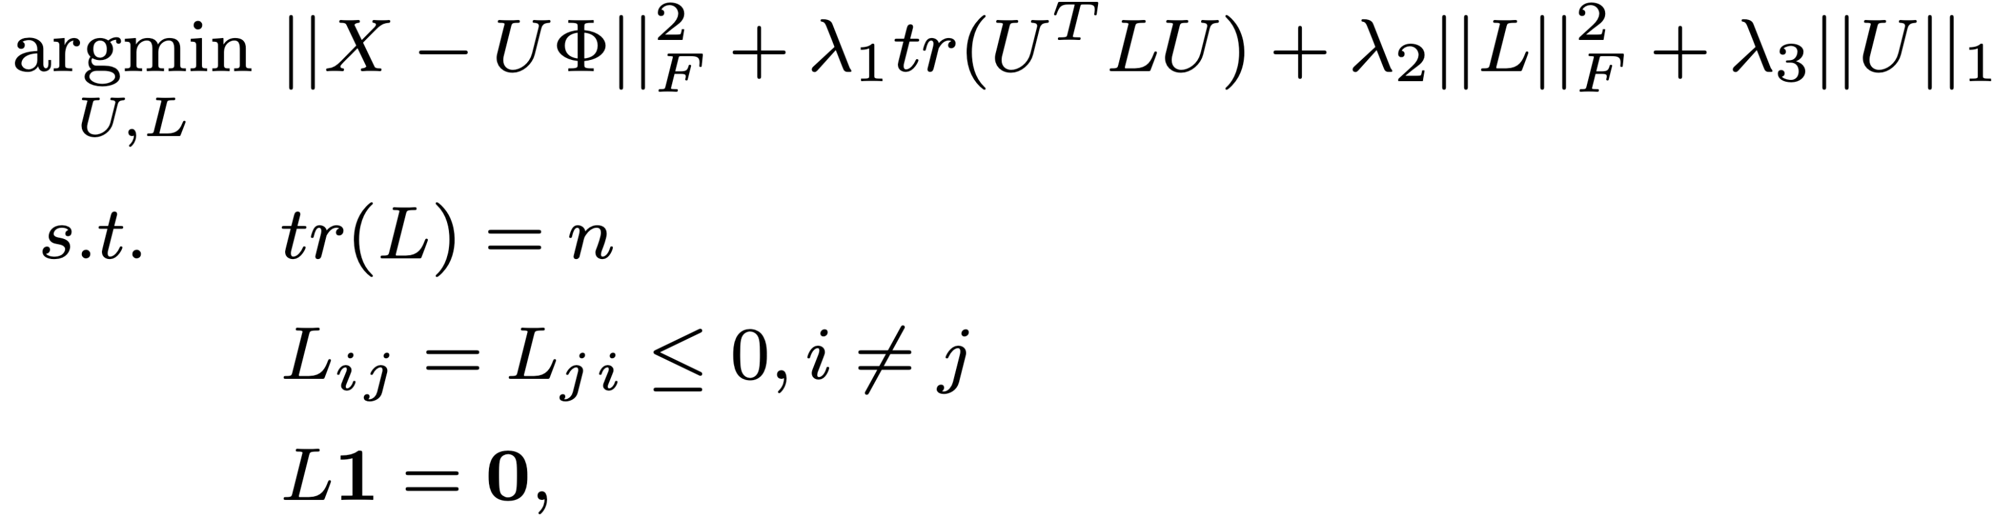
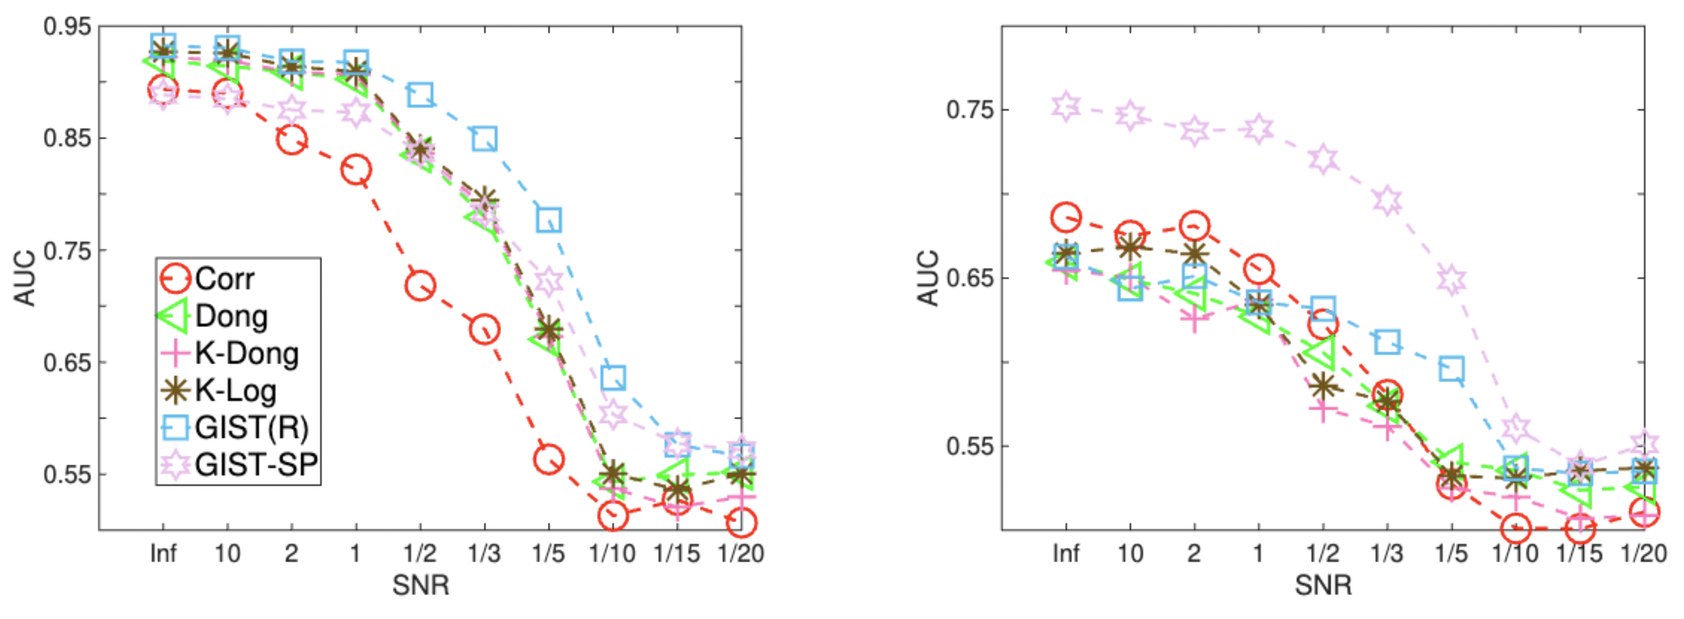
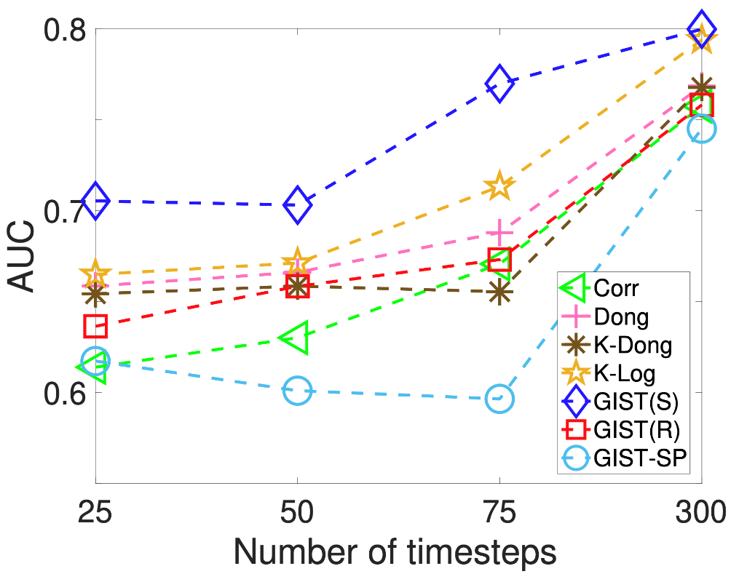
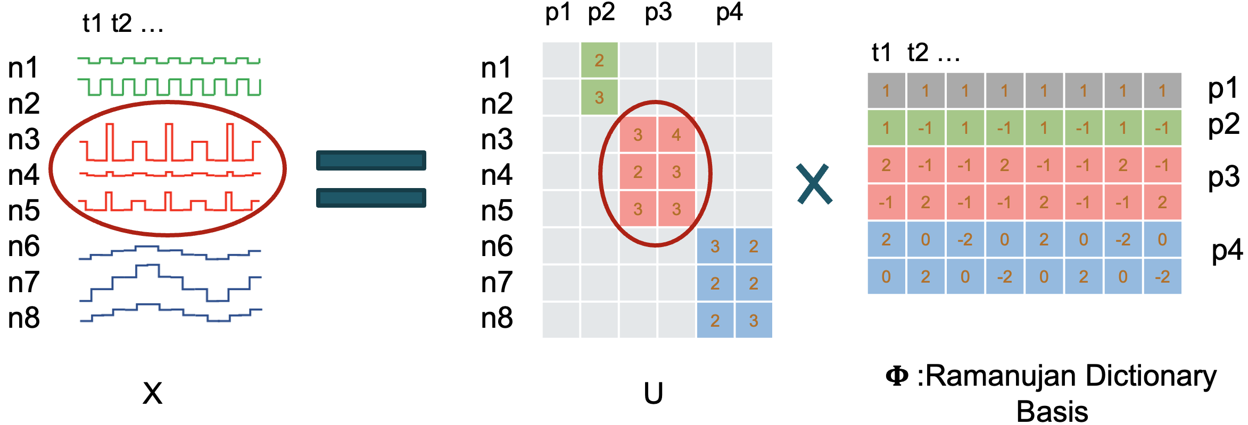
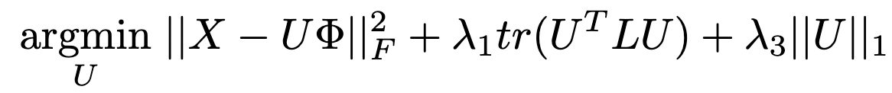
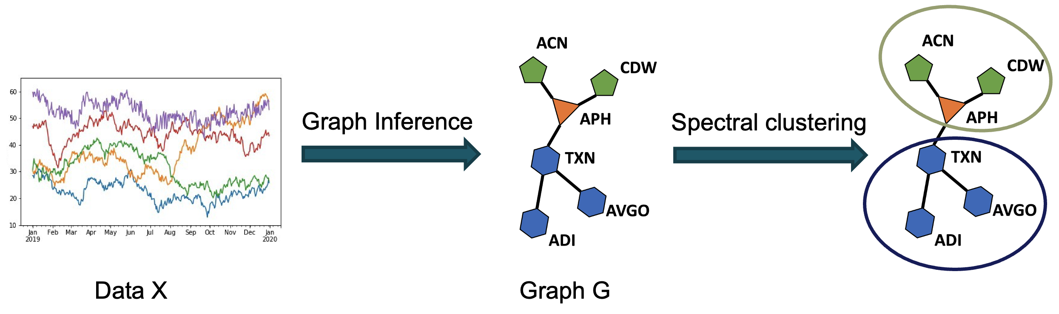

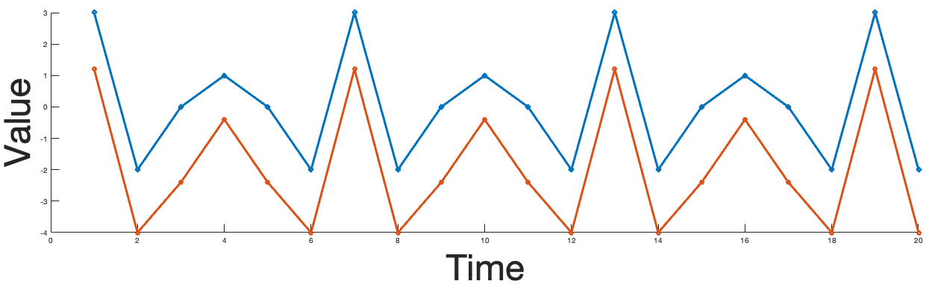
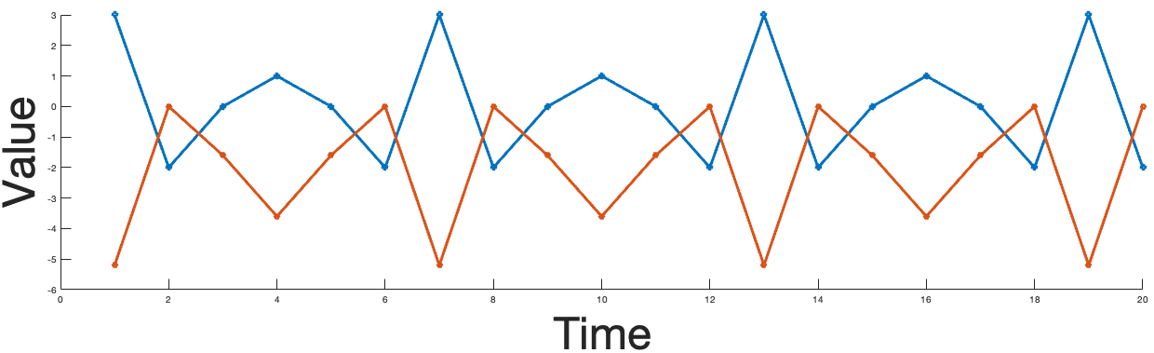
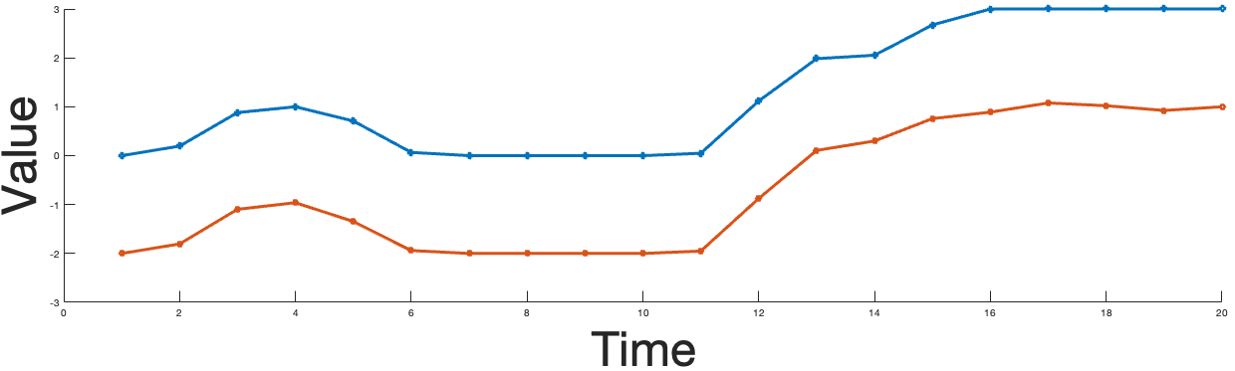

GIST:
Graph Inference for Structured Time Series
Boya Ma, Maxwell McNeil, Petko Bogdanov
Supported by:
#NGA-U-2022-00118
Department of Computer Science, University at Albany—SUNY
Supported by:
NSF SC&C #CMMI-1831547
Summary
GIST Model
GIST at work: Stock Data
Introduction:
Graphs represent relationships between time series
Machine Learning and Graph Signal Processing use these graphs for downstream tasks.
In many cases, a graph structure is not known, and instead must be inferred from data.
Can one infer a graph from time series data?
Key ideas behind GIST:
Time series are not independent.
Time series have strong temporal patterns and can be encoded via an interpretable fixed dictionary
Time series with similar encodings are connected.
.
Learn a network among time series with similar temporal behavior
GIST
Correlation
Dictionaries:
DFT
Spline
Ramanujan
……
Time series with similar behavior are connected
Encoding matrix
Unknown or not reflective of data
Top 15 edges learned from
Daily S&P 500 stocks closing prices (Tech Sector)
Nodes: Companies
GIST agrees better with sub-sectors.
Input
Learn
Objective & Optimization
Edge Learning
U𝛷 is close to X
U is smooth on L
Spread of edges
U is sparse
Synthetic test
Graph: Stochastic block graph (3 blocks)
Road speed data
Similar behavior = Similar periods
Valid Laplacian
Not
close
Signals in the same cluster
have similar period & phase
Signals in the same cluster
have similar period (lagged)
GIST(S) learns a high-quality graph with less observations
Alternating optimization between the graph L and temporal encoding U:
Sub-problem 1: Given L, solve for U
Clustering
Close
AO
Introduce proxy variable V = U, and solve V, U using ADMM.
U has closed form solution based on the Sylvester equation.
Example Dictionaries
Sub-problem 2: Given U, solve for L
Solved by primal-dual method.
Link to
Paper & code
 | Temperature | Covid | Stock subset | Stock S&P 500
Correlation | 65.4 | 47.7 | 45.2 | 20.7
Dong | 78.6 | 73.0 | 69.8 | 33.1
K-Dong | 78.6 | 69.1 | 69.2 | 32.7
K-Log | 78.6 | 69.0 | 69.2 | 34.0
GIST(S) | 80.0 | 62.2 | 73.8 | 33.4
GIST(R) | 94.3 | 69.4 | 69.2 | 36.4
GIST(SP) | 91.7 | 74.0 | 73.8 | 31.4
GIST(R) is best for Temperature because the data has strong periodicity.
GIST(SP) is best for Covid: It reflects its spread (similar period but lag in the spread).
Ramanujan
Ramanujan
Shared Period
Spline
Associate time series with shared period(s) and phase
Associates time series with shared period (lagged, anti-correlated, etc.)
Associates time series with a shared trend
http://www.cs.albany.edu/~petko/lab/publications.html

