Slide 1
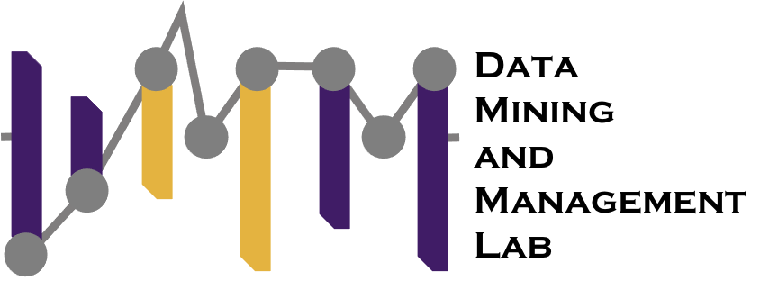
GIST: Graph Inference for Structured Time Series
Boya Ma
Maxwell McNeil
Petko Bogdanov
Department of Computer Science, University at Albany, SUNY
Notes:
Hello everyone, my name is Boya Ma, and today I will be presenting “GIST: Graph Inference for Structured Time Series.”
This work was conducted at the data mining and management lab at the university at Albany with the help of my co authors Max and Petko

Slide 2
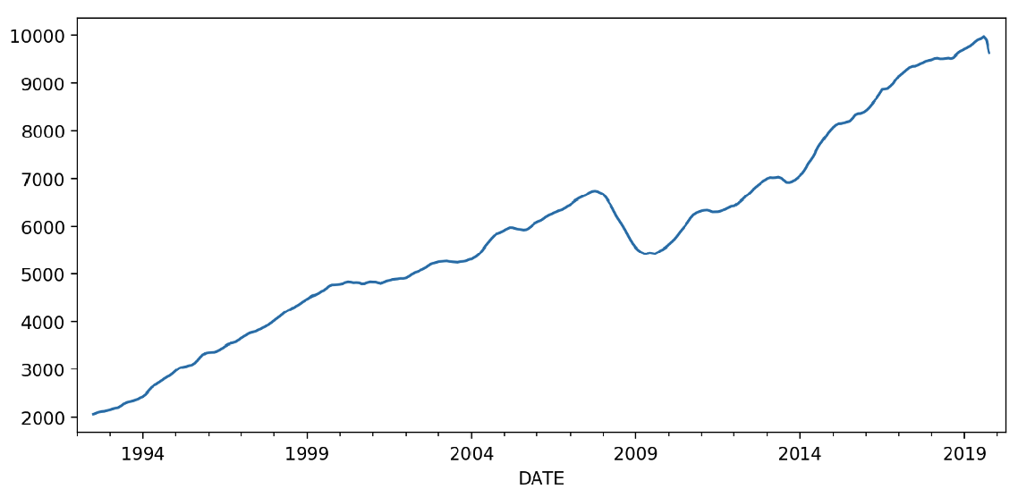
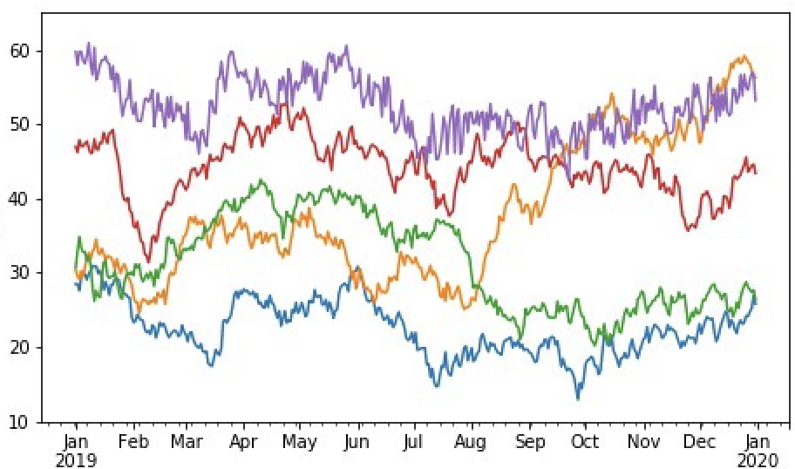
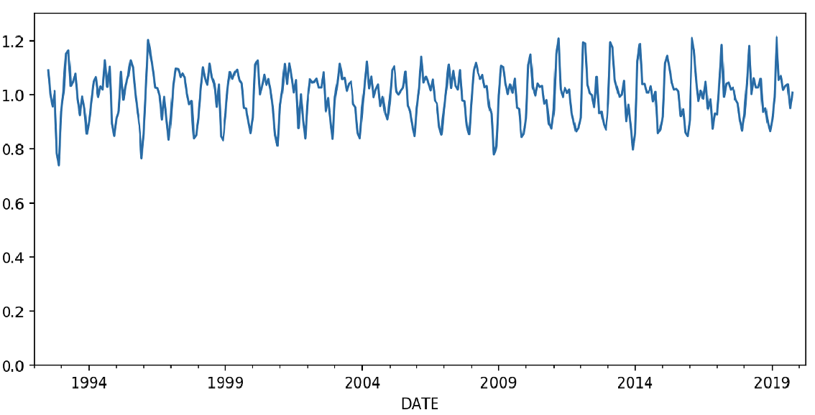
What is time series data?
Temporal patterns
Trend
Seasonality
Daily closing
stock prices
Notes:
Time-series are common in real world and
A key feature of such datasets is that they have temporal patterns, such as trend and seasonality.

Slide 3
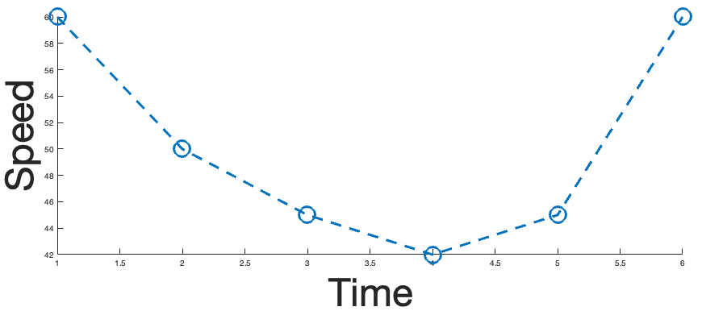
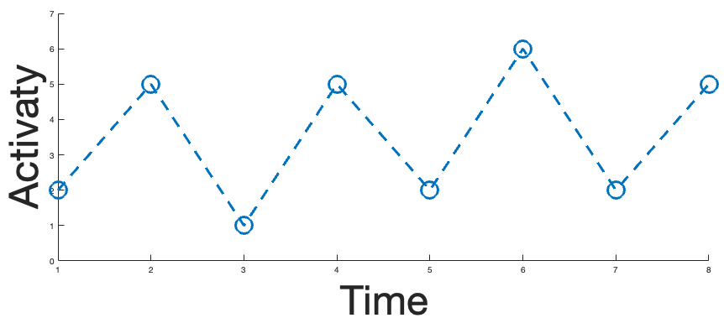
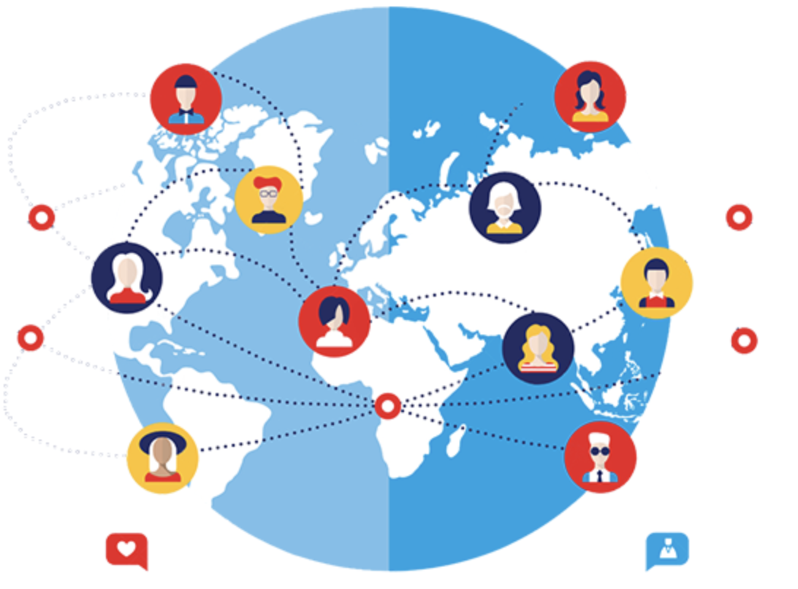
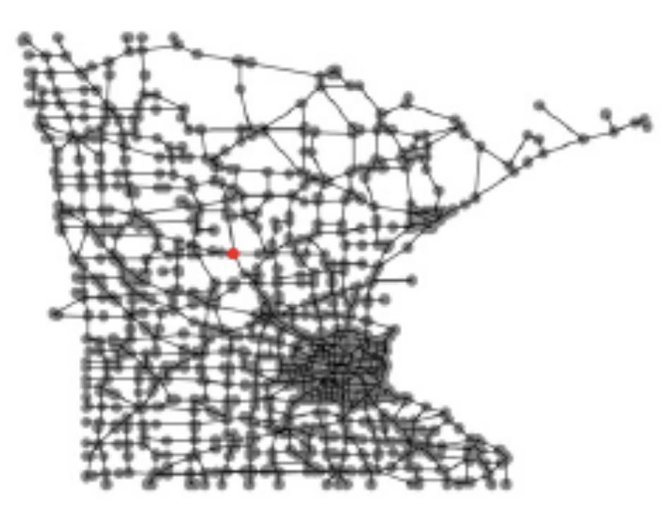
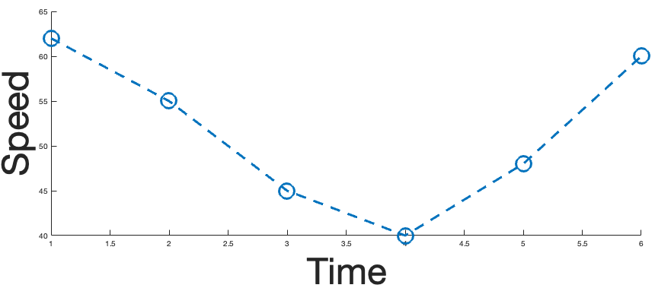
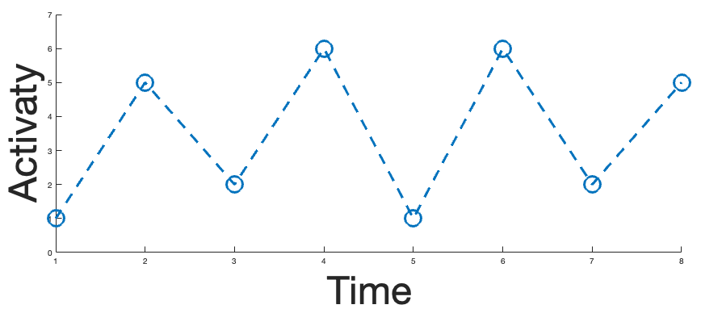
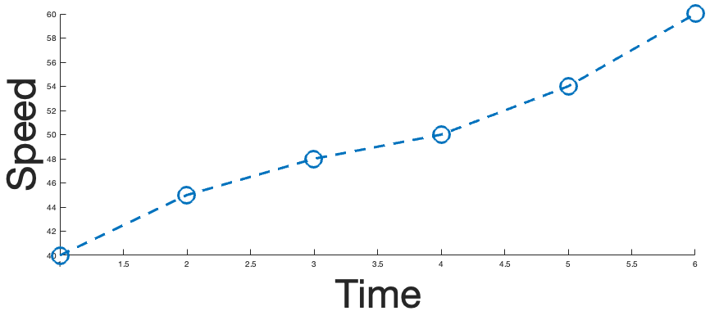
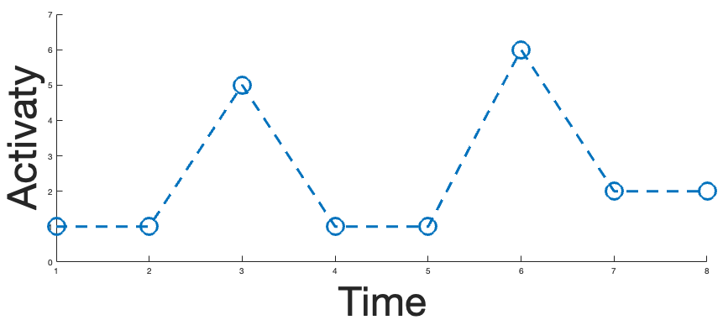
Time series are not independent
Graph:
Nodes: users
Edges: friendship
Time series: hourly posts
Graph:
Nodes: sensors
Edges: roads
Time series: speed every 5min
Notes:
Time-series are often not independent
Graph structure between time-series is often a useful way to model such dependencies. A graph may tell us that neighbors have similar values, or that a change in one’s values may affect a neighbors’ values. In short, graph tells how the system may work.
For example, in this social network, It’s very often that a user reposts his friend’s post. For the road sensor speed data, connected road segments are more likely to have similar speed.

Slide 4
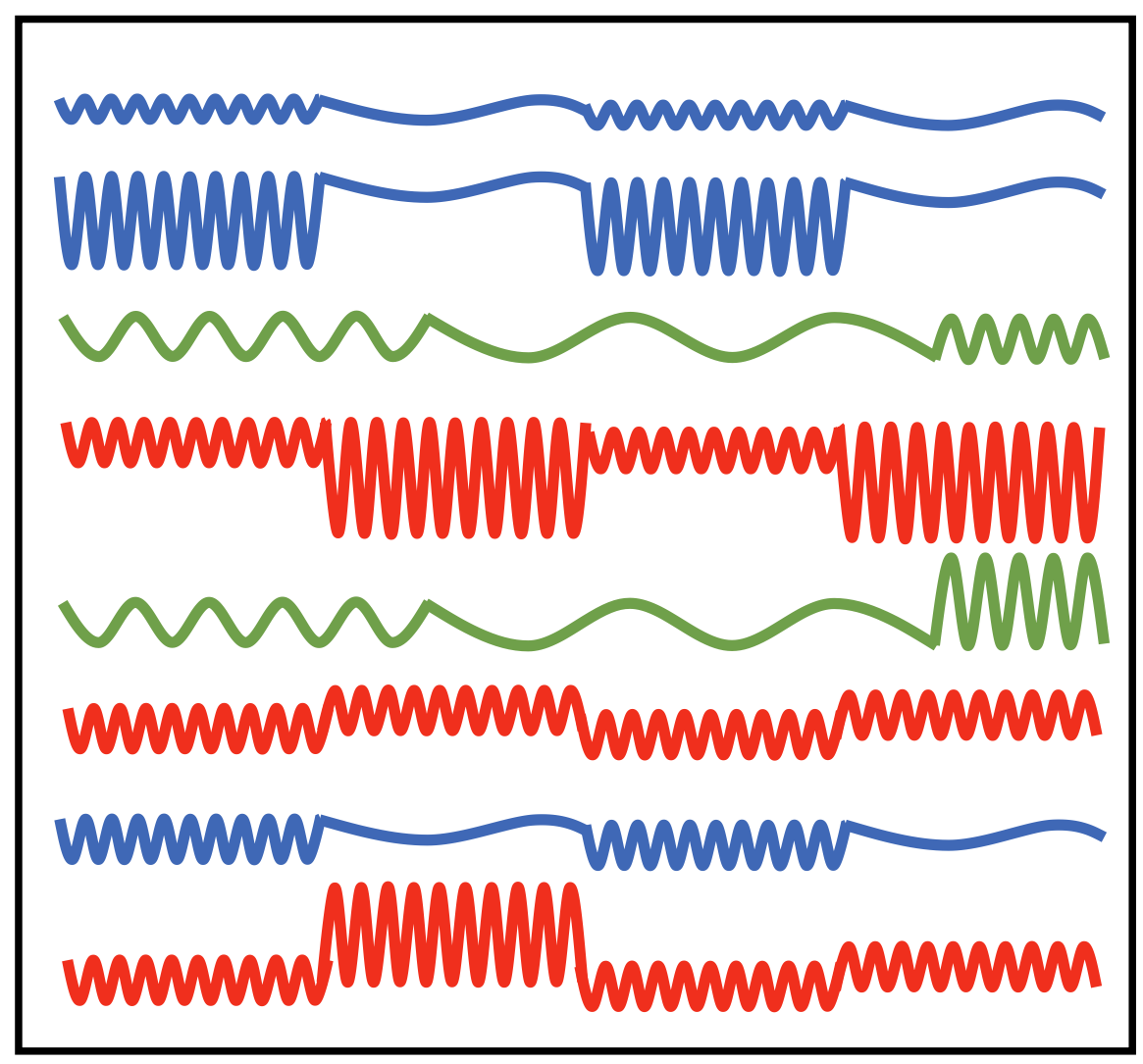
Graphs are important in time series analysis
Knowing graph structure is important in Machine Learning and Graph Signal Processing
Graph Signal Processing
Denoising/filtering
Missing value imputation
Graph Neural Networks
Node classification
Future value forecasting
Notes:
In many machine learning and graph signal processing models, knowing the graph structure enables increased performance.
Such models take advantages the dependency information provided by the graph can help us produce better result in tasks like signal denoising, missing value imputation, node classification, and etc.

Slide 5
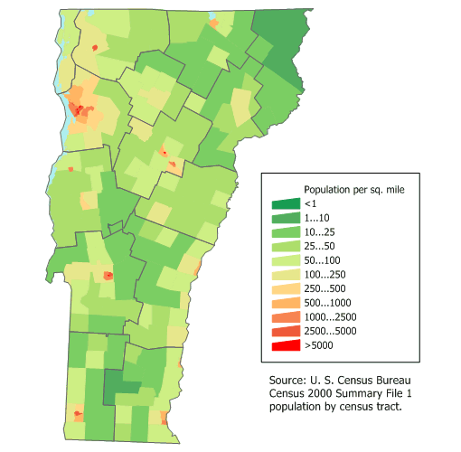
Graph Inference
(1) Not come with data
(2) Not agree with data
US cities covid data
No graph come with the data
The “natural” (e.g., spatial) graph may not “agree” with the data
Notes:
However, in practice, it’s likely that the graph is either not available or not informative enough.
Take the covid data in Vermont as an example.
For one, normally there is no graph come with the data.
To run downstream tasks, we need a graph. One option for us is to create a natural graph, such as spatial, as the input graph.
For example, we can build a simple k-nn graph, or a graph using connected highways. However, it is highly possible that these simple graphs are not agree with the data, we can not tell which “natural” graph is a good choice.

Slide 6
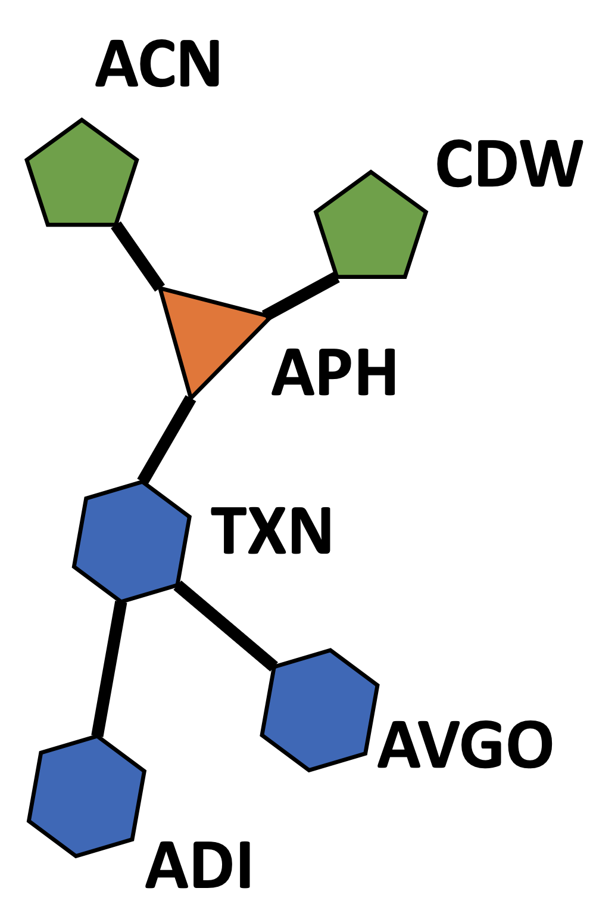
Problem: Graph Inference
Given time series, infer a graph among them.
T timesteps
Graph Signal Processing
N
Time
series
Graph Neural Networks
Input:
Data X
Output:
Graph G
Notes:
Graph inference is the process learning the dependency or similarity among timeseries.
The input is N time series, and the output is a graph, in which associated timeseries are connected to each other.

Slide 7
Prior Work
Physically-motivated:
Edges explain an underlying network process such as diffusion [cite].
Limits: edges are based on the predefined network process.
What if we don’t have a or know the network process?
Statistical models:
Graph lasso [Biostatistics’08]: based on the covariance matrix..
Graph signal processing:
Node values are smooth on the graph [TSP’16] [AI Stats’16].
What if the observed time-series has noise?
How can we connect time-series who have shared temporal patterns such as trends or periodicity?
Notes:
Previous work on graph inference can be groups to 3 kinds of models. Physically motivated model assumes an underlying network process, such as diffusion; Statistical models uses correlation to infer a graph; and Graph signal processing model assumes global signal smoothness.
Physically motivated methods require us to know what network process should motivate the graph whereas statistical models and graph signal processing methods can be sensitive to noise
Moreover all approaches do not consider an underlying temporal pattern we know are present in time series such as period and trends
How can we connect time-series who have such shared temporal patterns?

Slide 8
GIST: Graph Inference for Structured Time Series
Dictionaries:
DFT
Spline
Ramanujan
Encoding matrix
Temporal pattern can be encoded via fixed dictionaries
U is smooth on L
Similarity in frequency domain (U)
Notes:
we introduce GIST, which captures time series’ similarity in spectral domain.
Our assumption is that timeseries can be represented via fixed dictionary encoding. We can see X = U Phi here, U is the sparse encoding matrix, it tells us the temporal patterns of each time series.
And we want this encoding U to be smooth on L, that means timeseries with similar spectral will be connected.
Also, the dictionary used is arbitrary, we can use popular temporal dictionaries such as DFT, Spline for signals that are smooth, Ramanujan for periodic signals.

Slide 9
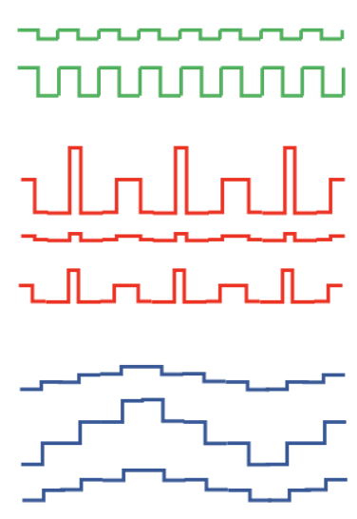
Example: similar behavior = similar periods
t1 t2 …
p1 p2 p3 p4
n1
n2
n3
n4
n5
n6
n7
n8
n1
n2
n3
n4
n5
n6
n7
n8
 | 2
 | 3
 |  | 3 | 4
 |  | 2 | 3
 |  | 3 | 3
 |  |  |  | 3 | 2
 |  |  |  | 2 | 2
 |  |  |  | 2 | 3
t1 t2 …
1 | 1 | 1 | 1 | 1 | 1 | 1 | 1
1 | -1 | 1 | -1 | 1 | -1 | 1 | -1
2 | -1 | -1 | 2 | -1 | -1 | 2 | -1
-1 | 2 | -1 | -1 | 2 | -1 | -1 | 2
2 | 0 | -2 | 0 | 2 | 0 | -2 | 0
0 | 2 | 0 | -2 | 0 | 2 | 0 | -2
p1
p2
p3
p4
$Φ$:Ramanujan Dictionary
Basis
X
U
U is sparse
Red signals are not close in signal domain
But similar in frequency domain (U)
Notes:
Here is a more concrete example shows how encoding works. We have 8 timeseries that can be grouped into 3 cliques. The dictionary we use here is Ramanujan periodic dictionary. Rows present for different periods.
From the encoding matrix we can see the timeseries can have 3 different periods. Take the middle 3 red timeseries as an example, which have a period of 3, they are not close in signal domain, but they are much closer in frequency domain, we can see their coefficients in U are very similar.

Slide 10
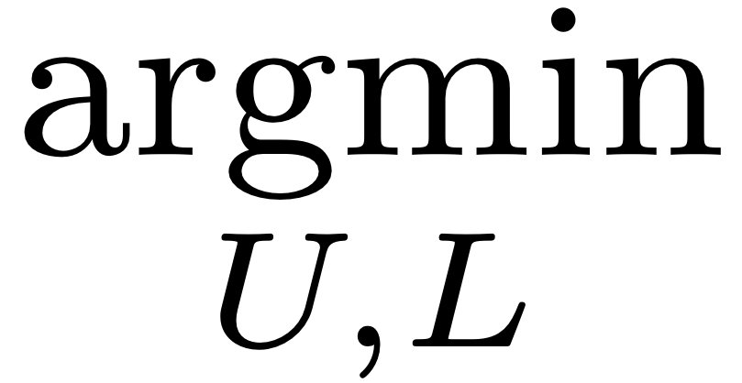
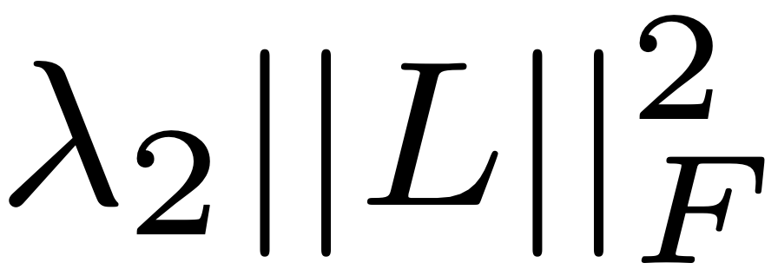
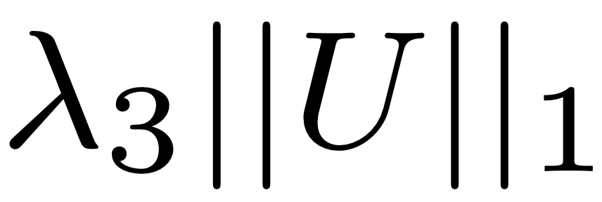
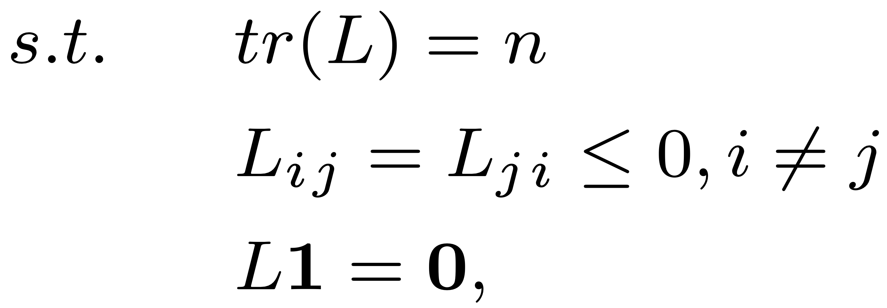
GIST - Objective
$UΦ$ is close to X
$$U is smooth on L$$
Spread of edges
U is sparse
Valid $Laplacian$
Notes:
Here is the GIST objective. We will learn both encoding U and graph Laplacian L in our model.
The objective function has 4 terms, the 1st term means U*Phi is a good approximation of the original input timeseries X; 2nd term ensures that the learned encoding is smooth on L; 3rd term tells the spread of the edges; the last term controls the sparsity of U.
And the 3 constrains below ensures the learned L is a valid Laplacian.

Slide 11
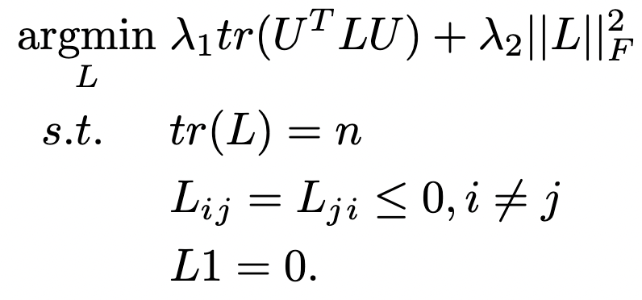
GIST Algorithm
We adopt Alternating Direction Method of Multipliers (ADMM) to solve L and U alternatively
Sub-problem 1: Given L, solve for U
Introduce proxy variable V = U, and solve V, U using ADMM.
U has closed form solution from a Sylvester equation
ADMM
Sub-problem 2: Given U, solve for L
Optimization details are in the paper
Solving by primal-dual method
Notes:
Since there are two unknown variables in GIST objective, we adopt ADMM to solve U and L separately.
In the first sub-problem L is given, and we solve for U. Since we have a sparsity term, we introduced a proxy variable V, and solve V and U alternatively. Note U has a closed form solution from the Sylvester equation.
In the second sub-problem, U is given, and we solve for L. This is solved using primal-dual method.
More details about optimization are in the supplement of the paper.

Slide 12
GIST-SP A GIST variation for lagged signal
p1 p2 p3 p4
1 | 1 | 1 | 1 | 1 | 1 | 1 | 1
1 | -1 | 1 | -1 | 1 | -1 | 1 | -1
2 | -1 | -1 | 2 | -1 | -1 | 2 | -1
-1 | 2 | -1 | -1 | 2 | -1 | -1 | 2
2 | 0 | -2 | 0 | 2 | 0 | -2 | 0
0 | 2 | 0 | -2 | 0 | 2 | 0 | -2
p1
p2
n1
n2
n3
n4
n5
n1
n2
n3
n4
n5
 |  | -2 | 2
 |  | 1 | -3
 |  | 3 | -2
 |  |  |  | 2 | -2
 |  |  |  | -1 | 3
p3
dist = 16
dist = 31
p4
X
Lagged signal
U
Has values in different signs
$Φ$:Ramanujan Dictionary
Encoding basis
L2 Distance(n3, n4) = 9 + 1 + 4 + 4 = 16
L2 Distance(n4, n5) = 9 + 25 = 31
Node 4 is closer to node 3,
but node 4 is more similar with node 5
Notes:
Vanila GIST allows us to compare time-series in the spectral domain. However it is often the case we are interested in comparing time-series which share the same period regardless of phase
As an illustrative example consider these 5 time-series. The top 3 share a period and the bottom 2 share a different period however they all have different phase.
If we measure the L2 distance between their spectral encodings, we can see that n4 and n3 will be closer than n4 and n5 despite the time-series in the latter relationship sharing a period
To expand the applicability of GIST to such cases where this undesirable we introduce GIST shared period or GIST-SP for short

Slide 13
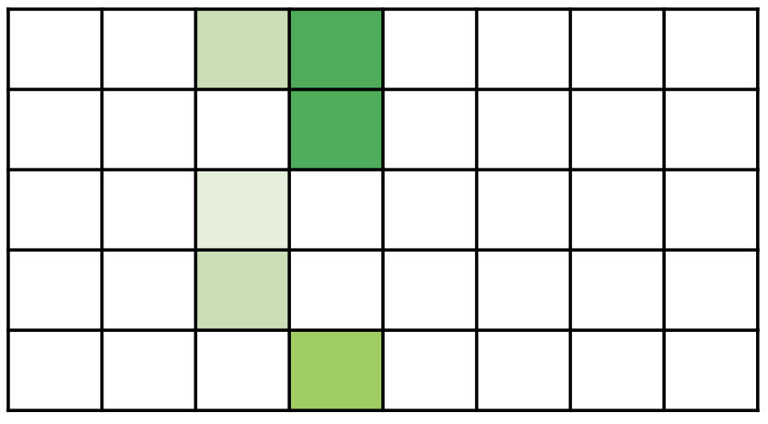
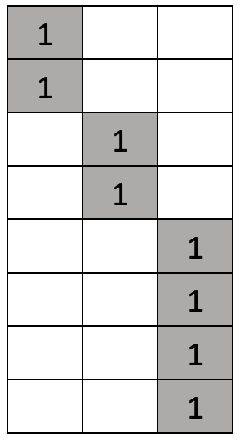
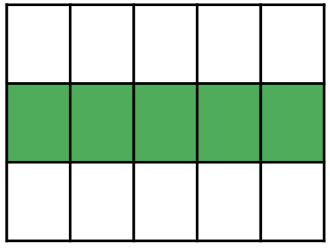
GIST-SP A GIST variation for lagged signal
Optimization details are in the paper
Us is the sum of absolute value of each period.
Us = abs(U) P, where P is an aggregation indication matrix of each period
p3 p4 p5
p3
p4
p5
p3 p4 p5
U
Us
P
Notes:
Instead of making U smooth on L, we make Us smooth on L. In this way, nodes with similar periods will be connected.
Us is the sum of absolute value of each period
Calculation example. Atoms in U (period 4), P is the aggregation indication matrix, output Us

Slide 14
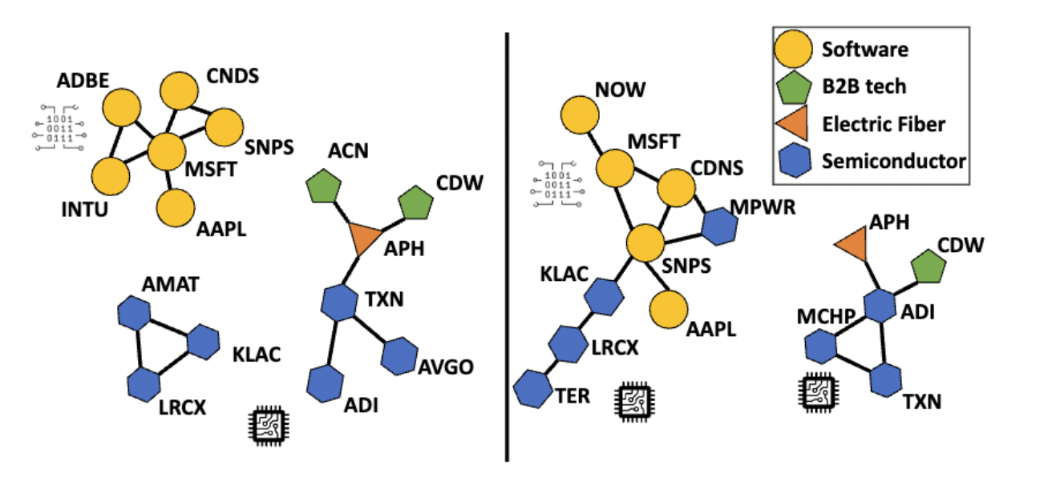
Case study: Tech Stocks
GIST
Correlation
Data:
Daily S&P 500 stocks closing prices for a year
Nodes: companies
GIST agrees better with
sub-sectors.
Top 15 learned edges
Notes:
We have two case studies that can demonstrate the advantage of GIST.
Here we present the results of running GIST on the S and P 500 closing price time series. We report the top 15 edges of GIST and correlation method.
We can see GIST can better separate the subsectors, companies from the same sector are well connected to each other. The big software companies are connected together; and APH bridging semiconductor producer and the b2b tech companies they supply.
In the correlation model, companies from different clusters are mixed together.

Slide 15
Dictionaries
Ramanujan:
Periodic data
Data changes at the same phase
Ramanujan Shared Period:
Periodic data
Data changes at the different phase
Spline:
Non-periodic data
Data changes smoothly

Slide 16
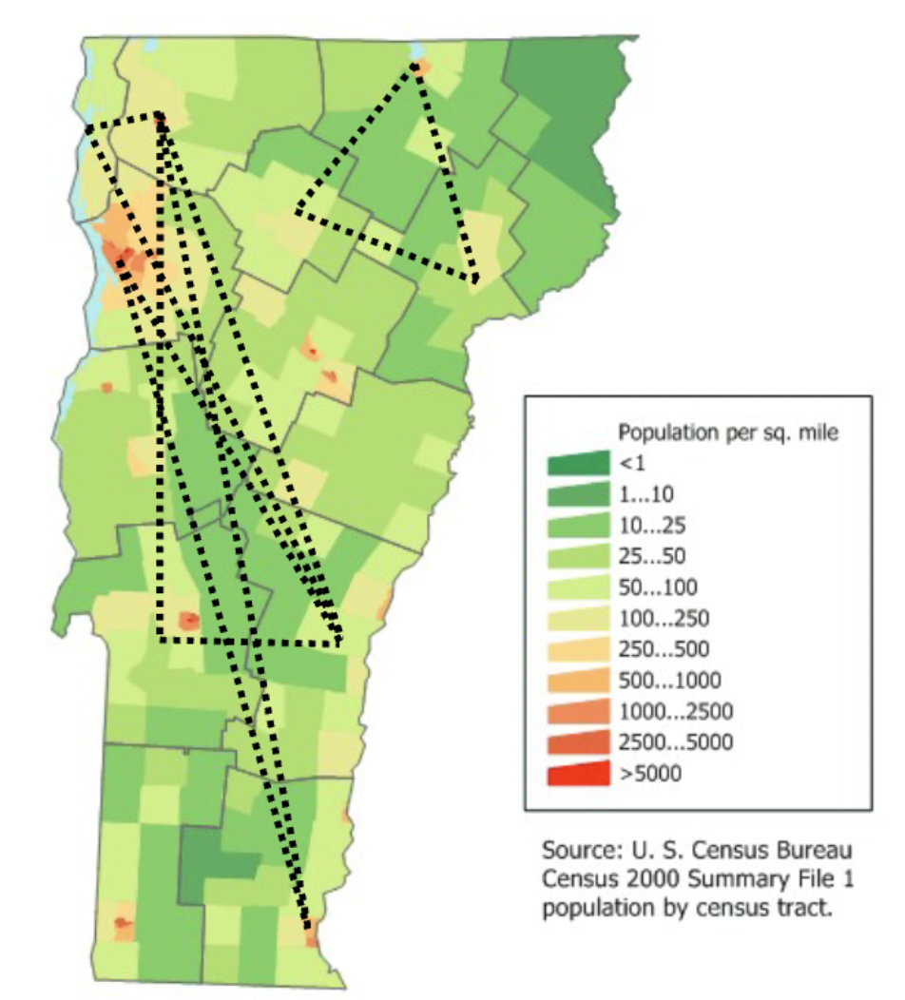
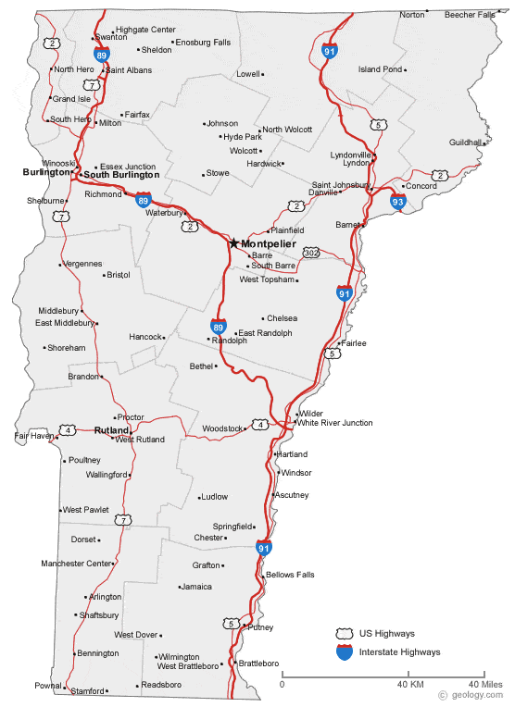
Case study: Covid in Vermont
Top 11 Edges
91
Highway
Data: Daily covid cases in Vermont for 2 years
Nodes: counties
Edges reflect potential spread of covid;
The edges are aligned with major highways.
89
7
91
Notes:
The second case study is on covid data for the state of Vermont.
Dotted lines are top 11 edges we learned with GIST-SP, counties where similar periods are connected.
These connected cities matched very well with the highways, which tells us possibly people’s mobility caused the spread of covid

Slide 17
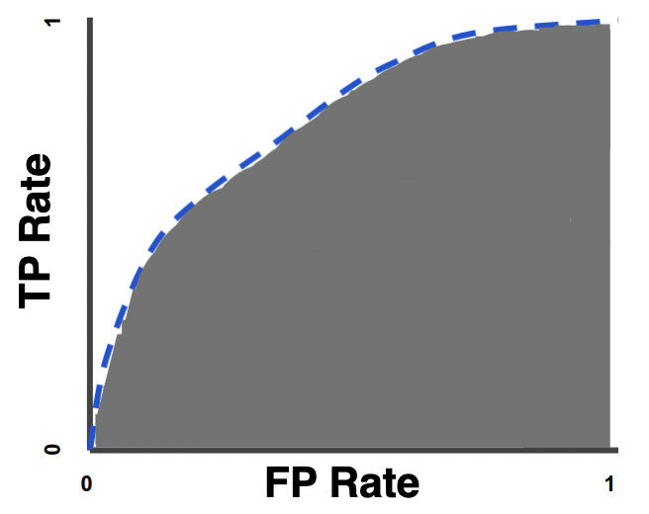
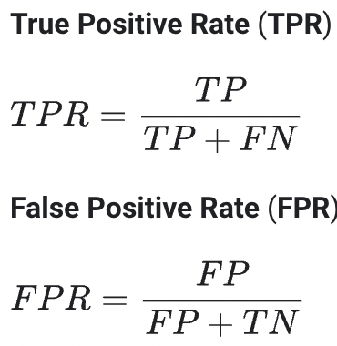
Experiments
Edge learning
GIST output a weighted adjacency matrix
Quality is measured via Area Under ROC Curve (AUC)
Notes:
We also conduct some other experiments. The first one is edge learning. GIST produces a weighted adjacency matrix. The quality is measured via Area Under ROC Curve.

Slide 18
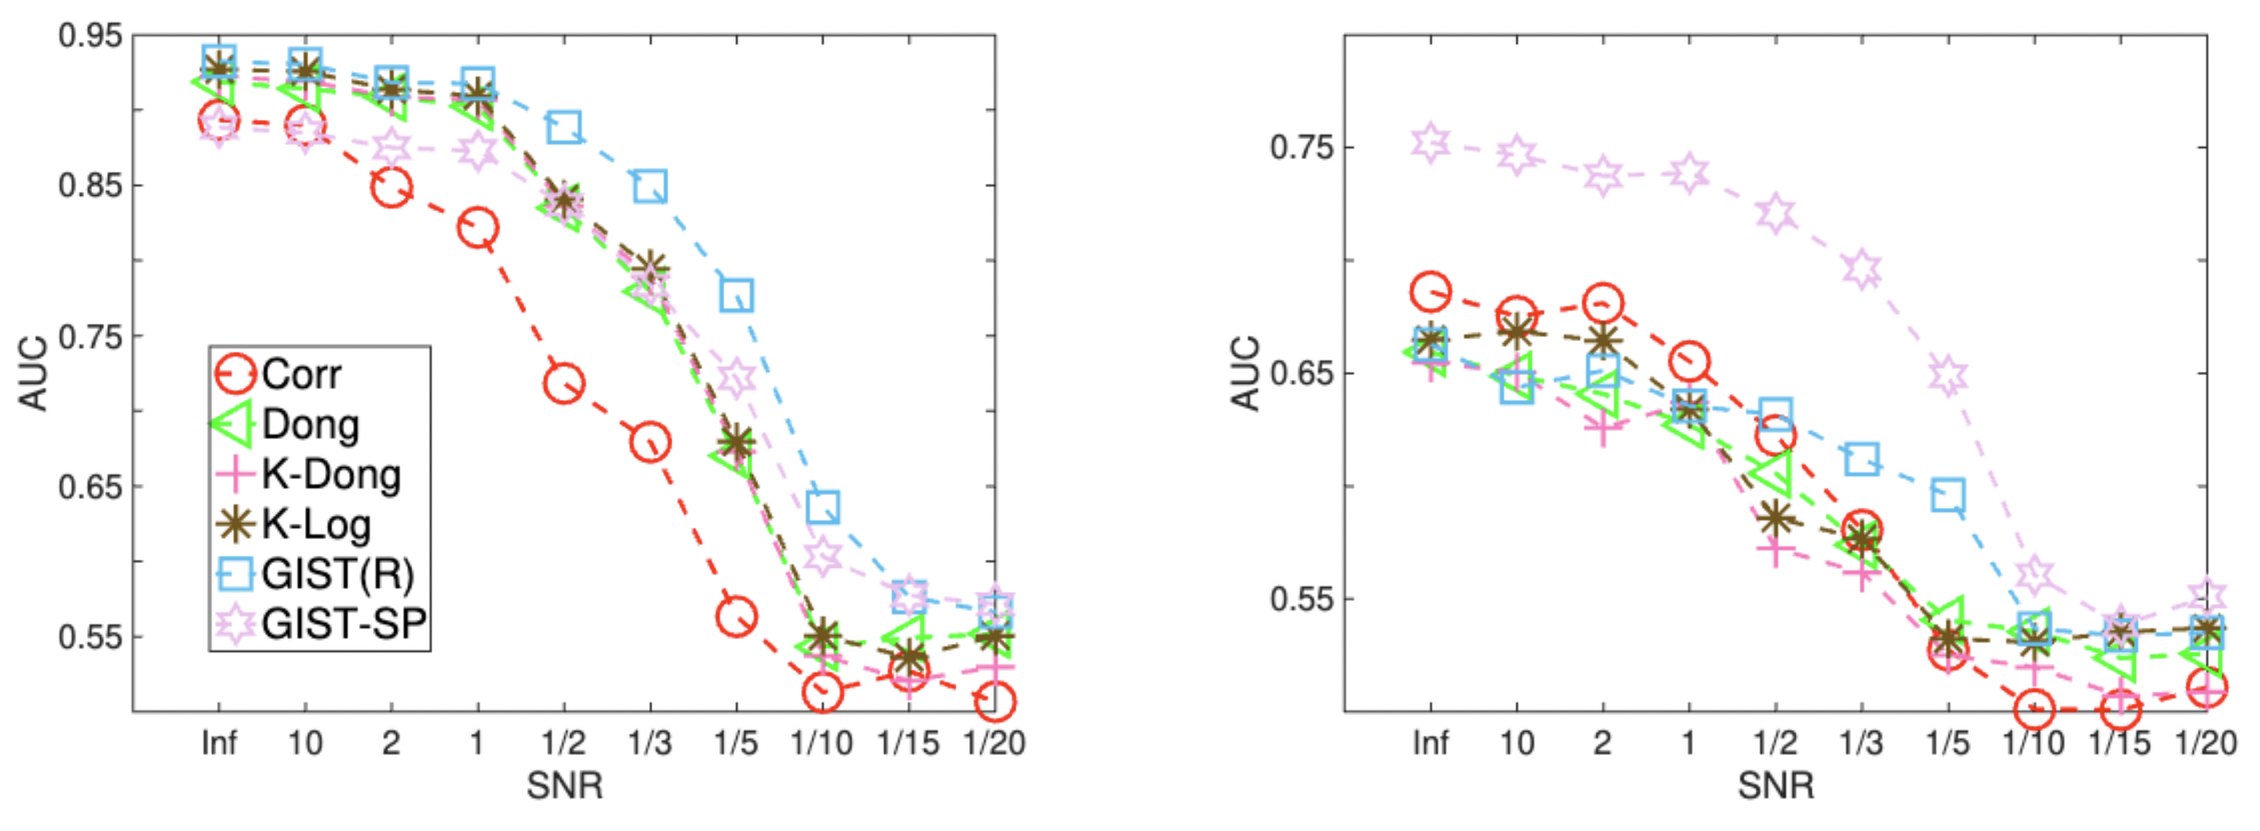
Edge learning in synthetic data
Graph: Stochastic block graph (3 blocks)
Signals in the same cluster share similar atoms in U
Signals in the same cluster
share similar period and lagged
Notes:
In this synthetic data test. We generate a ground truth graph using stochastic block model.
In the first test, signals in the same cluster share similar atoms in U, each period has multiple atoms. GIST with Ramanujan dictionary works best.
In the second test, signals in the same cluster share similar period but different lag, The GIST variation method, GIST-shared period works the best.

Slide 19
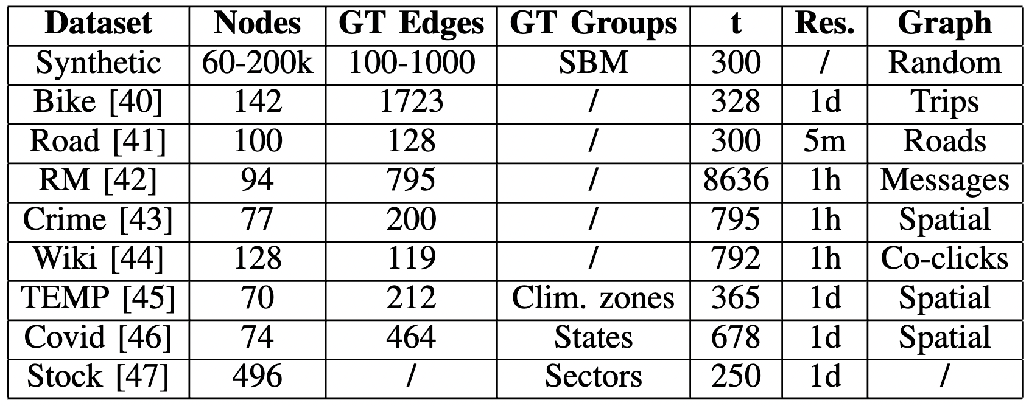
Real world dataset
Table: Datasets used in experiments
Notes:
We test GIST on 8 real world datasets from multiple domains, such as Transportation, Communication, Finance, and etc.
The ground truth graphs are different: some are behavior-based graph, such as in RM, bike, wiki; some are spatial graphs, like in Temperature, crime, COVID.
Also, There are 3 dataset that only have GT clusters. We will perform some clustering tests on them.

Slide 20
Edge learning in real world data (AUC)
 | RM | Wiki | Bike | Crime | Road
Corr | 64.4 | 50.9 | 61.0 | 52.5 | 75.7
Dong | 71.4 | 55.1 | 62.9 | 52.6 | 76.8
K-Dong | 71.7 | 55.4 | 56.4 | 49.8 | 76.8
K-Log | 73.4 | 52.5 | 62.3 | 49.8 | 79.4
GIST(S) | 73.4 | 57.4 | 64.0 | 53.8 | 80.0
GIST(R) | 71.6 | 52.4 | 60.7 | 53.8 | 75.8
GIST(SP) | 74.3 | 54.4 | 61.2 | 54.0 | 74.5
Spline
Ramanujan
Shared Period
GIST method performs the best in edge learning regarding AUC
Notes:
Here is the edge learning result.
GIST(S) spline for smooth signal, in wike, bike, road, signals are changing smoothly.
GIST-SP, RM, communication are lagged, same period; crime possible movement

Slide 21
Experiments
Clustering
Perform spectral clustering using the learned Laplacian matrix
Quality is measured via cluster Purity
Graph Inference
Spectral clustering
Data X
Graph G
21
Notes:
We also conduct clustering experiment. We perform special clustering using the learned laplacian. And the quality is measured via purity.

Slide 22
Clustering in real world data (Purity)
 | Temperature | Covid | Stock subset | Stock S&P 500
Correlation | 65.4 | 47.7 | 45.2 | 20.7
Dong | 78.6 | 73.0 | 69.8 | 33.1
K-Dong | 78.6 | 69.1 | 69.2 | 32.7
K-Log | 78.6 | 69.0 | 69.2 | 34.0
GIST(S) | 80.0 | 62.2 | 73.8 | 33.4
GIST(R) | 94.3 | 69.4 | 69.2 | 36.4
GIST(SP) | 91.7 | 74.0 | 73.8 | 31.4
Spline
Ramanujan
Shared Period
Notes:
From the result, we can see again gist family methods work best.
Temperature shows strong seasonality. Ramanujan dictionary work best
Covid shows the spread of covid, same period, but lagged. So, Gist shared period wins.

Slide 23
Contribution of GIST
Novelty
Dictionary-based graph learning framework for multivariate time series
Connected time series share similar encoding.
Generality
Applicable to time series with various temporal structures: seasonality, trends and custom temporal patterns.
Applicability
Accurately infers graphs across multiple application domains.
Notes:
read

Slide 24
Acknowledgement
Funded by the National Geospatial-Intelligence Agency
Funded by the NSF Smart and Connected Communities (SC&C)
Registration and travel support for this presentation was provided by the Society for Industrial and Applied Mathematics
Coauthors: Maxwell McNeil and Petko Bogdanov.
Paper and code are available at DMMLAB, UAlbany: http://www.cs.albany.edu/~petko/lab/publications.html
(SC&C)

Slide 25
Thanks!
Questions?
Boya Ma, Maxwell MacNeil, Petko Bogdanov
UAlbany, SUNY
DMM lab
GIST Paper & Code:

Slide 26
Reference:
Dong, Xiaowen, et al. "Learning Laplacian matrix in smooth graph signal representations." IEEE Transactions on Signal Processing 64.23 (2016): 6160-6173.
Kalofolias, Vassilis. "How to learn a graph from smooth signals." Artificial Intelligence and Statistics. PMLR, 2016.
Friedman, Jerome, Trevor Hastie, and Robert Tibshirani. "Sparse inverse covariance estimation with the graphical lasso." Biostatistics 9.3 (2008): 432-441.
S. V. Tenneti and P. P. Vaidyanathan. Nested periodic matrices and dictionaries: New signal representations for period estimation. IEEE Trans. Signal Processing, 63(14):3736–3750, 2015

Slide 27
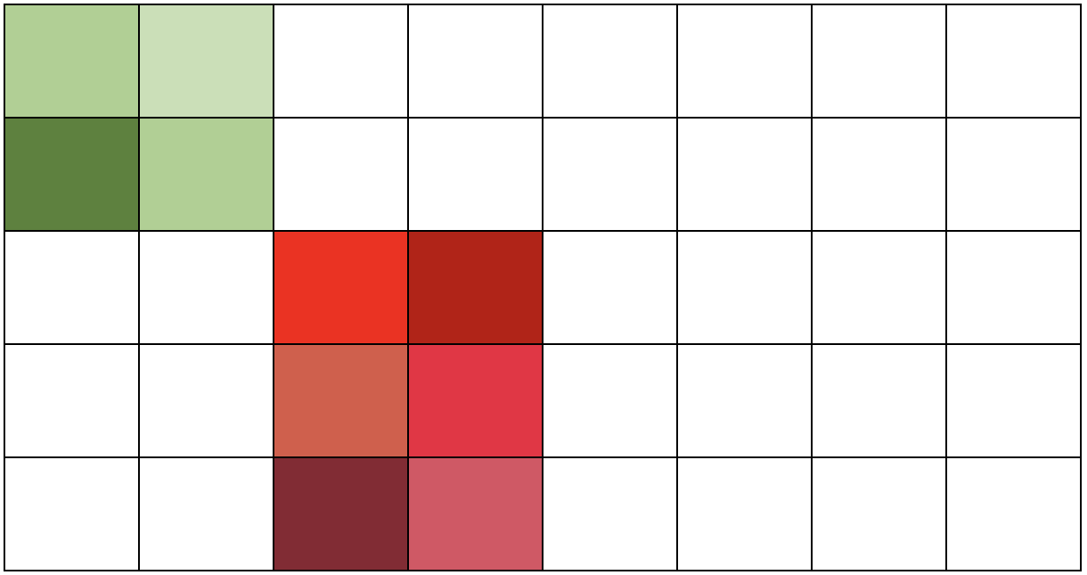
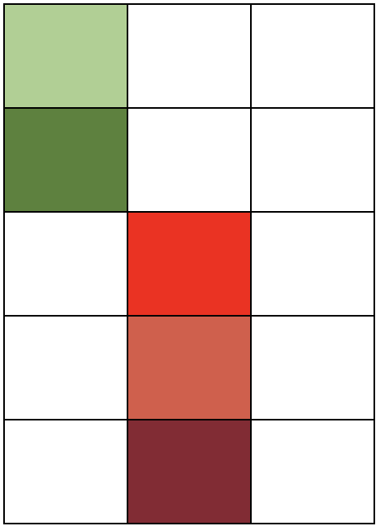
Two Objectives summary
Possibly omit
p3
p4
p5
1st objective (GIST)
Not lagged data
Distance in U: Atom level
2nd objective (GIST-SP)
Lagged data
Distance in U: Period level
Not lagged
U
p3 p4 p5
Lagged
Us
Notes:
sumarize

Slide 28
Informal problem definition
Input time series -> Output graph: relate to a practical application (choose from case studies
Say what are the challenges:
Neighbors might have different scales
“Neighbors” might be lagged or anti-correlated
…

Slide 29
Sparse coding & Dictionaries
Leave as extra slide
Represents data via a sparse combination of dictionary basis.
$Φ$ = $\left[\begin{matrix}\begin{aligned}⋮ \\ d_{1}\end{aligned} & \begin{aligned}⋮ \\ d_{2}\end{aligned} \\ ⋮ & ⋮\end{matrix} \begin{matrix}\begin{aligned} \\ ⋯\end{aligned} & \begin{aligned}⋮ \\ d_{T}\end{aligned} \\ & ⋮\end{matrix}\right]$
$$x_{i}= \sum_{t=1}^{T}{u_{i}d_{t}}$$
X: the signal which has n nodes and t timesteps
U: the encoding matrix - Sparse
$Φ$: Fourier, Ramanujan, Spline or other
$x_{i}$ is the i-th row in X
$u_{i}$ is sparse
Notes:
If we known structure in time in analyzing time series
We can find some sparse encoding to represent the data
Phi with column basis, xi can be reconstructed using u*d, we want to use less coefficients

Slide 30
Dictionaries for time series
Not much in this slide, omit
 | DFT | Ramanujan | Spline
Type | Temporal
Orthogonal | ✔️
Parameter-free | ✔️
Notes:
More dictionaries can be used in our topic.
There are spatial dictionaries like GFT and Graph wavelet, and temporal dictionaries like DFT, Ramanujan, and Spline
orthogonal atoms indicates we can solve it more efficiently.
Parameter-free, for example DFT has no parameter while building it, Ramanujan has max period

Slide 31
Temporal Dictionary: Ramanujan Periodic Dict
Dictionary
Sub-dictionary
Period basis
Ramanujan sum
Where g is a period, {d1, d2, …, dk} are the divisors of g

Slide 32
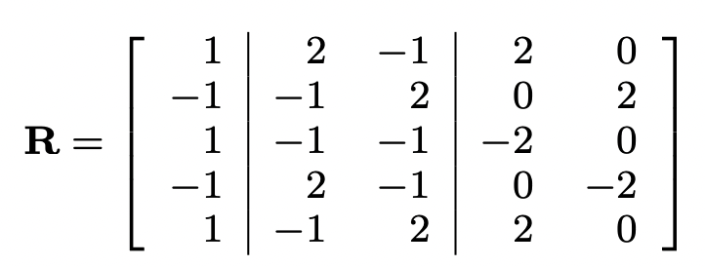
Temporal Dictionary: Ramanujan Periodic Dict
Example dictionary with 3 period, and signal length is 5

Slide 33
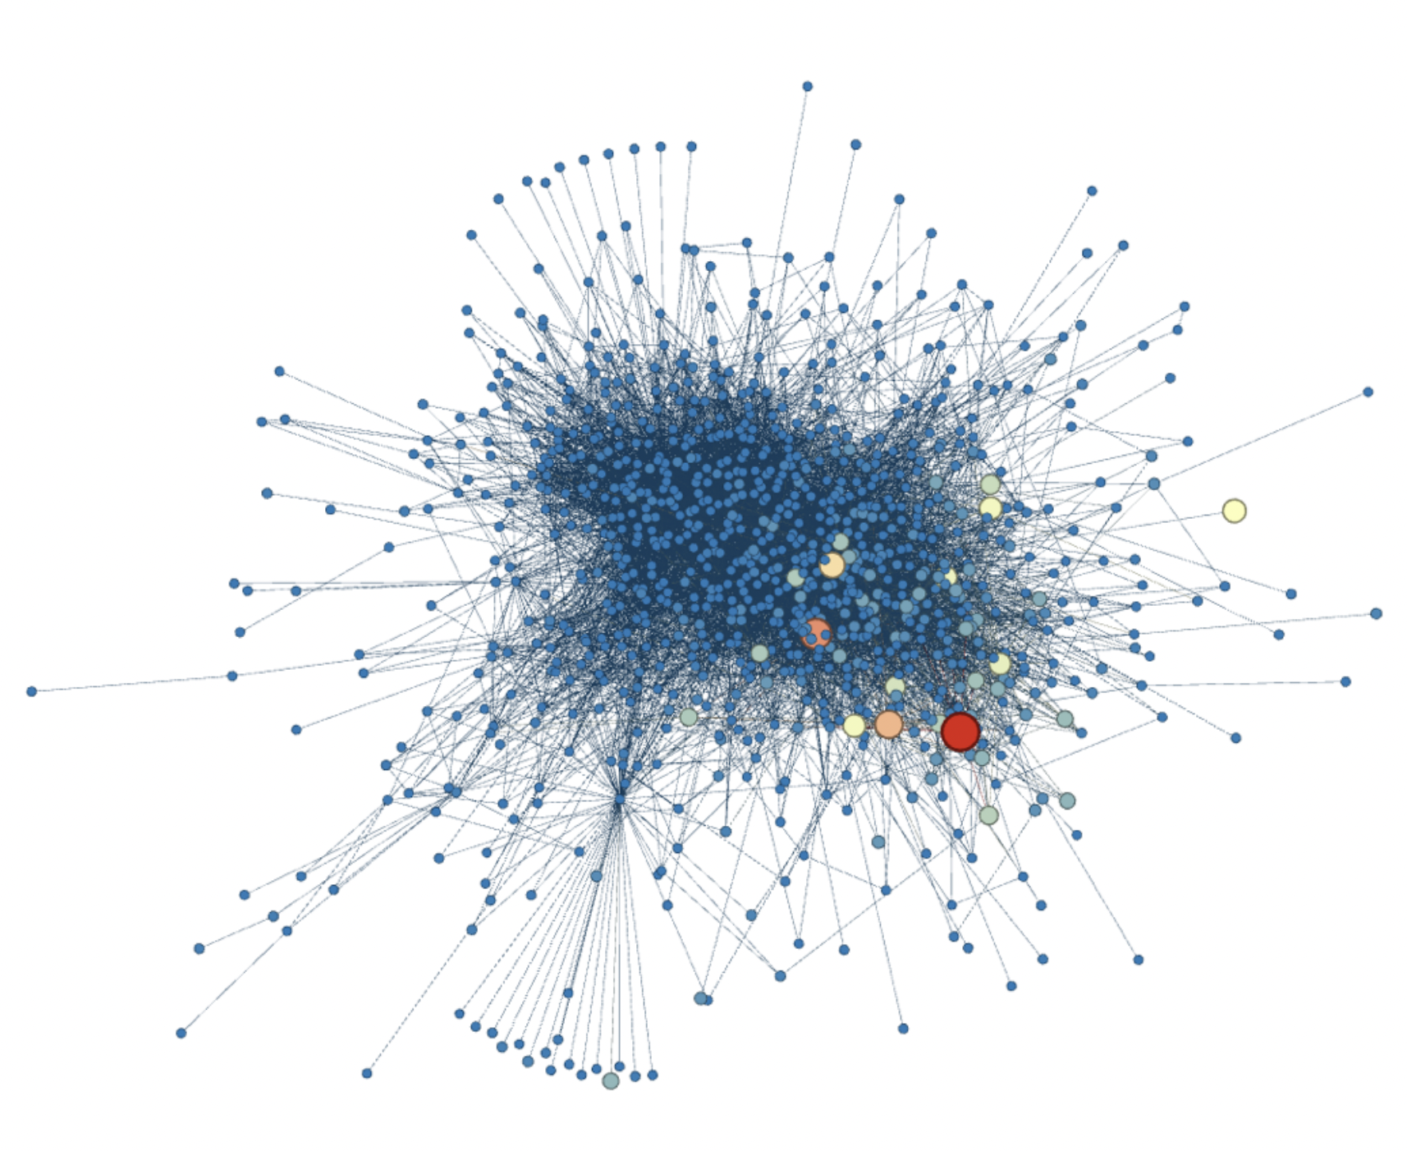
Graph Signal Processing
Node:
1000 Twitter users
Edge:
Following relationship
Signal:
Number of #Apple related hashtag posted in 6 weeks
https://web.media.mit.edu/~xdong/talk/BDI_GSP.pdf
Notes:
Now, comes to Graph signal processing, The second kind of structure is in the graph domain
In the figure is graph signal example.
We can see from the signal structure that shows local patterns, real-world data smooth, i.e. neighboring nodes have similar values.
when friends talk about apple, you are likely to also talk about apple.
So how do we represent/analyze such smooth signals on the graph? -> Graph signal processing

Slide 34
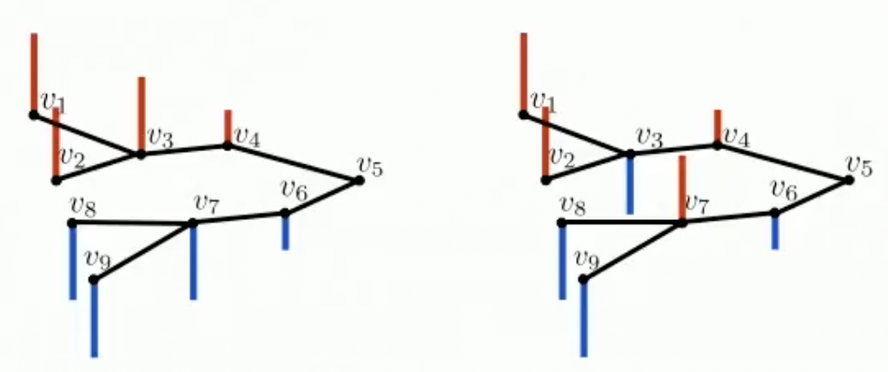
Graph Laplacian and Smoothness
Leave as extra slide
x(i) is the signal value of node i
$w_{ij}$ is the weight of edge(i,j)
$w_{ij}$ is 0 when no edge between i and j
Bars are node signals
Input signal: $X$
Smoothness: tr($X^{T}LX$)
(a)
$$x^{T}Lx=1$$
(b)
$$x^{T}Lx=21$$
Notes:
Explain notations
Smoothness is defined as the sum of edges weights times the power of the connected signal difference.
Note, non-edge weight is 0
For example (a) has a smoothness value of 1, and (b) is 21
Mathematically, if the input signal is a matrix with timesteps, the smoothness will be: trace(X’LX)

Slide 35
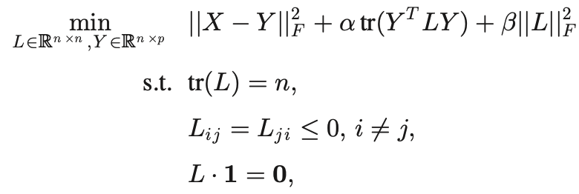
Dong’s method
Too much detail on a baseline, skip or leave as extra
Better reconstruction
Y is smooth on L
Distribution of edge weights
Ensure valid Laplacian
X: input signal
Y: denoised version of X
L: the learned Laplacian matrix
[1] Dong, Xiaowen, et al. "Learning Laplacian matrix in smooth graph signal representations." IEEE Transactions on Signal Processing 64.23 (2016): 6160-6173.
Notes:
Introduce symbols
Explain 3 terms
Constrain

Slide 36
Kalofolias’ method
Too much detail on a baseline, skip or leave as extra
X is smooth on L
Penalty on edges with small weights
Distribution of edge weights
W: adjacency matrix
Z: pair-vise distance matrix
[2] Kalofolias, Vassilis. "How to learn a graph from smooth signals." Artificial Intelligence and Statistics. PMLR, 2016.
Notes:
Explain the differences from Dong, notation is different but the objective is the. Only the sencod term is different.
Explain Z
Explain 3 terms

