Slide 1
The Internet
Mariya Zheleva, Assistant Professor
Karyn Doke, PhD student
Computer Science, University at Albany – SUNY

Slide 2
What is the Internet?

Slide 3
How to create a network that can survive a nuclear attack?
1926-2011
Image source: Kahn Academy

Slide 4
A packet-switched network
Break-up data into chunks
Task different nodes with transmitting different chunks
  No dedicated path; hard to break communication
You during summer camp
Mom in the city

Slide 5
A packet-switched network
Break-up data into chunks
Task different nodes with transmitting different chunks
  No dedicated path; hard to break communication
You during summer camp
Mom in the city

Slide 6
A packet-switched network
Break-up data into chunks
Task different nodes with transmitting different chunks
  No dedicated path; hard to break communication
You during summer camp
Notes:
Addressing
Internet network of networks
Devices

Slide 7
A packet-switched network
Break-up data into chunks
Task different nodes with transmitting different chunks
  No dedicated path; hard to break communication
You during summer camp
Mom in the city

Slide 8
A packet-switched network
Break-up data into chunks
Task different nodes with transmitting different chunks
  No dedicated path; hard to break communication
Attacking one node would not:
  Bring down the entire network
  Compromise the entire message
You during summer camp
Mom in the city

Slide 9
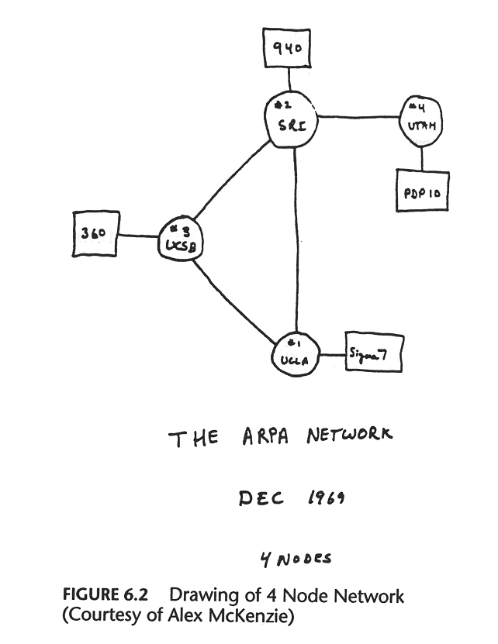
How can we transfer packets reliably through a distributed network?
The first packet-switched network
Invented TCP/IP protocol
  The glue that holds the Internet together
Four nodes
  Univ. of Utah
  UC Santa Barbara
  Stanford Research Institute
  UC Los Angeles
Share text messages between the Pentagon and the universities
Vinton Cerf and Robert Kahn
Image source: http://vingtcerf.blogspot.com/

Slide 10
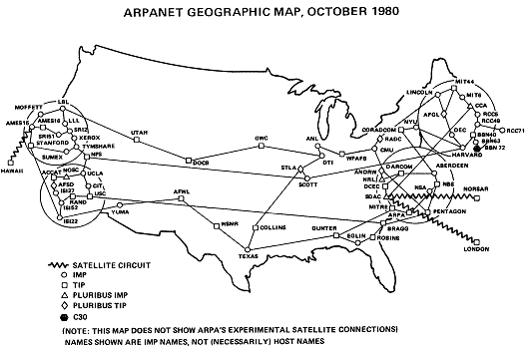
July 1977: The birth of the Internet
ARPA demonstrates ARPANET
  San Francisco (wireless) → Norway (satellite) → UCL (landline) → USA (satellite) → Los Angeles (ARPANET)
  Round trip of 94,000 miles to deliver a message 800 miles away.

Slide 11

The killer app
The World Wide Web
  Intended to allow researchers to exchange data on the ARPANET
Very well-received by the public; made the Internet go “viral”
Sir Tim Berners-Lee

Slide 12
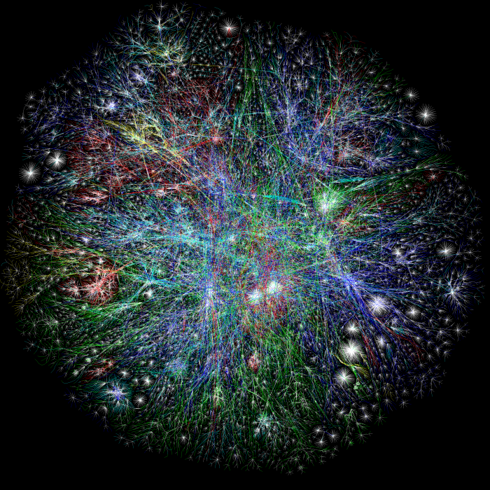
The Internet today: over 30 billion connected devices

Slide 13
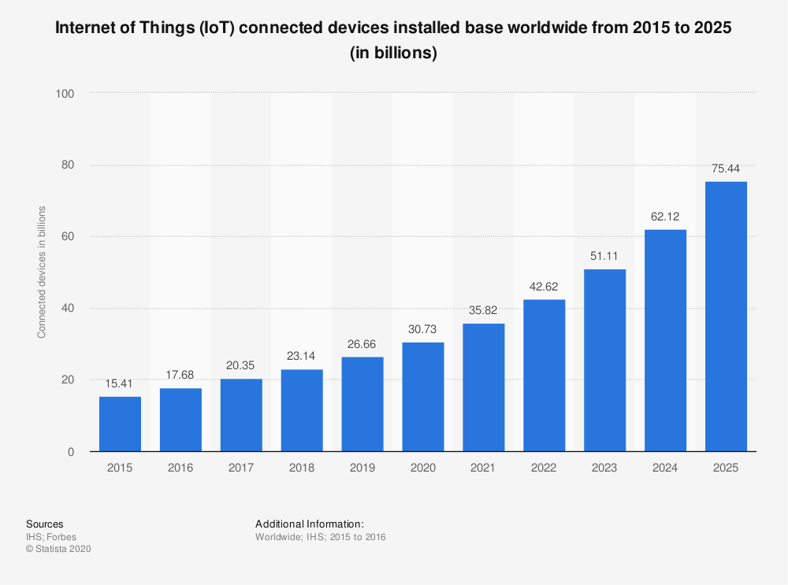
And rapidly growing
x2.5 in five years
Statista 2020

Slide 14
Who owns the Internet?

Slide 15
A network of networks
You during summer camp
Mom in the city

Slide 16
A network of networks
Anybody who thinks they can make use of the Internet can become a part of it, as long as they have devices that “speak” the Internet language.
Cogent
Telia
AT&T
Spectrum
Level 3
You during summer camp
Mom in the city

Slide 17
How do packets travel on the Internet?

Slide 18
Packet addressing
Interface | Next Hop Destination
1 | West Coast
2 | New York State
…
West Coast
1
New York State
Lake George
2
Albany
East Coast
3
Vermont
You during summer camp
Mom in the city

Slide 19
Packet addressing
Interface | Next Hop Destination
1 | West Coast
2 | New York State
…
West Coast
1
New York State
Src: L. George
Dst: Albany
Albany
Lake George
2
East Coast
3
Vermont
You during summer camp
Mom in the city

Slide 20
Packet addressing
Interface | Next Hop Destination
1 | West Coast
2 | New York State
…
West Coast
1
New York State
Src: L. George
Dst: Albany
Albany
Lake George
2
East Coast
3
Vermont
You during summer camp
Mom in the city

Slide 21
Packet addressing
Interface | Next Hop Destination
1 | West Coast
2 | New York State
Src: L. George
Dst: Albany
West Coast
…
1
New York State
Lake George
2
Albany
East Coast
3
Vermont
You during summer camp
Mom in the city

Slide 22
Packet addressing
Interface | Next Hop Destination
1 | West Coast
2 | New York State
…
West Coast
1
New York State
Src: L. George
Lake George
2
Dst: Albany
Albany
East Coast
3
Vermont
You during summer camp
Mom in the city

Slide 23
Thank you!
Mariya Zheleva, mzheleva@albany.edu
Karyn Doke, kdoke@albany.edu
Game design by Computer and Science Engineering for K-12 www.cse4k12.org
UbiNET Lab Sponsors:
Some material from

