Slide 1
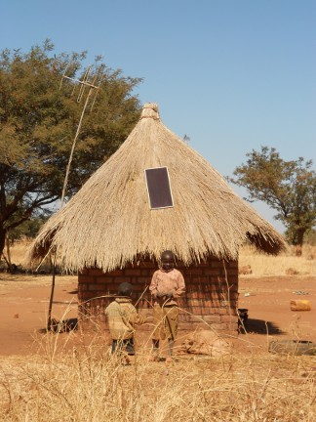
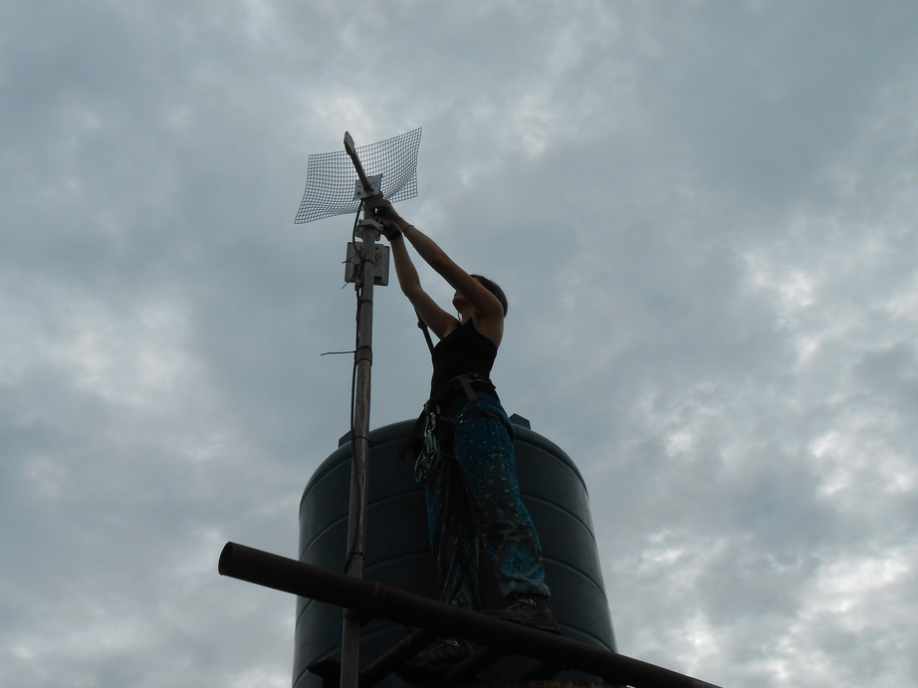
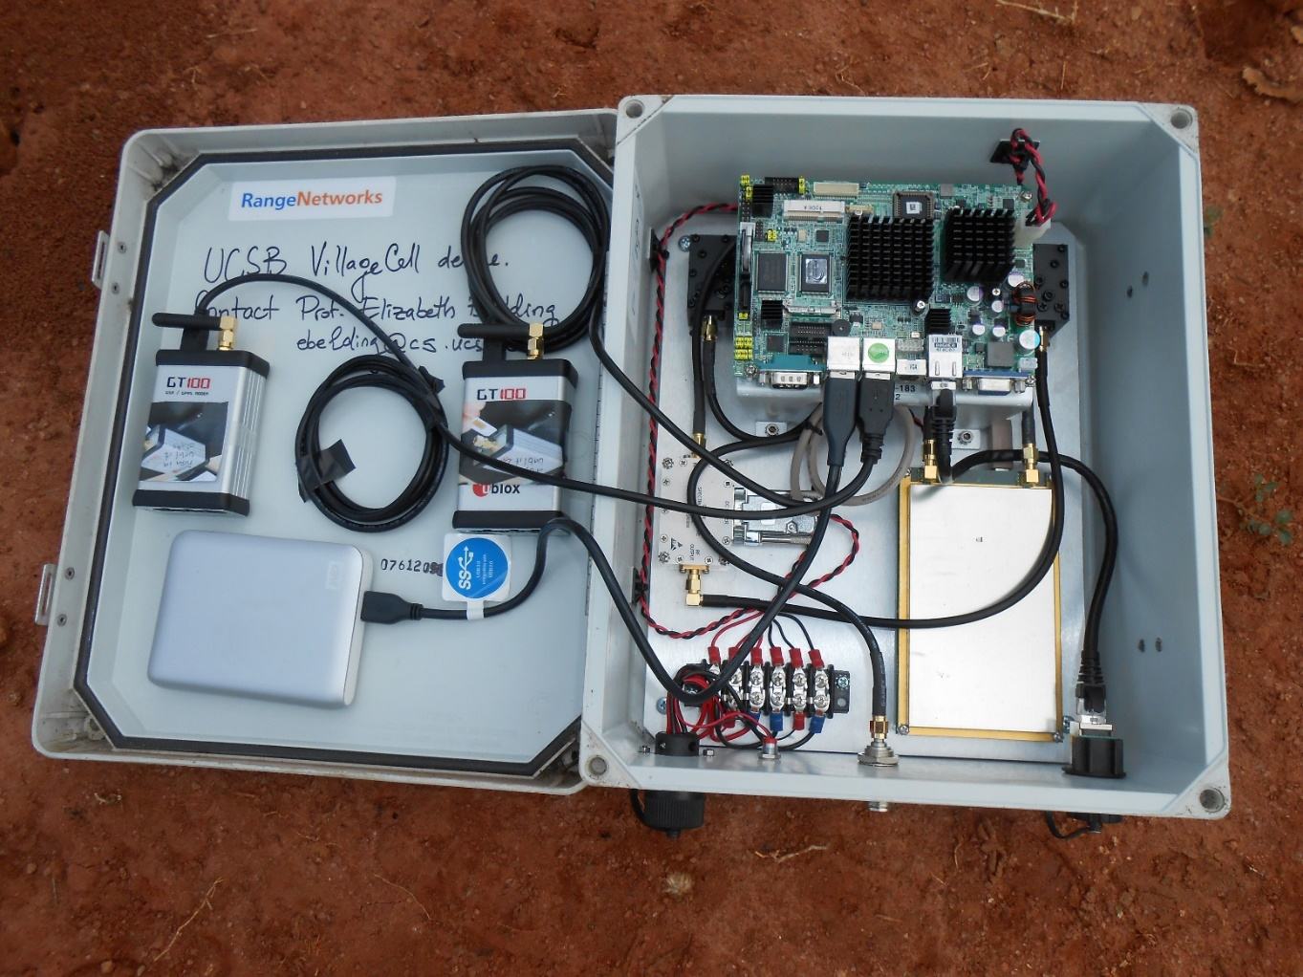
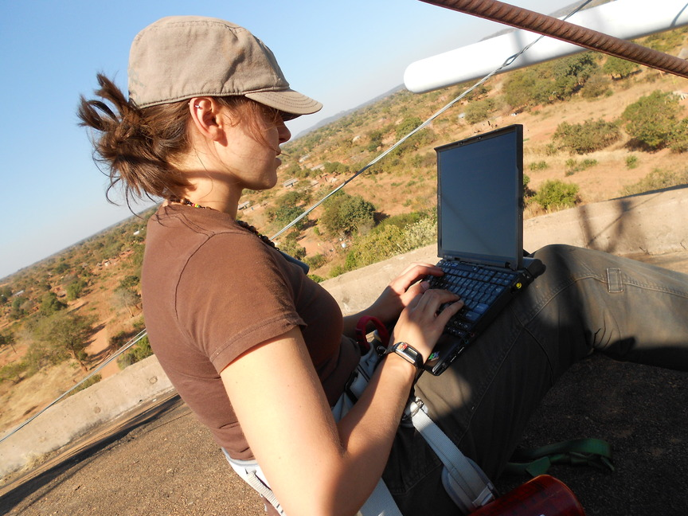
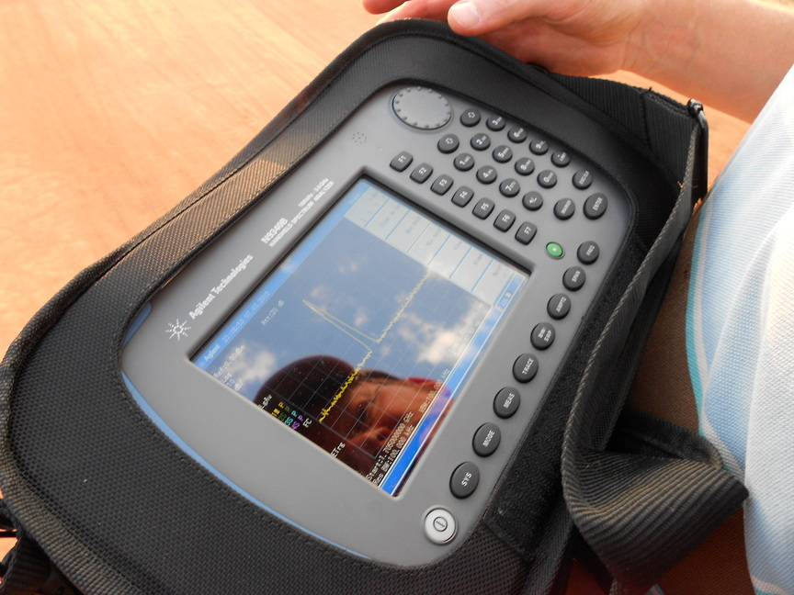
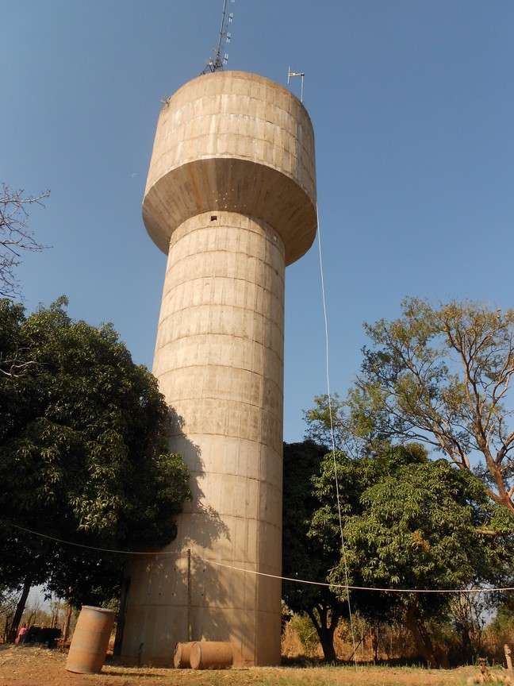
About Mariya and the UbiNET Lab
Instructor: Mariya Zheleva, mzheleva@albany.edu
Research interests
  Next generation wireless networks
  Spectrum management and measurements
  Infrastructure-less networks (cellular and ad-hoc)

Slide 2
Research for undergrads at UbiNET
Student placement
Georgia Tech
Carnegie Mellon
Northeastern
Stuti Misra
Honors student
Tim Larock
Honors student
Jason Viviano
NSF REU fellow
Eman Shah
NSF REU fellow
Industry
Possible research tracks
REU Fellows
Independent research
Capstone projects
Matt Jacobs
Student assistant
Ayman Salloum
Student assistant
Domenic Recchia
Student assistant
Honors program research and thesis

Slide 3

Wireless networks: Advances, principles and architectures
Instructor: Mariya Zheleva
mzheleva@albany.edu
UbiNET Lab
2020 Summer School on Wireless

Slide 4
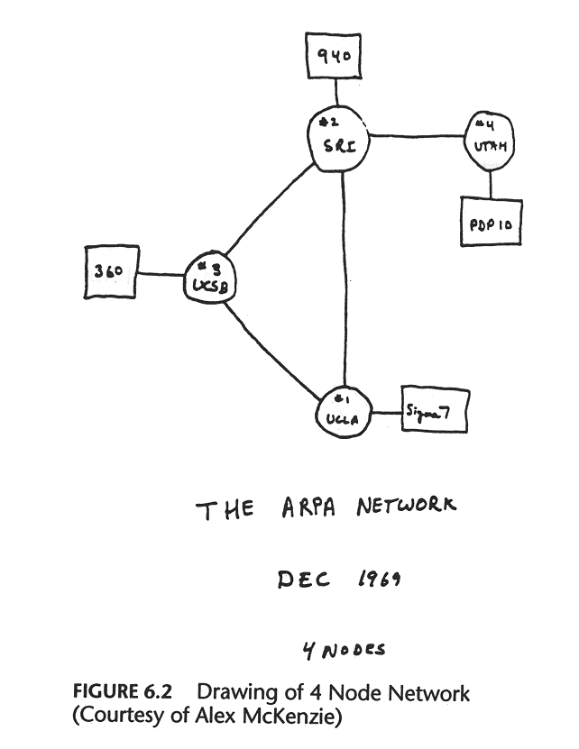
Getting connected: A roadmap
The beginning of the Internet – 1969
The first packet-switched network
Four nodes
  Univ. of Utah
  UC Santa Barbara
  Stanford Research Institute
  UC Los Angeles
Share text messages between the Pentagon
and a few universities

Slide 5
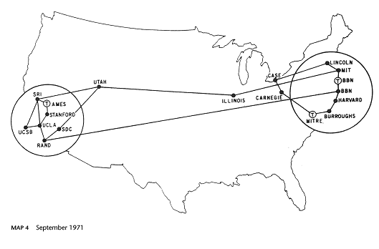
Getting connected: A roadmap
In 1971 the Internet had grown to 19 nodes – needed some protocols for how messages should be exchanged
  Network Control Protocol (NCP)

Slide 6

Meanwhile diversity began to appear…
The first Ethernet LAN (Local Area Network) at Xerox PARC (1970).
  Need of a protocol that would work across networks
  IP
WLANs (Wireless LANs)
  Flaky links could not guarantee packet delivery
  Need of a protocol to provide such guarantees
  TCP in Stanford, BBN and UCL
TCP/IP became the de-facto standard for the Internet architecture

Slide 7
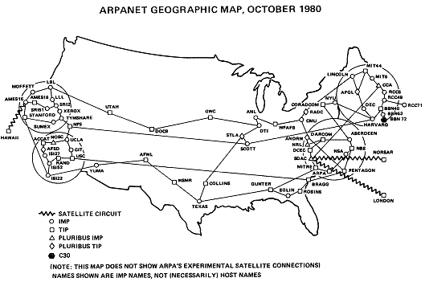
July 1977: The birth of the Internet
ARPA demonstrates ARPANET
  San Francisco (wireless) → Norway (satellite) → UCL (landline) → USA (satellite) → Los Angeles (ARPANET)
  Round trip of 94,000 miles to deliver a message 800 miles away.

Slide 8
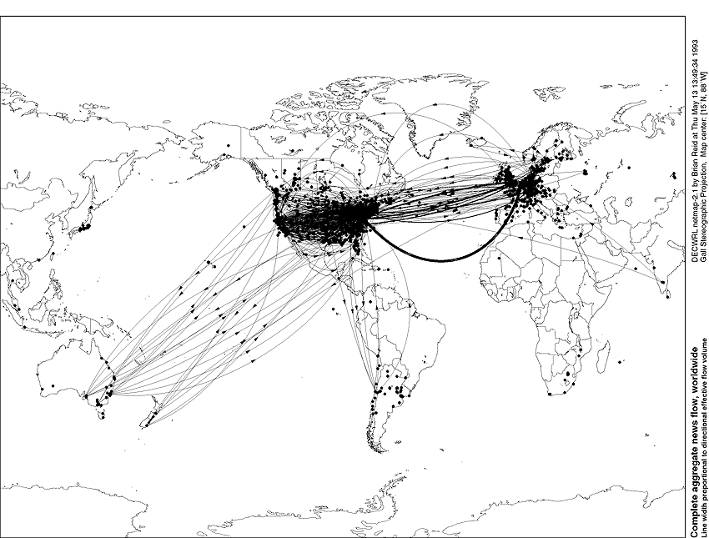
In 1993:
Commercialization → A truly global network

Slide 9
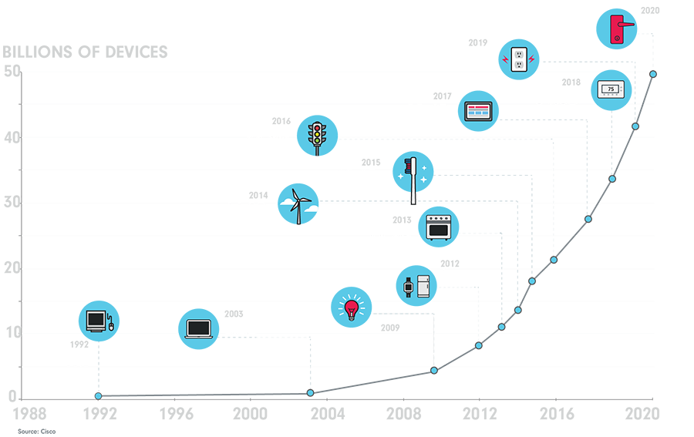
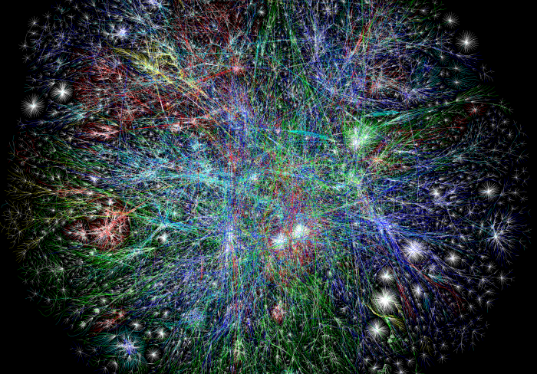
# Devices on the Internet today

Slide 10
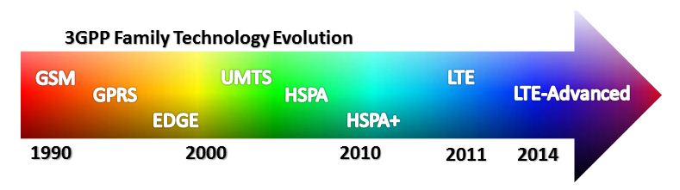
When did wireless come into the picture
Cellular
WiFi

Slide 11
Almost the entire world population lives within mobile network reach
https://www.itu.int/en/ITU-D/Statistics/Documents/facts/FactsFigures2019.pdf

Slide 12
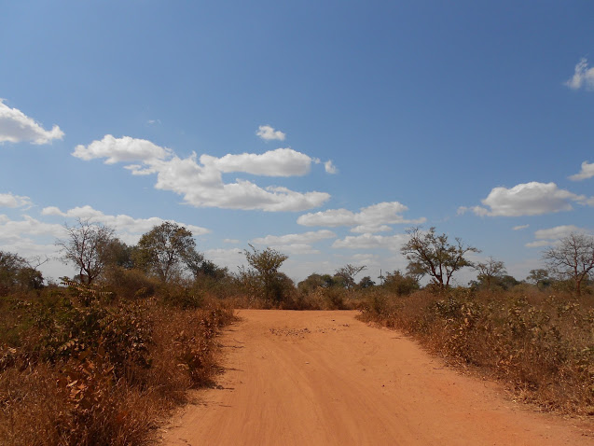
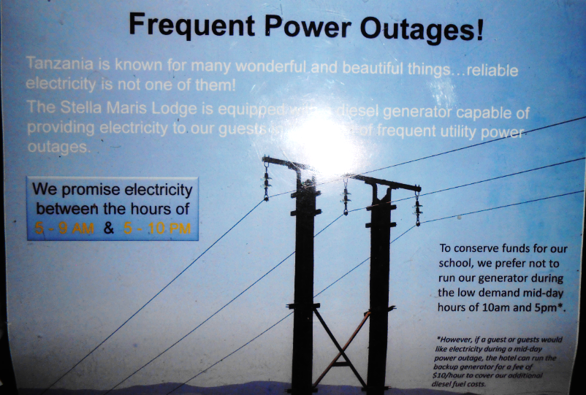
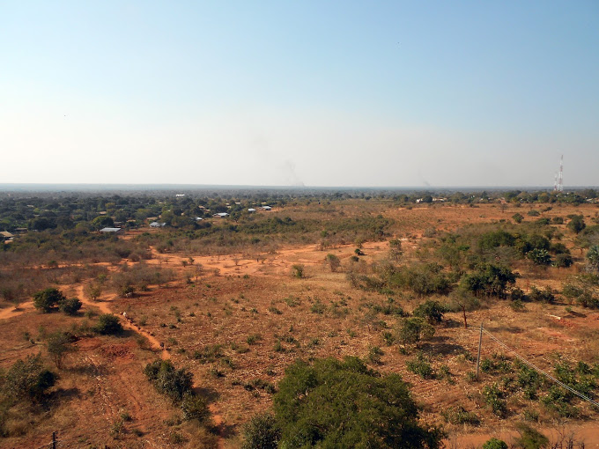
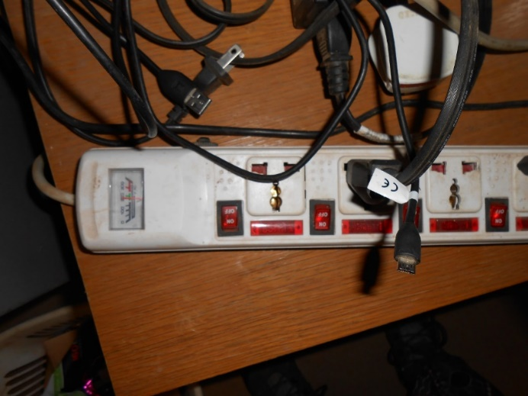
One More Argument: The Next 3 Billion
Developing countries characterized with:
  Poor infrastructure:
    Transportation.
    Power grid.
  Sparse populations:
    Networks are designed for dense populations.

Slide 13
As a result: large and widening digital divide

Slide 14
Wireless is projected to mitigate this divide

Slide 15
Why (Wire)Less is More?
Traditional (wired) Internet access:
Expensive to provision.
It limits the location of access.
Completely out of reach in remote/developing areas.
Wireless networks:
Cover larger user population.
Quicker to install
Can be an alternative to wired networks when no infrastructure is available
(Note: user perspective).

Slide 16
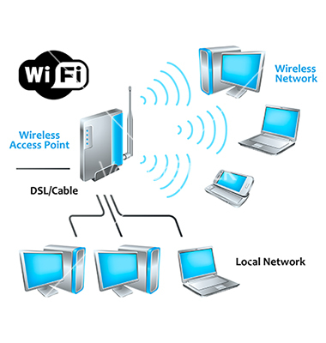
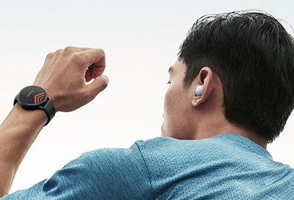
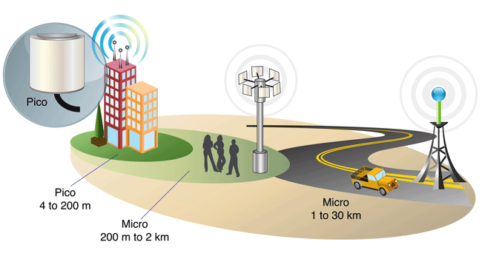
Who Accommodates This Demand?
Cellular Networks
Wireless Personal
Area Networks
Wireless Local
Area Networks

Slide 17



















Elements of a wireless network
network
infrastructure

Slide 18



Elements of a wireless network
wireless hosts
laptop, smartphone
run applications
may be stationary (non-mobile) or mobile
  wireless does not always mean mobility
network
infrastructure

Slide 19

Elements of a wireless network
base station
typically connected to wired network
relay - responsible for sending packets between wired network and wireless host(s) in its “area”
  e.g., cell towers, 802.11 access points
network
infrastructure

Slide 20
Elements of a wireless network
wireless link
typically used to connect mobile(s) to base station
also used as backbone link
multiple access (MAC) protocol coordinates link access
various data rates, transmission distance
network
infrastructure

Slide 21
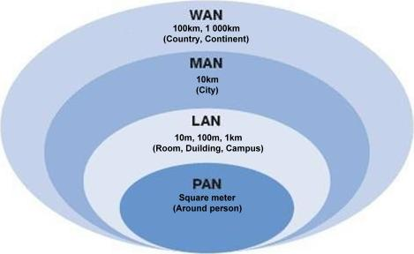
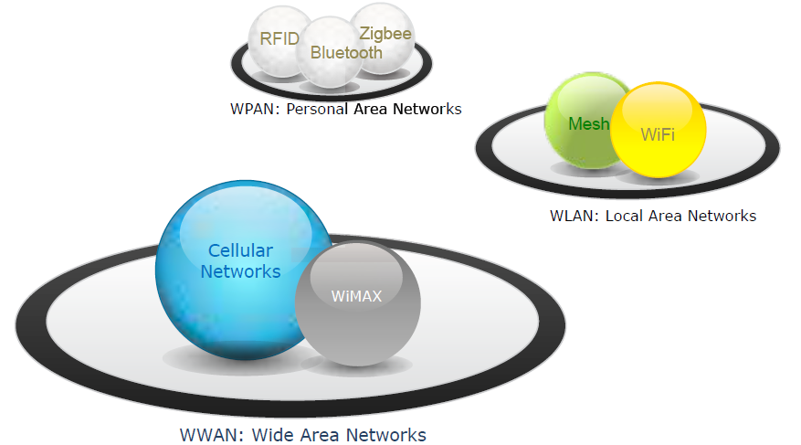
Overview of Networks
Based on Service Area
Wireless

Slide 22
Data rates and distances for popular technologies
200
802.11n
54
802.11a,g
802.11a,g point-to-point
5-11
802.11b
4G: LTWE WIMAX
4
3G: UMTS/WCDMA-HSPDA, CDMA2000-1xEVDO
Data rate (Mbps)
1
802.15
.384
2.5G: UMTS/WCDMA, CDMA2000
.056
2G: IS-95, CDMA, GSM
Indoor
10-30m
Outdoor
50-200m
Mid-range
outdoor
200m – 4 Km
Long-range
outdoor
5Km – 20 Km

Slide 23
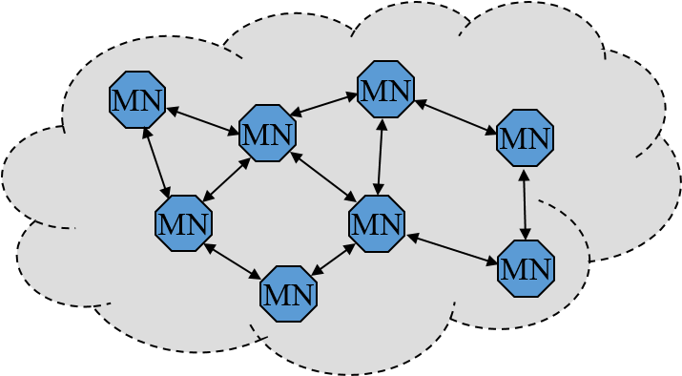
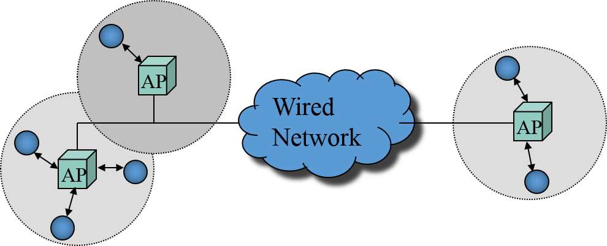
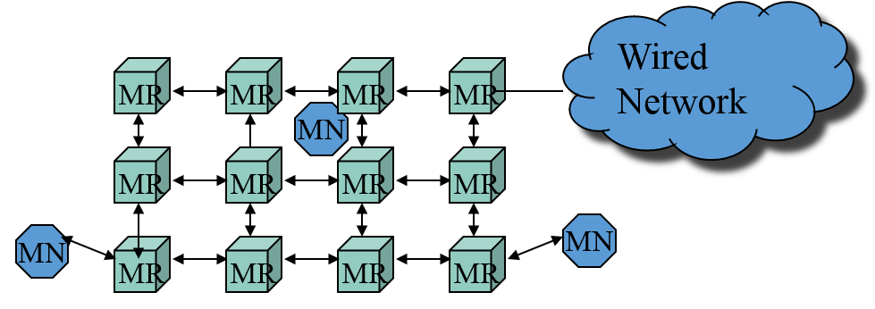
Overview of Network Architectures
Infrastructured
Mesh
Infrastructure-less
Based on Required Infrastructure

Slide 24
INFRASTRUCTURED NETWORKS
AP
Wired Network
AP
AP

Slide 25
Infrastructured
AP
Wired Network
AP
AP
Infrastructured Networks (Wireless LAN):
  Fixed, wired backbone.
  Mobiles communicate directly with access points.
  Suitable for locations where access points can be placed.

Slide 26
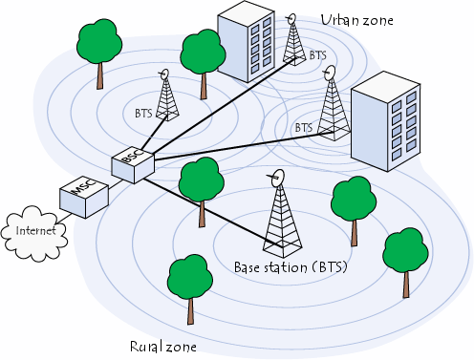
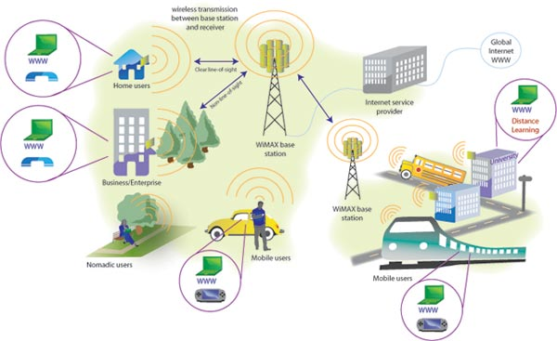
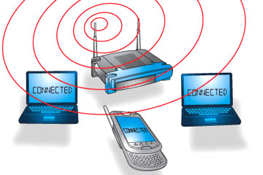
Examples of Infrastructured Networks
Thoughts?
  Cellular
  Wi-Fi
  WiMAX

Slide 27
Cellular Networks

Slide 28
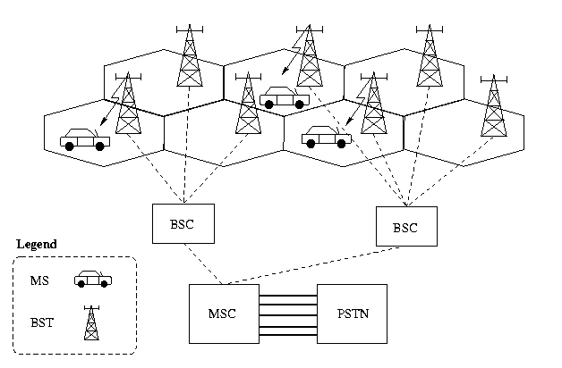
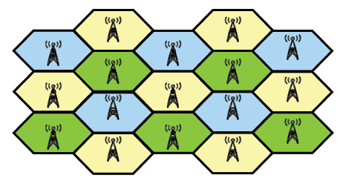
Cellular Networks Overview
Continuous coverage any time, anywhere.
Cellular = Geographical area divided into cells.
Different cells use different frequencies.
Operate in licensed spectrum (expensive).
Centralized = Expensive backbone.
<="" div="" border="2" align="BOTTOM" height="412" width="628">

Slide 29
Cellular Networks Evolution
2G/2.5G
Voice and up to 64kbps data
3G
Up to 2Mbps data
4G
x10Mbps data

Slide 30
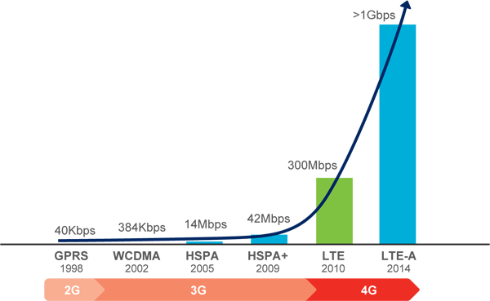
Future: LTE
Long Term Evolution (LTE) to provide Gbps speeds for mobile connectivity.
Advanced technologies including OFDMA and MIMO.

Slide 31
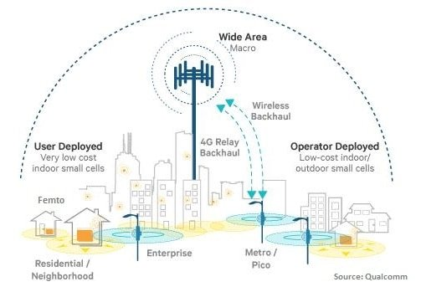
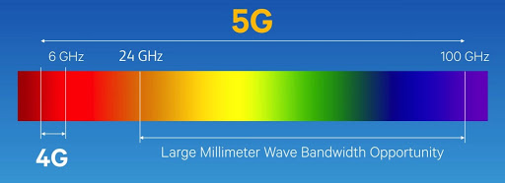
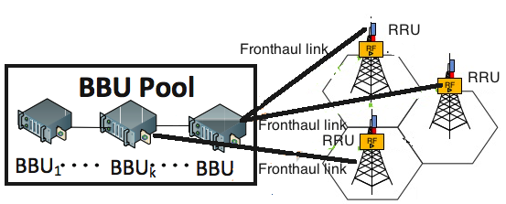
5G
Cell miniaturization
New frequency ranges
Cloud-RAN
Cell miniaturization
  At the extreme: BYO cell
Cloud radio-access networks
New frequency ranges
  60 Giga Hertz and Tera Hertz communications (compared to 30 MHz – 6GHz now)

Slide 32
Future: Distributed Cells
Cellular network in a box
CPU
GSM Modems
RF frontend
(Software-Defined
Radio)
Extra storage
Power amp

Slide 33


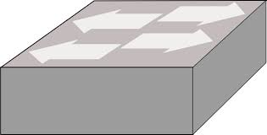

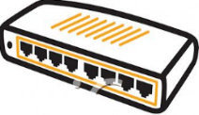

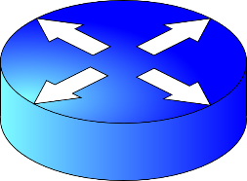
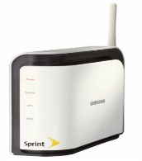
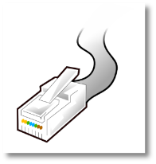
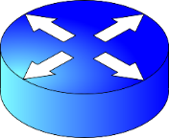
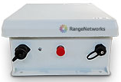
How Are These Different?
Users
RF Frontend
Core Network
VLR
LTE
HLR
MSC
PSTN
BTS
RNC
SGSN
GGSN
Femtocell
DSL
Femtocell
Internet
Cell in a Box
Internet
Gateway

Slide 34
WiFi Networks
.. another prominent example of infrastructured networks

Slide 35
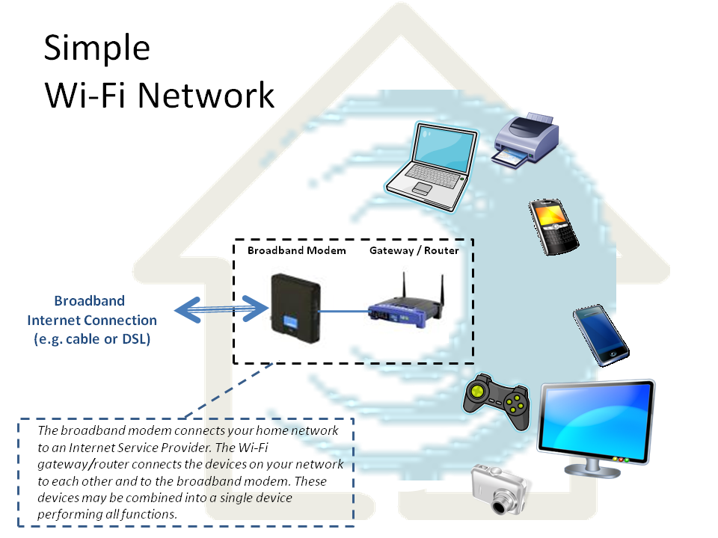
Traditionally…

Slide 36


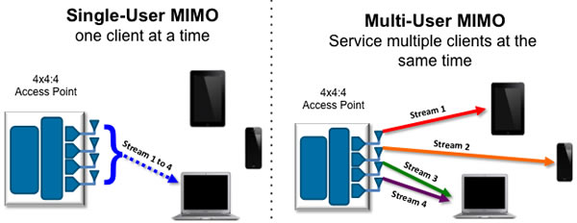
Multiple Input Multiple Output (MIMO)
Improved communication performance by the use of multiple Tx and Rx antennas.
Traditionally
New paradigm
Improve single-user
throughput.
OR
Serve multiple users
simultaneously (improve
overall network
throughput).

Slide 37

MIMO: Design Challenges
Determine the quality of the channel between each antenna pair.
Scheduling of antenna transmissions.
Scheduling of users for maximized throughput.
  All antennas serve a single user or each antenna serves a different user?

Slide 38
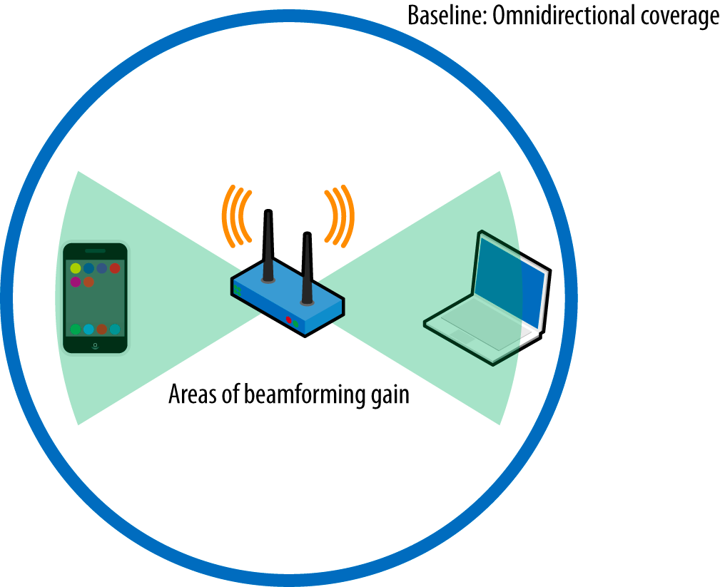
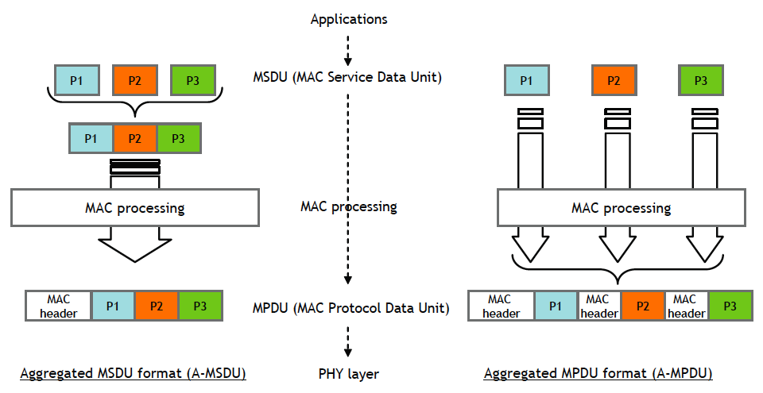
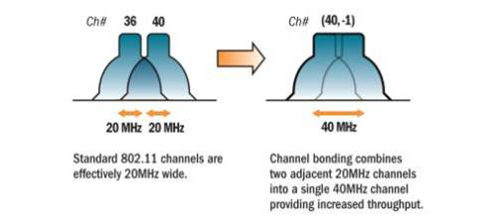
Other directions for advanced WiFi
Channel bonding
Frame aggregation
Beamforming

Slide 39
INFRASTRUCTURELESS NETWORKS
MN
MN
MN
MN
MN
MN
MN
MN

Slide 40
Infrastructure-less
MN
MN
MN
MN
MN
MN
MN
MN
Infrastructureless Networks (Ad hoc networks):
  No wired backbone.
  All nodes are capable of movement.
  All nodes serve as routers (multi-hop routes).
  Reduced administrative cost.
  Ease of deployment.

Slide 41


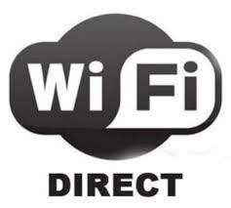



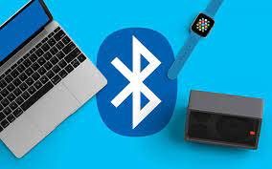
Examples of Infrastructureless Networks
App P2P NETWORK
Wi-Fi Direct
Bluetooth
App
WiFi
App
App
WiFi Direct
App
App
App
Mobile users with Internet access
Mobile users without Internet access; social
Mobile users without Internet access; not social

Slide 42
MESH NETWORKS
Wired Network
MR
MR
MR
MR
MN
MR
MR
MR
MR
MN
MN
MR
MR
MR
MR

Slide 43
Mesh
Wired Network
MR
MR
MR
MR
MN
MR
MR
MR
MR
MN
MN
MR
MR
MR
MR
Mesh Networks:
  fixed, wireless backbone.
  subset of Mesh Routers (MR) have wired interface to Internet.
  Mobile nodes connect to nearest MR.
  Targeted to solve last-mile problem for broadband access.
  An evolution of ad hoc networks.

Slide 44
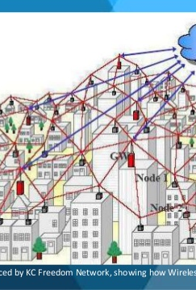
Examples of Mesh
Municipal Mesh
Wi-Fi clouds have been planned or deployed in large cities
  Google WiFi http://wifi.google.com
  Seattle Wireless http://seattlewireless.net/
  Wireless Leiden in Sweden http://www.wirelessleiden.nl
Chaska, Minnesota
  18K people, 16 square miles
  Built in a few weeks at the cost of $600K
  Service charge is $19.99 / month
  http://www.chaska.net
Claudville, VA
  First “white spaces” network deployment
  Used to reach rural community
  http://www.engadget.com/2009/10/21/first-white-space-network-hits-claudville-virginia/

Slide 45
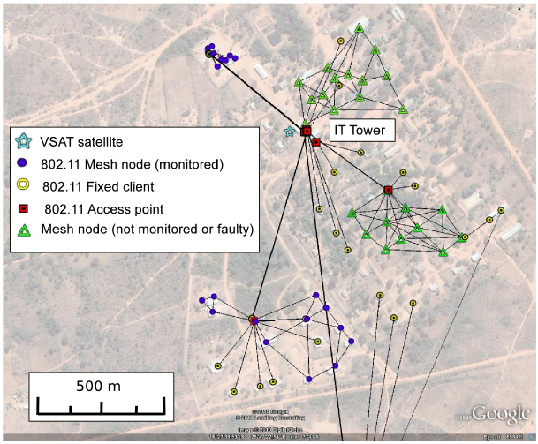
Wi-Fi Mesh in Remote Regions
What made it work:
  No interference.
  Cheap repeater design.
  No alternative network solutions.
  Community effort.
Village Wi-Fi Mesh in Macha, Zambia

Slide 46


Urban Wi-Fi in a New Form
The exponential growth in mobile data consumption causes cellular network overloads:
  Poor network performance and user dis-satisfaction.
  Loosing subscribers.
Cellular carriers are rolling out city Wi-Fi hotspots to help offload traffic from their networks:
  E.g. Starbucks Wi-Fi is provided by AT&T.

Slide 47

Vital resources for Wireless Networks
The radio spectrum

Slide 48
How Do These All Exist Together
Different operation frequencies:
  Exclusive.
  Shared.
Accessing shared medium:
  Different medium access control (MAC) schemes.
  A large body of wireless research deals with MAC.
In USA, the FCC mandates spectrum allocation:
  Go to http://reboot.fcc.gov/spectrumdashboard/searchSpectrum.seam for more information.
Frequency

Slide 49

Examples of Exclusive and Shared Spectrum
Thoughts?
The UHF bands (e.g. TV) – Exclusive
The Cellular bands – Exclusive
GSM 850/900
……..
PCS 1850/1900
Mobile Cellular Networks
The Industrial Scientific Medicine (ISM) bands – Shared
ISM1
ISM2
……..
Wi-Fi, Bluetooth, ZigBee

Slide 50

Spectrum deficit
Lost market potential due to lack of spectrum
What next? --> Stay tuned till Day 3.

Slide 51
The Future of Networking
Or what happens after we squeeze all the capacity out of the current technologies?

Slide 52
Avenues for Future Research
Rethink how we assign spectrum:
  Dynamic Spectrum Access Technologies (e.g. in TV White Spaces).
Utilize multiple antennas (of the same technology) in the same node:
  Multiple Input Multiple Output (MIMO) technologies.
Utilize a combination of all available wireless networks:
  Real time offload of data from mobile networks.

Slide 53


TV White Spaces
Make use of unused
TV channels.
Great propagation properties.
Wide range with a single base station.

Slide 54
TV White Spaces: Design Challenges
We want real-time communication, right?
How do we find out which bands are available?
How do we determine if a primary user is attempting to use the spectrum?
How do we switch between different bandwidths without disrupting user connectivity?
Agile (or Software-Defined) Radios to the rescue.

Slide 55

Utilizing Combination of Networks
Commercial Cellular Network
Distributed Cellular Network
Wi-Fi
Can talk:
3G, LTE, Wi-Fi, Bluetooth
Requires throughput X.

Slide 56
Combination of Networks: Design Challenges
Real-time network switching is hard.
How do we detect available networks?
How do we switch between cellular networks?
How do we provide seamless transition across networks?

Slide 57
Done with wireless network architectures
Questions?

Slide 58
Wireless links and network characteristics
How are wired networks different than mobile wireless networks?

Slide 59


Wired vs. wireless networks
Key differences between wired and wireless:
Link types
Link quality
  Delay
  Packet loss
  Bit-error rate
  Hidden terminals
Client behavior
Mobility
  Keeping track of client attachment point
  Migrating client traffic across networks
Medium type
Broadcast in wireless
Point-to-point in wired
WIRED
WIRELESS

Slide 60
Wireless Link Characteristics (1)
important differences from wired link ….
  broadcast channel: multiple users leverage the same medium to transmit.
    Who gets to send when, how much and at what rate?
  interference from other sources: standardized wireless network frequencies (e.g., 2.4 GHz) shared by other devices (e.g., phone); devices (microwaves) interfere as well
    How to assign frequencies to avoid interference?
  decreased signal strength: radio signal attenuates as it propagates through matter (path loss)
    How to plan base station positioning and rate selection?
  multipath propagation: radio signal reflects off objects ground, arriving at destination at slightly different times
    More challenges to base station positioning and rate selection.
…. make communication across (even a point to point) wireless link much more “difficult”

Slide 61
Multiple access
One of the top research challenges in Wireless Communications

Slide 62

The cocktail party analogy

Slide 63




Multiple access links, protocols
two types of “links”:
point-to-point
  PPP for dial-up access
  point-to-point link between Ethernet switch, host
broadcast (shared wire or medium)
  old-fashioned Ethernet
  upstream hybrid fiber-coaxial
  All wireless networks
    802.11 wireless LAN, mobile cellular, satellite networks…
shared wire (e.g.,
cabled Ethernet)
shared RF
(e.g., 802.11 WiFi)
shared RF
(satellite)
humans at a
cocktail party
(shared air, acoustical)

Slide 64
Multiple access protocols
single shared broadcast channel
two or more simultaneous transmissions by nodes: interference
  collision if node receives two or more signals at the same time
multiple access protocol
distributed algorithm that determines how nodes share channel, i.e., determine when node can transmit
communication about channel sharing must use channel itself!
  no out-of-band channel for coordination

Slide 65
MAC protocols: taxonomy
three broad classes:
channel partitioning
  divide channel into smaller “pieces” (time slots, frequency, code)
  allocate piece to node for exclusive use
random access
  channel not divided, allow collisions
  “recover” from collisions
“taking turns”
  nodes take turns, but nodes with more to send can take longer turns

Slide 66
Channel partitioning MAC protocols: TDMA
TDMA: time division multiple access
access to channel in "rounds"
each station gets fixed length slot (length = pkt trans time) in each round
unused slots go idle
example: 6-station LAN, 1,3,4 have pkt, slots 2,5,6 idle
6-slot
frame
6-slot
frame
1
3
4
1
3
4
time

Slide 67
Channel partitioning MAC protocols: FDMA
FDMA: frequency division multiple access
channel spectrum divided into frequency bands
each station assigned fixed frequency band
unused transmission time in frequency bands go idle
example: 6-station LAN, 1,3,4 have pkt, frequency bands 2,5,6 idle
time
frequency bands
FDM cable

Slide 68
Random access protocols
when node has packet to send
  transmit at full channel data rate R.
  no a priori coordination among nodes
two or more transmitting nodes ➜ “collision”,
random access MAC protocol specifies:
  how to detect collisions
  how to recover from collisions (e.g., via delayed retransmissions)
examples of random access MAC protocols:
  slotted ALOHA
  ALOHA
  CSMA, CSMA/CD, CSMA/CA
  Used in WiFi

Slide 69










Multiple access
global ISP
A key function of the Data Link Layer
Data Plane
Application
Transport
Wired
Wireless
Network
Data Link
Ethernet
802.11
3GPP
Physical

Slide 70



Where is the link layer (MAC) implemented?
in each and every host
link layer implemented in “adaptor” (aka network interface card NIC) or on a chip
  Ethernet card, 802.11 card; Ethernet chipset
  implements link, physical layer
attaches into host’s system buses
combination of hardware, software, firmware
application
transport
network
link
cpu
memory
link
physical
host
bus
(e.g., PCI)
controller
physical
transmission
network adapter
card

Slide 71
MAC in Cellular Networks

Slide 72

Components of cellular network architecture
MSC
connects cells to wired tel. net.
manages call setup (more later!)
handles mobility (more later!)
cell
covers geographical region
base station (BS) analogous to 802.11 AP
mobile users attach to network through BS
air-interface: physical and link layer protocol between mobile and BS
Mobile
Switching
Center
Public telephone
network
Mobile
Switching
Center
wired network

Slide 73
Cellular networks: the first hop
Two techniques for sharing mobile-to-BS radio spectrum
combined FDMA/TDMA: divide spectrum in frequency channels, divide each channel into time slots
CDMA: code division multiple access
time slots
frequency
bands

Slide 74
2G (voice) network architecture
Base station system (BSS)
MSC
BTS
BSC
G
Public
telephone
network
Gateway
MSC
Legend
BSC
Base transceiver station (BTS)
base station controller
controls few tens of BSs
  paging
  frequency assignment
  handoff
Base station controller (BSC)
Mobile Switching Center (MSC)
MSC
connects cells to wired tel. net.
manages call setup (more later!)
handles mobility (more later!)
Mobile subscribers

Slide 75
3G (voice+data) network architecture
MSC
G
Public
telephone
network
radio
network
controller
Gateway
MSC
G
Public
Internet
SGSN
Key insight: new cellular data
network operates in parallel
(except at edge) with existing
cellular voice network
voice network unchanged in core
data network operates in parallel
GGSN
Serving GPRS Support Node (SGSN)
Gateway GPRS Support Node (GGSN)
Notes:
What was a key design principle behind 3G?

Slide 76
3G (voice+data) network architecture
MSC
G
Public
telephone
network
radio
network
controller
Gateway
MSC
G
Public
Internet
SGSN
GGSN
radio interface
(WCDMA, HSPA)
radio access network
Universal Terrestrial Radio
Access Network (UTRAN)
core network
General Packet Radio Service
(GPRS) Core Network
public
Internet

Slide 77

4G LTE – Long Term Evolution
Evolved packet core (EPC)
  All-IP core
  Both voice and data carried in datagrams
  Network control plane (e.g. mobility management)
  User data plane (e.g. data vs. voice)
LTE Radio Access Network (RAN)
  Flexible channel size 1.25MHz – 20MHz
  Advanced MAC (OFDM)
    Allocates slots and channels to users
    Slot reallocation every 1ms
  Rate adaptation through adaptive MCS
  MIMO
  At 20MHz channel: 100Mbps DL; 50Mbps UL
Frequency
Time, ms (0.5ms slot size)
Example OFDM allocation

Slide 78
End of Day 1

Slide 79
DAY 2

Slide 80
CSMA (carrier sense multiple access)
CSMA: listen before transmit:
if channel sensed idle: transmit entire frame
if channel sensed busy, defer transmission
human analogy: listen before talk; don’t interrupt others!

Slide 81

CSMA collisions
spatial layout of nodes
collisions can still occur: propagation delay means two nodes may not hear each other’s transmission
collision: entire packet transmission time wasted
  distance & propagation delay play role in in determining collision probability
A
B
C
D

Slide 82
CSMA collisions
collisions can still occur: propagation delay means two nodes may not hear each other’s transmission
collision: entire packet transmission time wasted
  distance & propagation delay play role in in determining collision probability
spatial layout of nodes
A
B
C
D
Why are collisions bad?
Can we do anything to resolve such situations?

Slide 83
CSMA/CD (collision detection)
CSMA/CD: carrier sensing, deferral as in CSMA
  collisions detected within short time
  colliding transmissions aborted, reducing channel wastage
collision detection:
  easy in wired LANs: measure signal strengths, compare transmitted, received signals
  difficult in wireless LANs: received signal strength overwhelmed by local transmission strength
human analogy: the polite conversationalist

Slide 84

CSMA/CD (collision detection)
spatial layout of nodes

Slide 85
Key takeaways
Multiple access is a key feature of the data link layer
  Essential to coordinate concurrent medium access by multiple users
Multiple access today
  Wired – modern Ethernet switches create collision-free domains for each user. Multiple access made easy
  Wireless – shared medium. Multiple access is essential

Slide 86
802.11 Wi-Fi -- Wireless LANs
Ch 6.3.

Slide 87
IEEE 802.11 Wireless LAN
802.11b
2.4-5 GHz unlicensed spectrum
up to 11 Mbps
direct sequence spread spectrum (DSSS) in physical layer
  all hosts use same chipping code
802.11a
  5-6 GHz range
  up to 54 Mbps
802.11g
  2.4-5 GHz range
  up to 54 Mbps
802.11n: multiple antennae
  2.4-5 GHz range
  up to 200 Mbps
all use CSMA/CA for multiple access
all have base-station and ad-hoc network versions

Slide 88




802.11 LAN architecture
wireless host communicates with base station
  base station = access point (AP)
Basic Service Set (BSS) (aka “cell”) in infrastructure mode contains:
  wireless hosts
  access point (AP): base station
  ad hoc mode: hosts only
Internet
hub, switch
or router
BSS 1
BSS 2

Slide 89
802.11: Channels, association
802.11b: 2.4GHz-2.485GHz spectrum divided into 11 channels at different frequencies
  AP admin chooses frequency for AP
  interference possible: channel can be same as that chosen by neighboring AP!
2.4GHz channels
5GHz channels

Slide 90
802.11: Channels, association
802.11b: 2.4GHz-2.485GHz spectrum divided into 11 channels at different frequencies
  AP admin chooses frequency for AP
  interference possible: channel can be same as that chosen by neighboring AP!
host: must associate with an AP
  scans channels, listening for beacon frames containing AP’s name (SSID) and MAC address
  selects AP to associate with
  may perform authentication [Chapter 8]
  will typically run DHCP to get IP address in AP’s subnet

Slide 91
802.11: passive/active scanning
BBS 1
BBS 2
BBS 1
BBS 2
1
AP 2
AP 1
1
1
AP 2
AP 1
2
2
2
3
3
4
H1
H1
passive scanning:
beacon frames sent from APs
association Request frame sent: H1 to selected AP
association Response frame sent from selected AP to H1
active scanning:
Probe Request frame broadcast from H1
Probe Response frames sent from APs
Association Request frame sent: H1 to selected AP
Association Response frame sent from selected AP to H1

Slide 92
Wi-Fi multiple access

Slide 93
Handling Collision in Wireline Networks
A review of CSMA/CD:
  Carrier sense: a node waits until the channel is idle before transmitting a packet.
    If a channel is busy defer transmission
  Collision detection: after transmitting a node continuously monitors the channel.
    Has a collision occurred?
    If yes, abort, jam and retry.

Slide 94
Wireless radio design considerations
Wireless radios are half-duplex
Transmit power asymmetries
Self-interference >>> received signal strength

Slide 95
Can we employ CSMA/CD in wireless networks?
Key assumptions of CSMA/CD
  For carrier sensing (CS): any node can hear any other node in the network
  For collision detection (CD): a node can “listen” for concurrent transmissions while sending a packet
Will CS and CD work in wireless networks? Criteria to consider:
  Wireless radio operation
    Wireless radios are half-duplex (hardware restrictions)
  Emit power asymmetric between client and access point
    Not all wireless radios emit with the same power. The transmit power of a phone is orders of magnitude lower than that of the access point
Group activity

Slide 96
Two Problems
Collision detection doesn’t work in wireless
Carrier sensing doesn’t (always) work in wireless

Slide 97

Why Doesn’t Collision Detection Work in Wireless?
Radios can be half-duplex (so a node can’t transmit and sense a collision at the same time).
Tx and Rx voltages are different in wireless networks (in wired they are the same). This is another reason collision cannot be detected.
  Transmitter cannot hear what is being transmitted by other stations.
Illustration of CDMA/CD
Wireless LAN relies on
Collision Avoidance.

Slide 98
Why Doesn’t Carrier Sense Work in Wireless?
The hidden terminal problem:
  Even if the medium is free near the transmitter it might not be free at the receiver.
Range of Client A
Range of Client B
AP
Client A
Client B
Wants to transmit. Does
not hear A’s transmission
Currently transmitting
The two transmissions
will collide at the AP.

Slide 99
Why Doesn’t Carrier Sense Work in Wireless?
Exposed terminal problem
  Even if the medium is busy near the transmitter it might be free close to the intended receiver.
Range of Client B
Range of Client A
AP2
AP1
Client B
Client A
Wants to transmit to AP2.
Client B can’t transmit to AP2
due to Carrier Sense.
Currently transmitting to AP1.

Slide 100
In Summary
CSMA – Carrier Sense Multiple Access
  Listen before transmitting
Because of hidden terminals doesn’t always work in wireless
  Results in collisions
Because of exposed terminals will reduce the throughput in wireless
  Prevents terminals from transmitting when they actually can
In wireless, collision occurs at the receiver, not at the sender. So sender listening isn’t very helpful

