Slide 1
Day 2: Wi-Fi channelization, MAC and interference
Instructor: Mariya Zheleva
mzheleva@albany.edu
UbiNET Lab 2020 Summer School on Wireless

Slide 2
802.11 Wi-Fi -- Wireless LANs
Some material from chapter 6.3, Ross/Kurose 6th edition

Slide 3
Interference

Slide 4
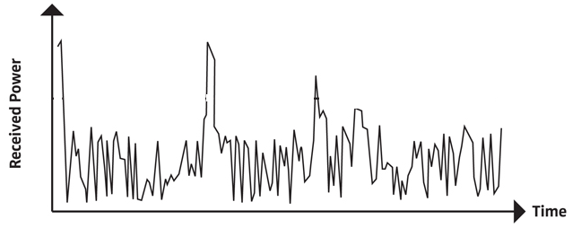
Wired vs. Wireless Channel
In wireline networks the channel can provide continuous connectivity with consistent quality.
In wireless: time-varying often unpredictable channel quality
Due to the nature of radio propagation, mobility, changing environment
Interference

Slide 5
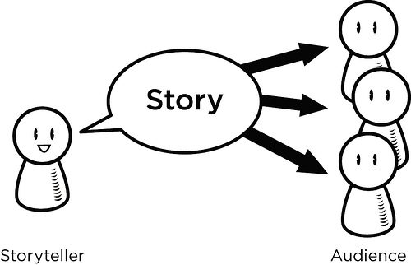
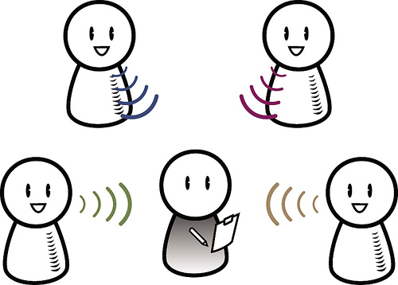
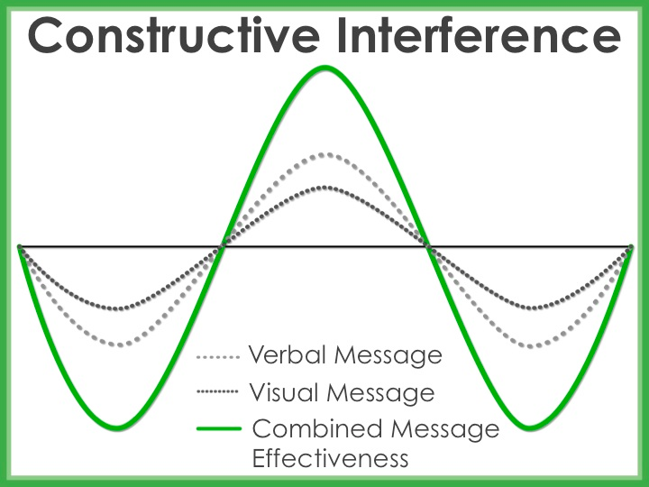
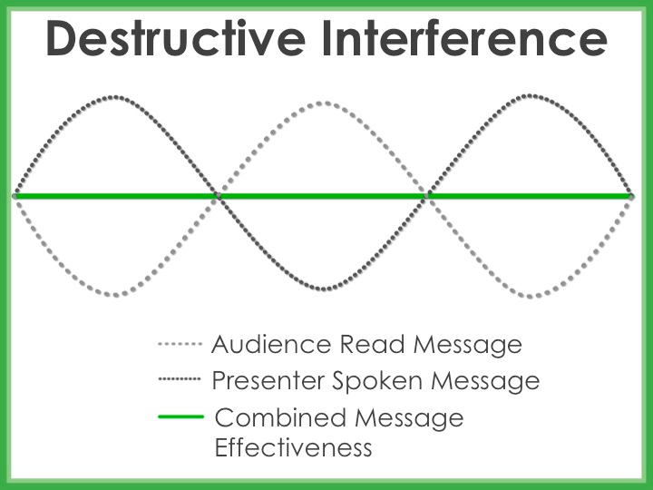
Interference
Notes:
EM waves of two identical sources are mixed.

Slide 6
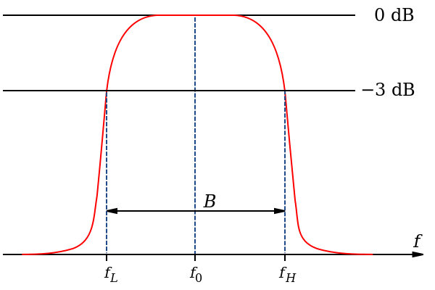
Shared vs. Exclusive Spectrum
Exclusive (licensed) spectrum (e.g. mobile cellular networks):
Protects us from interference
Expensive bandwidth
Must be spectrum efficient – large user population with a small spectrum band
No power constraints
High filtering requirements => expensive equipment
Time
Frequency
Notes:
How do we manage interference using spectrum allocation? Or when does interference occur?

Slide 7
Shared vs. Exclusive Spectrum (contd.)
Shared (unlicensed) spectrum (e.g. Wi-Fi networks):
Cheap to transmit on (no license fees)
Wider channels (frequency scarcity not as pronounced)
Maximum transmission power is constrained
Interference from co-existing devices
Major problem is spectral efficiency (pack as many bits as possible in a given frequency band)
Time
Frequency

Slide 8
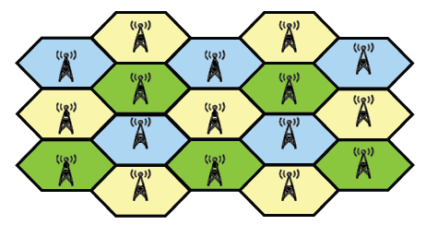
Fundamentally-Different System Design
Exclusive
Shared
C1
AP1
AP2
C2

Slide 9
IEEE 802.11 Wireless LAN
802.11b
2.4-5 GHz unlicensed spectrum
up to 11 Mbps
direct sequence spread spectrum (DSSS) in physical layer
all hosts use same chipping code
802.11a
5-6 GHz range
up to 54 Mbps
802.11g
2.4-5 GHz range
up to 54 Mbps
802.11n/ac: multiple antennae
2.4-5 GHz range
up to 200 Mbps
all use CSMA/CA for multiple access
all have base-station and ad-hoc network versions

Slide 10
802.11 LAN architecture
wireless host communicates with base station
base station = access point (AP)
Basic Service Set (BSS) (aka “cell”) in infrastructure mode contains:
wireless hosts
access point (AP): base station
ad hoc mode: hosts only
Internet
hub, switch
or router
BSS 1
BSS 2

Slide 11
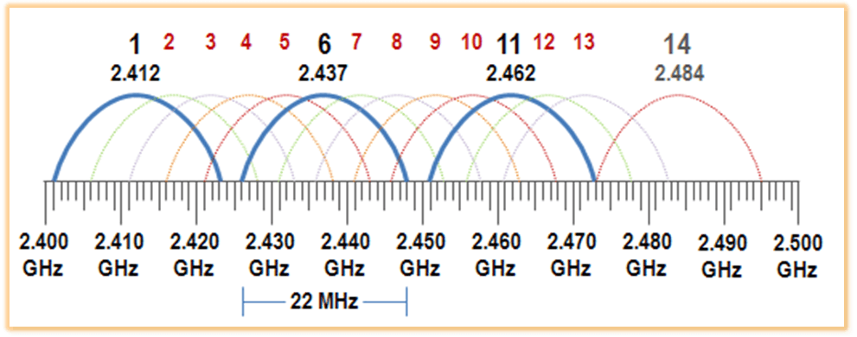
802.11 channels (2.4GHz range)
802.11b: 2.4GHz-2.485GHz spectrum divided into 11 channels at different frequencies
AP admin chooses frequency for AP
interference possible: channel can be same as that chosen by neighboring AP!
Only three channels are “orthogonal” (do not overlap)

Slide 12
802.11 channels (5GHz range)
The 5GHz range (802.11n/ac) divided into 25 20MHz channels at different frequencies
channel bonding up to 160MHz
all channels are orthogonal
interference still possible but much more space to avoid it

Slide 13
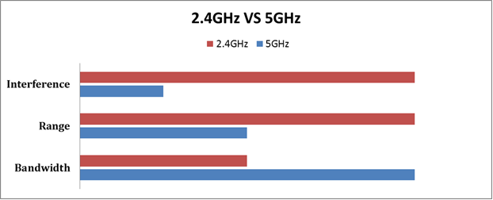
2.4 vs. 5GHz
Tradeoffs in distance, range and bandwidth
Non-qualitative visualization of the tradeoffs. Source: Phorus

Slide 14
802.11: Channels, association
802.11b: 2.4GHz-2.485GHz spectrum divided into channels at different frequencies
AP admin chooses frequency for AP
interference possible: channel can be same as that chosen by neighboring AP!
host: must associate with an AP
scans channels, listening for beacon frames containing AP’s name (SSID) and MAC address
selects AP to associate with
may perform authentication [Chapter 8]
will typically run DHCP to get IP address in AP’s subnet

Slide 15
802.11: passive/active scanning
BBS 1
BBS 2
BBS 1
BBS 2
1
AP 2
AP 1
1
1
AP 2
AP 1
2
2
2
3
3
4
H1
H1
passive scanning:
beacon frames sent from APs
association Request frame sent: H1 to selected AP
association Response frame sent from selected AP to H1
active scanning:
Probe Request frame broadcast from H1
Probe Response frames sent from APs
Association Request frame sent: H1 to selected AP
Association Response frame sent from selected AP to H1

Slide 16
Wi-Fi multiple access
… now that we have associated, how do we transmit a packet

Slide 17
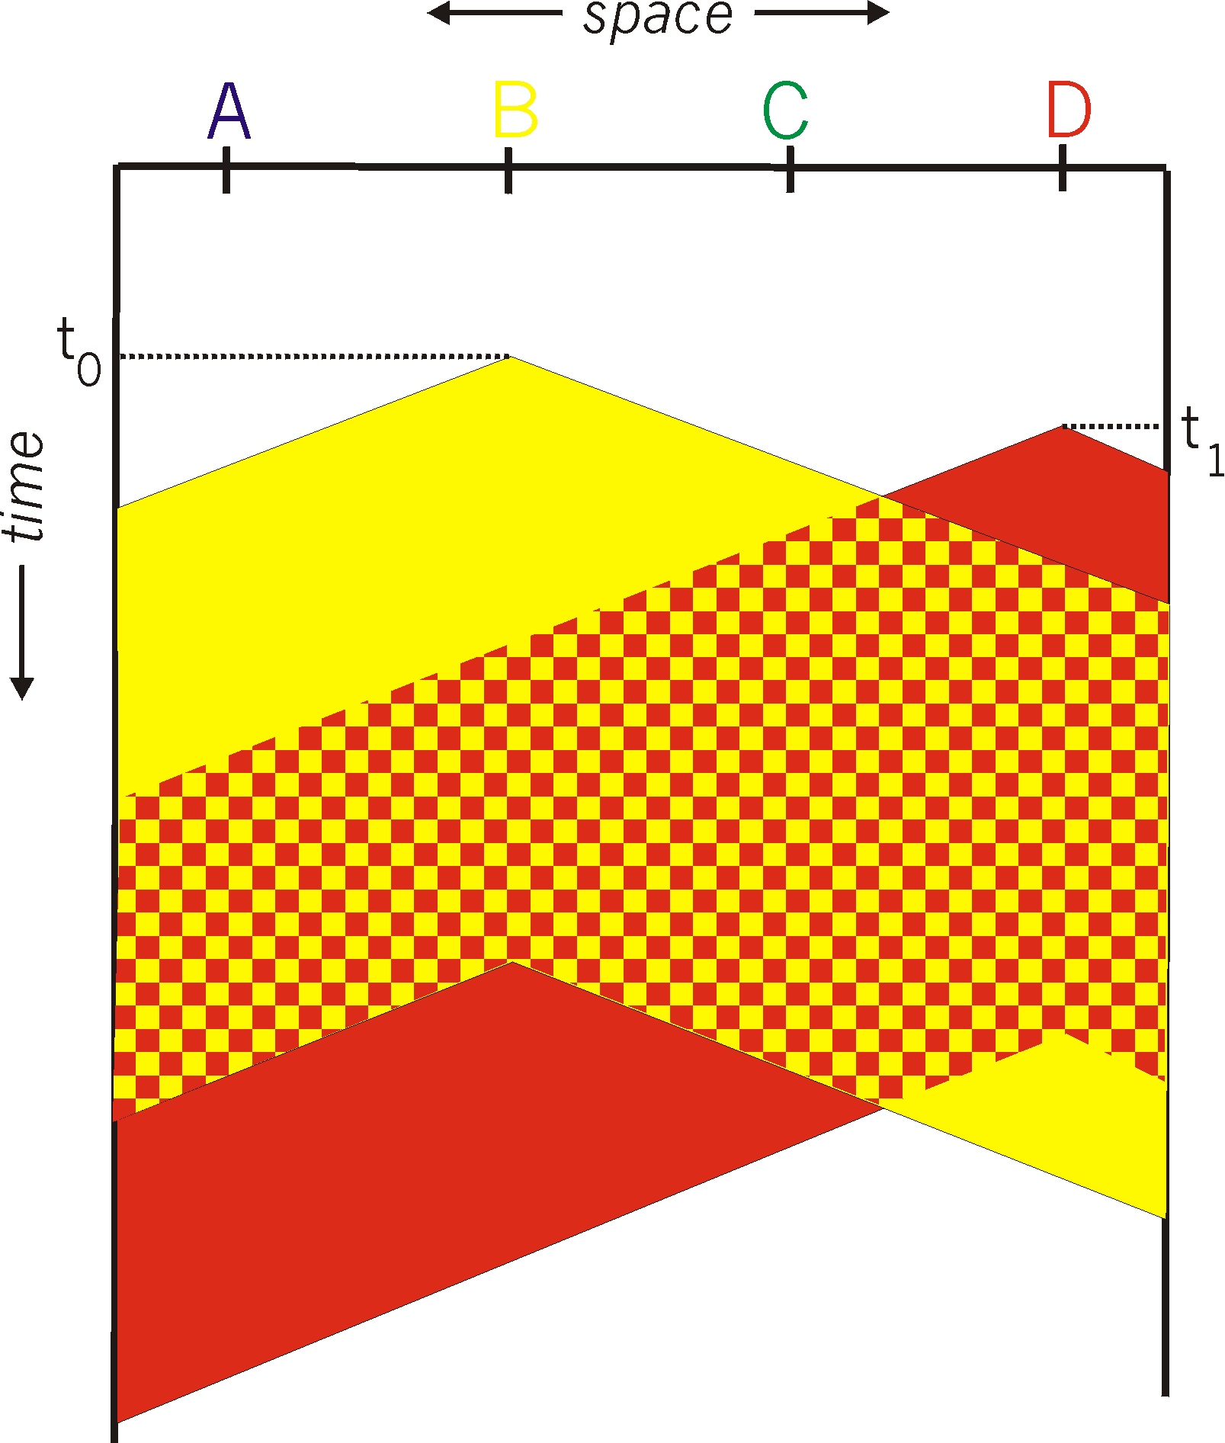
Packet collisions in networks
spatial layout of nodes
collision: entire packet transmission time wasted
distance & propagation delay play role in in determining collision probability
A
B
C
D

Slide 18
Random access protocols
when node has packet to send
transmit at full channel data rate R.
no a priori coordination among nodes
two or more transmitting nodes ➜ “collision”,
random access MAC protocol specifies:
how to detect collisions
how to recover from collisions (e.g., via delayed retransmissions)

Slide 19
Handling Collision in Wireline Networks
Carrier sense: a node waits until the channel is idle before transmitting a packet.
If a channel is busy defer transmission
Collision detection: after transmitting a node continuously monitors the channel.
Has a collision occurred?
If yes, abort, jam and retry.

Slide 20
Wireless radio design considerations
Wireless radios are half-duplex
Transmit power asymmetries
Self-interference >>> received signal strength

Slide 21
Can we employ CSMA/CD in wireless networks?
Key assumptions of CSMA/CD
For carrier sensing (CS): any node can hear any other node in the network
For collision detection (CD): a node can “listen” for concurrent transmissions while sending a packet
Will CS and CD work in wireless networks? Criteria to consider:
Wireless radio operation
Wireless radios are half-duplex (hardware restrictions)
Emit power asymmetric between client and access point
Not all wireless radios emit with the same power. The transmit power of a phone is orders of magnitude lower than that of the access point
Group activity

Slide 22
Two Problems
Collision detection doesn’t work in wireless
Carrier sensing doesn’t (always) work in wireless

Slide 23
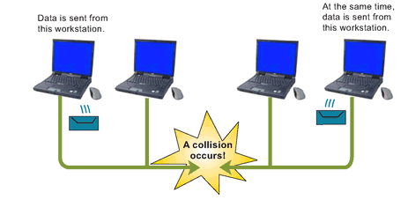
Collision detection doesn’t work in wireless?
Radios can be half-duplex (so a node can’t transmit and sense a collision at the same time).
Tx and Rx voltages are different in wireless networks (in wired they are the same). This is another reason collision cannot be detected.
Transmitter cannot hear what is being transmitted by other stations.
Illustration of CDMA/CD
Wireless LAN relies on
Collision Avoidance.

Slide 24
Carrier sense doesn’t (always) work in wireless
The hidden terminal problem:
Even if the medium is free near the transmitter it might not be free at the receiver.
Range of Client A
Range of Client B
AP
Client A
Client B
Wants to transmit. Does
not hear A’s transmission
Currently transmitting
The two transmissions
will collide at the AP.

Slide 25
Carrier sense doesn’t (always) work in wireless
Exposed terminal problem
Even if the medium is busy near the transmitter it might be free close to the intended receiver.
Range of Client B
Range of Client A
AP2
AP1
Client B
Client A
Wants to transmit to AP2.
Client B can’t transmit to AP2
due to Carrier Sense.
Currently transmitting to AP1.

Slide 26
In Summary
CSMA – Carrier Sense Multiple Access
Listen before transmitting
Because of hidden terminals doesn’t always work in wireless
Results in collisions
Because of exposed terminals will reduce the throughput in wireless
Prevents terminals from transmitting when they actually can
In wireless, collision occurs at the receiver, not at the sender. So sender listening isn’t very helpful

Slide 27
So how does WiFi actually do medium access control?
CSMA/CA

Slide 28
IEEE 802.11 MAC Protocol: CSMA/CA
802.11 sender
1 if sense channel idle for DIFS then
transmit entire frame (no CD)
2 if sense channel busy then
start random exponential backoff time
timer counts down while channel idle
transmit when timer expires
if no ACK, increase random backoff interval, repeat 2
802.11 receiver
- if frame received OK
return ACK after SIFS (ACK needed due to hidden terminal problem)
sender
receiver
DIFS
data
SIFS
ACK
Notes:
Distributed Inter-frame Space (DIFS);
Short Inter-frame Spacing (SIFS)

Slide 29
Random Exponential Backoff Algorithm
Select random number of slot times to defer transmission, keep as a state variable
After channel has been idle for specified interval, decrement variable after each idle slot passes
If carrier is sensed, freeze variable countdown, wait for channel to become idle again and resume countdown
B1 = 25
B1 = 5
Node 1
wait
data
Node 2
data
wait
B2 = 20
B2 = 15
B2 = 10
B1 and B2 are backoff intervalsat nodes 1 and 2

Slide 30
But what about the hidden terminal?
So far CSMA assumes that clients can hear each other’s transmissions.
The hidden terminal problem: two clients might not be able to hear each other’s transmissions → collision at the access point.
Range of Client A
Range of Client B
AP
Client A
Client B
Wants to transmit. Does
not hear A’s transmission
Currently transmitting
The two transmissions
will collide at the AP.
Carrier sensing and randomized backoff alone cannot help in this situation. We need to further enhance the Wi-Fi MAC to combat the hidden terminal.

Slide 31
Avoiding collisions (more)
idea: allow sender to “reserve” channel rather than random access of data frames: avoid collisions of long data frames
sender first transmits small request-to-send (RTS) packets to BS using CSMA
RTSs may still collide with each other (but they’re short)
BS broadcasts clear-to-send CTS in response to RTS
CTS heard by all nodes
sender transmits data frame
other stations defer transmissions
avoid data frame collisions completely
using small reservation packets!

Slide 32
Collision Avoidance: RTS-CTS exchange
A
B
AP
RTS(B)
RTS(A)
reservation collision
RTS(A)
CTS(A)
CTS(A)
DATA (A)
defer
time
ACK(A)
ACK(A)

Slide 33
WiFi rate adaptation

Slide 34
The goal of rate adaptation
Given a set of supported data rates , e.g. [1, 4, 8, 11, 32, 54] Mbps, select the optimal data rate to transmit.
Optimal?

Slide 35
Rate adaptation balances and important tradeoff
Objectives of wireless transmission (from end-user’s perspective)
Transmit data with high rate (get my content through as fast as possible)
Transmit without errors
But…
High data rate is prone to more errors (e.g. if the channel conditions are bad)
Low data rate is prone to less errors, but data takes longer to transmit
Low data rate → each user will take longer to transmit → less transmission opportunity for other users and more network congestion
Rate adaptation balances the tradeoff b/n bit errors and transmission speed.
High rate assured by the selected Modulation and Coding Scheme (MCS)
Low error assured by high Signal-to-Noise Ratio (SNR)

Slide 36
What are MSC and SNR?
MSC – Modulation and Coding Scheme
SNR – Signal-to-Noise Ratio
High SNR (good)
MCSs in increasing order of transmission rate:
BPSK (1Mbps)
QAM-16 (4Mbps)
QAM-64 (8Mbps)
Low SNR (bad)

Slide 37
Wireless Link Characteristics (2)
SNR: signal-to-noise ratio
larger SNR – easier to extract signal from noise (a “good thing”)
SNR versus BER tradeoffs
given physical layer: increase power -> increase SNR->decrease BER
given SNR: choose physical layer that meets BER requirement, giving highest thruput
SNR may change with mobility: dynamically adapt physical layer (modulation technique, rate)
10⁻¹
10⁻²
10⁻³
BER
10⁻⁴
10⁻⁵
10⁻⁶
10⁻⁷
10
20
30
40
SNR(dB)
QAM256 (8 Mbps)
QAM16 (4 Mbps)
BPSK (1 Mbps)

Slide 38
802.11: advanced capabilities
Rate adaptation
base station, mobile dynamically change transmission rate (physical layer modulation technique) as mobile moves, SNR varies
10⁻¹
10⁻²
10⁻³
BER
10⁻⁴
10⁻⁵
10⁻⁶
10⁻⁷
10
20
30
40
SNR(dB)
1. SNR decreases, BER increase as node moves away from base station
QAM256 (8 Mbps)
QAM16 (4 Mbps)
2. When BER becomes too high, switch to lower transmission rate but with lower BER
BPSK (1 Mbps)
operating point

Slide 39
Demonstrating interference and obstruction in WiFi networks

Slide 40
Tools
NetSpot – WiFi AP scanner
ping – a packet trace utility that measures the latency between two hosts
iperf – a packet generator utility that can inject traffic onto a network to measure the speed between two hosts

Slide 41
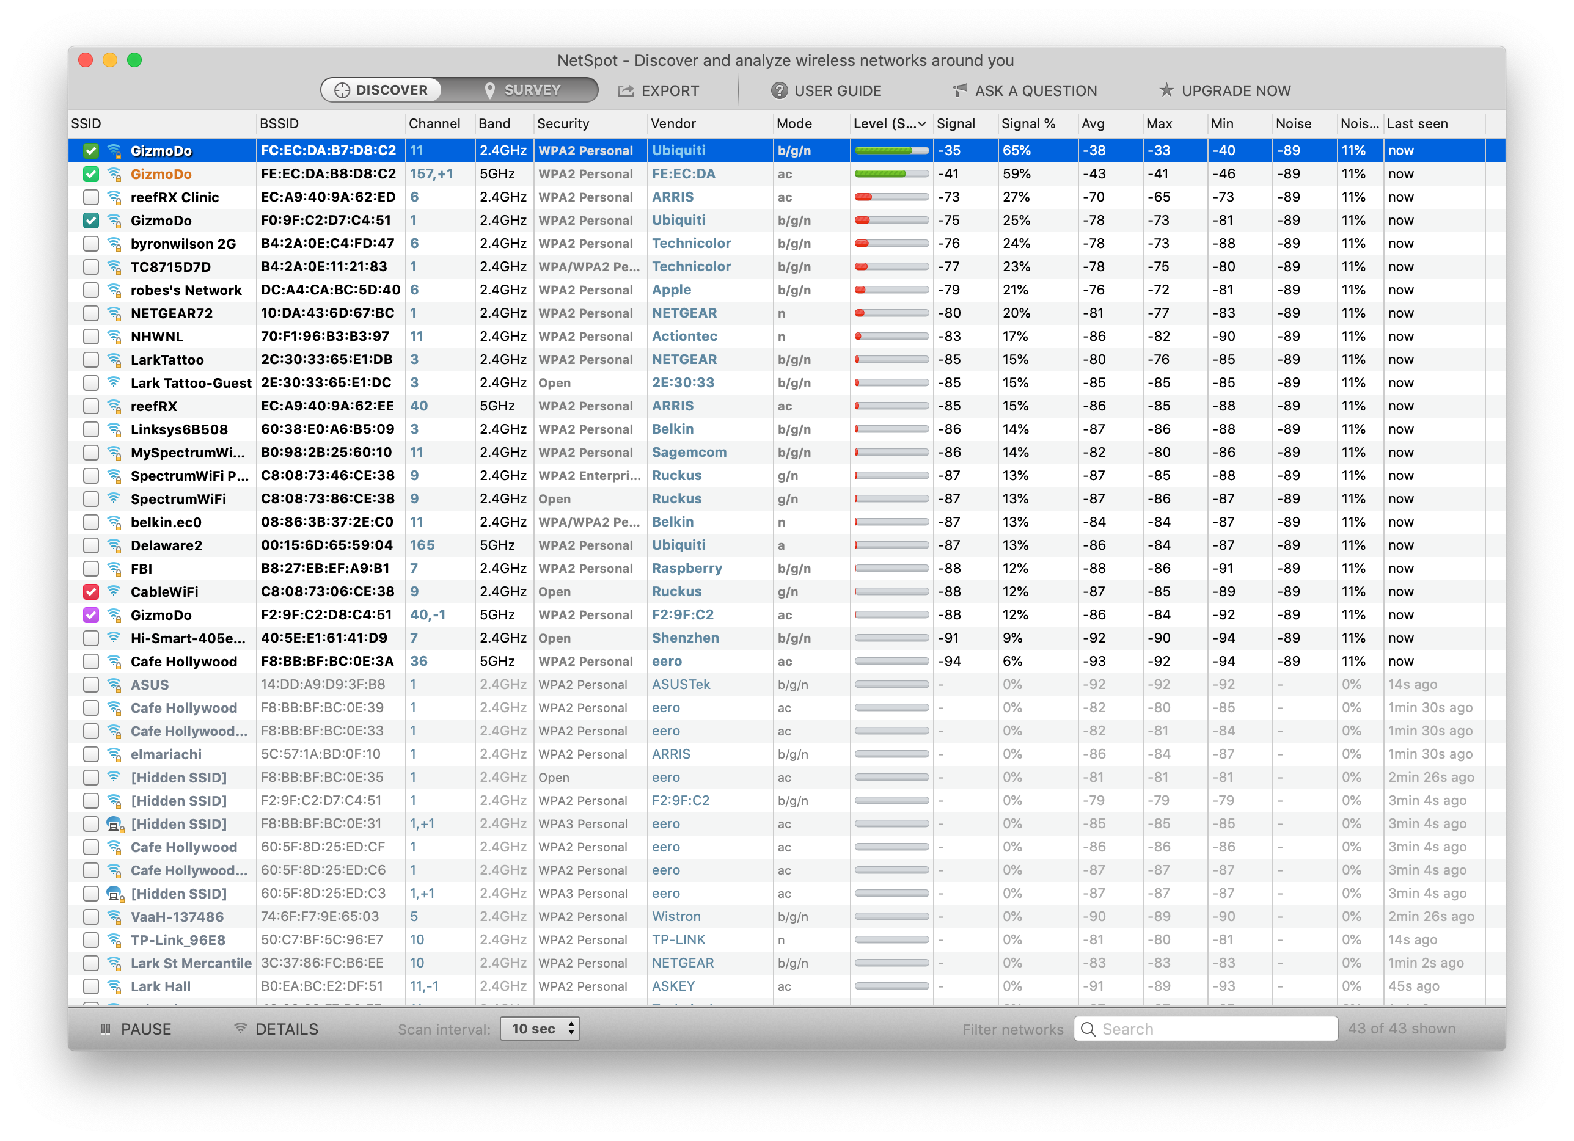
NetSpot

Slide 42
ping
Measures the round-trip time (RTT) between two hosts on the Internet
Uses special packets called ICMP (Internet measurement control protocol)
All L3 devices implement it, as it’s used to communicate Internet problems
You need control only over the host that sends the Ping Request
(or another computer, server, router…)
Lark-iMac:~ mariya$ ping google.com
PING google.com (216.58.192.142): 56 data bytes
64 bytes from 216.58.192.142: icmp_seq=0 ttl=118 time=35.810 ms
64 bytes from 216.58.192.142: icmp_seq=1 ttl=118 time=32.561 ms
64 bytes from 216.58.192.142: icmp_seq=2 ttl=118 time=33.563 ms
64 bytes from 216.58.192.142: icmp_seq=3 ttl=118 time=30.983 ms
64 bytes from 216.58.192.142: icmp_seq=4 ttl=118 time=43.526 ms
64 bytes from 216.58.192.142: icmp_seq=5 ttl=118 time=41.979 ms
64 bytes from 216.58.192.142: icmp_seq=6 ttl=118 time=36.329 ms
64 bytes from 216.58.192.142: icmp_seq=7 ttl=118 time=45.173 ms
64 bytes from 216.58.192.142: icmp_seq=8 ttl=118 time=49.349 ms
64 bytes from 216.58.192.142: icmp_seq=9 ttl=118 time=60.809 ms
^C
--- google.com ping statistics ---
10 packets transmitted, 10 packets received, 0.0% packet loss
round-trip min/avg/max/stddev = 30.983/41.008/60.809/8.732 ms
Lark-iMac:~ mariya$
Ping request
RTT
Ping response
time

Slide 43
iperf
An Internet measurement utility that measures the speed between two hosts
You need control over both hosts to run the iperf utility
Client
Server
iperf traffic
$ iperf -c <server IP>
$ iperf -s
------------------------------------------------------------ Server listening on TCP port 5001 TCP window size: 8.00 KByte (default) ------------------------------------------------------------ [852] local 10.1.1.1 port 5001 connected with 10.6.2.5 port 33453 [ ID] Interval Transfer Bandwidth [852] 0.0-10.6 sec 1.26 MBytes 1.03 Mbits/sec
------------------------------------------------------------ Client connecting to 10.1.1.1, TCP port 5001 TCP window size: 16384 Byte (default) ------------------------------------------------------------ [ 3] local 10.6.2.5 port 33453 connected with 10.1.1.1 port 5001 [ 3] 0.0-10.2 sec 1.26 MBytes 1.05 Mbits/sec
Client output
Server output

Slide 44
Processing ping with awk and bash
$ while :; do tail -5 ping.out | awk ‘BEGIN{sum=0; nrec=0}{split($7,a,”=”); if(a[2]>0) {sum=sum+a[2]; nrec=nrec+1} } END{if(nrec==0){print “All packets lost.”}else{print “Mean latency: ” sum/nrec “ ms”}}’; sleep 1; done

Slide 45
Processing ping with awk and bash
$ while :;
do
tail -5 ping.out
|
awk ‘BEGIN{sum=0; nrec=0}
{
split($7,a,”=”);
if(a[2]>0) {
sum=sum+a[2];
nrec=nrec+1
}
}
END{
if(nrec==0){
print “All packets lost.”}
else{
print “Mean latency: ” sum/nrec “ ms”}
}’;
sleep 1;
done

