Slide 1

Day 2: Wi-Fi channelization, MAC and interference
Instructor: Mariya Zheleva
mzheleva@albany.edu
UbiNET Lab
2021 Summer School on Wireless

Slide 2
Wireless links and network characteristics
How are wired networks different than mobile wireless networks?

Slide 3
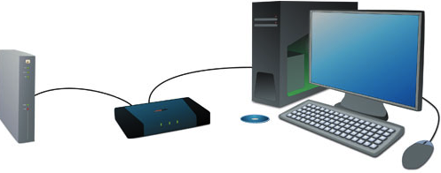
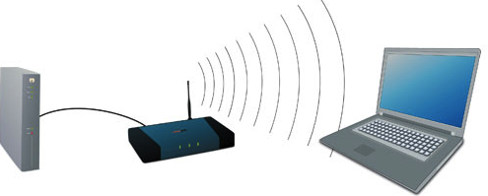
Wired vs. wireless networks
Key differences between wired and wireless:
Link types
Link quality
  Delay
  Packet loss
  Bit-error rate
  Hidden terminals
Client behavior
Mobility
  Keeping track of client attachment point
  Migrating client traffic across networks
Medium type
Broadcast in wireless
Point-to-point in wired
WIRED
WIRELESS

Slide 4
Wireless Link Characteristics (1)
important differences from wired link ….
  broadcast channel: multiple users leverage the same medium to transmit.
    Who gets to send when, how much and at what rate?
  interference from other sources: standardized wireless network frequencies (e.g., 2.4 GHz) shared by other devices (e.g., phone); devices (microwaves) interfere as well
    How to assign frequencies to avoid interference?
  decreased signal strength: radio signal attenuates as it propagates through matter (path loss)
    How to plan base station positioning and rate selection?
  multipath propagation: radio signal reflects off objects ground, arriving at destination at slightly different times
    More challenges to base station positioning and rate selection.
…. make communication across (even a point to point) wireless link much more “difficult”

Slide 5
Multiple access
One of the top research challenges in Wireless Communications

Slide 6

The cocktail party analogy

Slide 7






Multiple access links, protocols
two types of “links”:
point-to-point
  PPP for dial-up access
  point-to-point link between Ethernet switch, host
broadcast (shared wire or medium)
  old-fashioned Ethernet
  upstream hybrid fiber-coaxial
  All wireless networks
    802.11 wireless LAN, mobile cellular, satellite networks…
shared wire (e.g.,
cabled Ethernet)
shared RF
(e.g., 802.11 WiFi)
shared RF
(satellite)
humans at a
cocktail party
(shared air, acoustical)

Slide 8

Multiple access protocols
single shared broadcast channel
two or more simultaneous transmissions by nodes: interference
  collision if node receives two or more signals at the same time
multiple access protocol
distributed algorithm that determines how nodes share channel, i.e., determine when node can transmit
communication about channel sharing must use channel itself!
  no out-of-band channel for coordination

Slide 9
MAC protocols: taxonomy
three broad classes:
channel partitioning
  divide channel into smaller “pieces” (time slots, frequency, code)
  allocate piece to node for exclusive use
random access
  channel not divided, allow collisions
  “recover” from collisions
“taking turns”
  nodes take turns, but nodes with more to send can take longer turns

Slide 10

Channel partitioning MAC protocols: TDMA
TDMA: time division multiple access
access to channel in "rounds"
each station gets fixed length slot (length = pkt trans time) in each round
unused slots go idle
example: 6-station LAN, 1,3,4 have pkt, slots 2,5,6 idle
6-slot
frame
6-slot
frame
1
3
4
1
3
4
time

Slide 11

Channel partitioning MAC protocols: FDMA
FDMA: frequency division multiple access
channel spectrum divided into frequency bands
each station assigned fixed frequency band
unused transmission time in frequency bands go idle
example: 6-station LAN, 1,3,4 have pkt, frequency bands 2,5,6 idle
time
frequency bands
FDM cable

Slide 12

Random access protocols
when node has packet to send
  transmit at full channel data rate R.
  no a priori coordination among nodes
two or more transmitting nodes ➜ “collision”,
random access MAC protocol specifies:
  how to detect collisions
  how to recover from collisions (e.g., via delayed retransmissions)
examples of random access MAC protocols:
  slotted ALOHA
  ALOHA
  CSMA, CSMA/CD, CSMA/CA
  Used in WiFi

Slide 13










Multiple access
global ISP
A key function of the Data Link Layer
Data Plane
Application
Transport
Wired
Wireless
Network
Data Link
Ethernet
802.11
3GPP
Physical

Slide 14
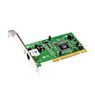
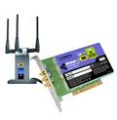


Where is the link layer (MAC) implemented?
in each and every host
link layer implemented in “adaptor” (aka network interface card NIC) or on a chip
  Ethernet card, 802.11 card; Ethernet chipset
  implements link, physical layer
attaches into host’s system buses
combination of hardware, software, firmware
application
transport
network
link
cpu
memory
link
physical
host
bus
(e.g., PCI)
controller
physical
transmission
network adapter
card

Slide 15
MAC in Cellular Networks

Slide 16

Components of cellular network architecture
MSC
connects cells to wired tel. net.
manages call setup (more later!)
handles mobility (more later!)
cell
covers geographical region
base station (BS) analogous to 802.11 AP
mobile users attach to network through BS
air-interface: physical and link layer protocol between mobile and BS
Mobile
Switching
Center
Public telephone
network
Mobile
Switching
Center
wired network

Slide 17
Cellular networks: the first hop
Two techniques for sharing mobile-to-BS radio spectrum
combined FDMA/TDMA: divide spectrum in frequency channels, divide each channel into time slots
CDMA: code division multiple access
time slots
frequency
bands

Slide 18
2G (voice) network architecture
Base station system (BSS)
MSC
BTS
BSC
G
Public
telephone
network
Gateway
MSC
Legend
BSC
Base transceiver station (BTS)
base station controller
controls few tens of BSs
  paging
  frequency assignment
  handoff
Base station controller (BSC)
Mobile Switching Center (MSC)
MSC
connects cells to wired tel. net.
manages call setup (more later!)
handles mobility (more later!)
Mobile subscribers

Slide 19
3G (voice+data) network architecture
MSC
G
Public
telephone
network
radio
network
controller
Gateway
MSC
G
Public
Internet
SGSN
Key insight: new cellular data
network operates in parallel
(except at edge) with existing
cellular voice network
voice network unchanged in core
data network operates in parallel
GGSN
Serving GPRS Support Node (SGSN)
Gateway GPRS Support Node (GGSN)
Notes:
What was a key design principle behind 3G?

Slide 20
3G (voice+data) network architecture
MSC
G
Public
telephone
network
radio
network
controller
Gateway
MSC
G
Public
Internet
SGSN
GGSN
radio interface
(WCDMA, HSPA)
radio access network
Universal Terrestrial Radio
Access Network (UTRAN)
core network
General Packet Radio Service
(GPRS) Core Network
public
Internet

Slide 21
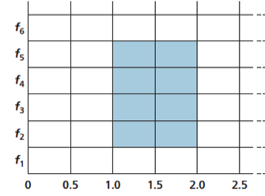
4G LTE – Long Term Evolution
Evolved packet core (EPC)
  All-IP core
  Both voice and data carried in datagrams
  Network control plane (e.g. mobility management)
  User data plane (e.g. data vs. voice)
LTE Radio Access Network (RAN)
  Flexible channel size 1.25MHz – 20MHz
  Advanced MAC (OFDM)
    Allocates slots and channels to users
    Slot reallocation every 1ms
  Rate adaptation through adaptive modulation and coding scheme (MSC)
  Multiple Input Multiple Output (MIMO) antenna technology
  At 20MHz channel: 100Mbps DL; 50Mbps UL
Frequency
Time, ms (0.5ms slot size)
Example OFDM allocation

Slide 22
In summary – cellular medium access
All generations of cellular networks (2G-5G) use channel partitioning for medium access
  Radio resources are divided both in frequency and time
Why is this good?
  Cellular networks are usually at capacity all the time
    No slots will be wasted
    Random access over long distances fails
  Cellular networks are inherently designed for tight centralized control (unlike Wi-Fi).

Slide 23
CSMA (carrier sense multiple access) – prominent random access scheme
CSMA: listen before transmit:
if channel sensed idle: transmit entire frame
if channel sensed busy, defer transmission
human analogy: listen before talk; don’t interrupt others!

Slide 24
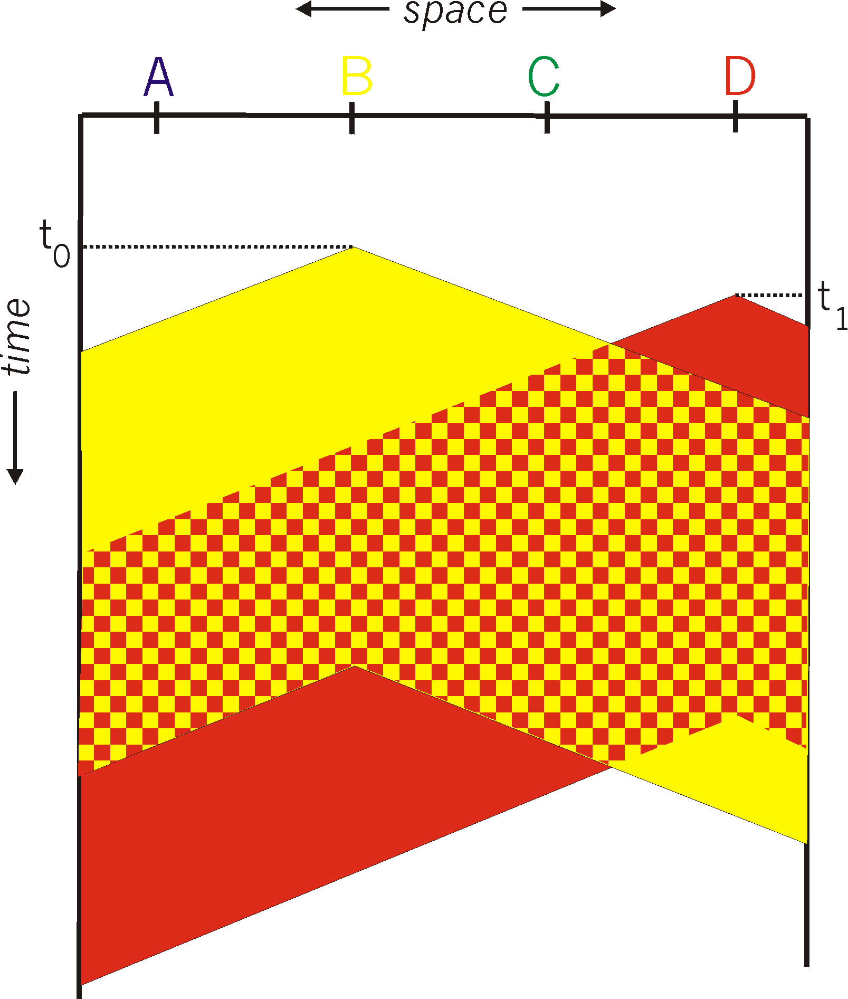
CSMA collisions
spatial layout of nodes
collisions can still occur: propagation delay means two nodes may not hear each other’s transmission
collision: entire packet transmission time wasted
  distance & propagation delay play role in in determining collision probability
A
B
C
D

Slide 25
CSMA collisions
collisions can still occur: propagation delay means two nodes may not hear each other’s transmission
collision: entire packet transmission time wasted
  distance & propagation delay play role in in determining collision probability
spatial layout of nodes
A
B
C
D
Why are collisions bad?
Can we do anything to resolve such situations? → We’ll see how WiFi deals with this in a few slides.

Slide 26
CSMA/CD (collision detection)
CSMA/CD: carrier sensing, deferral as in CSMA
  collisions detected within short time
  colliding transmissions aborted, reducing channel wastage
collision detection:
  easy in wired LANs: measure signal strengths, compare transmitted, received signals
  difficult in wireless LANs: received signal strength overwhelmed by local transmission strength
human analogy: the polite conversationalist

Slide 27
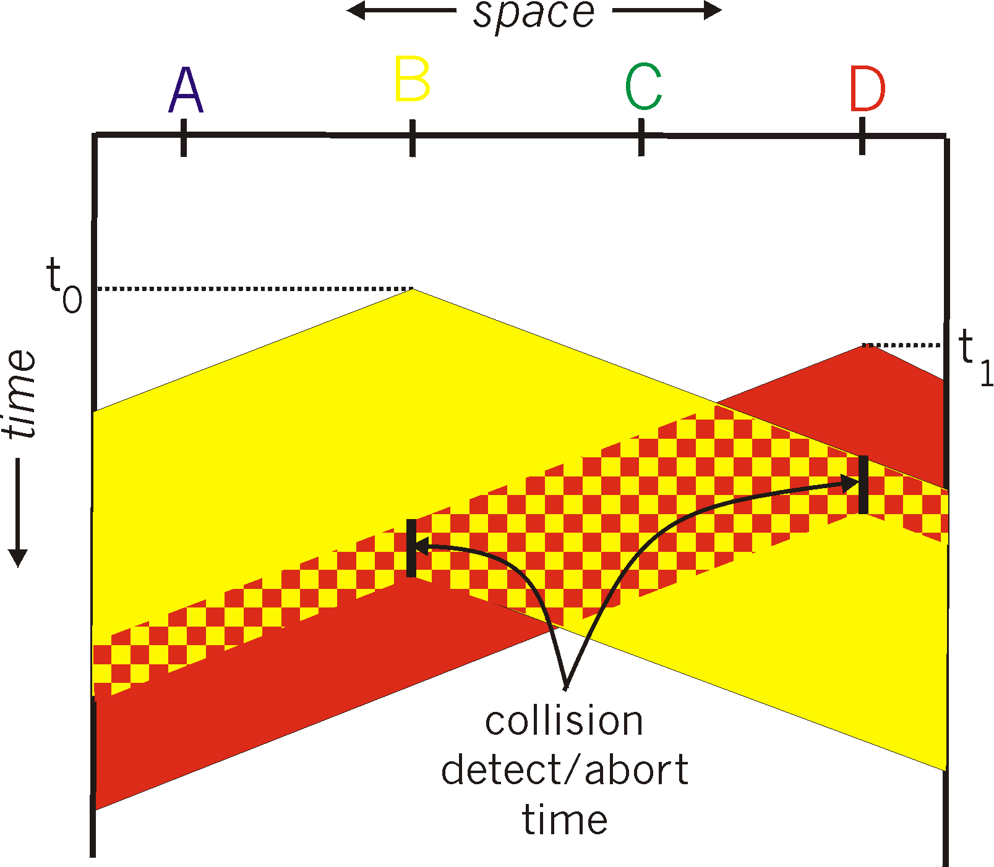
CSMA/CD (collision detection)
spatial layout of nodes

Slide 28
Key takeaways
Multiple access is a key feature of the data link layer
  Essential to coordinate concurrent medium access by multiple users
Multiple access today
  Wired – modern Ethernet switches create collision-free domains for each user. Multiple access made easy
  Wireless – shared medium. Multiple access is essential

Slide 29
802.11 Wi-Fi -- Wireless LANs
Ch 6.3. (Ross/Kurose 6th edition)

Slide 30
IEEE 802.11 Wireless LAN
802.11b
2.4-5 GHz unlicensed spectrum
up to 11 Mbps
direct sequence spread spectrum (DSSS) in physical layer
  all hosts use same chipping code
802.11a
  5-6 GHz range
  up to 54 Mbps
802.11g
  2.4-5 GHz range
  up to 54 Mbps
802.11n: multiple antennae
  2.4-5 GHz range
  up to 200 Mbps
all use CSMA/CA for multiple access
all have base-station and ad-hoc network versions

Slide 31





802.11 LAN architecture
wireless host communicates with base station
  base station = access point (AP)
Basic Service Set (BSS) (aka “cell”) in infrastructure mode contains:
  wireless hosts
  access point (AP): base station
  ad hoc mode: hosts only
Internet
hub, switch
or router
BSS 1
BSS 2

Slide 32
802.11: Channels, association
802.11b: 2.4GHz-2.485GHz spectrum divided into 11 channels at different frequencies
  AP admin chooses frequency for AP
  interference possible: channel can be same as that chosen by neighboring AP!
2.4GHz channels
5GHz channels

Slide 33
802.11: Channels, association
802.11b: 2.4GHz-2.485GHz spectrum divided into 11 channels at different frequencies
  AP admin chooses frequency for AP
  interference possible: channel can be same as that chosen by neighboring AP!
host: must associate with an AP
  scans channels, listening for beacon frames containing AP’s name (SSID) and MAC address
  selects AP to associate with
  may perform authentication [Chapter 8, Ross and Kurose 6th edition]
  will typically run DHCP to get IP address in AP’s subnet

Slide 34
802.11: passive/active scanning
BBS 1
BBS 2
BBS 1
BBS 2
1
AP 2
AP 1
1
1
AP 2
AP 1
2
2
2
3
3
4
H1
H1
passive scanning:
beacon frames sent from APs
association Request frame sent: H1 to selected AP
association Response frame sent from selected AP to H1
active scanning:
Probe Request frame broadcast from H1
Probe Response frames sent from APs
Association Request frame sent: H1 to selected AP
Association Response frame sent from selected AP to H1

Slide 35
Wi-Fi multiple access

Slide 36
Handling Collision in Wireline Networks
A review of CSMA/CD:
  Carrier sense: a node waits until the channel is idle before transmitting a packet.
    If a channel is busy defer transmission
  Collision detection: after transmitting a node continuously monitors the channel.
    Has a collision occurred?
    If yes, abort, jam and retry.

Slide 37
Wireless radio design considerations
Wireless radios are half-duplex
Transmit power asymmetries
Self-interference >>> received signal strength

Slide 38
Can we employ CSMA/CD in wireless networks?
Key assumptions of CSMA/CD
  For carrier sensing (CS): any node can hear any other node in the network
  For collision detection (CD): a node can “listen” for concurrent transmissions while sending a packet
Will CS and CD work in wireless networks? Criteria to consider:
  Wireless radio operation
    Wireless radios are half-duplex (hardware restrictions)
  Emit power asymmetric between client and access point
    Not all wireless radios emit with the same power. The transmit power of a phone is orders of magnitude lower than that of the access point
Group activity

Slide 39
Two Problems
Collision detection doesn’t work in wireless
Carrier sensing doesn’t (always) work in wireless

Slide 40
Why Doesn’t Collision Detection Work in Wireless?
Radios can be half-duplex (so a node can’t transmit and sense a collision at the same time).
Tx and Rx voltages are different in wireless networks (in wired they are the same). This is another reason collision cannot be detected.
  Transmitter cannot hear what is being transmitted by other stations.
Self-interference >>> received signal strength
Wireless LAN relies on
Collision Avoidance.

Slide 41
Why Doesn’t Carrier Sense Work in Wireless?
The hidden terminal problem:
  Even if the medium is free near the transmitter it might not be free at the receiver.
Range of Client A
Range of Client B
AP
Client A
Client B
Wants to transmit. Does
not hear A’s transmission
Currently transmitting
The two transmissions
will collide at the AP.

Slide 42
Why Doesn’t Carrier Sense Work in Wireless?
Exposed terminal problem
  Even if the medium is busy near the transmitter it might be free close to the intended receiver.
Range of Client B
Range of Client A
AP2
AP1
Client B
Client A
Wants to transmit to AP2.
Client B can’t transmit to AP2
due to Carrier Sense.
Currently transmitting to AP1.

Slide 43
In Summary
CSMA – Carrier Sense Multiple Access
  Listen before transmitting
Because of hidden terminals doesn’t always work in wireless
  Results in collisions
Because of exposed terminals will reduce the throughput in wireless
  Prevents terminals from transmitting when they actually can
In wireless, collision occurs at the receiver, not at the sender. So sender listening isn’t very helpful
  Receiver-driven design in wireless networks

Slide 44
802.11 Wi-Fi -- Wireless LANs
Some material from chapter 6.3, Ross/Kurose 6th edition

Slide 45
Interference

Slide 46
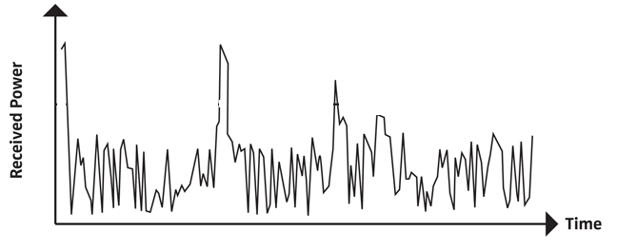

Wired vs. Wireless Channel
In wireline networks the channel can provide continuous connectivity with consistent quality.
In wireless: time-varying often unpredictable channel quality
  Due to the nature of radio propagation, mobility, changing environment
  Interference

Slide 47

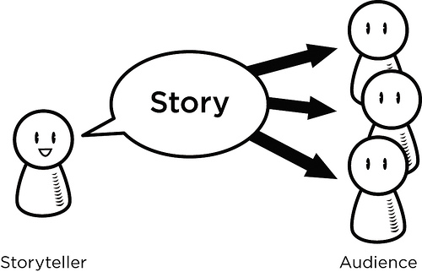
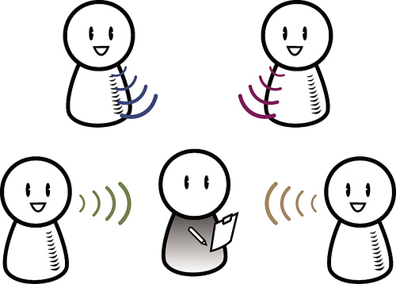
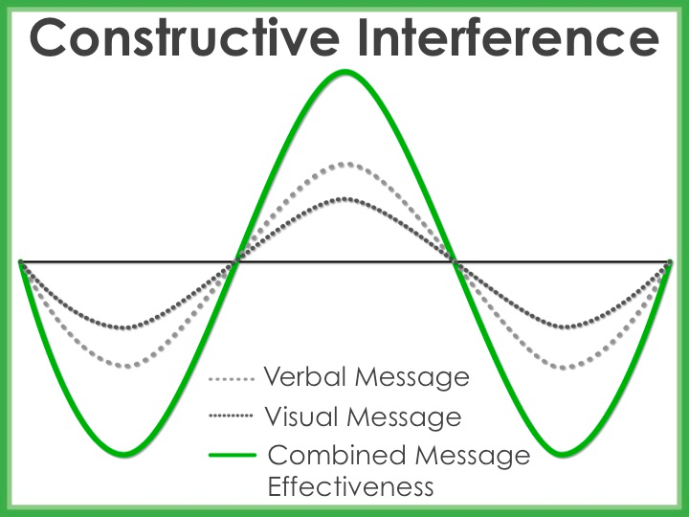
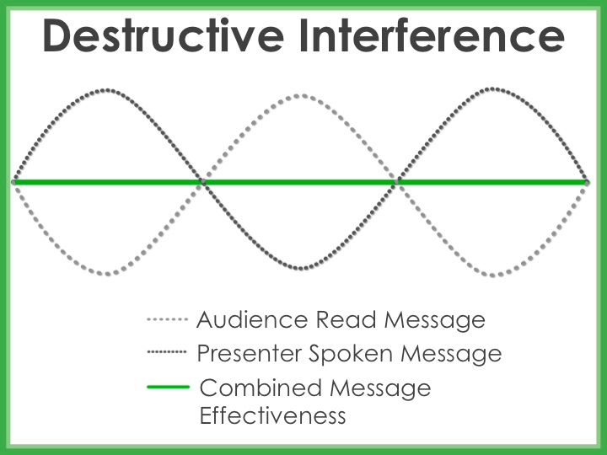
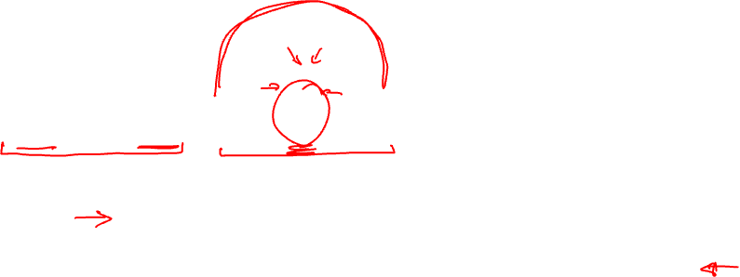
Interference
Notes:
EM waves of two identical sources are mixed.

Slide 48


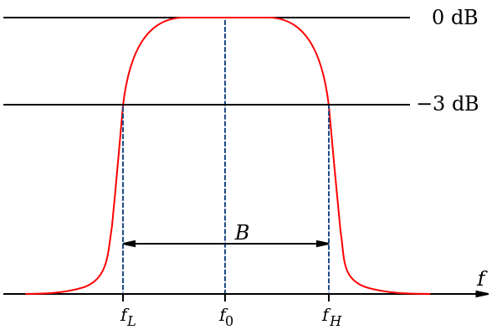

Shared vs. Exclusive Spectrum
Exclusive (licensed) spectrum (e.g. mobile cellular networks):
  Protects us from interference
  Expensive bandwidth
  Must be spectrum efficient – large user population with a small spectrum band
    No power constraints
    High filtering requirements => expensive equipment
Time
Frequency
Notes:
How do we manage interference using spectrum allocation? Or when does interference occur?

Slide 49

Shared vs. Exclusive Spectrum (contd.)
Shared (unlicensed) spectrum (e.g. Wi-Fi networks):
  Cheap to transmit on (no license fees)
  Wider channels (frequency scarcity not as pronounced)
  Maximum transmission power is constrained
  Interference from co-existing devices
  Major problem is spectral efficiency (pack as many bits as possible in a given frequency band)
Time
Frequency

Slide 50
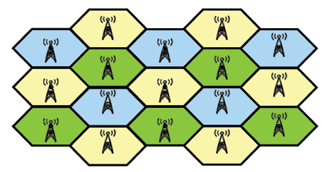

Fundamentally-Different System Design
Exclusive
Shared
C1
AP1
AP2
C2

Slide 51

IEEE 802.11 Wireless LAN
802.11b
2.4-5 GHz unlicensed spectrum
up to 11 Mbps
direct sequence spread spectrum (DSSS) in physical layer
  all hosts use same chipping code
802.11a
  5-6 GHz range
  up to 54 Mbps
802.11g
  2.4-5 GHz range
  up to 54 Mbps
802.11n/ac: multiple antennae
  2.4-5 GHz range
  up to 200 Mbps
all use CSMA/CA for multiple access
all have base-station and ad-hoc network versions

Slide 52

802.11 LAN architecture
wireless host communicates with base station
  base station = access point (AP)
Basic Service Set (BSS) (aka “cell”) in infrastructure mode contains:
  wireless hosts
  access point (AP): base station
  ad hoc mode: hosts only
Internet
hub, switch
or router
BSS 1
BSS 2

Slide 53
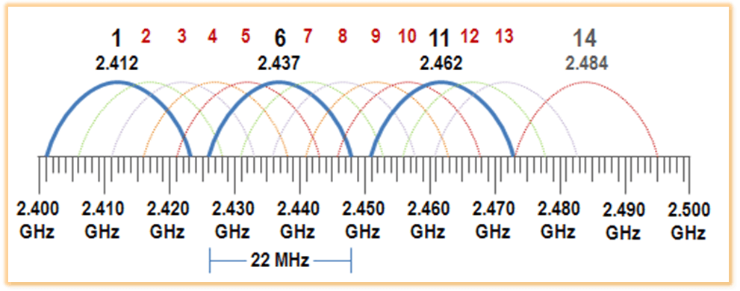

802.11 channels (2.4GHz range)
802.11b: 2.4GHz-2.485GHz spectrum divided into 11 channels at different frequencies
  AP admin chooses frequency for AP
  interference possible: channel can be same as that chosen by neighboring AP!
  Only three channels are “orthogonal” (do not overlap)

Slide 54

802.11 channels (5GHz range)
The 5GHz range (802.11n/ac) divided into 25 20MHz channels at different frequencies
  channel bonding up to 160MHz
  all channels are orthogonal
  interference still possible but much more space to avoid it

Slide 55
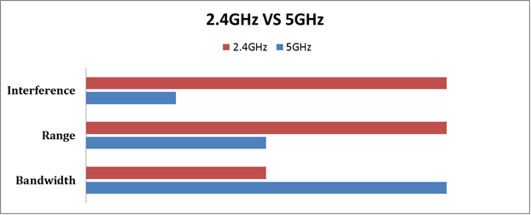

2.4 vs. 5GHz
Tradeoffs in distance, range and bandwidth
Non-qualitative visualization of the tradeoffs. Source: Phorus

Slide 56
802.11: Channels, association
802.11b: 2.4GHz-2.485GHz spectrum divided into channels at different frequencies
  AP admin chooses frequency for AP
  interference possible: channel can be same as that chosen by neighboring AP!
host: must associate with an AP
  scans channels, listening for beacon frames containing AP’s name (SSID) and MAC address
  selects AP to associate with
  may perform authentication [Chapter 8]
  will typically run DHCP to get IP address in AP’s subnet

Slide 57

802.11: passive/active scanning
BBS 1
BBS 2
BBS 1
BBS 2
1
AP 2
AP 1
1
1
AP 2
AP 1
2
2
2
3
3
4
H1
H1
passive scanning:
beacon frames sent from APs
association Request frame sent: H1 to selected AP
association Response frame sent from selected AP to H1
active scanning:
Probe Request frame broadcast from H1
Probe Response frames sent from APs
Association Request frame sent: H1 to selected AP
Association Response frame sent from selected AP to H1

Slide 58
Wi-Fi multiple access
… now that we have associated, how do we transmit a packet

Slide 59
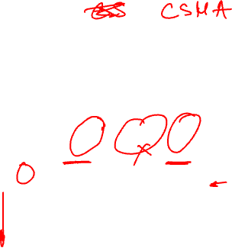
Packet collisions in networks
spatial layout of nodes
collision: entire packet transmission time wasted
  distance & propagation delay play role in in determining collision probability
A
B
C
D

Slide 60
Random access protocols
when node has packet to send
  transmit at full channel data rate R.
  no a priori coordination among nodes
two or more transmitting nodes ➜ “collision”,
random access MAC protocol specifies:
  how to detect collisions
  how to recover from collisions (e.g., via delayed retransmissions)

Slide 61
Handling Collision in Wireline Networks
Carrier sense: a node waits until the channel is idle before transmitting a packet.
    If a channel is busy defer transmission
Collision detection: after transmitting a node continuously monitors the channel.
    Has a collision occurred?
    If yes, abort, jam and retry.

Slide 62
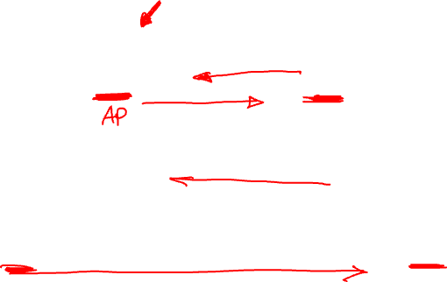
Wireless radio design considerations
Wireless radios are half-duplex
Transmit power asymmetries
Self-interference >>> received signal strength

Slide 63
Can we employ CSMA/CD in wireless networks?
Key assumptions of CSMA/CD
  For carrier sensing (CS): any node can hear any other node in the network
  For collision detection (CD): a node can “listen” for concurrent transmissions while sending a packet
Will CS and CD work in wireless networks? Criteria to consider:
  Wireless radio operation
    Wireless radios are half-duplex (hardware restrictions)
  Emit power asymmetric between client and access point
    Not all wireless radios emit with the same power. The transmit power of a phone is orders of magnitude lower than that of the access point
Group activity

Slide 64
Two Problems
Collision detection doesn’t work in wireless
Carrier sensing doesn’t (always) work in wireless

Slide 65
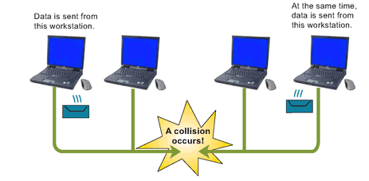
Collision detection doesn’t work in wireless?
Radios can be half-duplex (so a node can’t transmit and sense a collision at the same time).
Tx and Rx voltages are different in wireless networks (in wired they are the same). This is another reason collision cannot be detected.
  Transmitter cannot hear what is being transmitted by other stations.
Illustration of CDMA/CD
Wireless LAN relies on
Collision Avoidance.

Slide 66
Carrier sense doesn’t (always) work in wireless
The hidden terminal problem:
  Even if the medium is free near the transmitter it might not be free at the receiver.
Range of Client A
Range of Client B
AP
Client A
Client B
Wants to transmit. Does
not hear A’s transmission
Currently transmitting
The two transmissions
will collide at the AP.

Slide 67
Carrier sense doesn’t (always) work in wireless
Exposed terminal problem
  Even if the medium is busy near the transmitter it might be free close to the intended receiver.
Range of Client B
Range of Client A
AP2
AP1
Client B
Client A
Wants to transmit to AP2.
Client B can’t transmit to AP2
due to Carrier Sense.
Currently transmitting to AP1.

Slide 68
In Summary
CSMA – Carrier Sense Multiple Access
  Listen before transmitting
Because of hidden terminals doesn’t always work in wireless
  Results in collisions
Because of exposed terminals will reduce the throughput in wireless
  Prevents terminals from transmitting when they actually can
In wireless, collision occurs at the receiver, not at the sender. So sender listening isn’t very helpful

Slide 69
So how does WiFi actually do medium access control?
CSMA/CA

Slide 70
IEEE 802.11 MAC Protocol: CSMA/CA
802.11 sender
1 if sense channel idle for DIFS then
  transmit entire frame (no CD)
2 if sense channel busy then
  start random exponential backoff time
  timer counts down while channel idle
  transmit when timer expires
  if no ACK, increase random backoff interval, repeat 2
802.11 receiver
- if frame received OK
return ACK after SIFS (ACK needed due to hidden terminal problem)
sender
receiver
DIFS
data
SIFS
ACK
Notes:
Distributed Inter-frame Space (DIFS);
Short Inter-frame Spacing (SIFS)

Slide 71
Random Exponential Backoff Algorithm
Select random number of slot times to defer transmission, keep as a state variable
After channel has been idle for specified interval, decrement variable after each idle slot passes
If carrier is sensed, freeze variable countdown, wait for channel to become idle again and resume countdown
B1 = 25
B1 = 5
Node 1
wait
data
Node 2
data
wait
B2 = 20
B2 = 15
B2 = 10
B1 and B2 are backoff intervalsat nodes 1 and 2

Slide 72
But what about the hidden terminal?
So far CSMA assumes that clients can hear each other’s transmissions.
The hidden terminal problem: two clients might not be able to hear each other’s transmissions → collision at the access point.
Range of Client A
Range of Client B
AP
Client A
Client B
Wants to transmit. Does
not hear A’s transmission
Currently transmitting
The two transmissions
will collide at the AP.
Carrier sensing and randomized backoff alone cannot help in this situation. We need to further enhance the Wi-Fi MAC to combat the hidden terminal.

Slide 73
Avoiding collisions (more)
idea: allow sender to “reserve” channel rather than random access of data frames: avoid collisions of long data frames
sender first transmits small request-to-send (RTS) packets to BS using CSMA
  RTSs may still collide with each other (but they’re short)
BS broadcasts clear-to-send CTS in response to RTS
CTS heard by all nodes
  sender transmits data frame
  other stations defer transmissions
avoid data frame collisions completely
using small reservation packets!

Slide 74


Collision Avoidance: RTS-CTS exchange
A
B
AP
RTS(B)
RTS(A)
reservation collision
RTS(A)
CTS(A)
CTS(A)
DATA (A)
defer
time
ACK(A)
ACK(A)

Slide 75
In summary – WiFi MAC
Broadcast wireless medium makes it particularly challenging to perform medium access control
Carrier Sense Multiple Access with Collision Avoidance (CSMA/CA)
  Avoid collision by carrier sensing and channel reservation
  Ensure maximum network throughput
    Hidden and exposed terminal solved
Good for short-range communications. As distances increase CSMA/CA fails to eliminate collisions
  Cellular networks use channel partitioning

Slide 76
WiFi rate adaptation

Slide 77
The goal of rate adaptation
Given a set of supported data rates , e.g. [1, 4, 8, 11, 32, 54] Mbps, select the optimal data rate to transmit.
Optimal?

Slide 78
Rate adaptation balances and important tradeoff
Objectives of wireless transmission (from end-user’s perspective)
  Transmit data with high rate (get my content through as fast as possible)
  Transmit without errors
But…
  High data rate is prone to more errors (e.g. if the channel conditions are bad)
  Low data rate is prone to less errors, but data takes longer to transmit
  Low data rate → each user will take longer to transmit → less transmission opportunity for other users and more network congestion
Rate adaptation balances the tradeoff b/n bit errors and transmission speed.
  Transmission speed depends on the selected Modulation and Coding Scheme (MCS)
  Bit error rate depends on the Signal-to-Noise Ratio (SNR; aka channel quality)

Slide 79
What are MSC and SNR?
MSC – Modulation and Coding Scheme
SNR – Signal-to-Noise Ratio
High SNR (good)
MCSs in increasing order of transmission rate:
BPSK (1Mbps)
QAM-16 (4Mbps)
QAM-64 (8Mbps)
Low SNR (bad)

Slide 80
Wireless Link Characteristics (2)
SNR: signal-to-noise ratio
  larger SNR – easier to extract signal from noise (a “good thing”)
SNR versus BER tradeoffs
  given physical layer: increase power -> increase SNR->decrease BER
  given SNR: choose physical layer that meets BER requirement, giving highest thruput
    SNR may change with mobility: dynamically adapt physical layer (modulation technique, rate)
10⁻¹
10⁻²
10⁻³
BER
10⁻⁴
10⁻⁵
10⁻⁶
10⁻⁷
10
20
30
40
SNR(dB)
QAM256 (8 Mbps)
QAM16 (4 Mbps)
BPSK (1 Mbps)

Slide 81
802.11: advanced capabilities
Rate adaptation
base station, mobile dynamically change transmission rate (physical layer modulation technique) as mobile moves, SNR varies
10⁻¹
10⁻²
10⁻³
BER
10⁻⁴
10⁻⁵
10⁻⁶
10⁻⁷
10
20
30
40
SNR(dB)
1. SNR decreases, BER increase as node moves away from base station
QAM256 (8 Mbps)
QAM16 (4 Mbps)
2. When BER becomes too high, switch to lower transmission rate but with lower BER
BPSK (1 Mbps)
operating point

Slide 82
Demonstrating interference and obstruction in WiFi networks

Slide 83
Tools
NetSpot – WiFi AP scanner
ping – a packet trace utility that measures the latency between two hosts
iperf – a packet generator utility that can inject traffic onto a network to measure the speed between two hosts

Slide 84
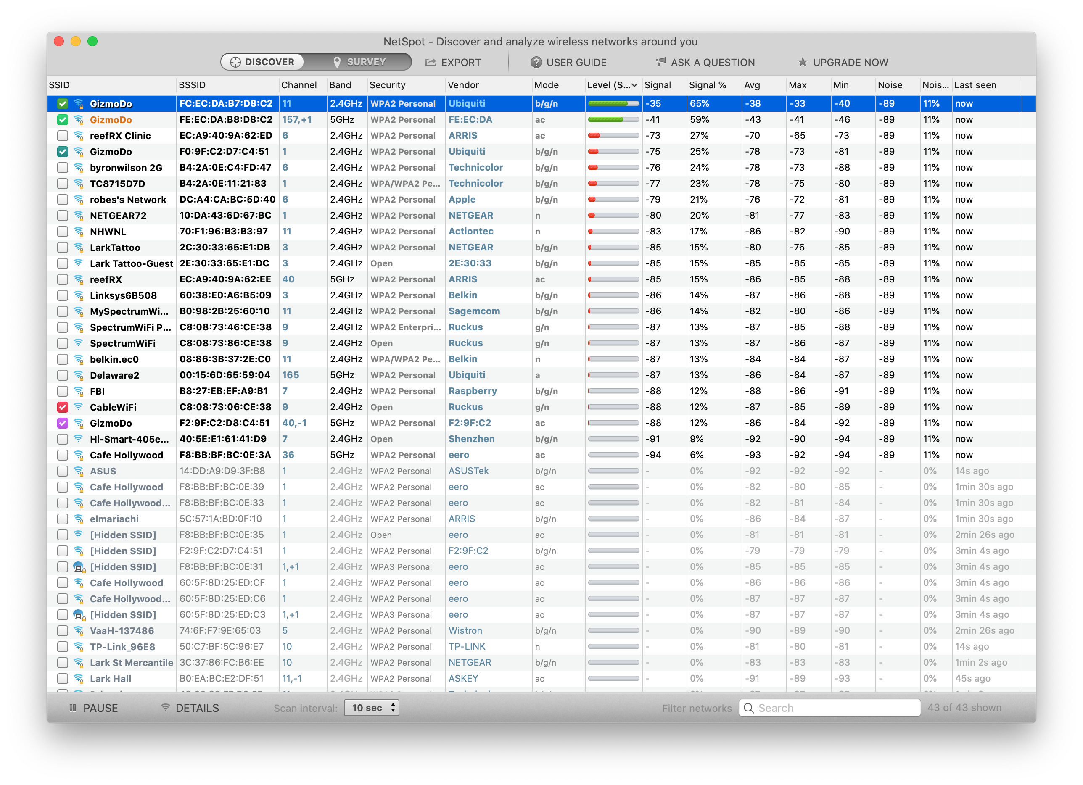
NetSpot

Slide 85


ping
Measures the round-trip time (RTT) between two hosts on the Internet
Uses special packets called ICMP (Internet measurement control protocol)
  All L3 devices implement it, as it’s used to communicate Internet problems
You need control only over the host that sends the Ping Request
(or another computer, server, router…)
Lark-iMac:~ mariya$ ping google.com
PING google.com (216.58.192.142): 56 data bytes
64 bytes from 216.58.192.142: icmp_seq=0 ttl=118 time=35.810 ms
64 bytes from 216.58.192.142: icmp_seq=1 ttl=118 time=32.561 ms
64 bytes from 216.58.192.142: icmp_seq=2 ttl=118 time=33.563 ms
64 bytes from 216.58.192.142: icmp_seq=3 ttl=118 time=30.983 ms
64 bytes from 216.58.192.142: icmp_seq=4 ttl=118 time=43.526 ms
64 bytes from 216.58.192.142: icmp_seq=5 ttl=118 time=41.979 ms
64 bytes from 216.58.192.142: icmp_seq=6 ttl=118 time=36.329 ms
64 bytes from 216.58.192.142: icmp_seq=7 ttl=118 time=45.173 ms
64 bytes from 216.58.192.142: icmp_seq=8 ttl=118 time=49.349 ms
64 bytes from 216.58.192.142: icmp_seq=9 ttl=118 time=60.809 ms
^C
--- google.com ping statistics ---
10 packets transmitted, 10 packets received, 0.0% packet loss
round-trip min/avg/max/stddev = 30.983/41.008/60.809/8.732 ms
Lark-iMac:~ mariya$
Ping request
RTT
Ping response
time

Slide 86


iperf
An Internet measurement utility that measures the speed between two hosts
You need control over both hosts to run the iperf utility
Client
Server
iperf traffic
$ iperf -c <server IP>
$ iperf -s
------------------------------------------------------------
Server listening on TCP port 5001
TCP window size: 8.00 KByte (default)
------------------------------------------------------------
[852] local 10.1.1.1 port 5001 connected with 10.6.2.5 port 33453
[ ID] Interval Transfer Bandwidth
[852] 0.0-10.6 sec 1.26 MBytes 1.03 Mbits/sec
------------------------------------------------------------
Client connecting to 10.1.1.1, TCP port 5001
TCP window size: 16384 Byte (default)
------------------------------------------------------------
[ 3] local 10.6.2.5 port 33453 connected with 10.1.1.1 port 5001
[ 3] 0.0-10.2 sec 1.26 MBytes 1.05 Mbits/sec
Client output
Server output

Slide 87
Processing ping with awk and bash
$ while :; do tail -5 ping.out | awk ‘BEGIN{sum=0; nrec=0}{split($7,a,”=”); if(a[2]>0) {sum=sum+a[2]; nrec=nrec+1} } END{if(nrec==0){print “All packets lost.”}else{print “Mean latency: ” sum/nrec “ ms”}}’; sleep 1; done

Slide 88
Processing ping with awk and bash
$ while :;
do
tail -5 ping.out
|
awk ‘BEGIN{sum=0; nrec=0}
{
split($7,a,”=”);
if(a[2]>0) {
sum=sum+a[2];
nrec=nrec+1
}
}
END{
if(nrec==0){
print “All packets lost.”}
else{
print “Mean latency: ” sum/nrec “ ms”}
}’;
sleep 1;
done
SAMPLE PING OUTPUT LINE
64 bytes from 216.58.192.142: icmp_seq=0 ttl=118 time=35.810 ms

