Slide 1

Day 3: Cellular networks.
The future of wireless
Instructor: Mariya Zheleva
mzheleva@albany.edu
UbiNET Lab
2021 Summer School on Wireless

Slide 2
WiFi performance demos contd.
WiFi performance with distance and obstacles

Slide 3
Cellular vs WLAN networks
Cellular
Frequency spectrum
  Licensed
Range
  1-35km
Data rate
  64kbps (2.5G) →
  1-14Mbps (3G) → 100Mbps (LTE)
WLAN (Wi-Fi)
Frequency spectrum
  Unlicensed
Range
  10-100m
Data rate
  16Mbps (802.11b) → 54Mbps (802.11a/g) → 300Mbps (802.11n)

Slide 4

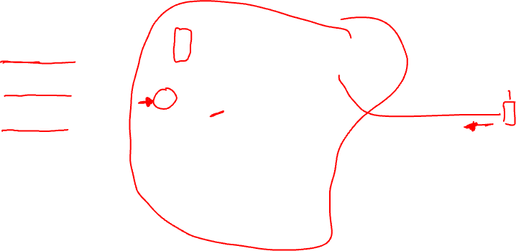
Components of cellular network architecture
MSC
connects cells to wired tel. net.
manages call setup (more later!)
handles mobility (more later!)
cell
covers geographical region
base station (BS) analogous to 802.11 AP
mobile users attach to network through BS
air-interface: physical and link layer protocol between mobile and BS
Mobile
Switching
Center
Public telephone
network
Mobile
Switching
Center
wired network

Slide 5
Cellular networks: the first hop
Two techniques for sharing mobile-to-BS radio spectrum
combined FDMA/TDMA: divide spectrum in frequency channels, divide each channel into time slots
CDMA: code division multiple access
time slots
frequency
bands
Cellular networks MAC

Slide 6

2G (voice) network architecture
Base station system (BSS)
MSC
BTS
BSC
G
Public
telephone
network
Gateway
MSC
Legend
BSC
Base transceiver station (BTS)
base station controller
controls few tens of BSs
  paging
  frequency assignment
  handoff
Base station controller (BSC)
Mobile Switching Center (MSC)
MSC
connects cells to wired tel. net.
manages call setup (more later!)
handles mobility (more later!)
Mobile subscribers

Slide 7
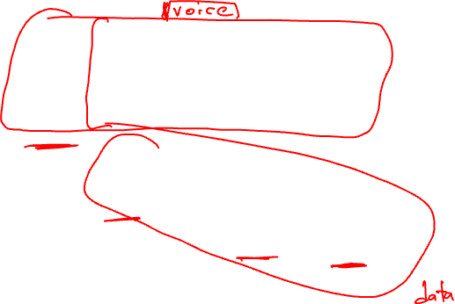
3G (voice+data) network architecture
MSC
G
Public
telephone
network
radio
network
controller
Gateway
MSC
G
Public
Internet
SGSN
Key insight: new cellular data
network operates in parallel
(except at edge) with existing
cellular voice network
voice network unchanged in core
data network operates in parallel
GGSN
Serving GPRS Support Node (SGSN)
Gateway GPRS Support Node (GGSN)
Notes:
What was a key design principle behind 3G?

Slide 8
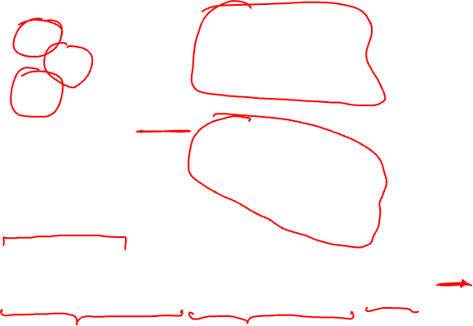
3G (voice+data) network architecture
MSC
G
Public
telephone
network
radio
network
controller
Gateway
MSC
G
Public
Internet
SGSN
GGSN
radio interface
(WCDMA, HSPA)
radio access network
Universal Terrestrial Radio
Access Network (UTRAN)
core network
General Packet Radio Service
(GPRS) Core Network
public
Internet

Slide 9


3G versus 4G LTE network architecture
MSC
G
Public
telephone
network
3G
radio
network
controller
Gateway
MSC
G
Public
Internet
SGSN
GGSN
4G-LTE
HSS
MME
G
G
Public
Internet
S-GW
P-GW
radio access network
Universal Terrestrial Radio
Access Network (UTRAN)
Evolved Packet Core
(EPC)
MME – Mobility Management Entity
HSS – Home Subscriber Server

Slide 10
4G: differences from 3G
all IP core: IP packets tunneled (through core IP network) from base station to gateway
no separation between voice and data – all traffic carried over IP core to gateway
Mobility
Management
Entity (MME)
Home Subscriber
Server(HSS)
(like HLR+VLR)
Serving
Gateway
(S-GW)
Packet data
network
Gateway
(P-GW)
UE
(user element)
eNodeB
(base station)
HSS
MME
control
G
G
Public
Internet
data
S-GW
P-GW
radio access network
Universal Terrestrial Radio
Access Network (UTRAN)
Evolved Packet Core
(EPC)

Slide 11
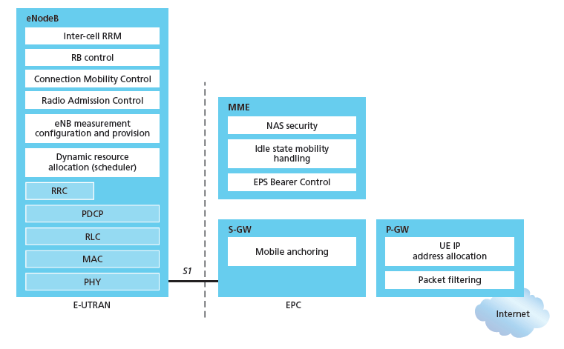
Functional split of major LTE components
handles idle/active UE transitions
pages UE
sets up eNodeB-PGW tunnel (aka bearer)
holds idle UE info
QoS enforcement

Slide 12
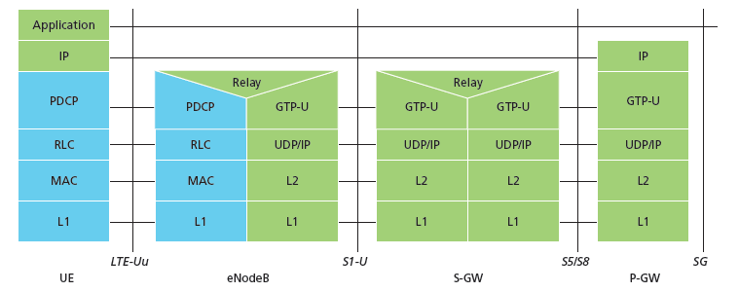
Radio+Tunneling: UE – eNodeB – PGW
IP packet from UE encapsulated in GPRS Tunneling Protocol (GTP) message at ENodeB
GTP message encapsulated in UDP, then encapsulated in IP. large IP packet addressed to SGW
G
G
UE
eNodeB
S-GW
P-GW
tunnel
link-layer radio net

Slide 13
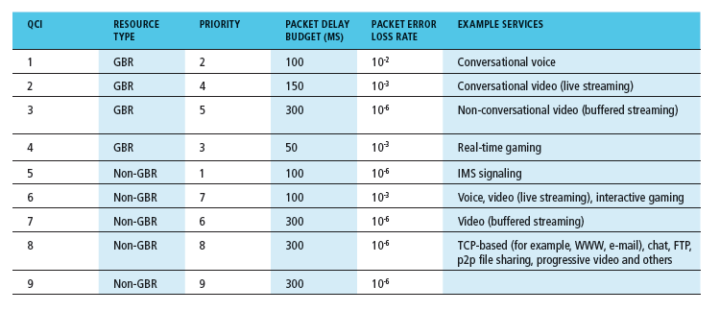
Quality of Service in LTE
QoS from eNodeB to SGW: min and max guaranteed bit rate
QoS in radio access network: one of 12 QCI values

Slide 14
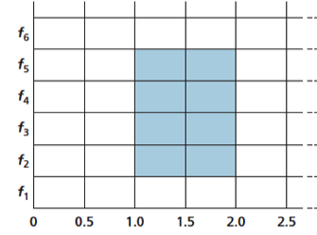
4G LTE – Long Term Evolution
Evolved packet core (EPC)
  All-IP core
  Both voice and data carried in datagrams
  Network control plane (e.g. mobility management)
  User data plane (e.g. data vs. voice)
LTE Radio Access Network (RAN)
  Flexible channel size 1.25MHz – 20MHz
  Advanced MAC (OFDM)
    Allocates slots and channels to users
    Slot reallocation every 1ms
  Rate adaptation through adaptive modulation and coding scheme (MSC)
  Multiple Input Multiple Output (MIMO) antenna technology
  At 20MHz channel: 100Mbps DL; 50Mbps UL
Frequency
Time, ms (0.5ms slot size)
Example OFDM allocation

Slide 15
In summary – cellular medium access
All generations of cellular networks (2G-5G) use channel partitioning for medium access
  Radio resources are divided both in frequency and time
Why is this good?
  Cellular networks are usually at capacity all the time
    No slots will be wasted
    Random access over long distances fails
  Cellular networks are inherently designed for tight centralized control (unlike Wi-Fi).

Slide 16
Mobility management

Slide 17
Various topics on mobility
Principles: addressing and routing to mobile users
Mobile IP
Handling mobility in cellular networks
Mobility and higher-layer protocols

Slide 18
Different notions of mobility
Physical mobility
  WiFi ←→ WiFi
  Cellular ←→ Cellular
  WiFi ←→ Cellular
Identity mobility
  Gmail on your mobile phone, tablet, laptop, desktop
Mobile infrastructure
  Moving base stations and access points
  COWs (Cell on Wheels) and CIABs (Cell in a Box)

Slide 19
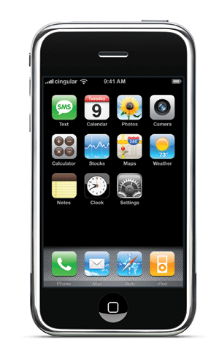
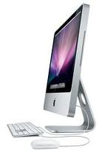
Our focus: Physical Mobility
Device attaches to a new attachment point

Slide 20
What is mobility?
spectrum of mobility, from the network perspective:
no mobility
high mobility
mobile wireless user,
using same access
point
mobile user, connecting/ disconnecting from network using DHCP.
mobile user, passing through multiple access point while maintaining ongoing connections (like cell phone)

Slide 21
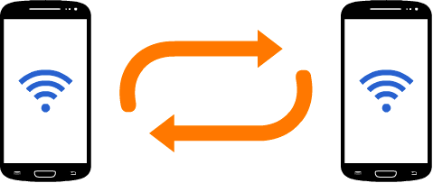
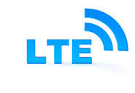
A thought experiment
What will happen at each of the TCP/IP layers in a hypothetical transition from a Wi-Fi to a Cellular network?
WiFi
Client
Server
P1
P2
Application
Time1: both phones same network
Trasnport
Network
WiFi
Cellular
DLL
Client
Server
PHY
P1
P2
Time2: phones in different networks

Slide 22
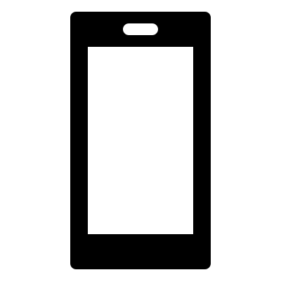


How does mobility affect user performance
Several abstractions of Internet use, depending on the scope
Application
Two communicating processes on physically-distant machines
Zoom meeting AV streaming
Underlying connectivity
The routers, links and protocols that establish communication
THE INTERNET

Slide 23
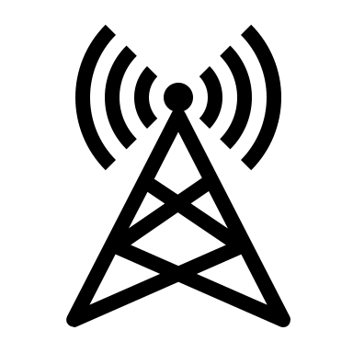
Mobility and application performance
Application
Two communicating processes on physically-distant machines
Zoom meeting AV streaming
Underlying connectivity
The routers, links and protocols that establish communication
THE INTERNET

Slide 24
Mobility and application performance
Application
Two communicating processes on physically-distant machines
Zoom meeting AV streaming
Underlying connectivity
The routers, links and protocols that establish communication
THE INTERNET

Slide 25

Mobility and application performance
Application
Two communicating processes on physically-distant machines
Zoom meeting AV streaming
Underlying connectivity
The routers, links and protocols that establish communication
THE INTERNET

Slide 26
Mobility and application performance
Application
Two communicating processes on physically-distant machines
Zoom meeting AV streaming
Underlying connectivity
The routers, links and protocols that establish communication
THE INTERNET

Slide 27
Supporting mobility
What does this mean?
Ideally, the application flow should not break as the mobile is moving from one cell to another.
Important both for cross-technology transitions (e.g. Wi-Fi <-> Cellular) and with mobility across base stations from the same network

Slide 28




Mobility: vocabulary
home network: permanent “home” of mobile
(e.g., 128.119.40/24)
home agent: entity that will perform mobility functions on behalf of mobile, when mobile is remote
wide area network
permanent address: address in home network, can always be used to reach mobile
e.g., 128.119.40.186

Slide 29
Mobility: more vocabulary
permanent address: remains constant (e.g., 128.119.40.186)
visited network: network in which mobile currently resides (e.g., 79.129.13/24)
care-of-address: address in visited network.
(e.g., 79,129.13.2)
wide area network
foreign agent: entity in visited network that performs mobility functions on behalf of mobile.
correspondent: wants to communicate with mobile

Slide 30

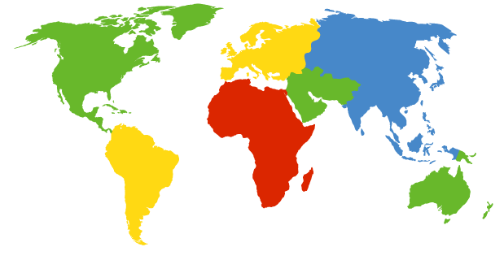

How do you contact a mobile friend:
Consider friend frequently changing addresses, how do you find her?
I wonder where Alice moved to?
search all phone books?
call her parents?
expect her to let you know where he/she is?

Slide 31
Mobility: approaches
let routing handle it: routers advertise permanent address of mobile-nodes-in-residence via usual routing table exchange.
  routing tables indicate where each mobile located
  no changes to end-systems
let end-systems handle it:
  indirect routing: communication from correspondent to mobile goes through home agent, then forwarded to remote
  direct routing: correspondent gets foreign address of mobile, sends directly to mobile
The “check all phone books in the world” approach.
The “check with her parents” approach.
The “expect her to let you know” approach.

Slide 32
Mobility: approaches
let routing handle it: routers advertise permanent address of mobile-nodes-in-residence via usual routing table exchange.
  routing tables indicate where each mobile located
  no changes to end-systems
let end-systems handle it:
  indirect routing: communication from correspondent to mobile goes through home agent, then forwarded to remote
  direct routing: correspondent gets foreign address of mobile, sends directly to mobile
Think about routing for a moment.
What needs to happen for a new prefix to be advertised to the rest of the world?

Slide 33
Mobility: approaches
let routing handle it: routers advertise permanent address of mobile-nodes-in-residence via usual routing table exchange.
  routing tables indicate where each mobile located
  no changes to end-systems
let end-systems handle it:
  indirect routing: communication from correspondent to mobile goes through home agent, then forwarded to remote
  direct routing: correspondent gets foreign address of mobile, sends directly to mobile
not
scalable
to millions of
mobiles
Notes:
Which one do you think is better?

Slide 34
Mobility: registration
visited network
home network
1
2
wide area network
mobile contacts foreign agent on entering visited network
foreign agent contacts home agent home: “this mobile is resident in my network”
end result:
foreign agent knows about mobile
home agent knows location of mobile

Slide 35

Mobility via indirect routing
foreign agent receives packets, forwards to mobile
home agent intercepts packets, forwards to foreign agent
visited
network
home
network
3
wide area network
2
1
correspondent addresses packets using home address of mobile
4
mobile replies directly to correspondent

Slide 36



Indirect Routing: comments
mobile uses two addresses:
  permanent address: used by correspondent (hence mobile location is transparent to correspondent)
  care-of-address: used by home agent to forward datagrams to mobile
foreign agent functions may be done by mobile itself
triangle routing: correspondent-home-network-mobile. Implications?
  inefficient when
  correspondent, mobile
  are in same network
  may cause path asymmetry

Slide 37
Indirect routing: moving between networks
suppose mobile user moves to another network
  registers with new foreign agent
  new foreign agent registers with home agent
  home agent update care-of-address for mobile
  packets continue to be forwarded to mobile (but with new care-of-address)
Question: will an ongoing session be interrupted as the mobile transitions from one network to another?
WiFi
Client
Server
P1
P2
Application
Time1: both phones same network
Trasnport
Network
WiFi
Cellular
DLL
Client
Server
PHY
P1
P2
Time2: phones in different networks

Slide 38
Indirect routing: moving between networks
suppose mobile user moves to another network
  registers with new foreign agent
  new foreign agent registers with home agent
  home agent update care-of-address for mobile
  packets continue to be forwarded to mobile (but with new care-of-address)
mobility, changing foreign networks transparent: ongoing connections can be maintained!
WiFi
Client
Server
P1
P2
Application
Time1: both phones same network
Trasnport
Network
WiFi
Cellular
DLL
Client
Server
PHY
P1
P2
Time2: phones in different networks

Slide 39


Mobility via direct routing
foreign agent receives packets, forwards to mobile
correspondent forwards to foreign agent
visited
network
home
network
3
1
2
4
correspondent requests, receives foreign address of mobile
mobile replies directly to correspondent

Slide 40




Mobility via direct routing: comments
overcome triangle routing problem
non-transparent to correspondent (i.e. correspondent has to do extra work): correspondent must get care-of-address from home agent
foreign address received once upon session initiation
  what if mobile changes visited network?
    Session interrupt
3
1
2
4

Slide 41


Accommodating mobility with direct routing
anchor foreign agent: FA in first visited network
data always routed first to anchor FA
when mobile moves: new FA arranges to have data forwarded from old FA (chaining)
foreign net visited
at session start
anchor
foreign
agent
wide area network
2
1
4
5
3
new
foreign
network
correspondent
agent
new foreign
agent
correspondent

Slide 42
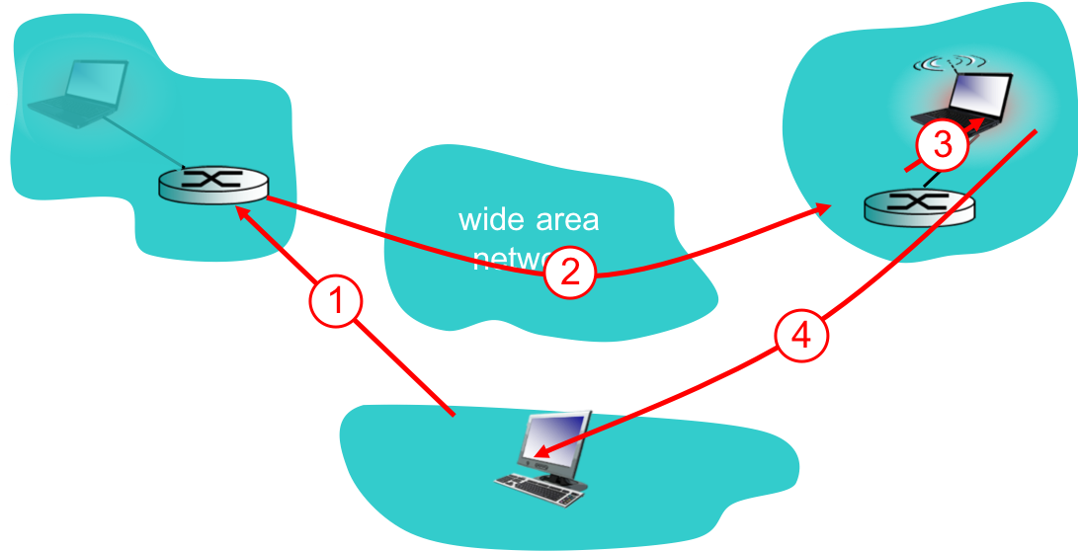
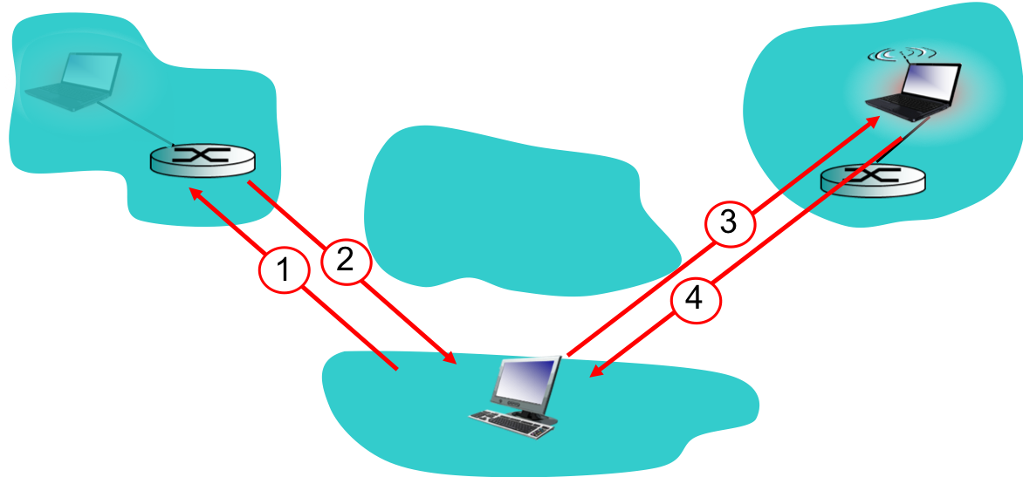
Direct vs. Indirect routing
Compare and contrast the effects of direct and indirect routing on transport layer performance.
  Hint: What is a key assumption of transport layer design regarding path symmetry?
Compare and contrast the effects of direct and indirect routing on control overhead; i.e. which one would require the exchange of more control messages to maintain the connection with mobility?
Compare and contrast the effects of direct and indirect routing on network architecture.
Compare and contrast the effects of direct and indirect routing on the complexity of the correspondent and the mobile.
For what kind of mobility scenarios would you prefer direct vs. indirect routing?
Group activity

Slide 43
Mobility in cellular networks

Slide 44
Components of cellular network architecture
recall:
correspondent
wired public telephone
network
MSC
MSC
MSC
MSC
MSC

Slide 45
Notions of mobility in cellular networks
correspondent
wired public telephone
network
MSC
MSC
Mobility within the same MSC
MSC
MSC
MSC
Mobility across MSCs of the same provider
Mobility across cellular networks,
operated by different providers

Slide 46
Handling mobility in cellular networks
home network: network of cellular provider you subscribe to (e.g., Sprint PCS, Verizon)
  home location register (HLR): database in home network containing permanent cell phone #, profile information (services, preferences, billing), information about current location (could be in another network)
visited network: network in which mobile currently resides
  visitor location register (VLR): database with entry for each user currently in network

Slide 47
GSM: indirect routing to mobile
HLR
home
network
2
correspondent
home
Mobile
Switching
Center
home MSC consults HLR,
gets roaming number of
mobile in visited network
1
call routed
to home network
3
Public switched
telephone
network
VLR
Mobile
Switching
Center
4
home MSC sets up 2nd leg of call
to MSC in visited network
mobile
user
MSC in visited network completes
call through base station to mobile
visited
network

Slide 48
GSM: handoff with common MSC
handoff goal: route call via new base station (without interruption)
reasons for handoff:
  stronger signal to/from new BSS (continuing connectivity, less battery drain)
  load balance: free up channel in current BSS
  GSM doesnt mandate why to perform handoff (policy), only how (mechanism)
handoff initiated by old BSS
VLR
Mobile
Switching
Center
old
routing
new
routing
old BSS
new BSS

Slide 49
GSM: handoff with common MSC
1. old BSS informs MSC of impending handoff, provides list of 1⁺ new BSSs
2. MSC sets up path (allocates resources) to new BSS
3. new BSS allocates radio channel for use by mobile
4. new BSS signals MSC, old BSS: ready
5. old BSS tells mobile: perform handoff to new BSS
6. mobile, new BSS signal to activate new channel
7. mobile signals via new BSS to MSC: handoff complete. MSC reroutes call
8 MSC-old-BSS resources released
VLR
Mobile
Switching
Center
4
2
1
8
7
3
old BSS
5
6
new BSS

Slide 50
GSM: handoff between MSCs
anchor MSC: first MSC visited during call
  call remains routed through anchor MSC
new MSCs add on to end of MSC chain as mobile moves to new MSC
optional path minimization step to shorten multi-MSC chain
home network
correspondent
Home MSC
anchor MSC
PSTN
MSC
MSC
MSC
(a) before handoff

Slide 51
GSM: handoff between MSCs
anchor MSC: first MSC visited during call
  call remains routed through anchor MSC
new MSCs add on to end of MSC chain as mobile moves to new MSC
optional path minimization step to shorten multi-MSC chain
home network
correspondent
Home MSC
anchor MSC
PSTN
MSC
MSC
MSC
(b) after handoff

Slide 52
Some reflections on mobility support
WiFi support of mobility
Cellular support of mobility

Slide 53
Cellular MAC

Slide 54
Cellular vs. Wi-Fi
Range
Mobility
Data rates
Cost
1-5km
High (e.g. 100mph train)
3G – 16Mbps
4G – 100Mbps
High
Cellular
10-100m
Low (e.g. slow walking)
802.11a/b/g – 54Mbps
802.11n/ac – 300Mbps-1Gbps
Moderate-Low
802.11 WiFi
What MAC schemes are appropriate to support these?
Notes:
TDD/FDD/TDD+FDD for celllular
Random access for WiFi

Slide 55
Cellular vs. Wi-Fi
Range
Mobility
Data rates
Cost
1-5km
High (e.g. 100mph train)
3G – 16Mbps
4G – 100Mbps
High
TDD/FDD/
Combined
(i.e. channel partitioning)
Cellular
10-100m
Low (e.g. slow walking)
802.11a/b/g – 54Mbps
802.11n/ac – 300Mbps-1Gbps
Moderate-Low
CSMA/CA
(i.e. random access)
802.11 WiFi
Why?
Notes:
TDD/FDD/TDD+FDD for celllular
Random access for WiFi

Slide 56
A thought exercise: why random access doesn’t work for cellular?
CSMA/CA for cellular networks -- 1-5km range
  How does CSMA/CA work?
    Listen before talk (consider links are half-duplex, power asymmetries and hidden terminal issues)
  What would happen if you try to speak CSMA/CA over long distances?
    Hidden terminal exacerbated (signals have to travel longer distances)
  What would happen if you try to speak CSMA/CA while moving fast?
    You might miss other’s transmissions or channel reservation (RTS/CTS)
  What would happen if you try to speak CSMA/CA while all other users are also moving?
    The above issue further exacerbated.

Slide 57
Cellular networks: the first hop
Two techniques for sharing mobile-to-BS radio spectrum
combined FDMA/TDMA: divide spectrum in frequency channels, divide each channel into time slots
CDMA: code division multiple access
time slots
frequency
bands

Slide 58
The future of wireless

Slide 59
The tipping point
From network-enabled applications to application-driven networks
The applications
(bandwidth-hungry, latency-intolerant)
The
researcher
The researcher
The network
The network
(trailing behind)
The application
network-enabled applications
application-driven networks

Slide 60
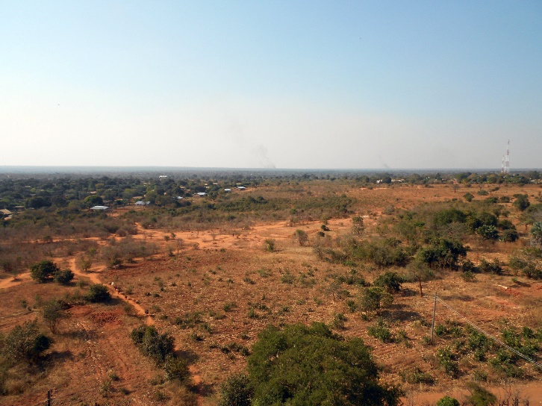
Examples of driving applications
Augmented/Virtual reality
  high-volume, low-latency
Internet of Things
  billions of connected devices
Inclusiveness

Slide 61
An example of a driving app: Virtual Reality
Input of many sensor
On-body
Environment
Processing/rendering on a dedicated unit
Connectivity for sensors to communicate with processing/rendering unit

Slide 62
An example of a driving app
[The Climb, CRYTEK]

Slide 63
Ideal VR
Visual quality
Responsiveness
Mobility
[MobiCom’16 David Chu, Google]

Slide 64
Networks of the future: Requirements
Low-latency
  Highly-efficient protocols for data transmission
High-throughput
  Very high capacity of the medium
Seamless user mobility
  Support of VR in a fast-moving car or train
Equally cater to heterogeneous applications
  Human-generated and IoT-generated traffic
Designed for inclusiveness
  Rural, post-disaster, displaced
Highly-capable
Application-driven
Use-case-driven

Slide 65
The ambition of 5G: Increased scope, Transformed performance
Unlimited experience
  >10Gbps peak data rates
  100Mbps whenever needed
  X100 more traffic over 10 years
Instant action
  <1ms
  Ultra-reliable <10⁻⁵ E2E outage
  ZERO mobility interruption
“For everything”
  1,000,000 devices/km²
  Ultra-low cost
  10 years on battery
[Nokia talk at MobiCom16]

Slide 66
What would the 5G connected device look like
Heterogeneous device capabilities and requirements
  Battery life
  Charge-ability
  Emit power capabilities
  Capacity requirements
  Delay tolerance

Slide 67
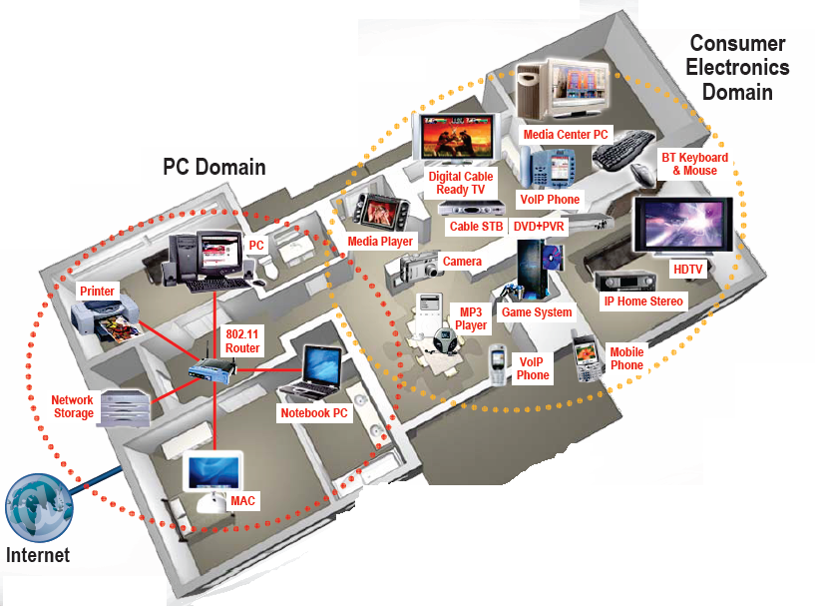

What would the 5G infrastructure look like
No gaps, ubiquitous coverage
Next-generation Cellular
Wireless Internet Access
Wireless Multimedia
Sensor Networks
Smart Homes/Spaces
Automated Highways
In-Body Networks
All this and more …
[Andrea Goldsmith, MIT 5G days]

Slide 68
Enablers for increased wireless data rates
More spectrum
  New bands – mmWave, THz
  Spectrum reuse
Novel radio architectures -- e.g. full duplex radios
(Massive) MIMO
  Harness diversity and multiplexing for improved capacity
  Challenges
    Measuring channel performance
    Computational challenges with multiple antenna input/output
Innovation in cellular system design
  Beyond the PHY/MAC, what can we do with the architecture
Software-defined wireless networking
Efficient multihoming

Slide 69
As easy as more spectrum…

Slide 70

Traditional spectrum access
Channel 6: 2.437GHz, 20MHz width

Slide 71

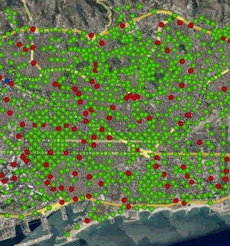
But…
Wireless network deployments become more and more dense
User demand grows rapidly
Number of wireless devices per user grows as well
Wireless access points in Barcelona used for municipal access.

Slide 72
“Sorry America: your wireless airwaves are full*”
* CNN Money, Feb 2012

Slide 73
Dynamic Spectrum Access
DSA for more efficient spectrum use

Slide 74
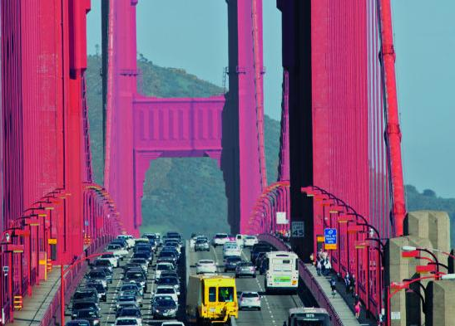
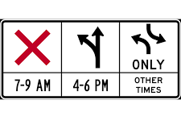
A Road Traffic Analogy
Reversible traffic lanes

Slide 75
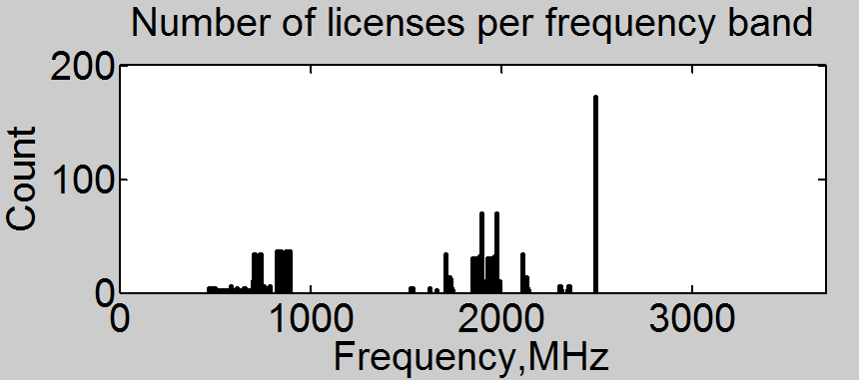
Traditional spectrum access
FM
VHF/UHF
Cellular
Satellite
Military
Cellular
Spectrum allocation
Spectrum assignment
(InmarSat, Verizon, AT&T, NPR)
Spectrum use
According to FCC dashboard:
  A total of 2498MHz (77.3%) appear unassigned.
  Assignments are granted to 88 unique entities in Washington.
  50% of all licenses are owned by 10 companies.
Broadband
and
Educational
Radio Services
(BRS and EBS)
PCS Cellular
1700-2200MHz
Cellular 628-960MHz
Cellular 698-902MHz
UHF TV
Source: http://www.fcc.gov/developers/spectrum-dashboard-api

Slide 76

Traditional spectrum access
FM
VHF/UHF
Cellular
Satellite
Military
Cellular
Spectrum allocation
Spectrum assignment
(InmarSat, Verizon, AT&T, NPR)
Spectrum use
According to FCC dashboard:
  A total of 2498MHz (77.3%) appear unassigned.
  Assignments are granted to 88 unique entities in Washington.
  50% of all licenses are owned by 10 companies.
Source: http://www.fcc.gov/developers/spectrum-dashboard-api
Artificial spectrum scarcity

Slide 77
Dynamic Spectrum Access (DSA)
FM
VHF/UHF
Cellular
Satellite
Military
Cellular
Spectrum allocation
Spectrum assignment
(InmarSat, Verizon, AT&T, NPR)
Spectrum use
According to FCC dashboard:
  A total of 2498MHz (77.3%) appear unassigned.
  Assignments are granted to 88 unique entities in Washington.
  50% of all licenses are owned by 10 companies.
Source: http://www.fcc.gov/developers/spectrum-dashboard-api
Artificial spectrum scarcity → DSA

Slide 78
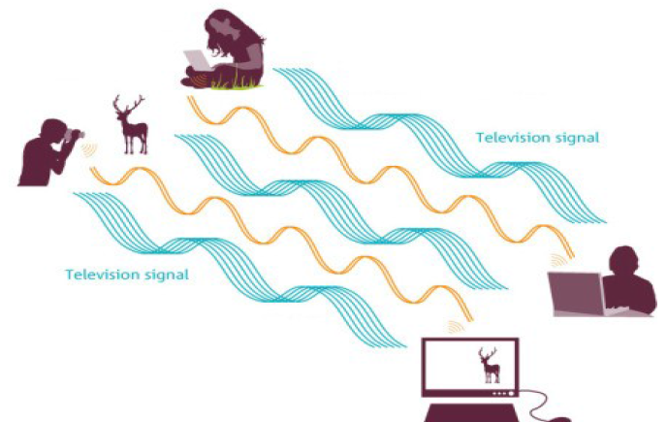
Key Terms
Dynamic Spectrum Access
Cognitive Radio == Software-Defined Radio == Agile Radio
Primary users (incumbents, licensed users)
Secondary users (unlicensed users)
Primary Users
Secondary Users

Slide 79
Can we reuse Wi-Fi/LTE, as is, for DSA?

Slide 80

Conventional vs. DSA
The case for Wi-Fi
Fixed channel width (e.g. 20, 40, 80, 160MHz)
Operation in predetermined (ISM) bands only
Frequency
Frequency
Time
Time

Slide 81
Conventional vs. DSA
Frequency
Frequency
Time
Time
Spectrum occupied by licensed (primary) user
Spectrum for secondary communication

Slide 82
Key challenges in Dynamic Spectrum Access
Where to operate?
How to make frequency decisions?
Devices are agile. How do I make sure I am not under wireless attack?
How to measure and adapt to channel conditions?
Mandates detailed understanding of spectrum use in time, frequency and space and
at the granularity of individual transmitter.
How to detect rogue spectrum activity?
What is a meaningful detection of spectrum activity?
How to regulate spectrum for DSA?

Slide 83
DSA is becoming a commercial technology
... and its success has as much to do with technology as it does with policy

Slide 84
Dynamic spectrum access technologies you can buy
DSA in TV White Spaces
  Reuse the white spaces in television bands 500-700MHz
  Set up Internet networks on channels that are unused
  Primary and secondary users
  Problem: no guarantees (at least not with the current policy model). Secondary Internet users might not get access if the TV stations make a come back.
Carlson Wireless, Redline Communications, Adaptrum, 6 Harmonics…

Slide 85
Dynamic spectrum access technologies you can buy
DSA in Citizen Broadband Radio Services (CBRS)
  Three-tier user types
    Primary users: satellite ground stations and Navy radars (protected by exclusion zones)
    Priority licensees – fixed fraction of the band for licensed use
    General access – another portion of the band available for unlicensed use
  No licensees means more room for general access. Great for rural ISPs.
  LTE-U (LTE in unlicensed bands) projected as a part of 5G

Slide 86
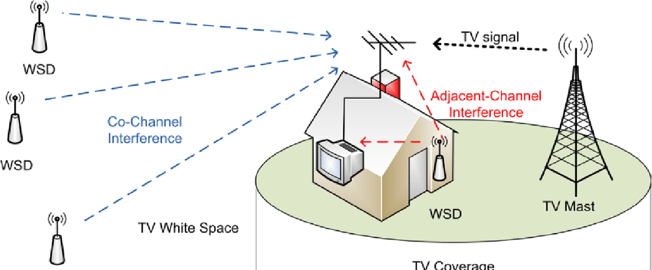
TV White Spaces

Slide 87
TV White Spaces

Slide 88
TV White Spaces
TVWS Database

Slide 89
TV White Spaces medium access control
Projected to cover tens of miles with a single base station.
Which MAC scheme (channel partitioning or random access) do you think is appropriate?
Two MAC schemes for TVWS
  802.22 – channel partitioning
  802.11af – random access

Slide 90
802.22 vs 802.11af
802.22
802.11af
CSMA/CA Figure credit: Jardosh et. al IMC’05

Slide 91
What makes 802.11af possible
UHF bands (400-700MHz) as opposed to ISM (2.4 or 5GHz)
  Propagates farther; goes around obstacles
Higher transmit power possible
Devices are predominantly stationary; not the case in WiFi

Slide 92
In conclusion
Wireless broadband communications – a critical enabler
Physical resources to sustain our networks are increasingly limited
  New spectrum bands for wireless
    TVWS, CBRS, Satellite mega-constellations (Starlink)
    Better technology to use the existing spectrum
  Synergy between policy and technology will be required to move forward
Broadband communications are not the only user of the radio spectrum
  Scientific and environmental applications

