Slide 1
Local Cellular Network Services in Remote Areas
Mariya Zheleva
Department of Computer Science
University of California Santa Barbara

Slide 2
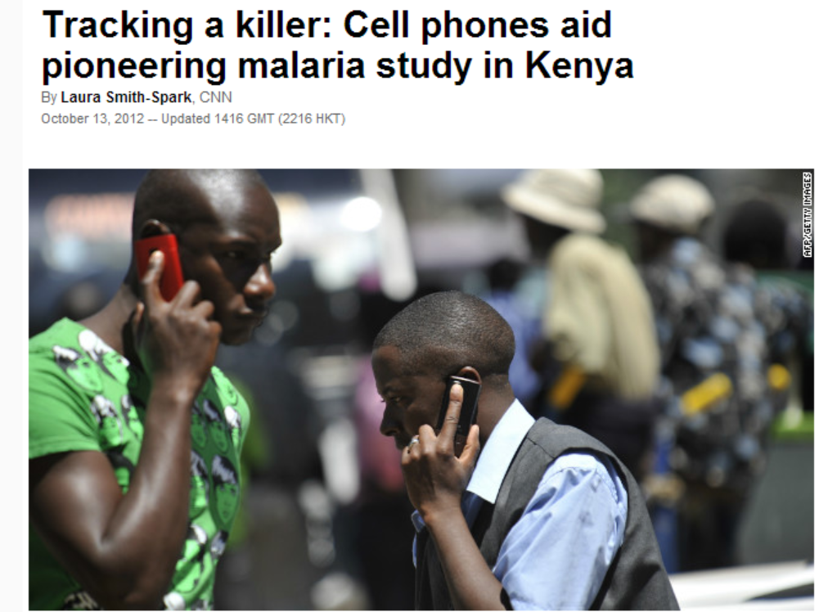
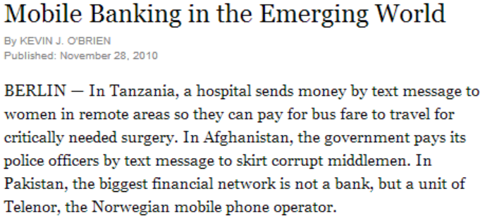
The Cellular Revolution

Slide 3
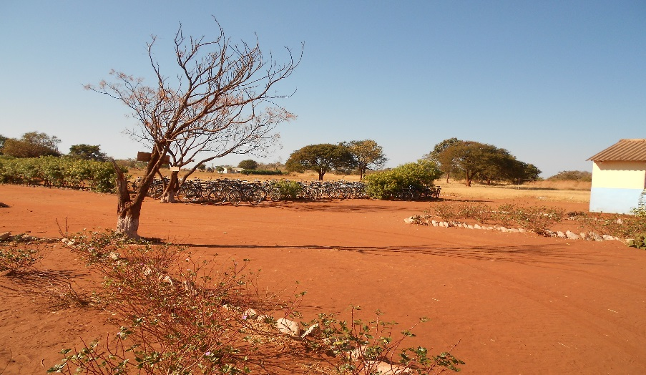
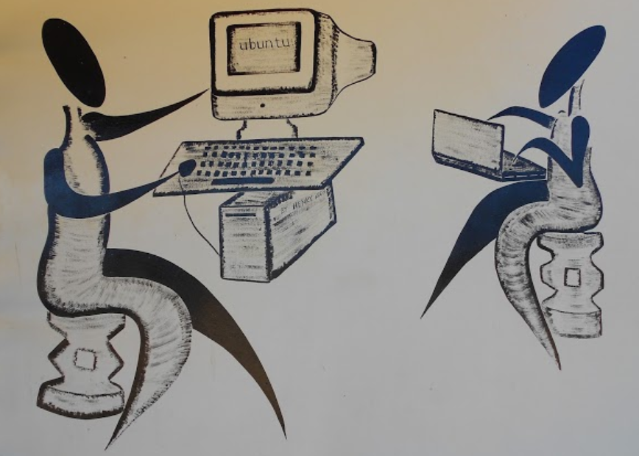
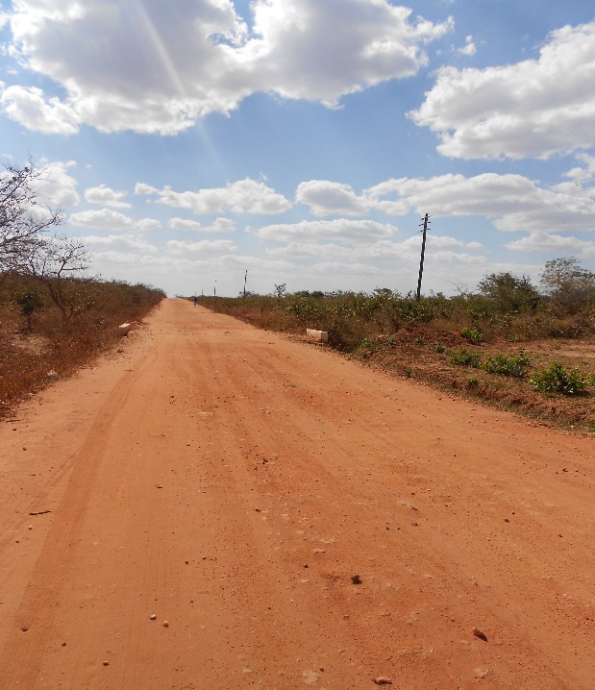
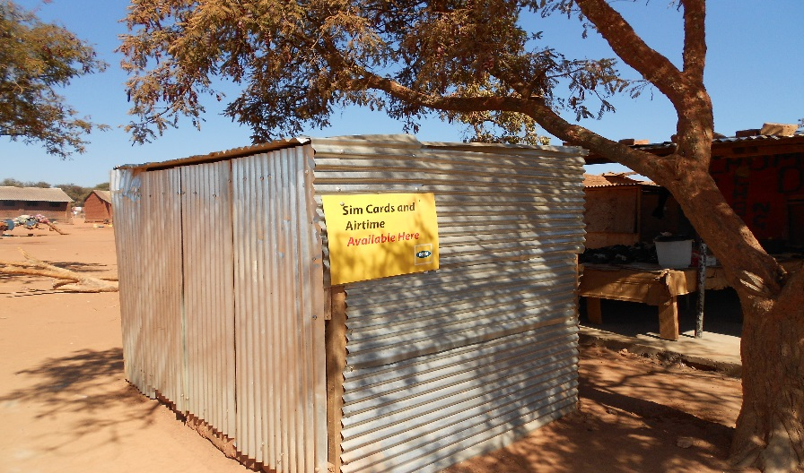
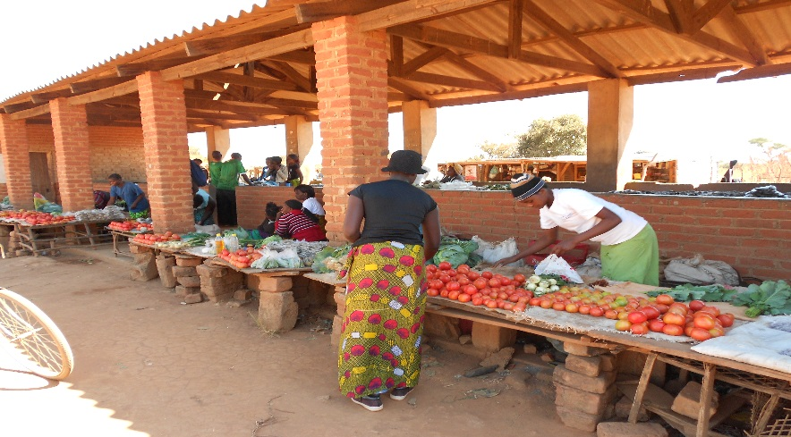
The Cellular Revolution

Slide 4
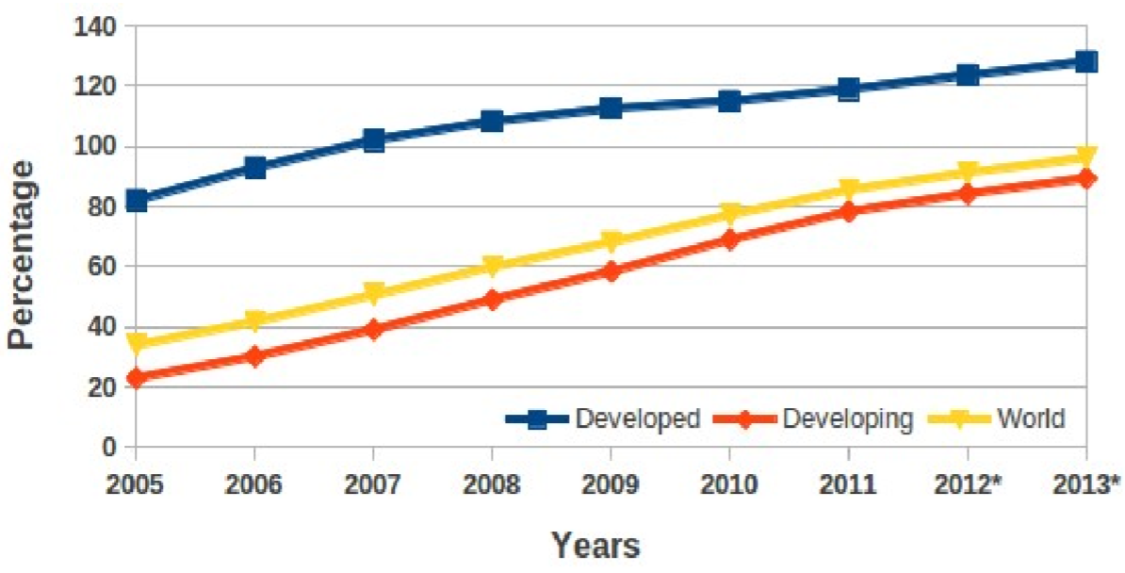
Mobile Cellular Subscriptions
Source: ITU
* Estimates

Slide 5
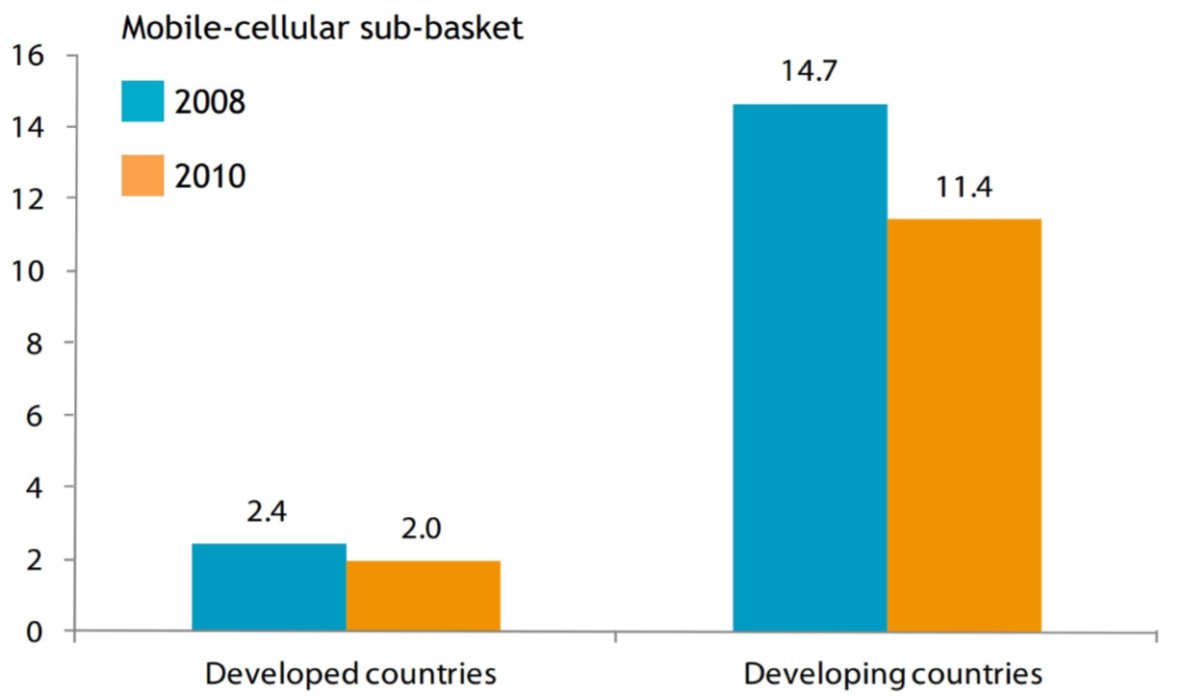
Affordability and Accessibility
Source: ITU

Slide 6
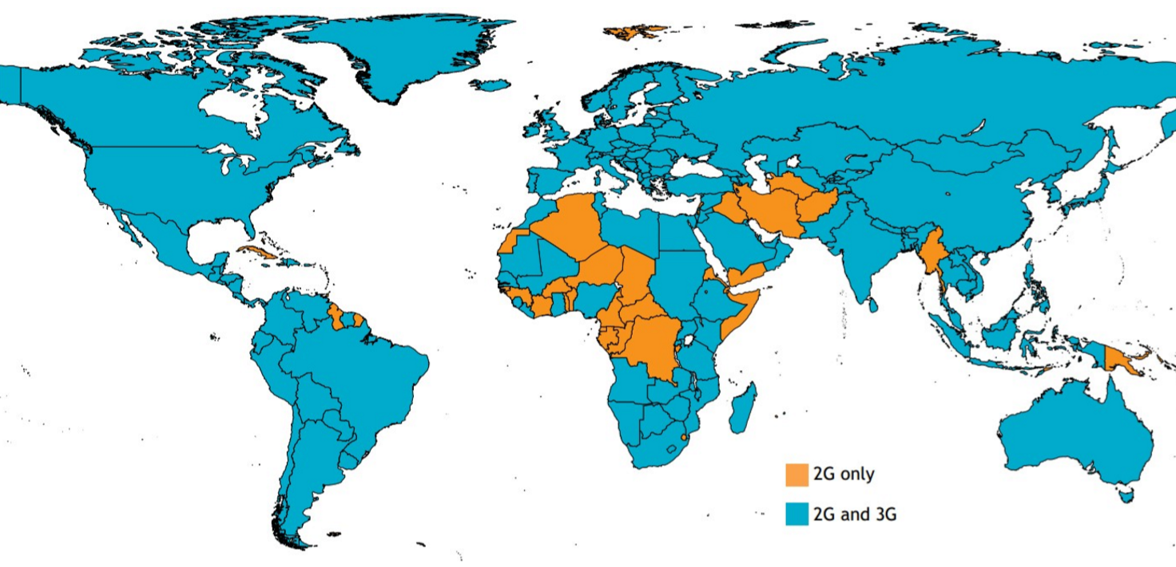
Affordability and Accessibility

Slide 7
“Mobile network operators find it commercially infeasible to operate in rural areas.”
World Bank’s 2012 report
on maximizing mobile

Slide 8
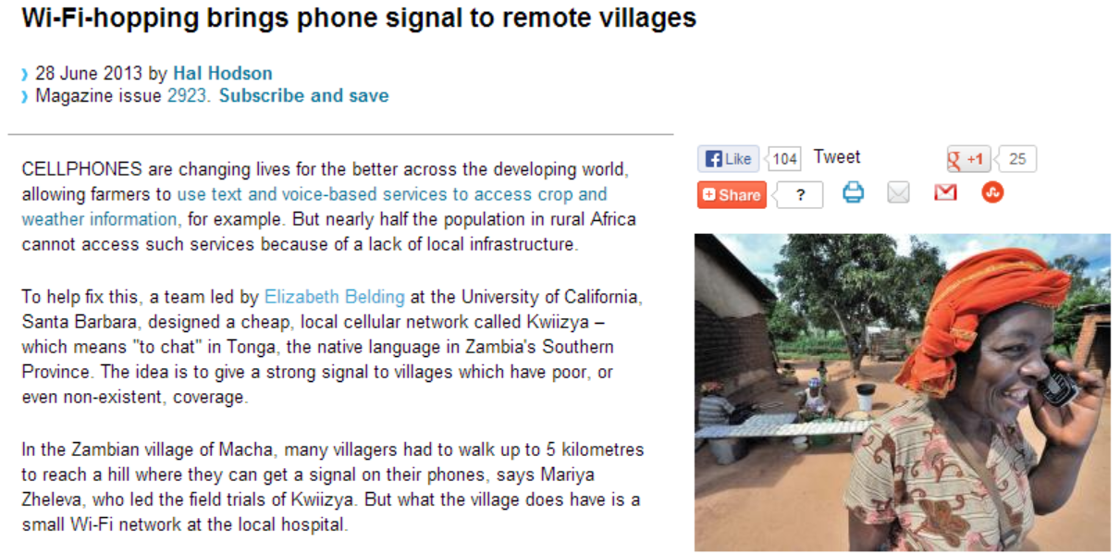
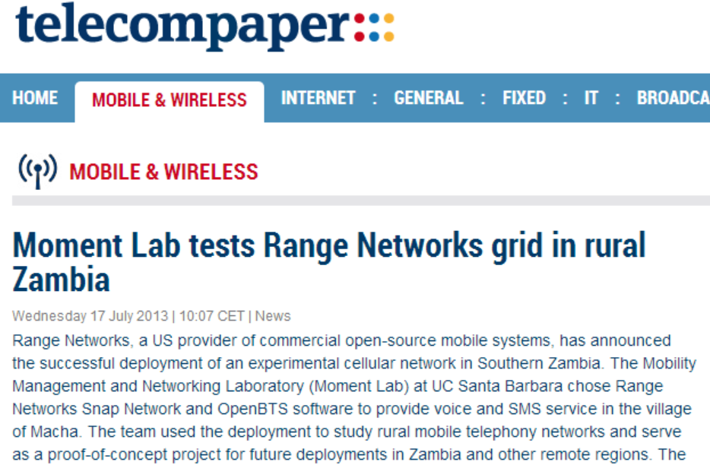
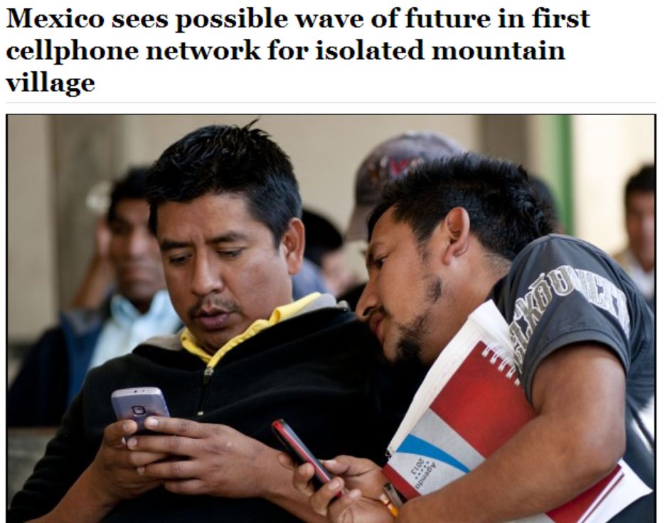
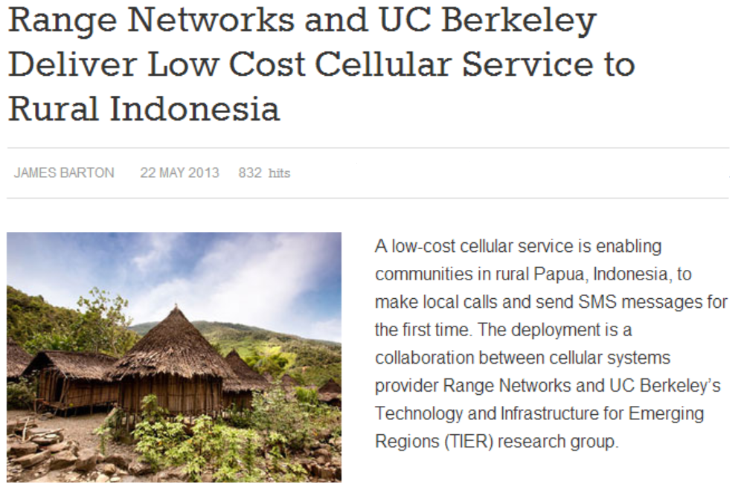
Alternatives to Commercial Networks

Slide 9
Bringing Visibility to Rural Users
December 1, 2011
April 1, 2012
Orange in Cote D’Ivoire
Antenna-to-Antenna communication
Aggregate # calls/hour
+ AfriPop
population density dataset
Aggregate duration of calls/hour
+ OECD typology
Antenna ID
Latitude
Longitude
Antenna ID
Latitude
Longitude
< 150/km2 – Rural
150 – 300/km2 – Suburban
> 300/km2 – Urban
[Zheleva, Schmitt, Vigil, Belding, ICTD 2013]

Slide 10
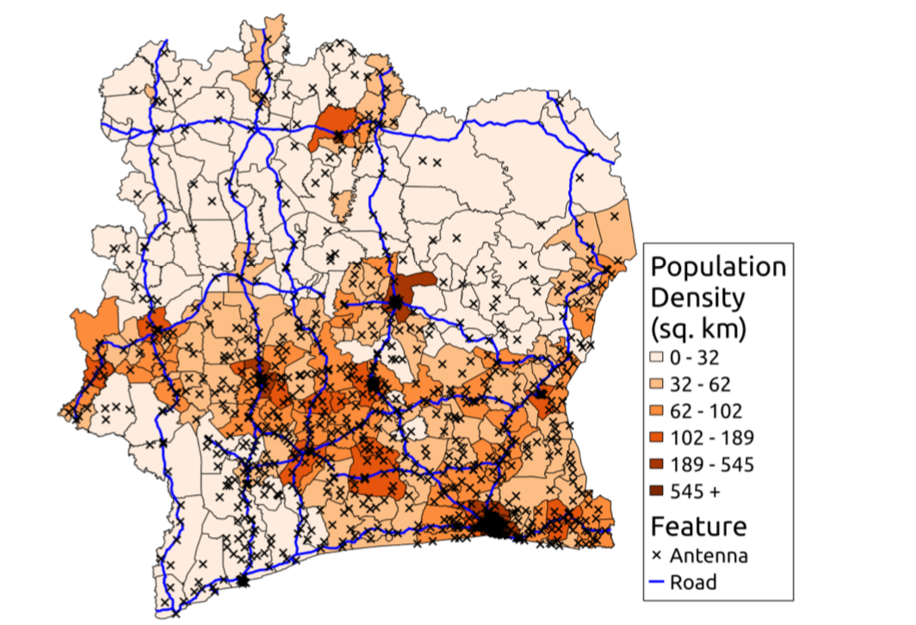
Bringing Visibility to Rural Users
98% Rural territory
2% Urban territory
[Zheleva, Schmitt, Vigil, Belding, ICTD 2013]

Slide 11
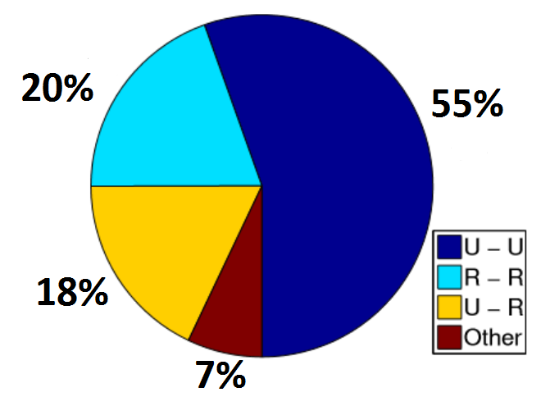
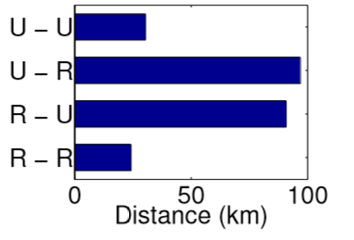
Bringing Visibility to Rural Users
55% of activity is between
urban users and another
18% involves urban users
Same type calls within
close proximity.
[Zheleva, Schmitt, Vigil, Belding, ICTD 2013]

Slide 12
Bringing Visibility to Rural Users
51.7%
Rural antennas associated with
Transportation

Slide 13
Bringing Visibility to Rural Users
Average call duration
decreased
from 95.5 seconds to 84.8 seconds.
Average distance
decreased
from 22.4 km to 13.4 km.
[Zheleva, Schmitt, Vigil, Belding, ICTD 2013]

Slide 14
Bringing Visibility to Rural Users
Mobile cellular services are expensive.
Prepaid is prevalent.
Improve the situation by providing alternatives.
Rural users are under-provisioned.
High locality of interest.

Slide 15
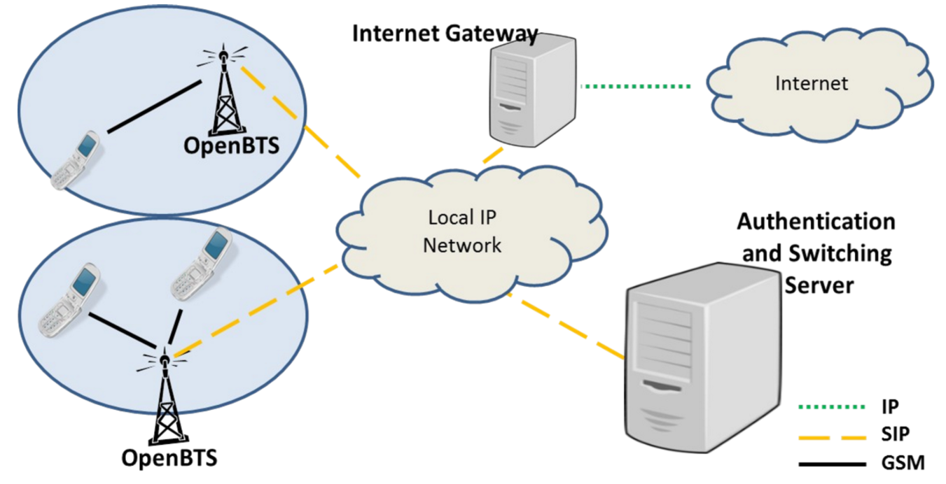
Kwiizya*: Architecture
* Kwiizya means
“to chat” in Tonga
[Zheleva, Paul, Johnson, Belding, MobiSys 2013]

Slide 16
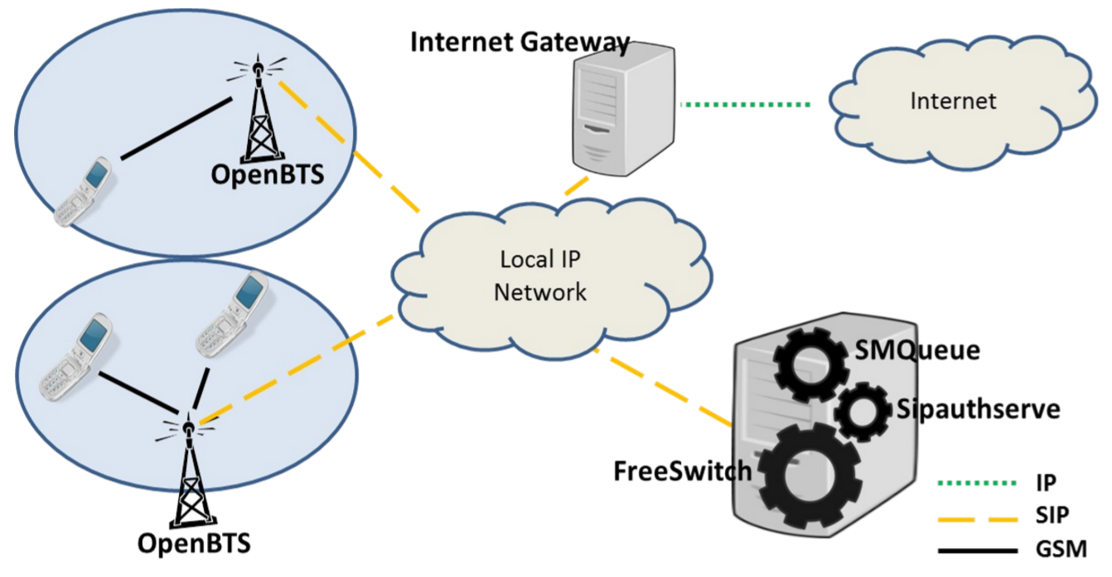
Kwiizya: Architecture
[Zheleva, Paul, Johnson, Belding, MobiSys 2013]

Slide 17
Kwiizya: Call Switching
[Zheleva, Paul, Johnson, Belding, MobiSys 2013]

Slide 18
Kwiizya: SMS Switching
[Zheleva, Paul, Johnson, Belding, MobiSys 2013]

Slide 19
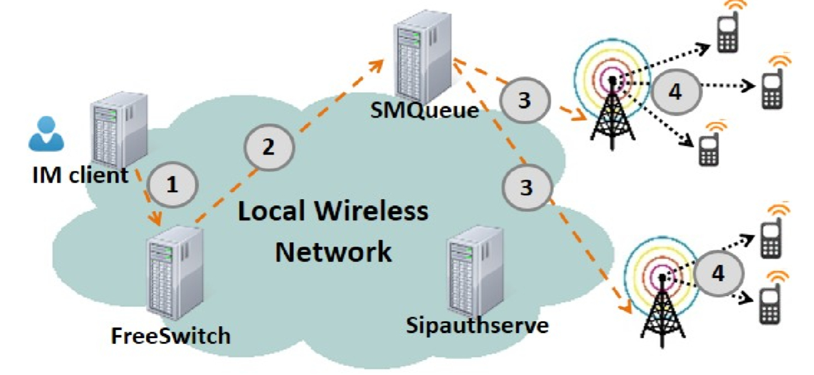
Support of SMS Applications (IM-SMS)
[Zheleva, Paul, Johnson, Belding, MobiSys 2013]

Slide 20
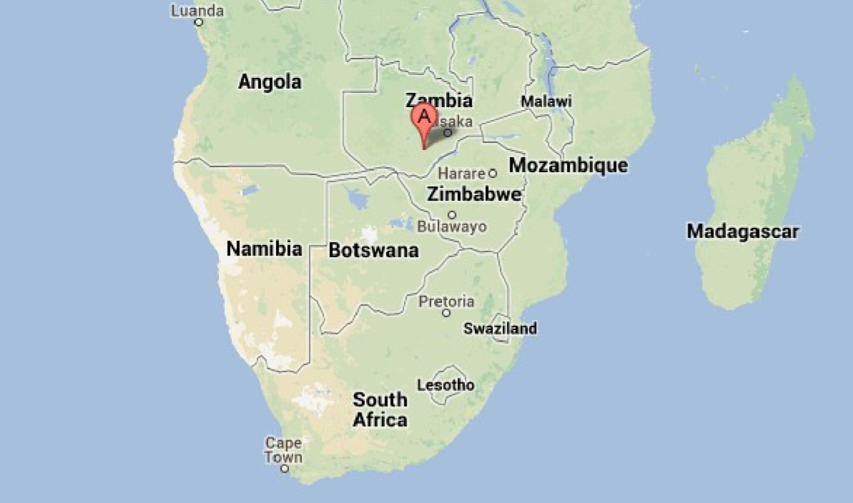
Macha, Zambia
Source: GoogleMaps
[Zheleva, Paul, Johnson, Belding, MobiSys 2013]

Slide 21
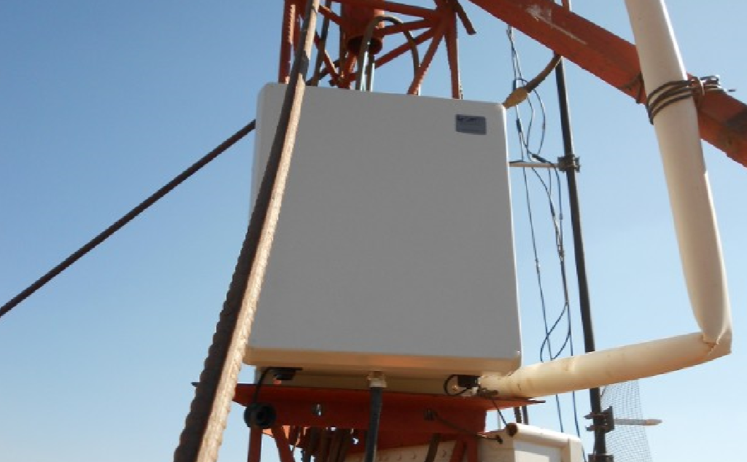
The Base Station
A RangeNetworks
SNAP unit
[Zheleva, Paul, Johnson, Belding, MobiSys 2013]

Slide 22
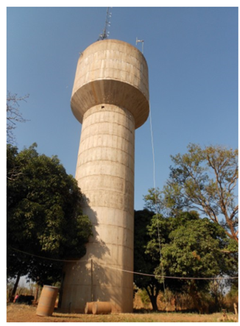
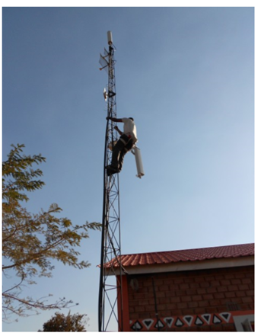
Installation Sites
Water Tower
LITA
[Zheleva, Paul, Johnson, Belding, MobiSys 2013]

Slide 23
Power Quality in Macha
[Zheleva, Paul, Johnson, Belding, MobiSys 2013]

Slide 24
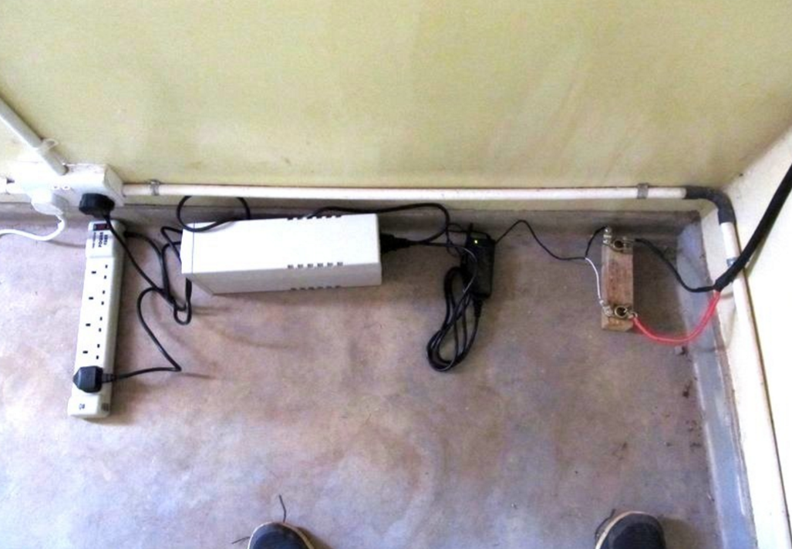
The Power Supply
[Zheleva, Paul, Johnson, Belding, MobiSys 2013]

Slide 25
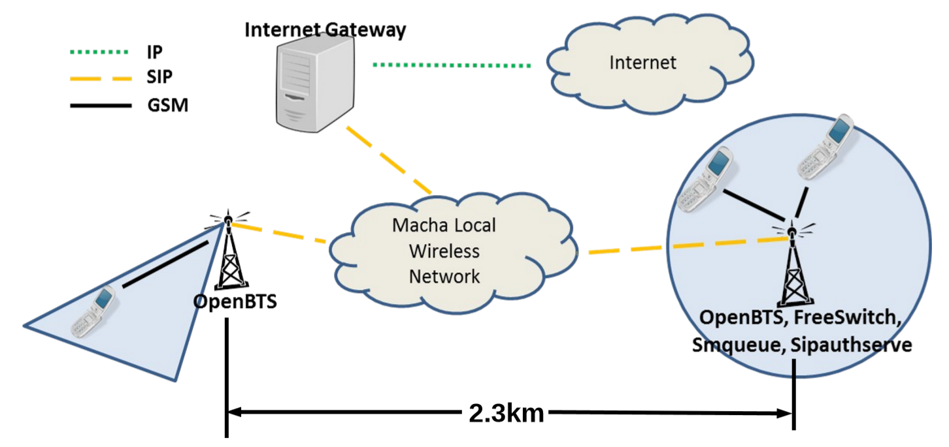
The Network in Macha
[Zheleva, Paul, Johnson, Belding, MobiSys 2013]

Slide 26
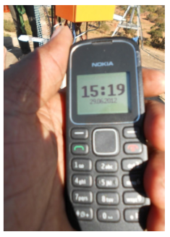
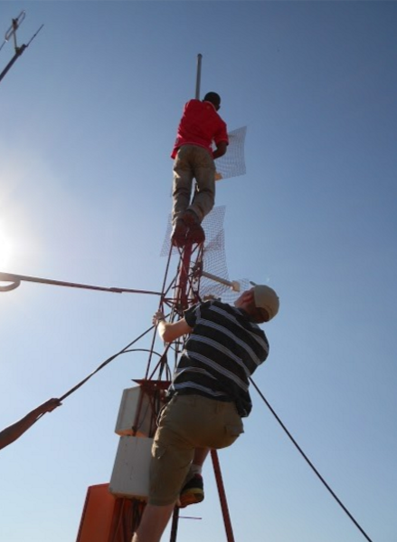
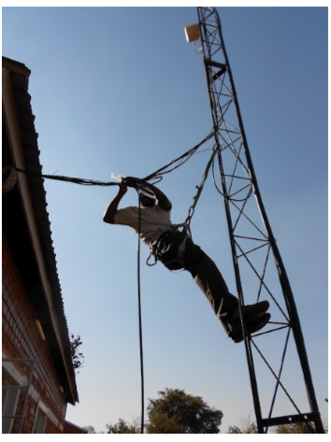
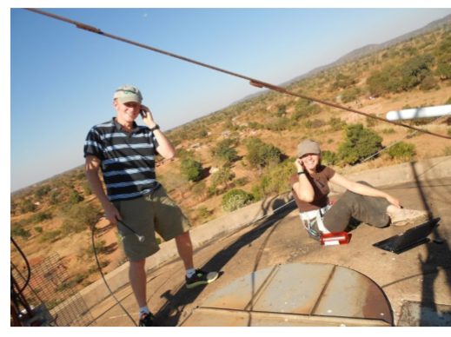
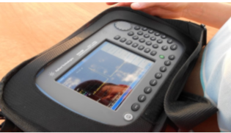
Evaluation
20 SIM cards
Local partners (IT staff)
Restricted registration
Voice and SMS
[Zheleva, Paul, Johnson, Belding, MobiSys 2013]

Slide 27
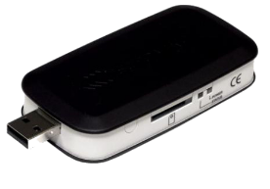
Controlled Experiments Setup
[Zheleva, Paul, Johnson, Belding, MobiSys 2013]

Slide 28
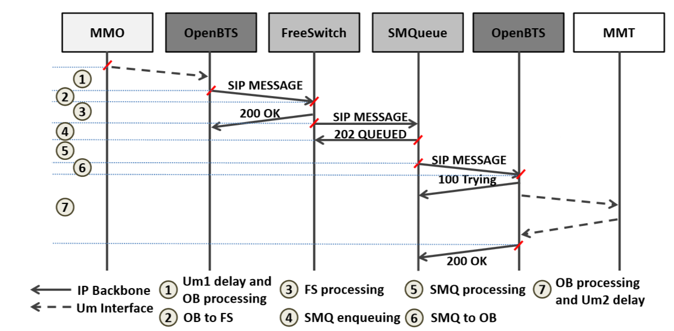
Performance: SMS Delay
[Zheleva, Paul, Johnson, Belding, MobiSys 2013]

Slide 29
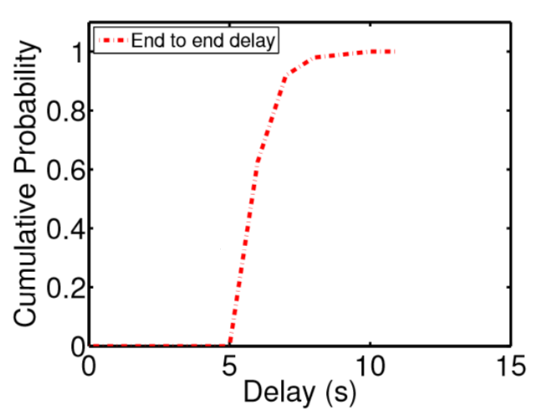
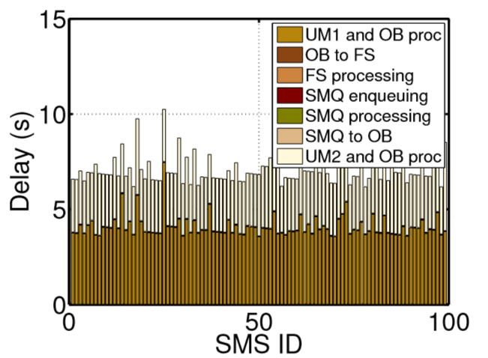
Performance: SMS Delay
SMS delivery in Tanzania takes between
6 and 16 seconds depending on provider.
[Zheleva, Paul, Johnson, Belding, MobiSys 2013]

Slide 30
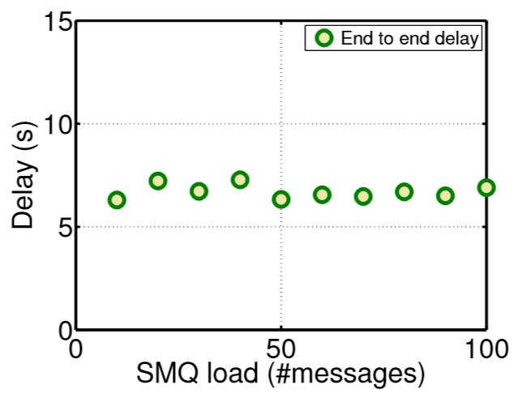
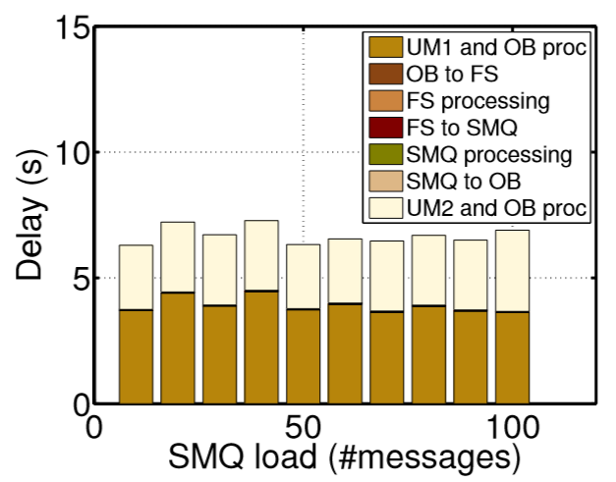
Performance: SMS Delay with Load
[Zheleva, Paul, Johnson, Belding, MobiSys 2013]

Slide 31
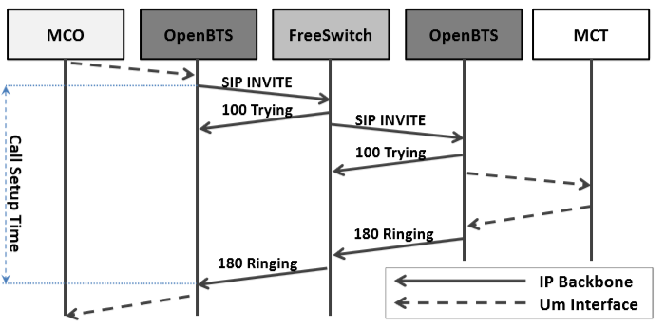
Performance: Call Setup
[Zheleva, Paul, Johnson, Belding, MobiSys 2013]

Slide 32
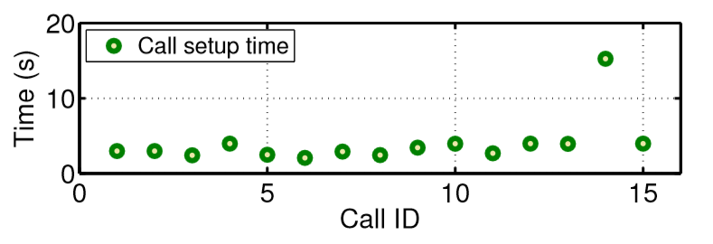
Performance: Call Setup
[Zheleva, Paul, Johnson, Belding, MobiSys 2013]

Slide 33
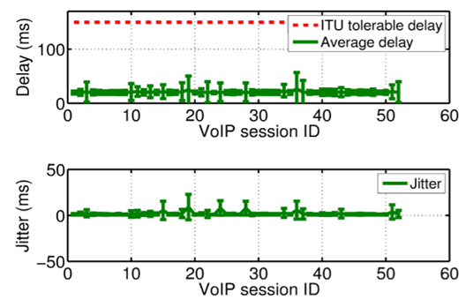
Performance: Call Quality
GSM FR (6.10)
Min delay 20ms
GSM FR (6.10)
Max MOS 3.46
[Zheleva, Paul, Johnson, Belding, MobiSys 2013]

Slide 34
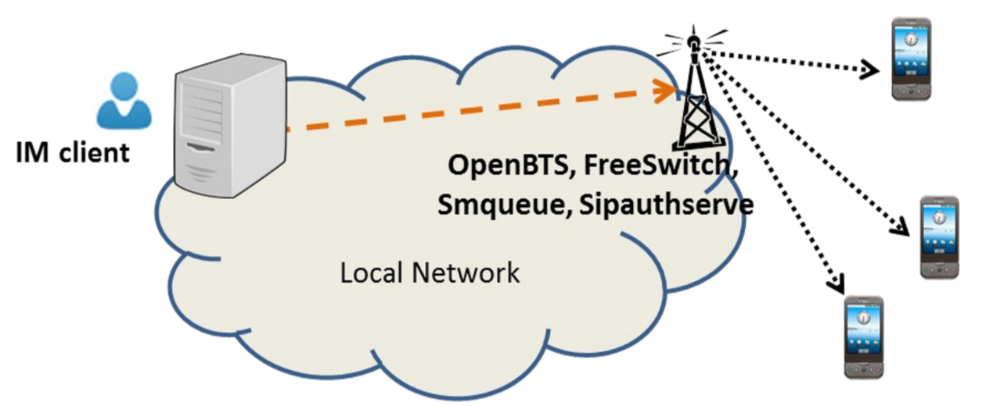
Performance: IM to SMS
[Zheleva, Paul, Johnson, Belding, MobiSys 2013]

Slide 35
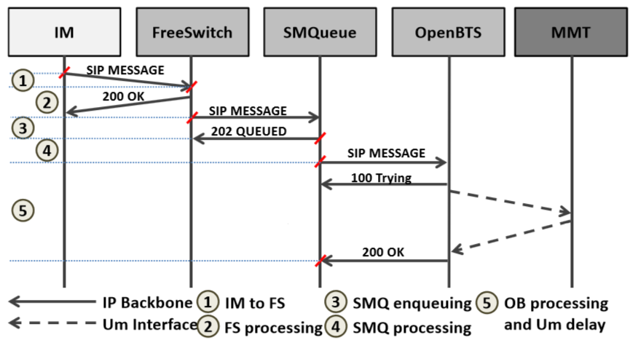
Performance: IM to SMS
[Zheleva, Paul, Johnson, Belding, MobiSys 2013]

Slide 36
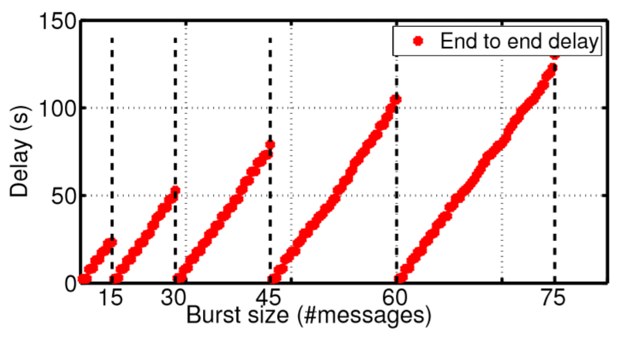
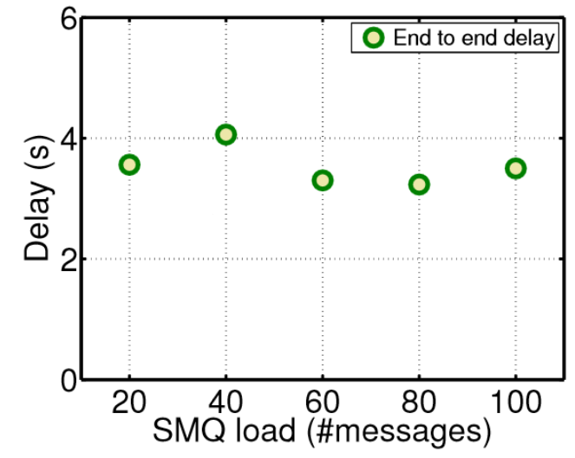
Performance: IM to SMS
[Zheleva, Paul, Johnson, Belding, MobiSys 2013]

Slide 37
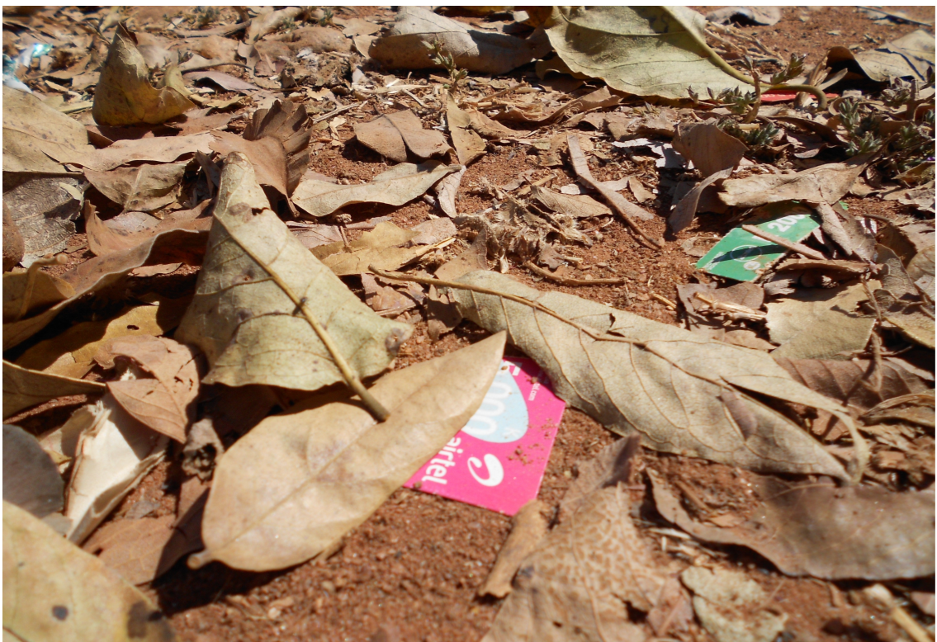
* The trash in front of a store in Macha is comprised of used talk-time vouchers.

Slide 38
Factors for Success
Economic
Technology
Licensing

Slide 39
Video
Edited by
Abigail Hinsman
Film and Media Studies, UCSB
and
Mariya Zheleva
Computer Science, UCSB
Interviews by
Prof. Lisa Parks
Film and Media Studies, UCSB

Slide 40
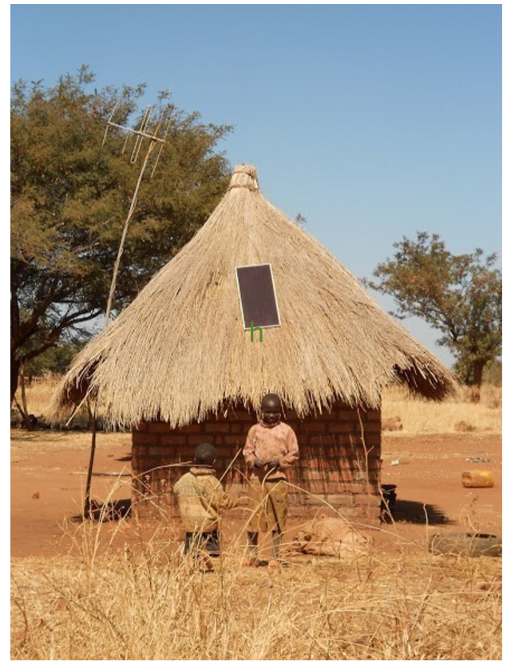
Thank you.
Mariya Zheleva
mariya@cs.ucsb.edu
Find out more at:
http://moment.cs.ucsb.edu
Acknowledgements:
LinkNet
Range Networks
NSF
Bill and Melinda Gates Foundation
Orange
Veljko Pejovic

