Slide 1
Modular Wireless Networks for Infrastructurally-Challenged Environments
PhD Proposal Talk
Mariya Zheleva
PhD Advisor:
Committee Members:
Professor Elizabeth Belding, UCSB
Professor Heather Zheng, UCSB
Professor Ben Zhao, UCSB
Ranveer Chandra, Microsoft Research

Slide 2
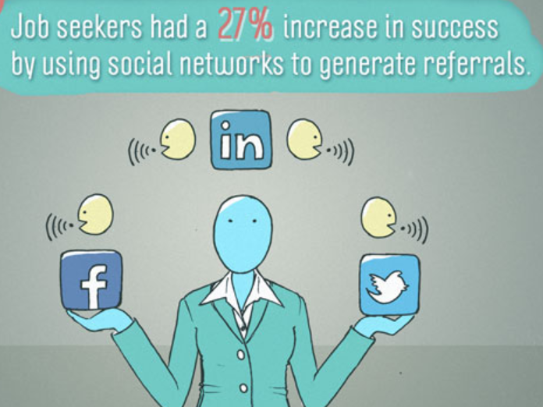
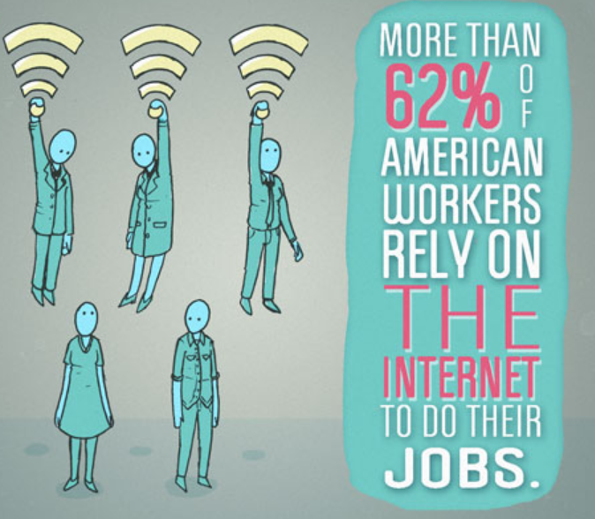
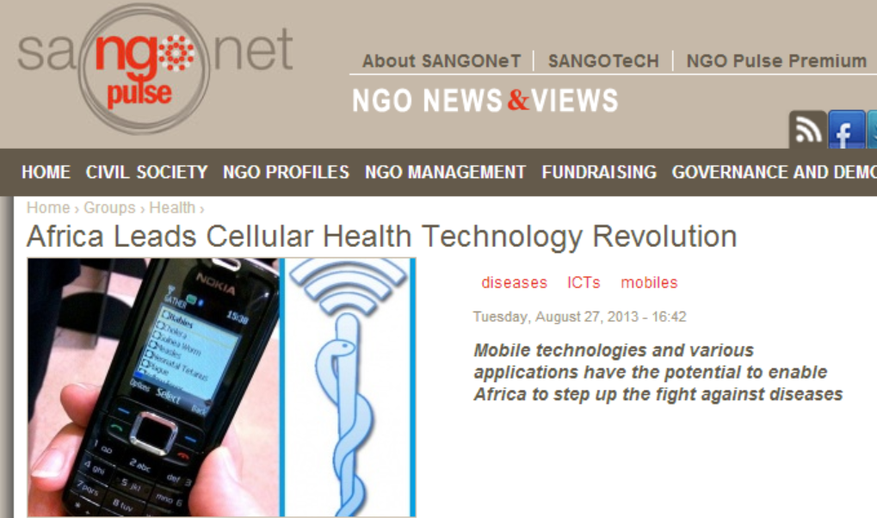
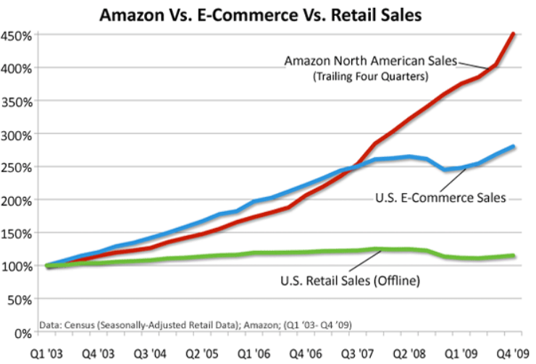
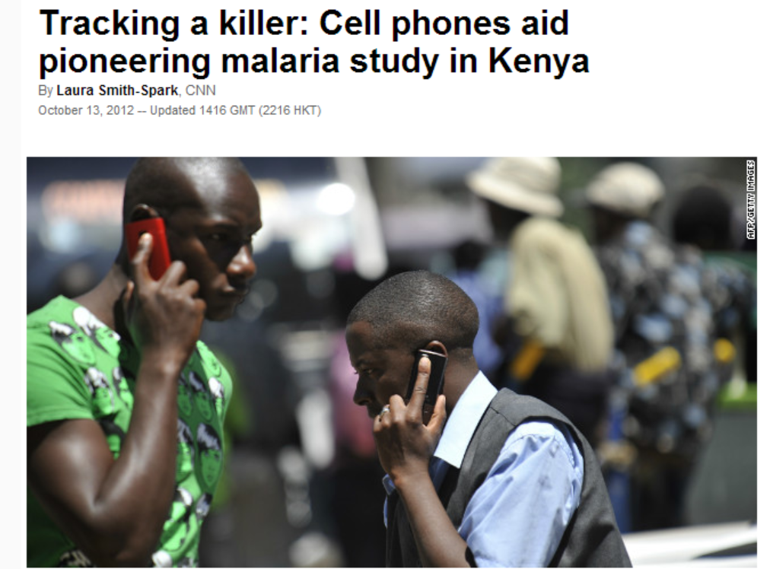
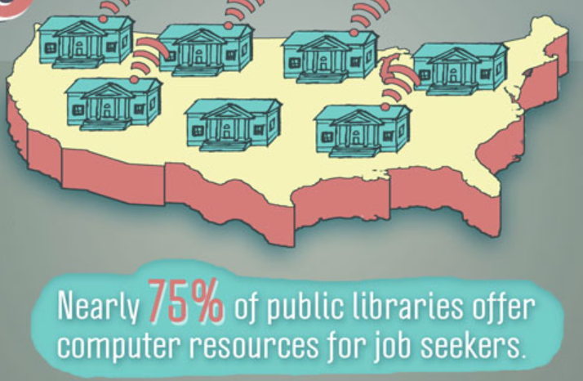
Connectivity as an Enabler
Economic growth
High-quality workforce
Improved job-search
Purchasing ability
Education
Online education
Remote tutoring
Healthcare
Disease spread
prediction
[Silicon Alley Insider]
[internetinnovation.org]

Slide 3
Affordability and Accessibility
An African may pay 39 times more than a Westerner for Internet access.
Source: ITU

Slide 4
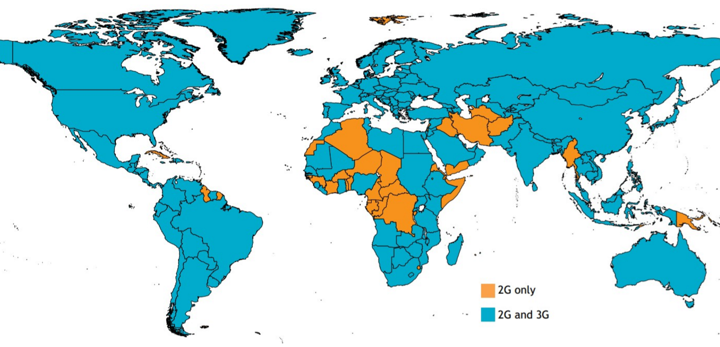
Affordability and Accessibility
Source: ITU

Slide 5
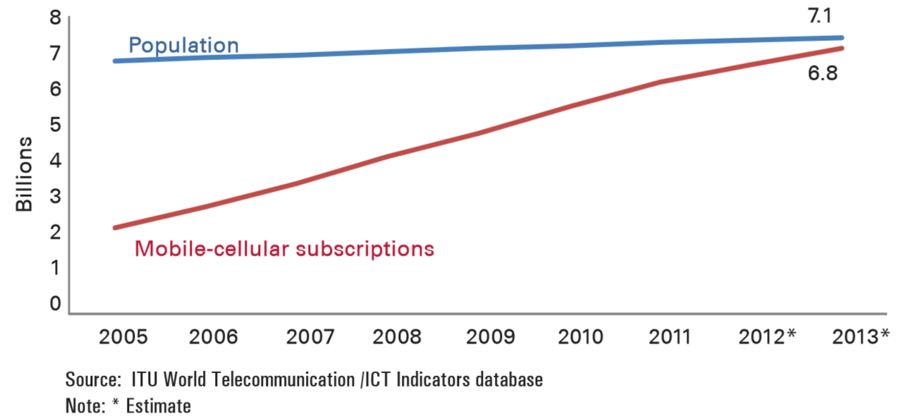
Subscription Trends
Plain Cellular
Mobile subscriptions approach the world population
Developing world subscription stats do not capture the number of people with access
People carry multiple SIM cards
Pricing
Coverage availability

Slide 6
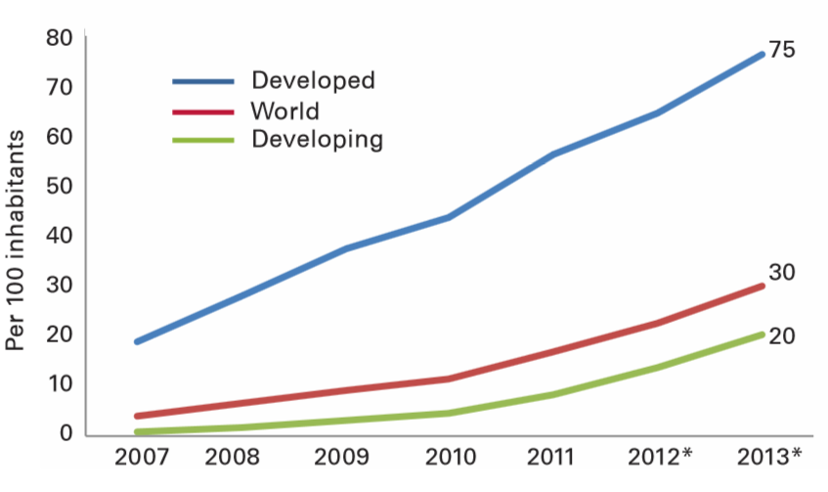
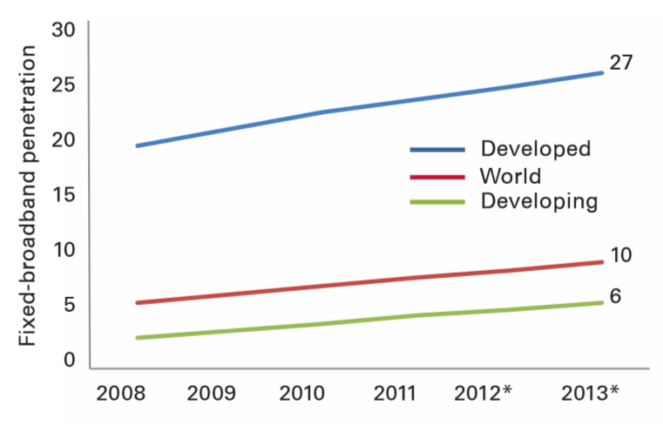
Subscription Trends
Broadband access is still very limited.
Broadband
Mobile-based
Computer-based

Slide 7
“Mobile network operators find it commercially infeasible to operate in rural areas.”
World Bank’s 2012 report
on maximizing mobile

Slide 8
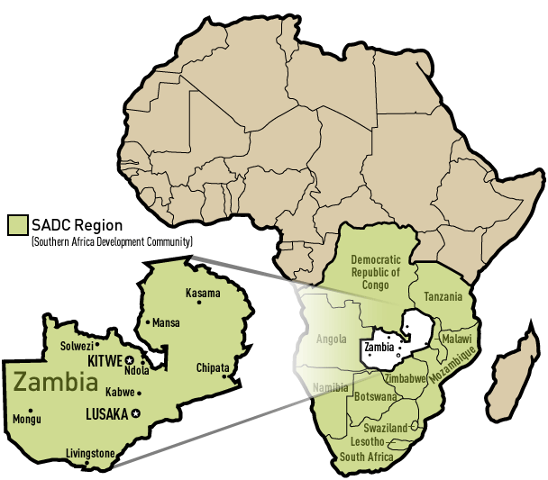
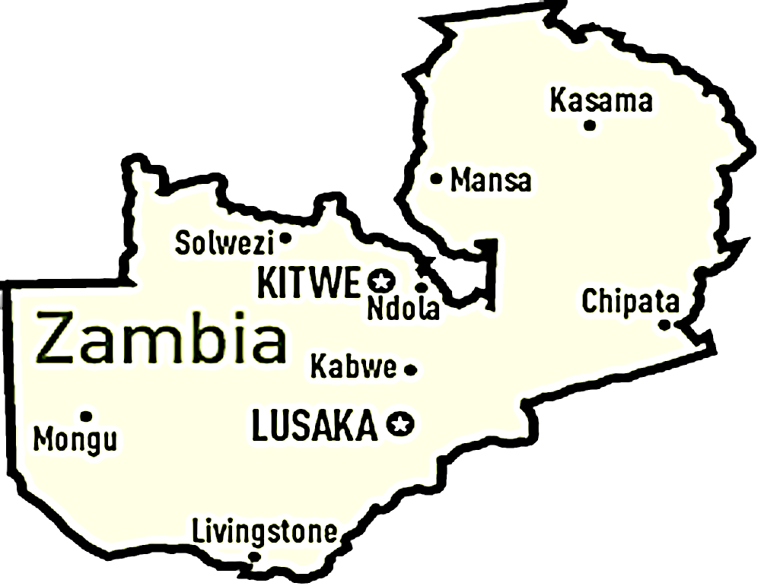
Why Commercially-Infeasible?

Slide 9
What if the call could be local?

Slide 10
Thesis Statement
In order to optimize user experience, rural networks and applications need to be highly modular and use this modularity to switch between global and local context according to network conditions and demand.
In order to optimize user experience, rural networks and applications need to be highly modular and use this modularity to switch between global and local context according to network conditions and demand.
In order to optimize user experience, rural networks and applications need to be highly modular and use this modularity to switch between global and local context according to network conditions and demand.

Slide 11
Sociological Approach
(interviews)
Technological Approach
Internet usage [IJoC12]
Cellular network
traces analysis
Internet traffic
analysis
Enabling network
performance analysis
Identifying
challenges
Bringing visibility to rural users [ICTD13]
Cellphone usage [MobiSys13]
Bringing visibility to rural users [ICTD13]
The bandwidth divide [IJoC12]
AirLab [SIGCOMM CCR11]
The increased bandwidth fallacy [ACM DEV13] and WiP
Cellphones in healthcare [GSWC12]
Community detection in cellular [ICTD13]
The increased bandwidth fallacy [ACM DEV13] and WiP
Connectivity
Applications
PHY/MAC Layer
Application Layer
ImmuNet [GSWC12]
Long distance
Last mile
Connectivity
solutions
VillageLink [COMSNETS14]
Kwiizya [MobiSys13]
Kwiizya [MobiSys13]
TxMiner
WiP
Completed
In progress
HybridCell
WiP
*WiP – Work in Progress

Slide 12
Identifying Challenges

Slide 13
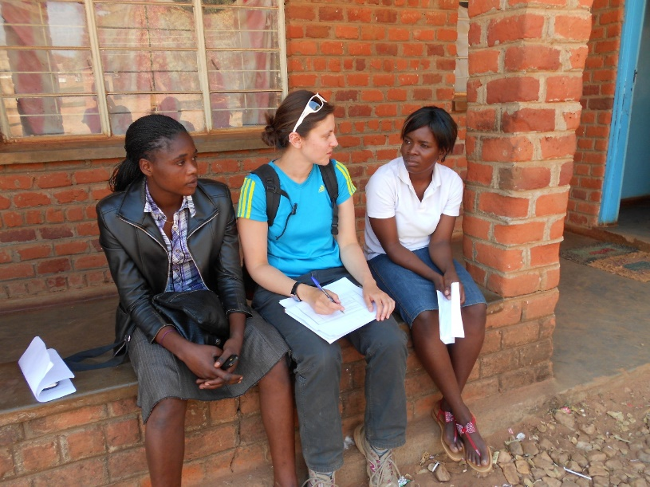
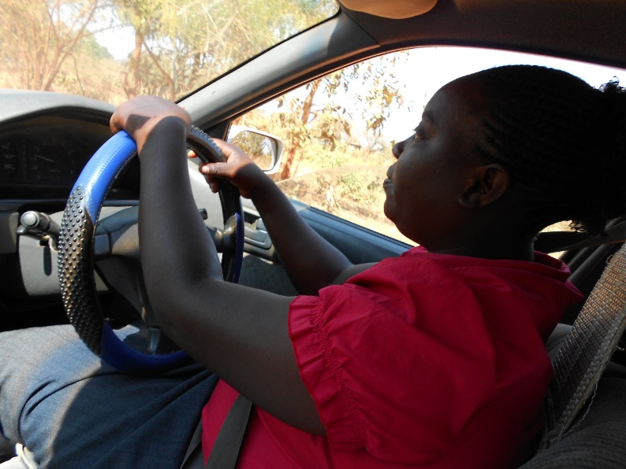
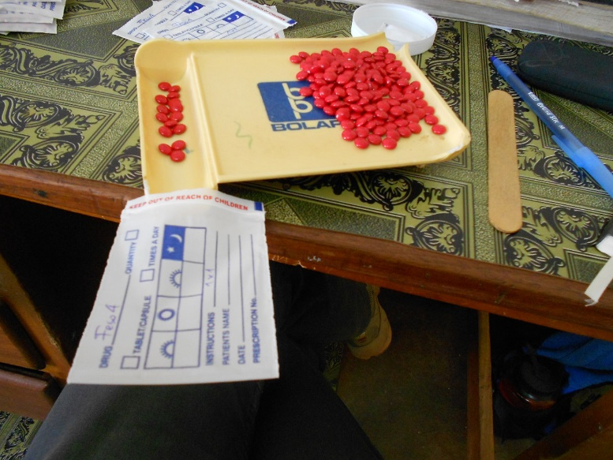
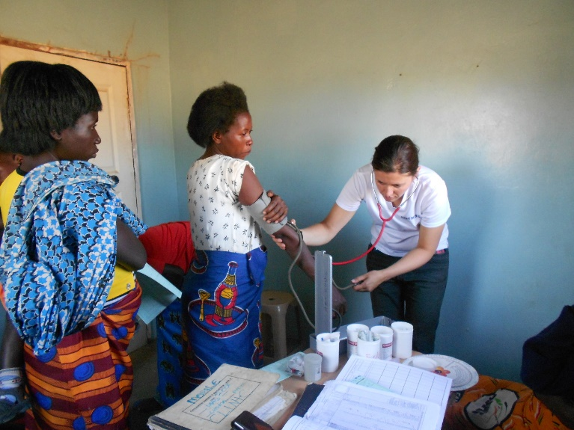
Methodology: Sociological Approach
Goal:
Understand cellphone usage
Cellphones in healthcare
Methodology:
In-person interviews
Volunteer at the hospital in Macha

Slide 14
Methodology: Technological Approach
Goal:
Cellphones (rural vs. urban) :
Usage
Provisioning
Community detection
Internet:
Usage
Performance
Avenues for improvement
Methodology:
Cellular: Analysis of large-scale datasets
Internet: Rural network traffic analysis
Antenna-to-
antenna
statistics
Egocentric
graphs over
time

Slide 15
Identifying Challenges: Internet Usage

Slide 16
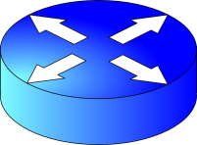
Network Architecture
Pre-upgrade
DL: 256kbps (bursting to 1Mbps)
UL: 64kbps
Switch
Gateway
Macha WLAN
Internet
Monitoring
Server
2Mbps
Post-upgrade
Switch
Gateway
Macha WLAN
Internet
Monitoring
Server
[Zheleva, Schmitt,
Vigil, Belding, ACM DEV 2013]

Slide 17
Background of Analysis
Pre
Post
Long-Term (LT)
time
April 9th, 2011
March 9th – April 9th, 2011
April 9th – May 9th, 2011
July, 2011
While bandwidth increase may improve network usability,
it is not proportional to improved user experience.
[Zheleva, Schmitt,
Vigil, Belding, ACM DEV 2013]

Slide 18
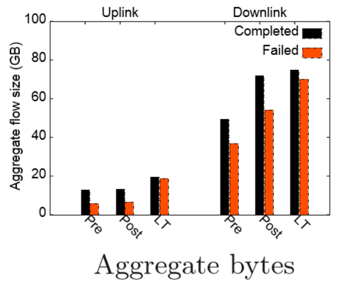
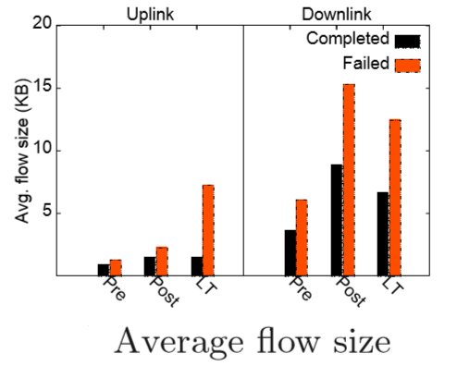
Implications on Content Access/Generation
TCP Flow analysis: Success and Failure of TCP Uploads and Downloads
x4
[Zheleva, Schmitt,
Vigil, Belding, ACM DEV 2013]

Slide 19
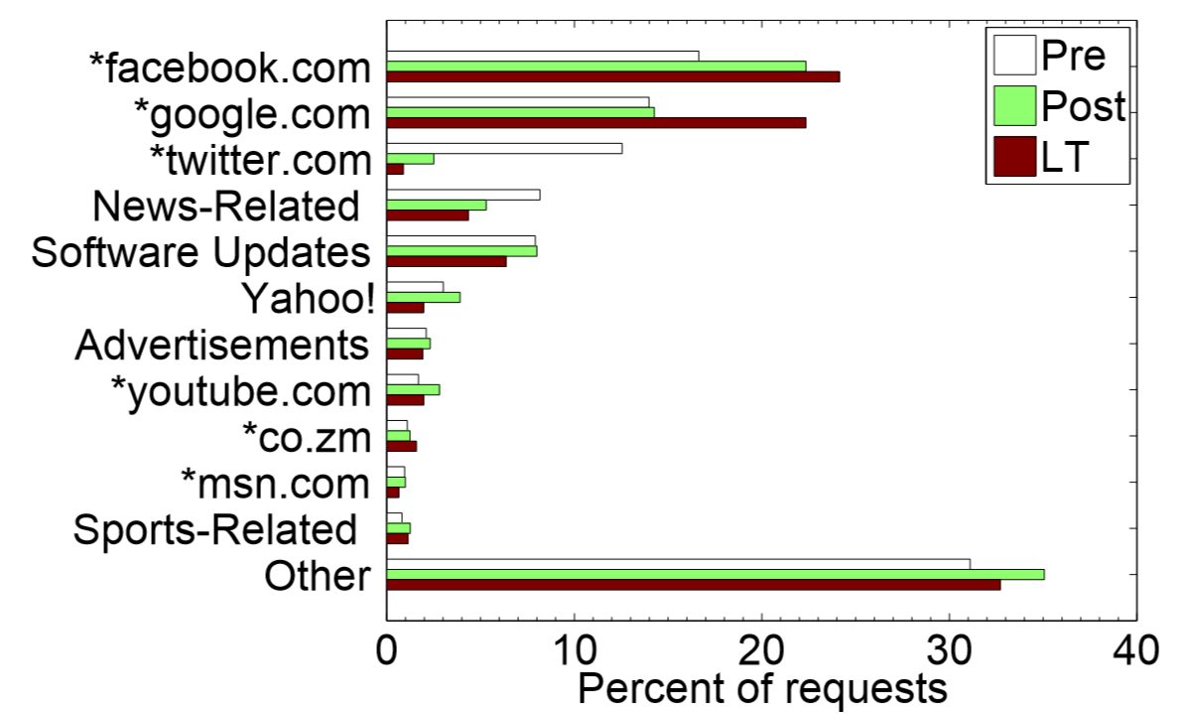
Usage: Top Web Sites
[Zheleva, Schmitt,
Vigil, Belding, ACM DEV 2013]

Slide 20
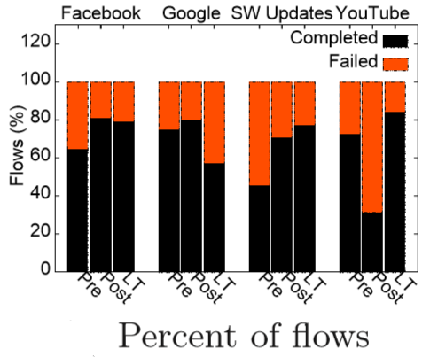
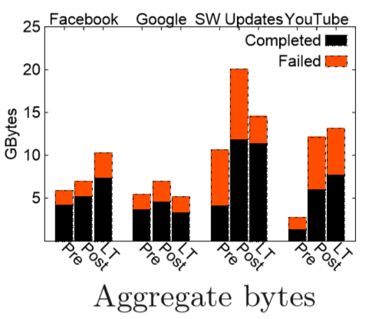
Usage: Top-4 Services Success and Failure
*200 – OK
400 – Bad Request
408 – Request Timeout
[Zheleva, Schmitt,
Vigil, Belding, ACM DEV 2013]

Slide 21
The Increased Bandwidth Fallacy
Increased bandwidth can improve usability
Bandwidth increase not proportional to improved user experience
Prioritize bandwidth for critical services
E.g. software updates
Internet
Local WLAN
Increased 400 and 408 + Failure to update Mozilla = Prioritize SW update
[Zheleva, Schmitt,
Vigil, Belding, ACM DEV 2013]

Slide 22
Sociological Approach
(interviews)
Technological Approach
Internet usage [IJoC12]
Cellular network
traces analysis
Internet traffic
analysis
Enabling network
performance analysis
Identifying
challenges
Bringing visibility to rural users [ICTD13]
Cellphone usage [MobiSys13]
Bringing visibility to rural users [ICTD13]
The bandwidth divide [IJoC12]
AirLab [SIGCOMM CCR11]
The increased bandwidth fallacy [ACM DEV13] and WiP
Cellphones in healthcare [GSWC12]
Community detection in cellular [ICTD13]
The increased bandwidth fallacy [ACM DEV13] and WiP
Connectivity
Applications
PHY/MAC Layer
Application Layer
ImmuNet [GSWC12]
Long distance
Last mile
Connectivity
solutions
VillageLink [COMSNETS14]
Kwiizya [MobiSys13]
Kwiizya [MobiSys13]
TxMiner
WiP
Completed
In progress
HybridCell
WiP
*WiP – Work in Progress

Slide 23
Identifying Challenges: Bringing Visibility to Rural Cellular Users

Slide 24
Bringing Visibility to Rural Users
December 1, 2011
April 1, 2012
Orange in Cote D’Ivoire
Antenna-to-Antenna communication
Aggregate # calls/hour
+ AfriPop
population density dataset
Aggregate duration of calls/hour
+ OECD typology
Antenna ID
Latitude
Longitude
Antenna ID
Latitude
Longitude
< 150/km² – Rural
150 – 300/km² – Suburban
> 300/km² – Urban
[Zheleva, Schmitt, Vigil, Belding, ICTD 2013]

Slide 25
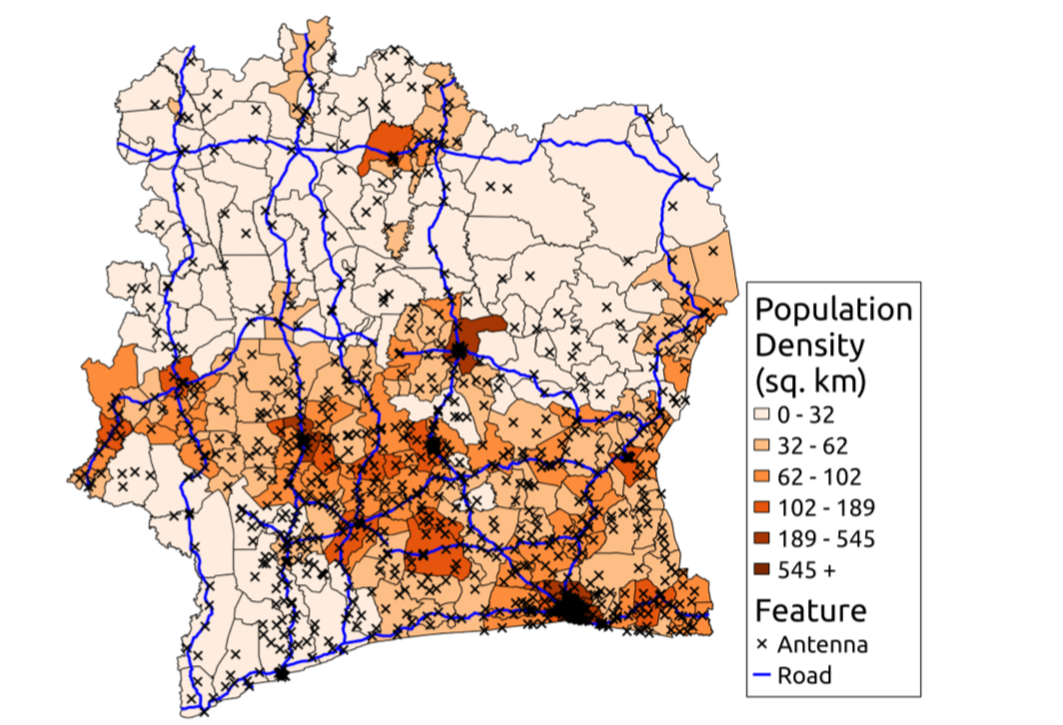
Bringing Visibility to Rural Users
98% Rural territory
2% Urban territory
[Zheleva, Schmitt, Vigil, Belding, ICTD 2013]

Slide 26
Bringing Visibility to Rural Users
High locality of rural cellular communications.
[Zheleva, Schmitt, Vigil, Belding, ICTD 2013]
51.7% of rural antennas are TRANSPORTATION.

Slide 27
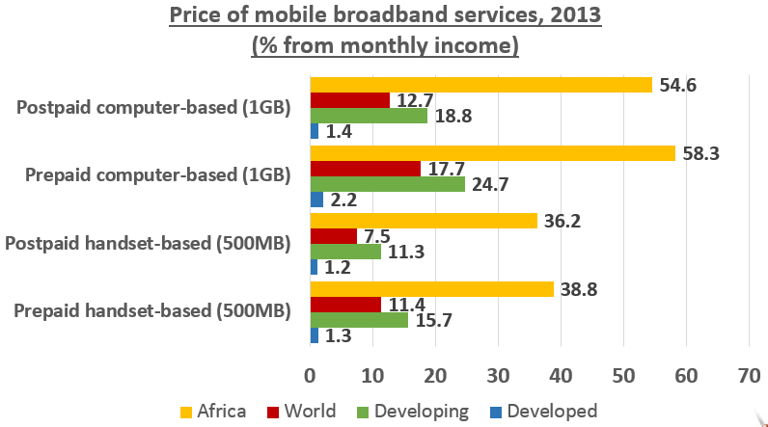
Bringing Visibility to Rural Users
An African may pay 39 times more than a Westerner for Internet access.
Mobile cellular services are expensive.
Prepaid is prevalent.
Improve the situation by providing alternatives.
Rural users are under-provisioned.
High locality of interest.

Slide 28
Connectivity Solutions: Local Cellular Network Services in Remote Areas

Slide 29
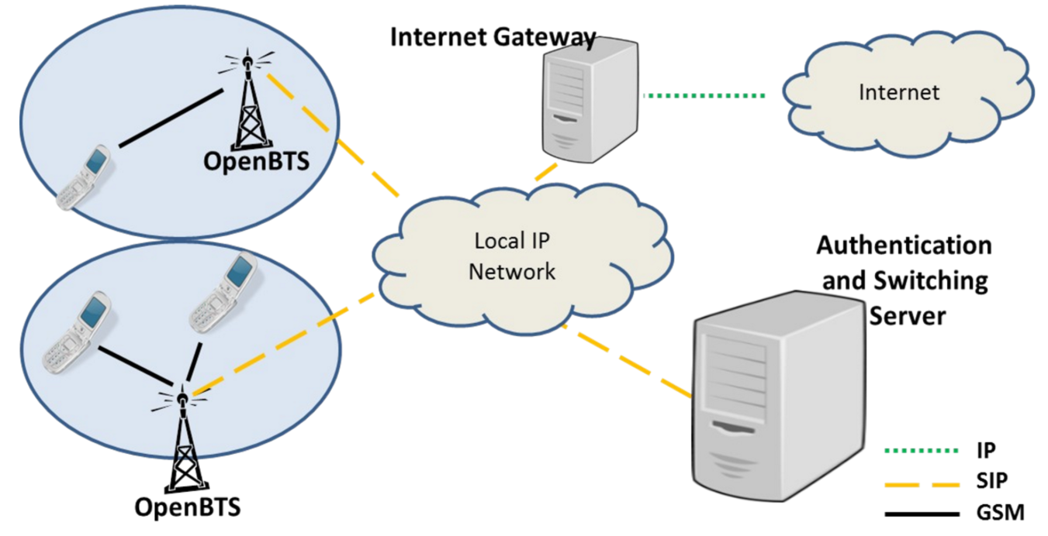
Kwiizya*: Architecture
* Kwiizya means
“to chat” in Tonga
[Zheleva, Paul, Johnson, Belding, MobiSys 2013]

Slide 30
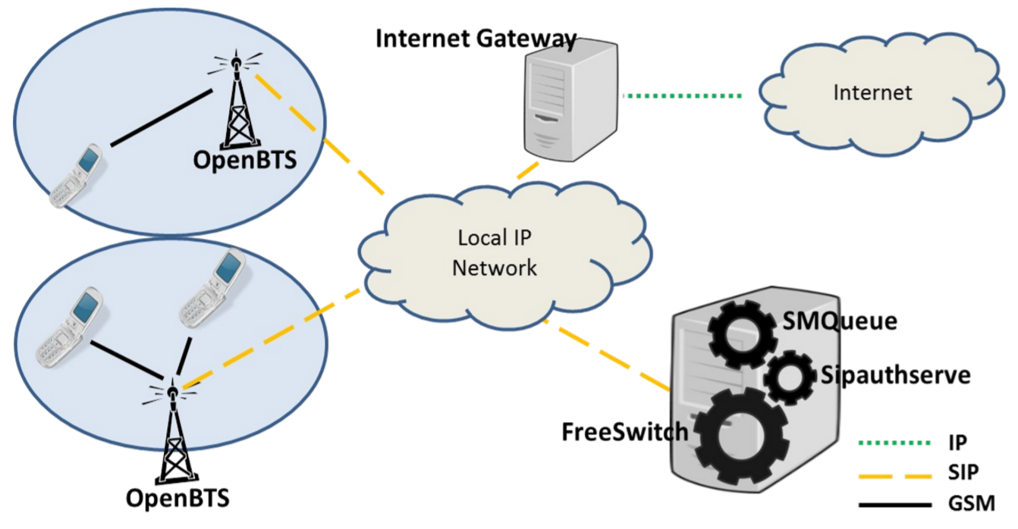
Kwiizya: Architecture
[Zheleva, Paul, Johnson, Belding, MobiSys 2013]

Slide 31
Kwiizya: Call Switching
[Zheleva, Paul, Johnson, Belding, MobiSys 2013]

Slide 32
Kwiizya: SMS Switching
[Zheleva, Paul, Johnson, Belding, MobiSys 2013]

Slide 33
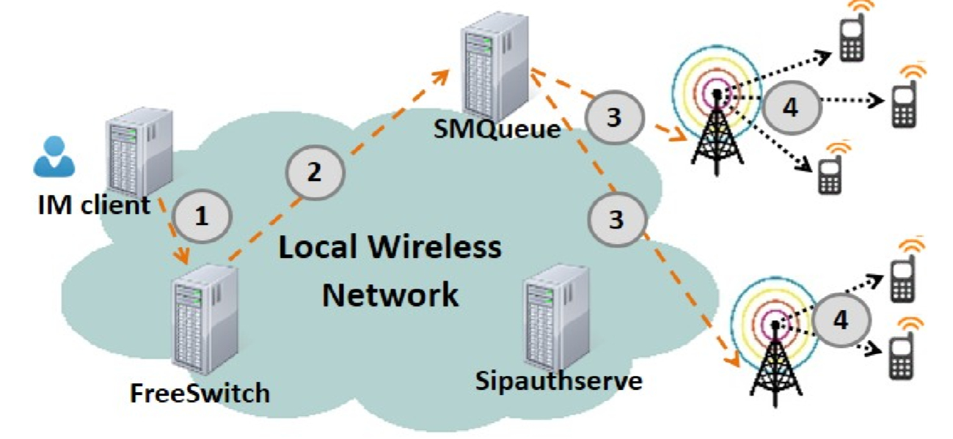
Support of SMS Applications (IM-SMS)
[Zheleva, Paul, Johnson, Belding, MobiSys 2013]

Slide 34
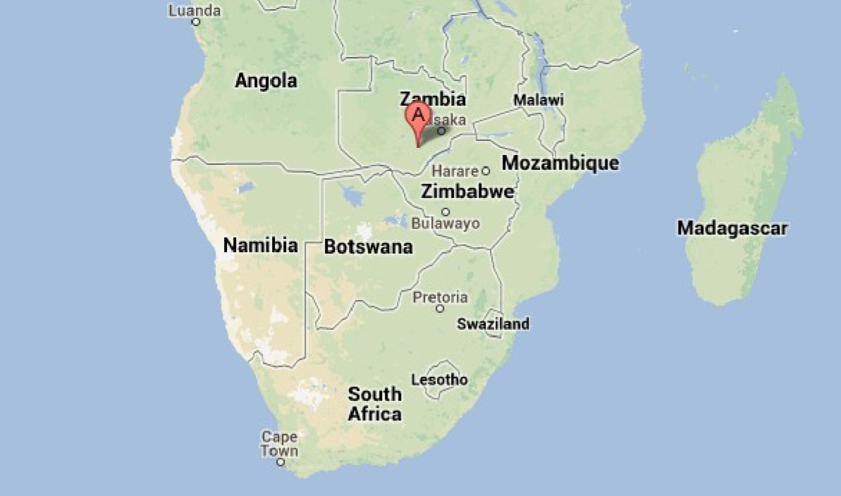
Macha, Zambia
Source: GoogleMaps
[Zheleva, Paul, Johnson, Belding, MobiSys 2013]

Slide 35
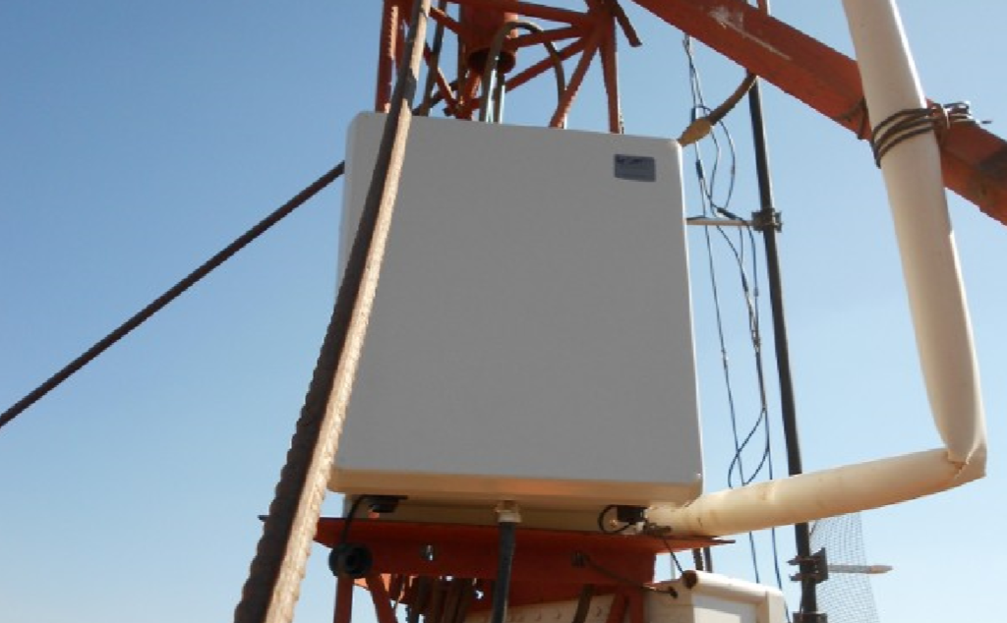
The Base Station
A RangeNetworks
SNAP unit
[Zheleva, Paul, Johnson, Belding, MobiSys 2013]

Slide 36
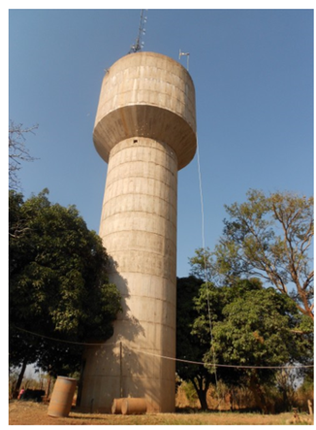
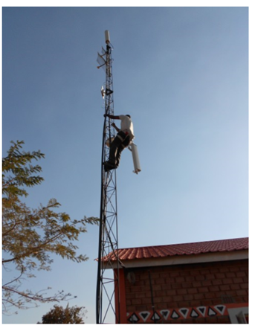
Installation Sites
Water Tower
LITA
[Zheleva, Paul, Johnson, Belding, MobiSys 2013]

Slide 37
Power Quality in Macha
[Zheleva, Paul, Johnson, Belding, MobiSys 2013]

Slide 38
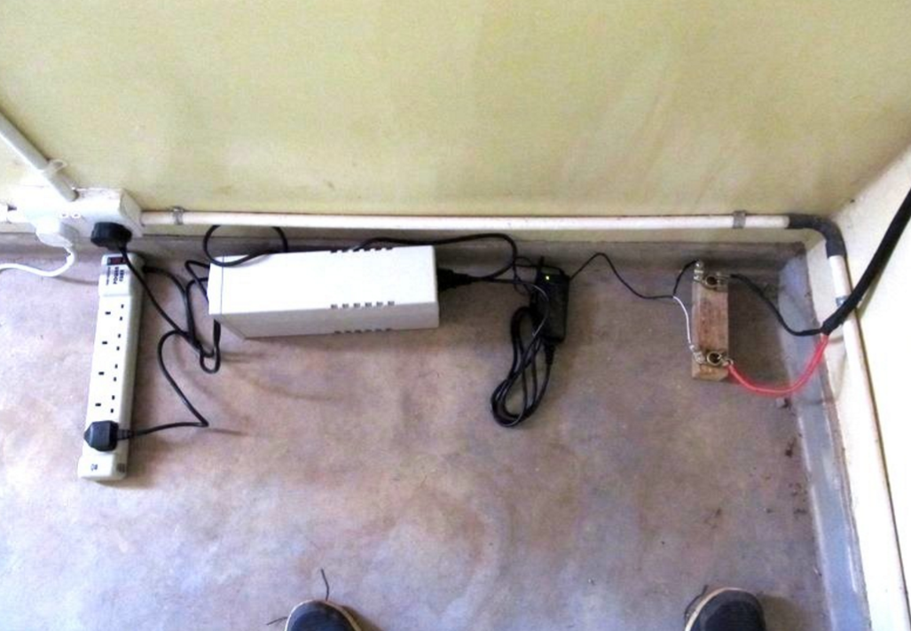
The Power Supply
[Zheleva, Paul, Johnson, Belding, MobiSys 2013]

Slide 39
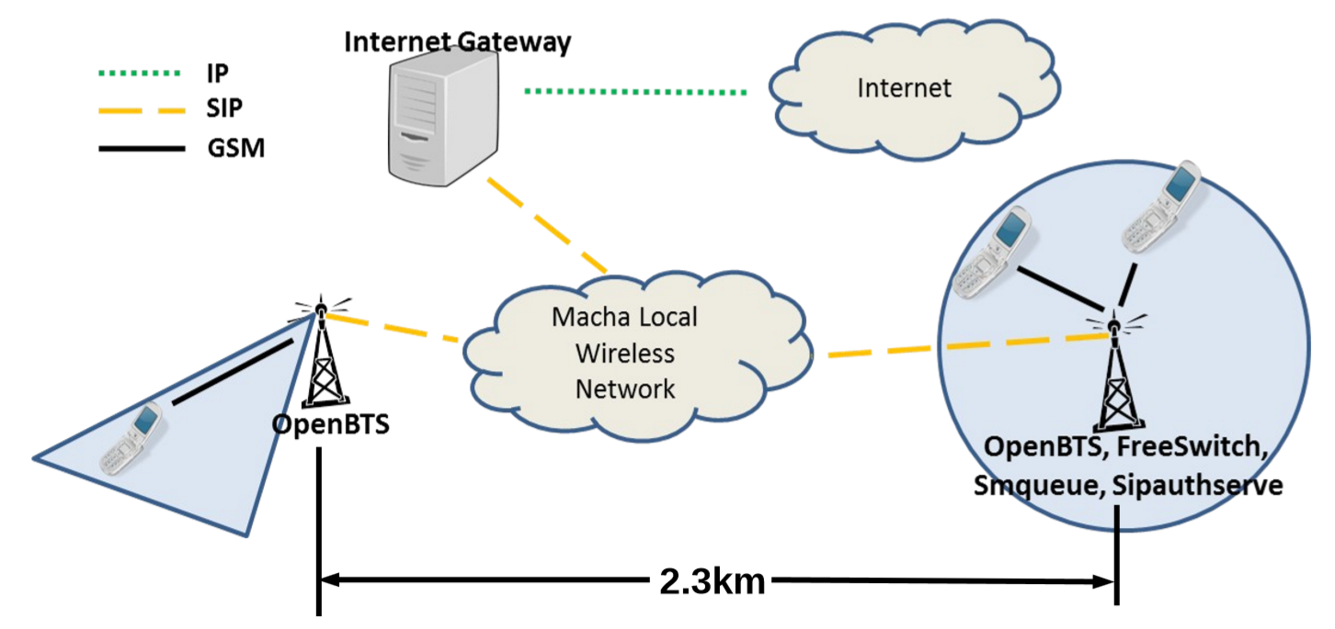
The Network in Macha
[Zheleva, Paul, Johnson, Belding, MobiSys 2013]

Slide 40
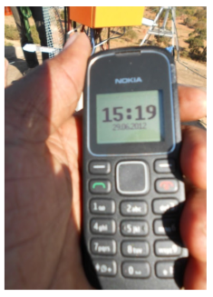
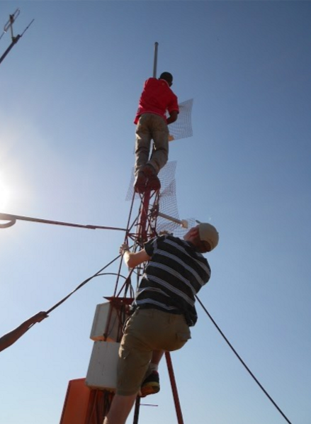
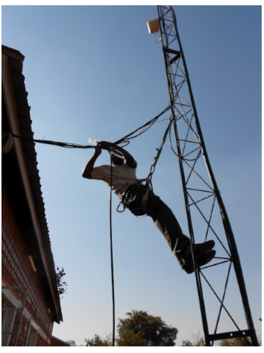
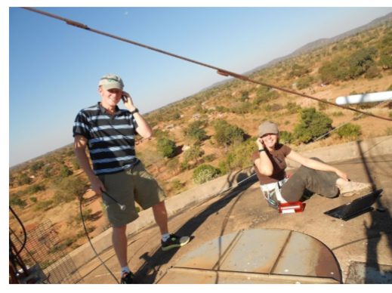
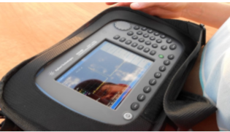
Evaluation
20 SIM cards
Local partners (IT staff)
Restricted registration
Voice and SMS
[Zheleva, Paul, Johnson, Belding, MobiSys 2013]

Slide 41
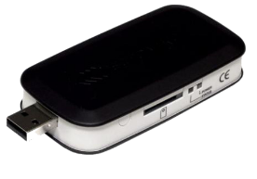
Controlled Experiments Setup
[Zheleva, Paul, Johnson, Belding, MobiSys 2013]

Slide 42
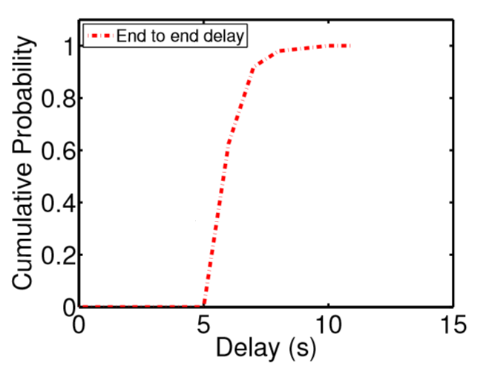
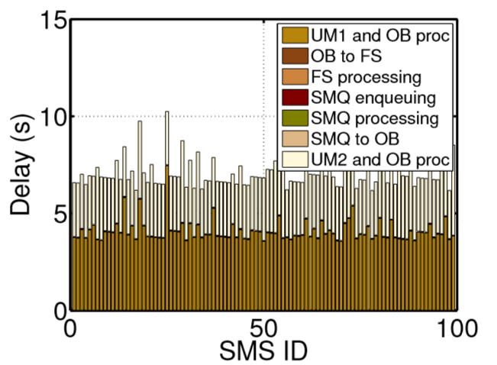
Performance: SMS Delay
SMS delivery in Tanzania takes between
6 and 16 seconds depending on provider.
[Zheleva, Paul, Johnson, Belding, MobiSys 2013]

Slide 43
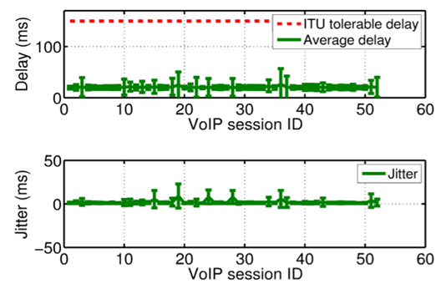
Performance: Call Quality
GSM FR (6.10)
Min delay 20ms
GSM FR (6.10)
Max MOS 3.46
[Zheleva, Paul, Johnson, Belding, MobiSys 2013]

Slide 44
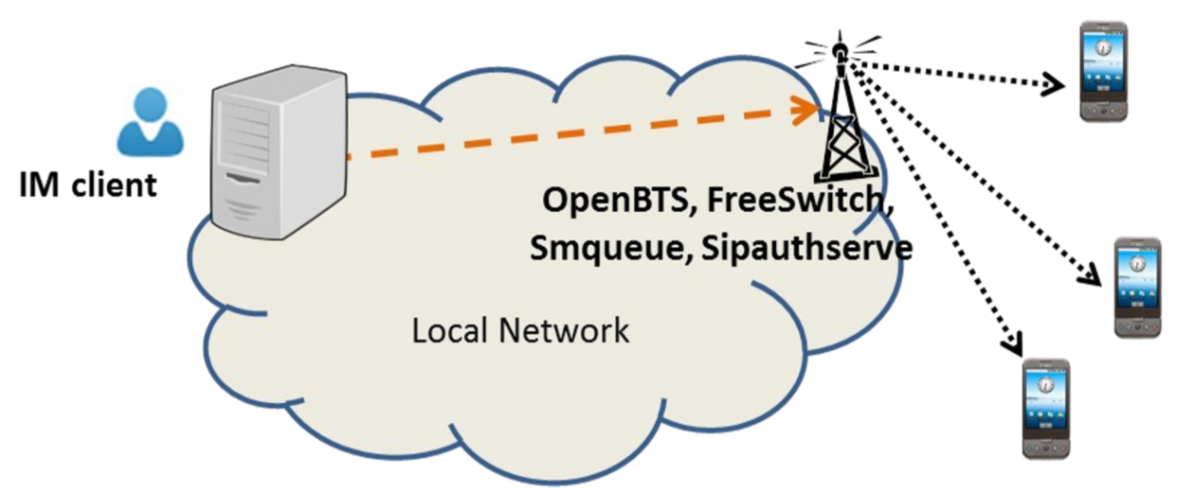
Performance: IM to SMS
[Zheleva, Paul, Johnson, Belding, MobiSys 2013]

Slide 45
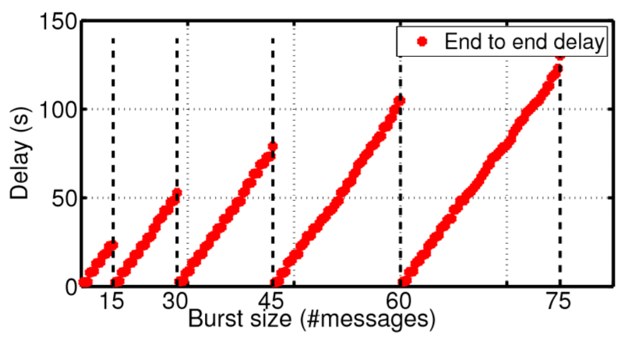
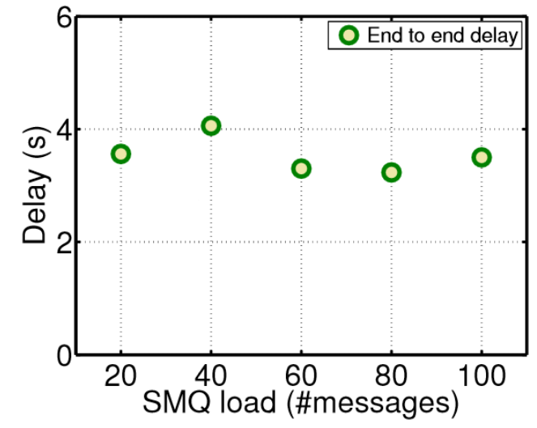
Performance: IM to SMS
[Zheleva, Paul, Johnson, Belding, MobiSys 2013]

Slide 46
Sociological Approach
(interviews)
Technological Approach
Internet usage [IJoC12]
Cellular network
traces analysis
Internet traffic
analysis
Enabling network
performance analysis
Identifying
challenges
Bringing visibility to rural users [ICTD13]
Cellphone usage [MobiSys13]
Bringing visibility to rural users [ICTD13]
The bandwidth divide [IJoC12]
AirLab [SIGCOMM CCR11]
The increased bandwidth fallacy [ACM DEV13] and WiP
Cellphones in healthcare [GSWC12]
Community detection in cellular [ICTD13]
The increased bandwidth fallacy [ACM DEV13] and WiP
Connectivity
Applications
PHY/MAC Layer
Application Layer
ImmuNet [GSWC12]
Long distance
Last mile
Connectivity
solutions
VillageLink [COMSNETS14]
Kwiizya [MobiSys13]
Kwiizya [MobiSys13]
TxMiner
WiP
TxMiner
WiP
Completed
In progress
HybridCell
WiP
HybridCell
WiP
*WiP – Work in Progress

Slide 47
Proposed Work: HybridCell: Coexistence of Cellular Networks

Slide 48
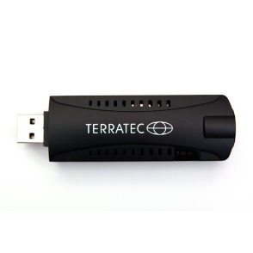
HybridCell: Architecture
Village
Observe
C-Cell
Control
L-Cell
*C-Cell – Commercial cell
*L-Cell – Local cell
RTL-SDR
sniffer

Slide 49
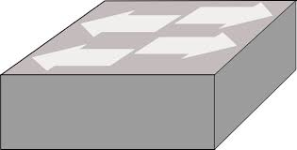
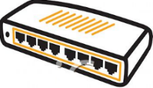
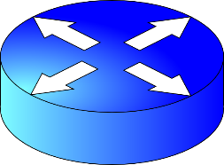
HybridCell vs. Commercial Network
Users
RF Frontend
Core Network
Expensive:
Highly centralized
Hardware
Software
Backbone
VLR
HLR
PSTN
Commercial
MSC
RNC
SGSN
GGSN
BTS
Low-cost:
Local
SDR hardware
Open-source software
Generic IP backbone
Internet
Local (Kwiizya)
Wireless
Internet
Gateway
MSC+VLR
+HLR + GSN
BTS
In-Village
Out-Village

Slide 50
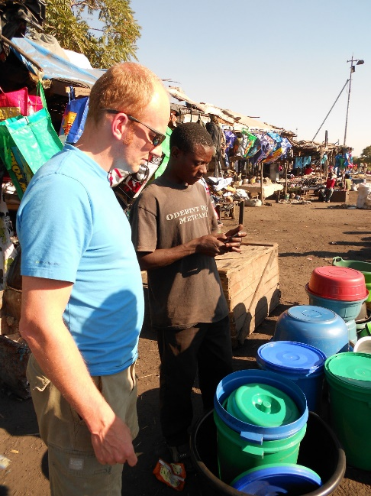
HybridCell Use-Cases
Local Services for End Users
Local Services for Organizations
Low-Cost Packet-Switched Data
Disaster
Communications
[Source: BBC]

Slide 51
HybridCell: Research Challenges
Understanding the state of rural commercial cellular access:
Measuring signal quality – capture SNR using an RTL-SDR setup
Measuring packet-switched data quality
HybridCell use with existing SIM.
User-triggered
System-triggered
Monitoring C-Cell’s activity:
RTL-SDR setup
Use TxMiner
Mobile data offload through local cells.

Slide 52
Proposed Work: TxMiner: DSA beyond TV White Spaces

Slide 53
TxMiner: DSA Beyond TV White Spaces
Power Spectral Density: TVWS
Power Spectral Density: Beyond TVWS
-130dBm -60dBm
-130dBm -30dBm
-110dBm
512MHz 700MHz
30MHz 6000MHz

Slide 54
TxMiner Goal
Power Spectral Density Graph
Transmissions:
Bandwidth
TDMA/FDMA
Mobility
Direction
PSD, dBm/Hz
Frequency, MHz

Slide 55
TxMiner Applications
Enhance existing DSA systems
Support spectrum regulations in developing nations and worldwide
TX periodicity
TX bandwidth
Mobile TX over time
Primary or Secondary
3) Bandwidth X
satisfies user
demand
1) Spectrum availability?
2) Spectrum availability +
Transmitter Characteristics
TxMiner-enhanced
DSA Database
Secondary User
Network
Geo-location
database

Slide 56
In Conclusion
Thesis Statement: In order to optimize user experience, rural networks and applications need to be highly modular and use this modularity to switch between global and local context according to network conditions and demand.
Identified challenges associated with access
Cellular networks
Internet
Designed solutions for local cellular access
With support for SMS applications
Propose extensions
Cellular networks coexistence
DSA beyond TV White Spaces

Slide 57
PhD Timeline
NOV DEC JAN FEB MAR APR MAY JUN
Africa conferences and fieldwork
Preparing job applications
Preparing job talk/interviewing
TxMiner evaluation and paper submission
HybridCell research
HybridCell paper
Increased bandwidth fallacy, journal
PhD dissertation and defence

Slide 58
Thank you!
Mariya Zheleva
mariya@cs.ucsb.edu
This work was done in collaboration with: Elizabeth Belding; Veljko Pejovic; David Johnson; Arghyadip Paul; Morgan Vigil; Paul Schmitt; Partners from LinkNet, Macha; Kate Milosavljevic

