Slide 1
Dynamic Spectrum Access
Methods, Requirements, and Concerns
Greg Buchwald Motorola Solutions, Inc.

Slide 2
Database-Enabled Access
Offers greatest protection to incumbents
Requires access to the internet or control channel to query a trusted source database
Current de facto method of choice
TVWS
3.55GHz
Trusted sensing; credentials via database
Excellent for fixed or nomadic access; can present issues for some mobile use-cases
MSI is a proponent of Geo-location Database spectrum access methods and has been a contributor to the art.

Slide 3
Spectrum Sensing-Enabled Access
On the surface, appears to be the best solution, but:
Issues practical issues can make this difficult
Hidden nodes
Protection of RX sites; Receivers don’t radiate (much)
Generally, must sense below the noise floor to avoid de-sense of incumbent services (time element)
-132dBm Narrowband emissions
-118dBm LTE (with many caveats)
-116dBm TV
MSI fielded an early TVWS sensing system during FCC testing; channel sampling and ranking.

Slide 4
Making Sensing Work Properly
Multiple system components required
Network of fixed sensing devices
Establishes a long term and dynamic database of known waveforms correlated to frequency, location, and temporal behaviors
Cooperative sensing gain – several papers on the subject
Augmented by sensing-enabled subscriber / individuals units
A form of “pay for play”; pay with device use and battery life in return for access
At a minimum, sense the spectral neighborhood you intend to utilize
Essentially passive mesh sensing with active feedback to the network of fixed devices

Slide 5
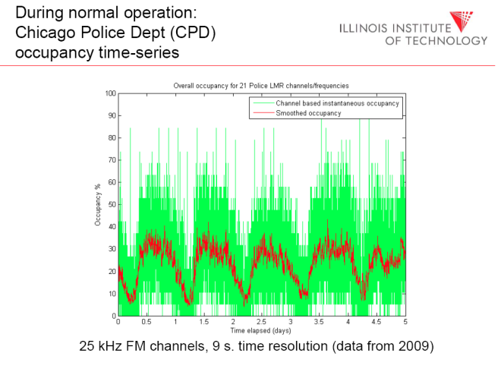
Concerns
Sensing levels
Generally into the noise; collaborative
Dynamic range; IM performance of sensing RX
Waveform ID and spectral characteristics of the DSA signals
Determine interference threshold and resilience
Hidden nodes / RX-only
Particularly in P-P cm and mm wave bands
Some services require more protection than others (not my words but in full agreement)
May not be fixed; may need dynamic rules
Stepping on preamble / headers of signals; response time
Protecting critical infrastructure services

Slide 6
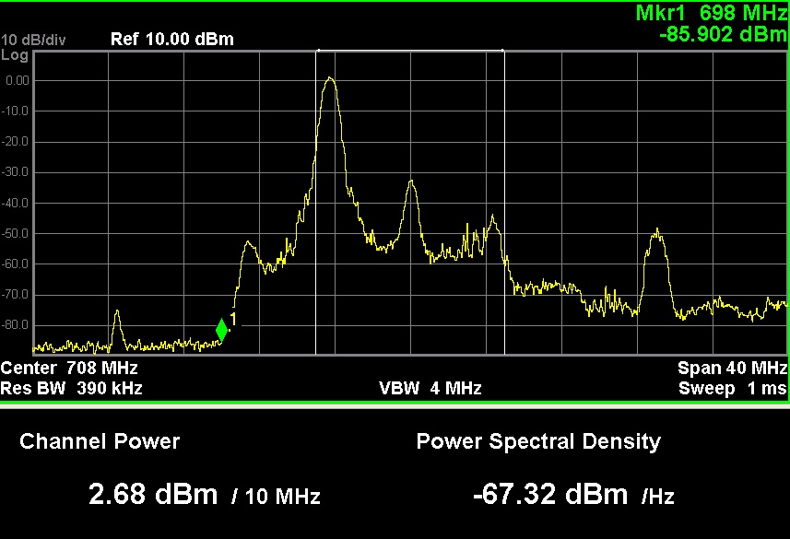
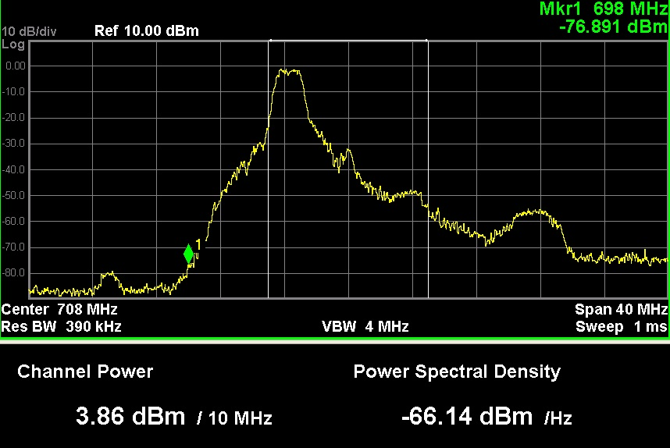
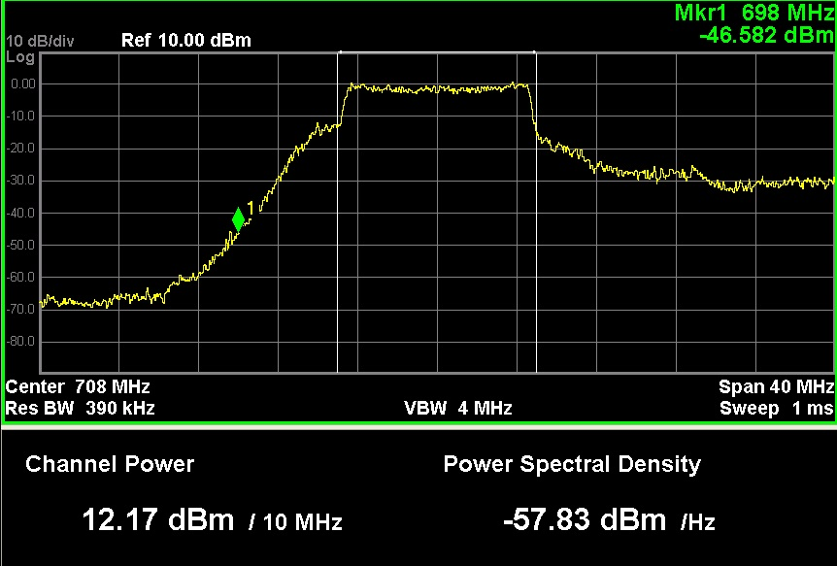
Something to Ponder
Thank You

