Slide 1
Advanced RF Mapping – RadioMap
UNCLASSIFIED
Dr. Joseph Evans
Program Manager, DARPA/STO
NSF Spectrum Measurement Workshop
Chicago, IL
April 2016
Approved for public release; distribution is unlimited.

Slide 2
Program Purpose
Spectrum Management
National Broadband Plan: Re-allocating DoD Spectrum
DoD Spectrum Strategy: Move toward spectrum sharing
Spectrum Situational Awareness (SA)
Providing tactical military units with awareness of the signal environment: (friendly, commercial, adversary)
Support to emerging Department of Defense concepts
    U. S. Marine Corps Cyber Electronic Warfare Coordination Cell
    U. S. Army Cyber Electromagnetic Activities
    U. S. Navy Electromagnetic Maneuver Warfare
Technical Innovations
Sensing capability to be built into existing tactical software-defined radios: e.g., PRC-117G
Management and tasking of heterogeneous sensor network, a.k.a. Wireless And Large-area Distributed Operations (WALDO)
Approved for public release; distribution is unlimited.

Slide 3
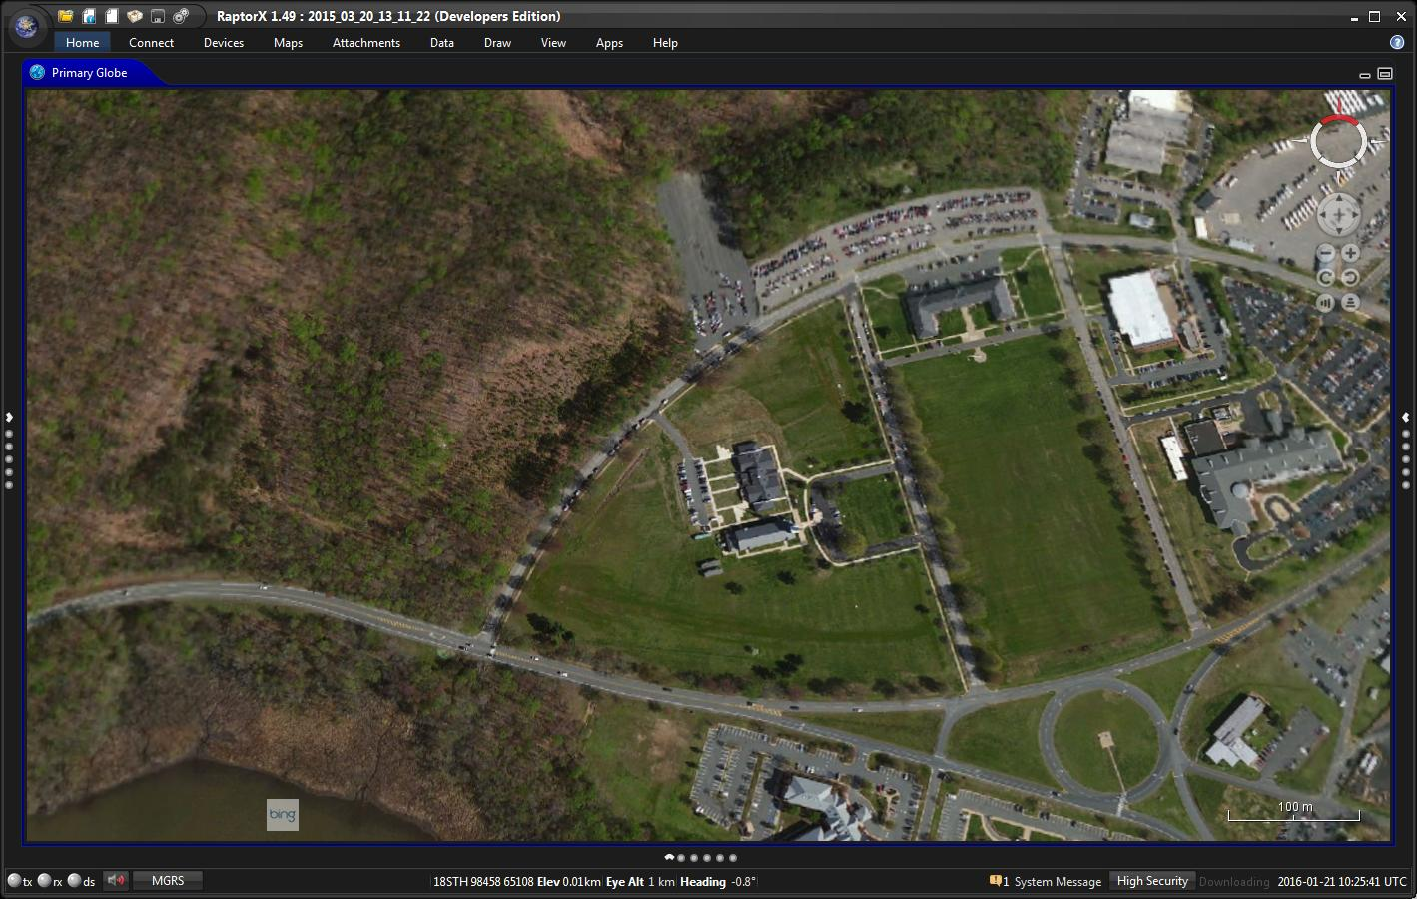



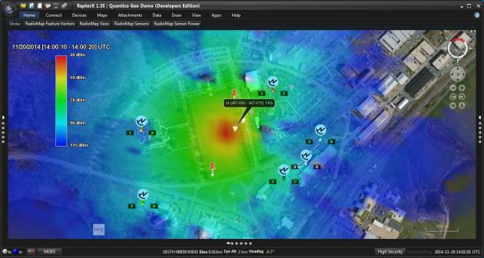
RadioMap Overview
UNCLASSIFIED
Objective: spectrum situational awareness
  Re-use of existing devices
  No harm to primary functionality
  Real time information
Increases capacity to conduct support a variety of missions
  Command and control of sensor network
Currently focused on transition
  U. S. Marine Corps is transition partner
Integrates 3rd party applications and devices
  Software is flexible and extensible
  Promotes Joint Force interoperability
Opportunities related to airborne component
  Precise spectrum (emitter geo-location)
MCCN
PRC-117g
RF Emitter
RadioMap field trial with sensors, emitter, and application
  MCCN Marine Corps CREW New
RF Heatmap
Approved for public release; distribution is unlimited.

Slide 4
Building a RadioMap
UNCLASSIFIED
Desire to estimate the RadioMap in an area of operation
Typically can only deploy a limited number of sensors due to availability
Sensor deployment limited by mission profile and security
Network used to gather spectrum observation by deployed sensors
Potential algorithms for predicting the RF field:
Geo-localize all emitters and use electromagnetic propagation models to calculate the field strength
Interpolate or extrapolate based on measurement sites
Match measured fields based upon hypothesized emitters
Approved for public release; distribution is unlimited.

Slide 5
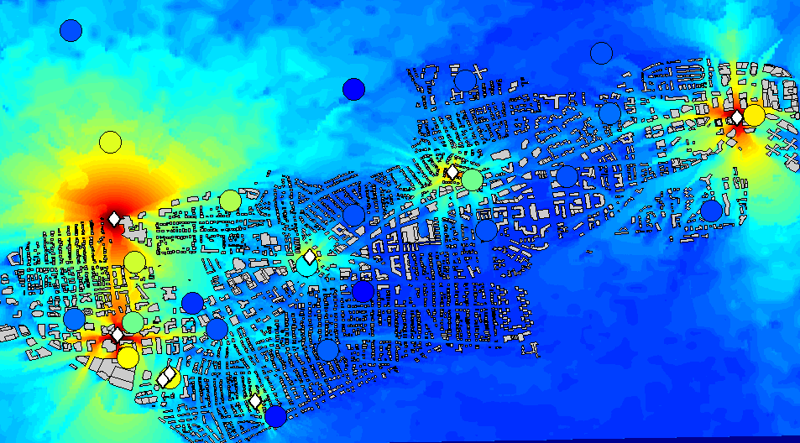
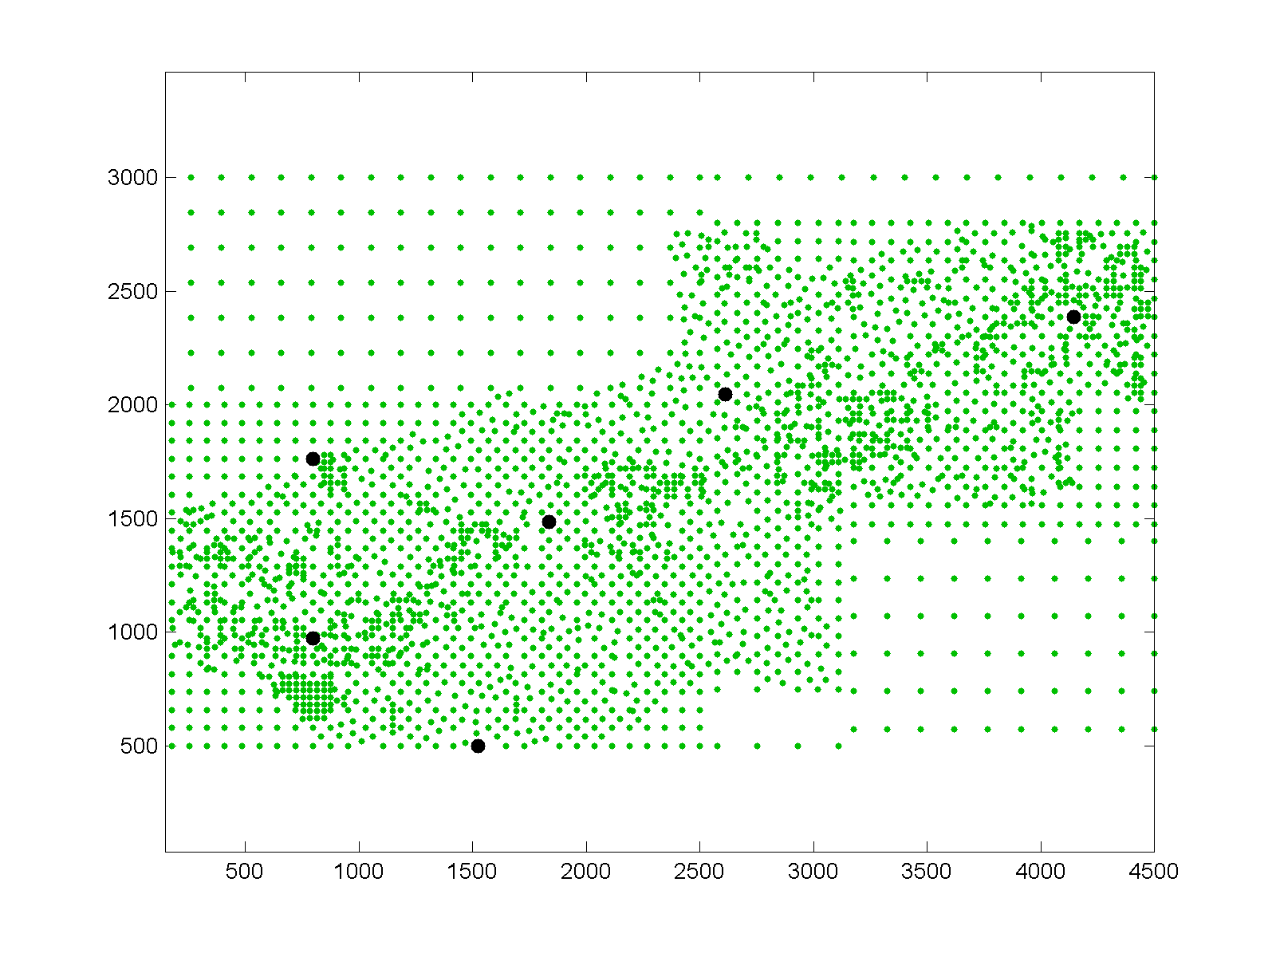
PRISM RF Fusion Example
Reverse Model
Forward Model
Start PRISM Processing
Backpropagate Receiver Observations to Get PRISM TX Power Solution
Propagate PRISM TX Solution Forward to Generate Heatmap
Finish PRISM Processing
RF Power From Solved TX Propagated Across Entire Map
Hypothetical TX Locations (Green)
Transmitters locations that best match receiver measurements
Approved for public release; distribution is unlimited.

Slide 6
Propagation Model Approach


Empirical Methods
  Statistics based methods
  Fast, but lacks specific building knowledge
  Tunable
Dominant Path Model
  Robust to model errors
  Auto-calibration of model
  Computationally efficient
  Combines terrain and building data to model rural and urban environments
T
T
R
R

Ray-Tracing
  High accuracy
  Very sensitive to 3D building errors
  Slow
T
Tunable Parameters
R
Transmit Power + Constant
Distance Path Loss
Diffraction Path Loss
Antenna Gain
Waveguide Gain
The Dominant Path Model has the accuracy of a ray-tracer
with the benefits of an empirical propagation model
Approved for public release; distribution is unlimited.

Slide 7

RadioMap Architecture
UNCLASSIFIED
  WALDO – C2 and integration of new applications & devices
  Application(s)
  RF Mapping
  WALDO Management System
  WALDO Architecture (C2)
  Discovery Function
  Job Decomposition/Task Management
  Domain Management
  RF Device
  WALDO executive/remote
RF
Mapping
New
RF Apps
WALDO Software Layer
New
Devices
Tactical Radios
Tactical RF Device
Sensors
C2 Command and Control
WALDO Wireless And Large-scale Distributed Operations
Approved for public release; distribution is unlimited.

Slide 8
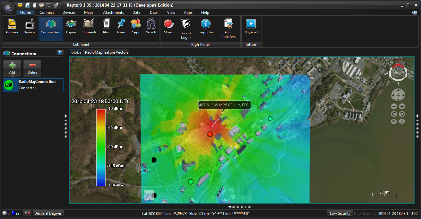


Flexibility to Support Multiple Environments
UNCLASSIFIED
Future Vision
Data Devices
Hand held Radio Frequency (RF) Alerting System
RaptorX
Aerial Layer
Operations
Intelligence
Communications
EW & Software Defined Payloads
Operations Center
RF Emissions
RadioMap application provides universal situational awareness to all stakeholders
Approved for public release; distribution is unlimited.

Slide 9

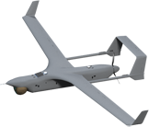


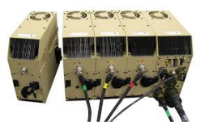
Major Program Efforts Leading to Transition(s)
UNCLASSIFIED
RadioMap
Airborne
Component
RF Mapping
WALDO
Air-Ground Sensor fusion
Advanced EMS Mission Module
Tactical Radio
Tactical RF Device
Tactical RF Device
New Transition
New Transition
Phase 3 Key Milestones
July 2016 (Base) | Demo: Marine Corps Warfighting Lab (MCWL) - Quantico, VA
August 2016 | RadioMap Advanced EMS Mission Module Integration (Projected Date)
October 2016 | RadioMap Tactical RF Device (Projected Date)
~Feb 2017 (Option) | Exercise: USMC Integrated Tactical Exercise (ITX) - Twentynine Palms
EMS Electromagnetic Spectrum USMC United States Marine Corps
WALDO Wireless And Large-Scale Distributed Operations
Approved for public release; distribution is unlimited.

Slide 10
UNCLASSIFIED
Approved for public release; distribution is unlimited.

