Slide 1
Distributed, Synchronous RF Sensor Networks
Raymond Shen, PhD
August 2015
Signal Networks Division
June 2014

Slide 2
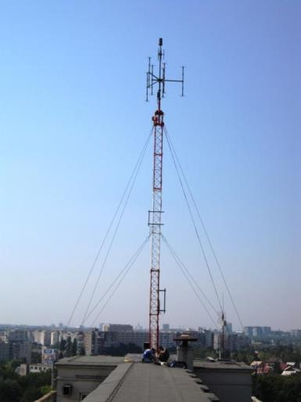
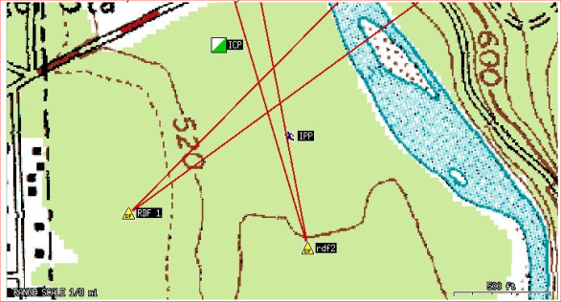
Monitoring equipment is changing
It has to in order to keep up…
Traditional spectrum monitoring and DF systems are too big, too expensive, and hard to “site” for today’s high-density urban settings and modern wideband signals.

Slide 3
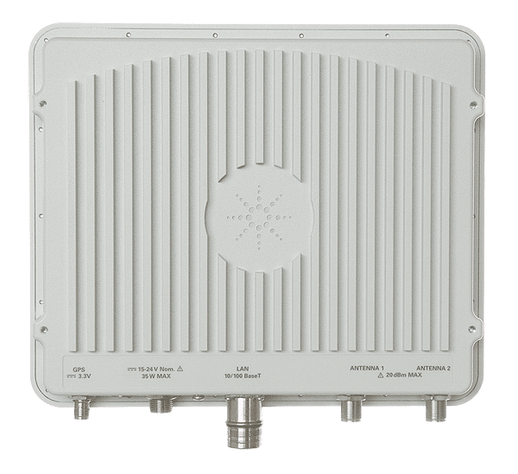
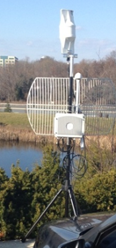
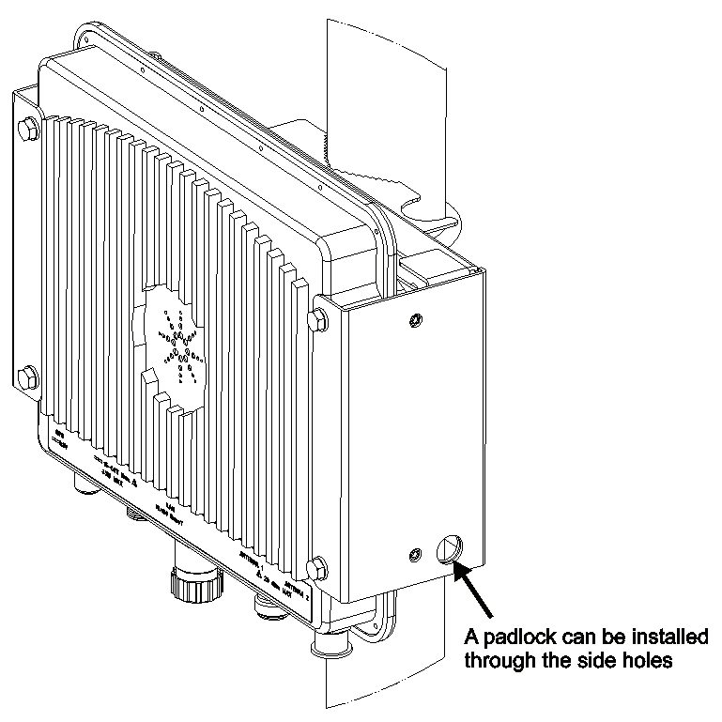
Remote spectrum monitor and signal analyzer…
Pole / wall mount bracket included with Sensor
GPS Antenna mounting slot
One pole connection to mount RF Sensor plus GPS antenna.
Very easy to install.
GPS
DC Power
RF Inputs 1 & 2
LAN
Size: 292 x 220 x 50 mm Weight: 3.4 kg
Notes:
Advances in equipment design and packaging have produced low-cost wideband receivers that can be remotely controlled by capable search and analysis software. The devices can be shipped to a trouble site and controlled from distant end for troubleshooting, service measurements, interference detection, classification and mitigation.

Slide 4
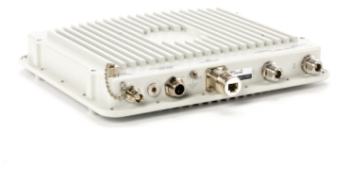
Brief Overview of the N6841A RF Sensor
The basic specifications
20MHz to 6GHz tuning range
20MHz processing bandwidth (completely digital IF)
4.8 seconds of IQ capture LookBack memory (20MHz wide)
Integrated GPS receiver used for location and time synchronization
Compact, low-power design (15-24VDC, 30W max)
Standard 100 baseT network interface for data output, command and control
Integrated 2-port RF Input Switch
7 pre-selector bands, pre-amplifiers and attenuators (~ 60 dB range)
Onboard computer (LINUX kernel) and FPGA
N6841A Value Points:
****Low-Cost
***Weatherproof: IP 67
**Synchronization < 20 nsec
*Proven Reliability (~2% CCAFR)
Notes:
For those new to this product, here is a brief description.
Over one thousand units shipped worldwide and used in a variety of applications – many in use 24 hours per day, 7 days per week. A large percentage of the sensors are mounted outdoors; and they are immersed in the active RF environment. The rugged design and robust packaging has yielded a very high reliability on this product (about 2% annual failure rate). The N6841A incorporates the following basic elements:
20MHz to 6GHz tuning range
20MHz processing bandwidth (completely digital IF)
4.8 seconds of capture memory (20MHz wide)
Integrated GPS receiver used for location and time synchronization
Compact, low-power design (draws 30W maximum)
Standard 100 baseT network interface for data output, command and control
Integrated 2-port RF Input Switch
7 pre-selector bands
Onboard computer (LINUX kernel) and FPGA
And now, I’ll describe the primary software application used with the RF Sensor.

Slide 5
Applications that make Sensor networks plausible
Built around the deployment process
Network Planning and deployment
RF Survey, Signal Classification
Emitter Location
Signals Analysis
Spectrum Data and Report Generation

Slide 6
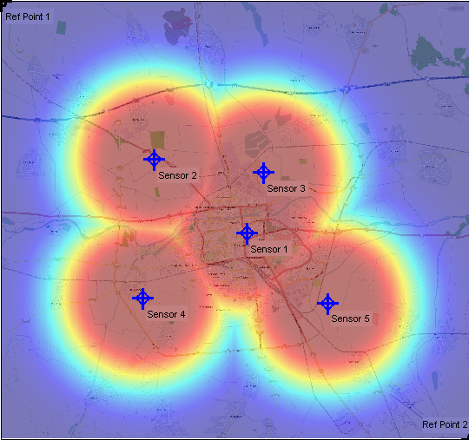
Planning a Distributed Sensor Network
Sensor Placement and Optimization Tool (SPOT)
SPOT enables network planning and prediction of RF Detection Range and Geolocation Coverage Area.
Density of sensors required for coverage
Effectiveness of geometry to detect and locate emitters (GDOP)
Model sensor installations:
Antennas, pre-amps,
RF cable runs, Elevation
Propagation models for terrain and line of sight
Reference Report ITU SM.2211, Annex 1 for more discussion.
Free download on www.keysight.com

Slide 7
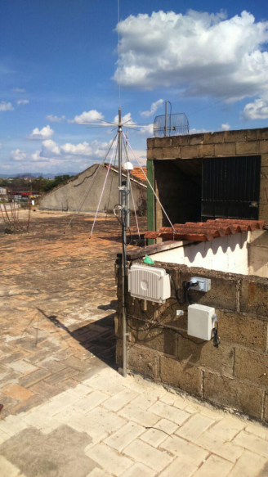
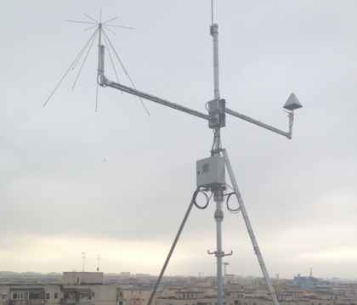
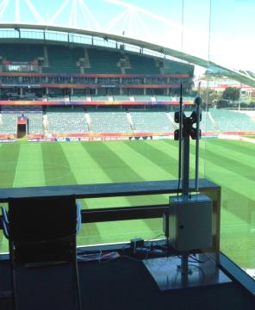
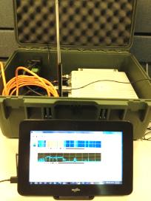
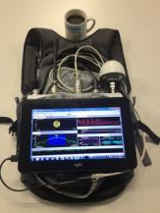
Deployment: Other Examples
Rural
Installations from around the world
Urban
Mobile
Events
Manpack

Slide 8
Deployment: Keysight Broadband Omni Antenna
Model Number N6850A
Consistent pattern in both azimuth & elevation. Improves potential for effective power-based geolocation
Compact, Simple to mount (~42 cm high)
Operating range 20 MHz to 6 GHz
Best performance 350 MHz to 6 GHz
Creative mounting bracket suitable for:
Tripod, Pole/Rail or Mobile (magnetic)
Notes:
This is exciting. We are introducing a new Keysight lab designed broadband antenna for use with the RF Sensor and other spectrum analyzer products. We expect shipments to begin in September.
Best part of the pattern is from 300MHz to 6GHz, but expected to be useable down to 20MHz.

Slide 9
Applications that make Sensor networks plausible
Built around the deployment process
Deployment Planning and modelling
RF Survey, Signal Classification
Emitter Location
Signals Analysis
Spectrum Data and Report Generation

Slide 10
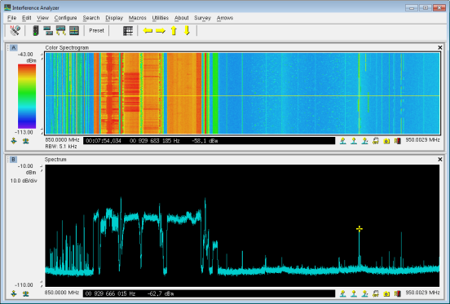
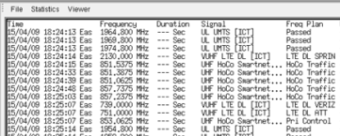
Automating RF Survey, Signal Classification
Software Enabler: N6820ES Signal Surveyor 4D
Awareness of spectrum use, advanced energy detection, trigger and automatic alarm tasking
Creates SQL database statistics collection including:
Externals/Internals
A Priori knowledge
Modulation and Symbol rate classification
Flexible Search modes (single or multi-band)
Execute automatic or manual IQ or demodulated audio collection
Licensed SW www.keysight.com
Notes:
Signal Surveyor 4D is the most comprehensive and flexible spectrum monitoring software available commercially in the world today.
Key points are:
Robust energy detection algorithms
Database support
Integrated Modulation classification
It is customizable – making good opportunities to sell services.

Slide 11
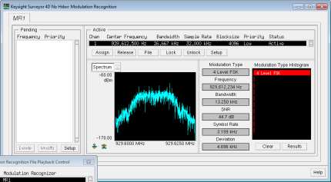
Signal Classification: The Signal Database
Using Surveyor 4D Modulation Recognition (MR1)
An example of the Signal Database in Surveyor 4D – it keeps track of signal “Internals”. Classification takes place automatically or manually with Universal Signal Detection (Option USD) and Mod Rec (option MR1).
Notes:
Modulation format and symbol rate are additional signal parameters used to classify signal energy. The ability to isolate signals that meet a specific frequency plan, bandwidth filter, modulation format and symbol rate is a powerful tool for intercept and collection missions.
Once the signal has been classified as a likely candidate, it can be collected (recorded) for additional processing.
S4D has an embedded (optional) Modulation classifier that can support either Survey or Intercept tasks. This example report shows 4800 baud signal energy in the 700 MHz band.

Slide 12
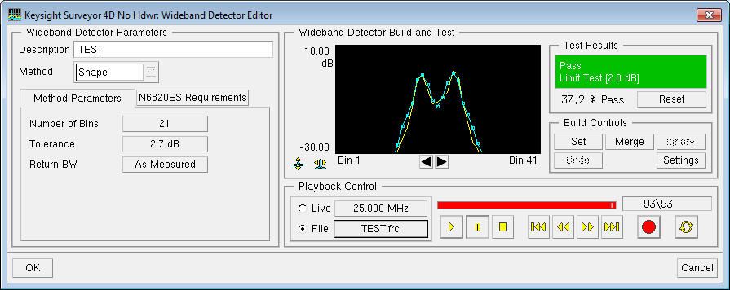
Signal Classification:
Universal Signal Detection (Option USD)
Enables Surveyor 4D to classify signals with no frequency plan and minimal a priori knowledge.
Frequency Range, Channel Plan plus Bandwidth Filter – this can help isolate candidates
Once the signal has been recorded, a wideband detector (spectral shape template) that requires no frequency plan can be used to isolate and collect candidate signals.
Notes:
USD facilitates this with a robust spectral shape detection scheme as seen in this example. Once the signal is observed in the spectrum and recorded, this type of detector requires no frequency channel plan to work.

Slide 13
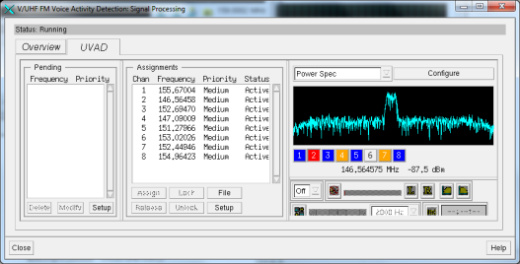
Signal Classification: Multiple DDC Mode
For Intercept and Collection Missions
Beginning with version 2.0.5 of the RF Sensor software/firmware, Multiple DDC mode is an orderable option on the RF Sensor (as N6841A-MFP).
This option enables a new FPGA image in the RF Sensor that will support up to 8 DDC’s each with streaming bandwidth up to 200 kHz.
These narrowband DDC’s are dynamically assigned to classify and collect signals of interest – based on external and/or internal characteristics.
NarrowBand Recorder (NBR) feature can stream single channel of IQ data to disc with bandwidth up to 2MHz.

Slide 14
Applications that make Sensor networks plausible
Built around the deployment process
Deployment Planning and modelling
RF Survey, Signal Classification
Emitter Location
Signals Analysis
Spectrum Data and Report Generation

Slide 15
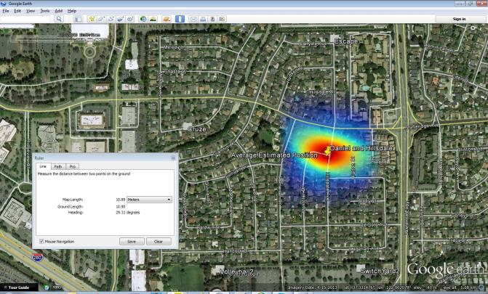
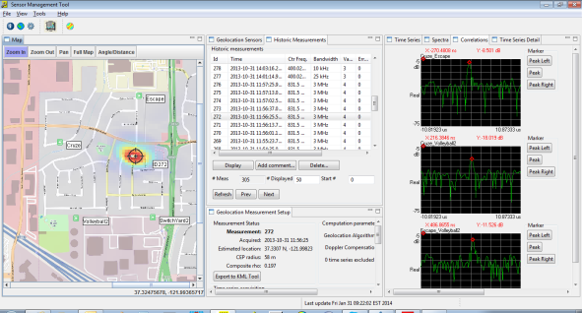
Emitter Location: N6854A Geo Server SW
Part of the Sensor Management Tool download
Synchronizes a group of RF sensors to locate RF emitters using TDOA (Time Difference of Arrival), RSS (Received Signal Strength) or Hybrid algorithms.
Licensed SW www.keysight.com
Notes:
Networks of sensors are synchronized with make TDOA or RSS geolocation measurements with the N6854A geolocation server software.

Slide 16
Applications that make Sensor networks plausible
Built around the deployment process
Deployment Planning and modelling
RF Survey, Signal Classification
Emitter Location
Signals Analysis
Spectrum Data and Report Generation

Slide 17
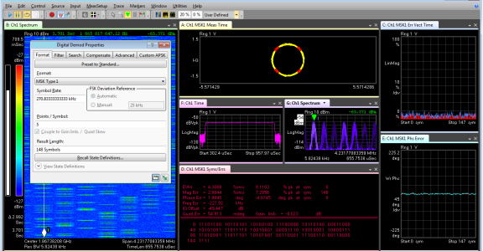
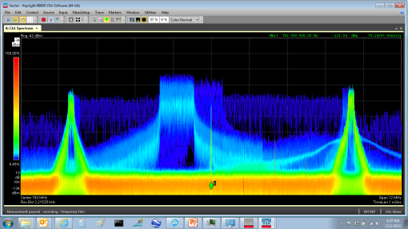
Signals analysis & identification: 89601B
Refer to Recommendation ITU-R SM.1600, “Technical identification of digital signals”
Once an IQ recording is made of the interference event, it can be loaded into Keysight 89601B Vector Signal Analysis software and analyzed.
Licensed SW www.keysight.com

Slide 18
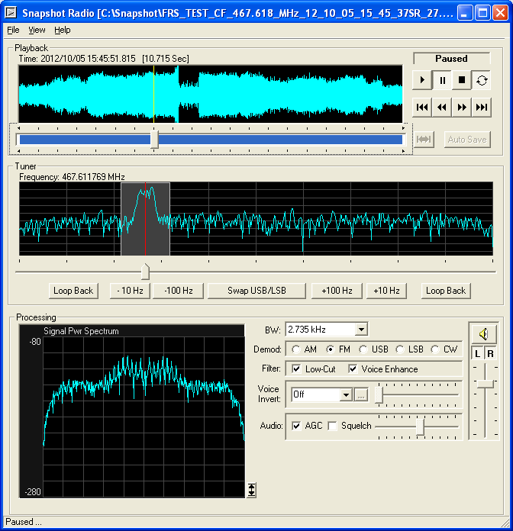
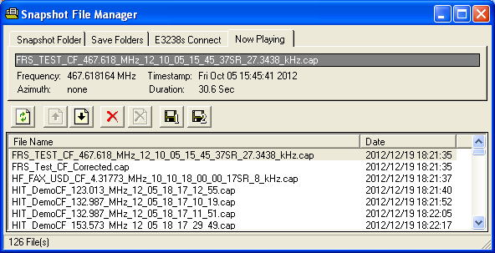
Signals analysis & identification: N6829BS
Snapshot Radio SW produces audio from IQ files
Complete control over the audio demodulation process
Identify source and nature of signals
Interface with commercial decoders (i.e. Wavecom, Hoka)
AM, FM, U/LSB, CW formats. Voice inversion
Convenient File Manager
Licensed SW www.keysight.com

Slide 19
Applications that make Sensor networks plausible
Built around the deployment process
Deployment Planning and modelling
RF Survey, Signal Classification
Emitter Location
Signals Analysis
Spectrum Data and Report Generation

Slide 20
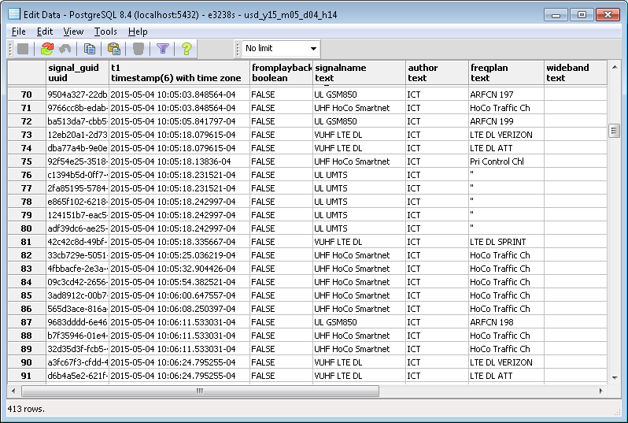
Spectrum Data & Report Generation
SQL Spectrum Visualizer
The PostgreSQL database is a powerful feature of the Surveyor 4D code. It allows Users to understand trends occurring in spectrum use.
Surveyor 4D includes an SQL visualizer tool built on web PHP – enabling Users to create plots, charts, graphs and tables of the spectrum data versus time, etc.

Slide 21
Example Deployment Architecture
Surveyor 4D SMT
Location 1
Location 3
(Mobile)
Surveyor 4D
SMT, GEO
SMT, VSA, SSR
Remote Client
SMS: Server
User Intranet
Ops WkStn
VPN/Wireless
VPN/Firewall
Remote Client
Location 2
Location ‘n’
SMT

Slide 22
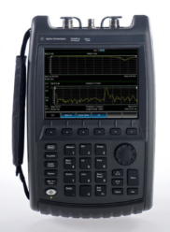
Keysight’s Handheld tools for Interference Detection
Handheld analyzers and directional antenna have become readily available for monitoring and interference work.
Once a coarse location is arrived at, a refined location
Using handheld analyzers can then be done

