Slide 1
Spectrum Measurements and the Impact to Spectrum Sharing
Paul Kolodzy, PhD
6 April 2016

Slide 2
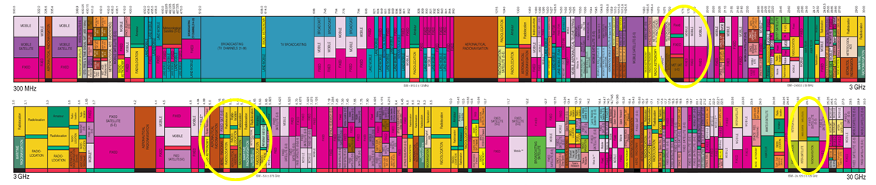
Measurements and Spectrum Sharing
CSMAC is investigating the challenges associated with spectral measurements for spectrum sharing
  Moving from non-directional transmissions at lower frequencies to more directional transmissions at higher frequencies.
  How does this impact the entire story? In some respects, directionality helps sharing. However, directionality hurts sensing.

Slide 3
Overview
Spectrum sharing measurement with respect to application diversity
Signal and deployment characteristics impact to measurement architectures
Challenges for current and future sharing measurements
Path forward for NSF

Slide 4
Measurement Needs
Prior to Sharing and Enabling Sharing
Prior to sharing
  Quantify the opportunity for spectrum sharing
    Bandwidth, Area, Time
  Threshold for occupancy
    Optimistic
    Pessimistic
Measurements to enable sharing
  Infrastructure- and Non-Infrastructure-Based
  Higher level of reliability, coverage

Slide 5
Measurement Needs
Post-Sharing and Enforcement
Measurements after sharing is allowed
  Interference trends
  Usage trends – verify predictions used to enable sharing
  Potential modifications of technical rules
Enforcement
  Interference forensics
  Real-time monitoring for interference (e.g. AWS-3)

Slide 6
Complete “Systems” Approach to Types of Measurement Architectures
What needs to be measured and how well (power, space, time, etc)?
  Characterization of the systems and the measurements to be made
  Heroic measurements are not always necessary
How is it measured?
  Strengths/Weaknesses of Measurement Architectures
  Large tradespace
What remediation for measurement limitations?
  Policy implications and work-arounds for measurement weaknesses from the regulator’s perspective
  More stringent technical rules or policies to ease measurements

Slide 7
Span of Emission Parameters
High Power/ Low Power
Broadband/ Narrowband
Large Footprint/ Small Footprint
Elevated Transmitter/ Near Ground Transmitter
High Gain Antennas/Low Gain Antennas
Continuous Transmission/ Intermittent Transmission
Fixed Transmitter/ Mobile Transmitter
Emission space is so vast that one measurement architecture does not meet all needs

Slide 8
Measurement Architectural Parameters
Fixed Site/Nomadic/Mobile
  Number of transmitters
  Latency and temporal/spatial requirements
Narrowband/Broadband
  Detection thresholds
  Bandwidth occupancy requirements
Low Density/High Density
  Continuous coverage requirement
  Many/few transmitters that are fixed or mobile
Terrestrial/Aerostat/Crowdsourced
  Spatial and temporal resolution requirements
Measurement architectures address different system challenges

Slide 9
Systems Spreadsheet
Band (MHz) | Application | Current or Future Use | Characterization (Power/Bandwidth/Footprint/Elevation/Continuous or Intermittent/Fixed or Mobile | Attempt at finding real specifications:
4940 - 4990 | DoD - tactical communications | Current | HP/WB/LF/EL/IN/MO - operating tactical systems that are used for line-of-sight and over-the-horizon communications. The Air Force uses the band to train aircrews in electronic combat, to send radar data over microwave links, and for such uses as missile testing and drone aircraft control. The Navy operates the Light Airborne Multipurpose System, a wideband data link between helicopters and ships in this band. Other military agencies operate tactical data links and drone command and control systems in this band. | May not be applicable example since at Ku Band - The LAMPS Hawklink is a high-speed, air-to-ground, digital data link that transmits reconnaissance and other data from MK III H-60 helicopters to their host surface ships, such as Arleigh Burke Class destroyers. The Hawklink will enable data, imagery, electronic support measures, communications, and radar information gathered by the helicopter's sensors to be multiplexed and transmitted in excess of >100nm, at a rate of 10.71 to 45 Mbps, to the host ship via the Ku-band link
4950 - 4990 | NASA | Current | LP/WB/LF/LO/CO/FX - passive observations and measurements to advance many areas of environmental change research including water salinity and soil moisture content. This band is also used for radio astronomy research (at selected radio astronomy observatories) via continuum measurement to study the detailed brightness distributions of both galactic and extragalactic objects and to make radio maps of interstellar clouds and supernova remnants.
4990 - 5000 | Radio Astronomy Service | Current | LP/NB/LF/LO/CO/FX - used for radio astronomy research via continuum measurement to study the detailed brightness distributions of both galactic and extragalactic objects and to make radio maps of interstellar clouds and supernova remnants. Highly sensitive receivers used to detect weak signals from space

Slide 10
SPECTRUM MEASUREMENT ARCHITECTURES
- Strengths and Weaknesses vs. Applications
 | HP/WB/LF/EL/CO/FX |  |  | HP/WB/LF/EL/CO/MO |  |  | HP/WB/LF/EL/IN/FX |  |  | HP/WB/LF/EL/IN/MO |  |  | HP/WB/LF/LO/CO/FX
Examples => |  |  |  | 5470-5570, 5570-5650, 5650-5925 GHz - DoD UAS CMD & Control |  |  |  |  |  | 5250-5255, 5255-5350, 5470-5570, 5570-5650, 5650-5925 GHz - military & special purpose radars
 | PRE | OPN | POST | PRE | OPN | POST | PRE | OPN | POST | PRE | OPN | POST | PRE | OPN | POST
Architecture
Fixed Site (~30 meters)
- Low Density (> 250 km2)
- Narrowband (=> fast sweep) | Y | Y | Y | Y | Y | Y | Y | Y | Y | R | R | R | Y | Y | Y
- Wideband (=> slow sweep) | G | G | G | G | G | G | G | G | G | G | G | G | Y | Y | Y
- High Density (</= 250 km2)
- Narrowband | Y | Y | Y | Y | Y | Y | Y | Y | Y | Y | Y | Y | Y | Y | Y
- Wideband | G | G | G | Y | Y | Y | G | G | G | G | G | G | G | G | G
Nomadic Site (~6 meters)
- Terrestrial
- Narrowband | Y | Y | Y | Y | Y | Y | Y | Y | Y | R | R | R | Y | Y | Y
- Wideband | G | G | G | G | G | G | G | G | G | Y | Y | Y | G | G | G
- Aerostat
- Narrowband | Y | Y | Y | Y | Y | Y | Y | Y | Y | Y | Y | Y | R | R | R
- Wideband | G | G | G | G | G | G | G | G | G | G | G | G | Y | Y | Y
Mobile (~2 meters)
- Terrestrial
- Narrowband | Y | Y | Y | Y | Y | Y | Y | Y | Y | R | R | R | Y | Y | Y
- Wideband | G | G | G | Y | Y | Y | Y | Y | Y | R | R | R | Y | Y | Y
- Aviation
- Narrowband | Y | Y | Y | Y | Y | Y | R | R | R | R | R | R | R | R | R
- Wideband | G | G | G | Y | Y | Y | Y | Y | Y | Y | Y | Y | Y | Y | Y
- Crowd Sourcing
- Narrowband | Y | Y | Y | Y | Y | Y | Y | Y | Y | Y | Y | Y | Y | Y | Y
- Wideband | G | G | G | Y | Y | Y | G | G | G | G | G | G | G | G | G

Slide 11
Remediation Techniques
Prior to Sharing
  Beaconing, use of known preambles, etc; lower threshold for determination of coordination zones
Enable Sharing
  Databases; coordination; low interference thresholds; intermediary for security/privacy
Post Sharing
  Re-evaluation of transmission / receiver parameters; trending to determine if base assumptions were correct; collaborative actions between co-primary or primary/secondary users
Enforcement
  Signal storage and forensics; collaborative and/or coherent signaling; transponder identification

Slide 12

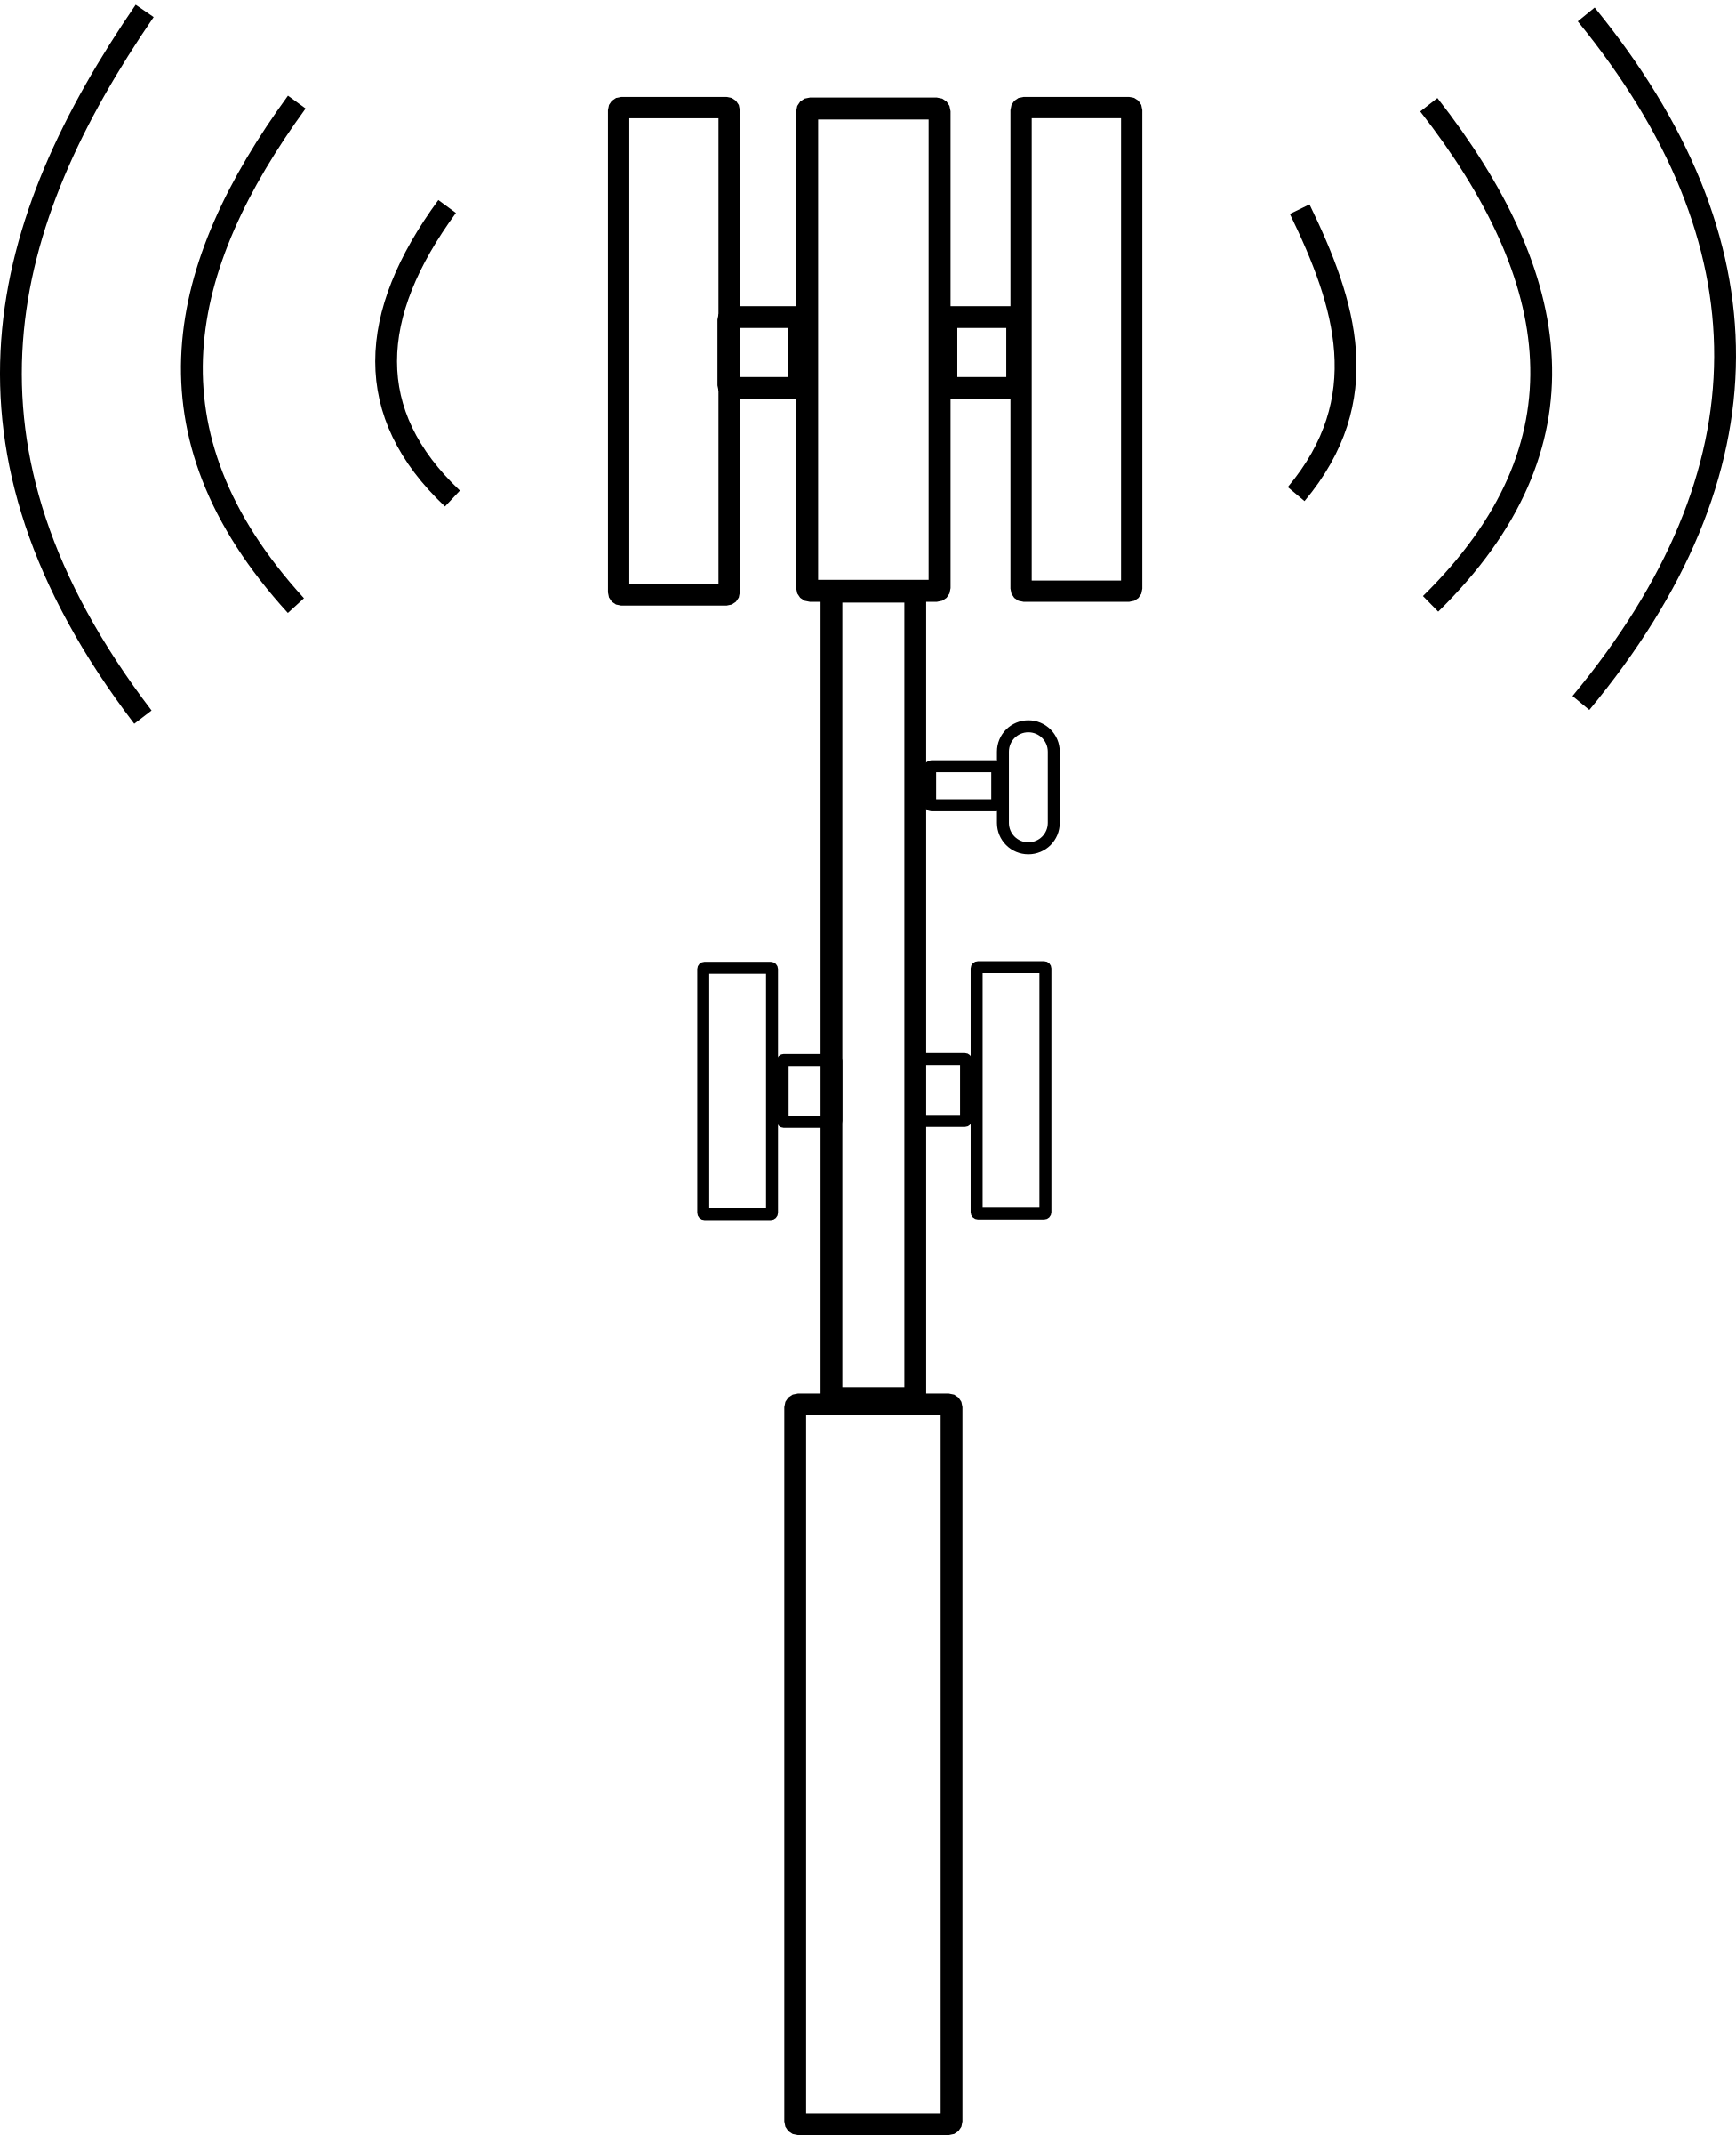


Current Example
POES/GOES Spectrum Monitoring (AWS-3)
Monitoring systems to be deployed around ground stations to determine if interference events are about to occur
Challenge: Protecting a receiver using high aperture gain
  Impact is an incoherent integration of many emitters at the aperture
  How to make cost effective without building a duplicate system
Payoff: Cooperative spectrum management to allow for more active control of the secondary service
Interference and signal monitoring can be extremely challenging for directional systems

Slide 13
Possible New Measurement Challenges
Multi-antenna systems with coherent gain
  Distributed MIMO (including Macro-MIMO) are becoming viable technologies
  Given the large extend of the “array”, get many grating lobes, etc
  Signal level varies wildly from coherent gain regions to incoherent gain areas
So measurements may be only valid at a precise location
  Challenge problem for all measurement needs
Spatial reuse is become a primary driver (if it isn’t already) for meeting capacity → spatial analysis may become critical

Slide 14
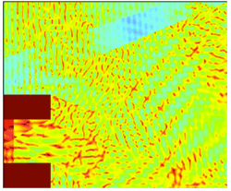
Distributed MIMO and Interference Measurements

Slide 15
Impact to NSF
Statistical analysis to meet the requirements
  What is needed for each applications (before, during, after sharing)
  Single platform / multiple platform techniques
  Coherent versus incoherent measurements
  Statistical analysis versus noise floor
Impact of space on measurements
  Environmental Blocking (buildings, etc) versus NLOS propagation
  Beamforming
  Distributed MIMO

Slide 16
Impact to NSF
Advanced Measurement Architectures
  Quantity vs Quality
  Mobile vs Fixed
  Coordinated vs Coherent
Impact of Policy to Measurements
  How can policy make measurements easier?
  How can measurements address privacy-security concerns?

Slide 17
Summary
Measurements are critical for making spectrum availably for sharing as well as enabling sharing
One size does not fit all: need to look at different architectures and address privacy-security concerns
Beamforming and distributed MIMO create significant challenges for measurements
  Getting “appropriate” situational awareness is the goal
There are significant challenges for NSF to address that impact
  Education (understanding new paradigms and methods)
  Science/Engineering
  US Competitiveness

Slide 18
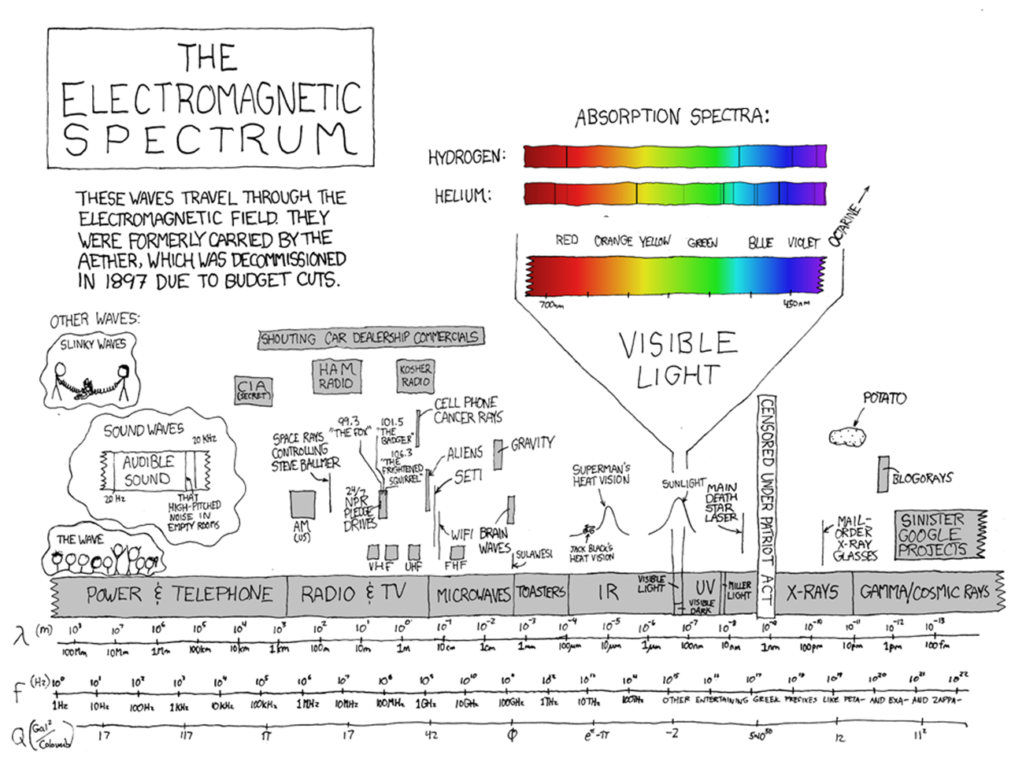

Slide 19
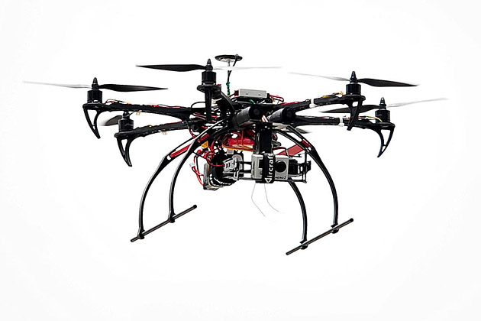
Off-Topic but Not Irrelevant → CUAV
Policies limiting looking at signal internals
  Private versus public networks
Use of RF signaling as mitigation
  Commandeering (commanded overpowering)
  Signal Insertion (overpower and timing)
  Jamming (partial or complete band overpowering)
Testing in complex environments
  Lack of controls for signal intercept
  Deleterious impacts of RF mitigation
“Interference Bubbles” are now a reality
  Distributed coherent techniques
Propagation environments are becoming virtual
  e.g. RF Nest, and similar, Scalable to 10’s of nodes
Software Defined Radars
  On the horizon

