Slide 1
CAC Spectrum Monitoring
Program Status
6 April, 2016
Mike Cotton
National Telecommunications and Information Administration (NTIA)
Institute for Telecommunication Sciences (ITS)
- for -
NSF Workshop on Spectrum Measurements
and Spectrum Management

Slide 2
Project Goals
Develop an infrastructure to acquire and amass spectrum monitoring data and make it available to the spectrum community in near real-time via the Internet.
Establish best practices for the acquisition of spectrum data.
Maintain small network of ITS spectrum monitors (e.g., 2 in FY15, 6 in FY16, 12 in FY17) in high-priority scenarios to support spectrum rulemaking, engineering, management, and enforcement.
To evaluate whether a more comprehensive monitoring program would create additional opportunities for more efficient spectrum access through, for example, increased and more dynamic sharing.

Slide 3


Spectrum
Monitoring Network
RF
C
M
F
Sensor 1
Authorized Users
RF
C
M
F
IP Internet
Sensor 2
IP Network
RF
C
M
F
Sensor 3
RF
C
M
F
Sensor 4
NTIA/ITS Boulder
M
F
RF
C
M
F
Modem/Firewall
and Data Staging Station
Sensor N
Measured Spectrum Occupancy Database (MSOD)

Slide 4

Sensor Design(s)
General Architecture
IP Network
Example Site Requirements for 3.5 GHz Sensor:
180⁰ Filed of View of Ocean/Gulf
AC Power: (1 A)
Shelter: Driver, COTS sensor, and modem are not weatherproof
Access to Outside to run 30’ RF and Ethernet cables
Structure outside shelter for mounting antenna and preselector
Preselector
COTS Sensor
Measurement Controller

Slide 5
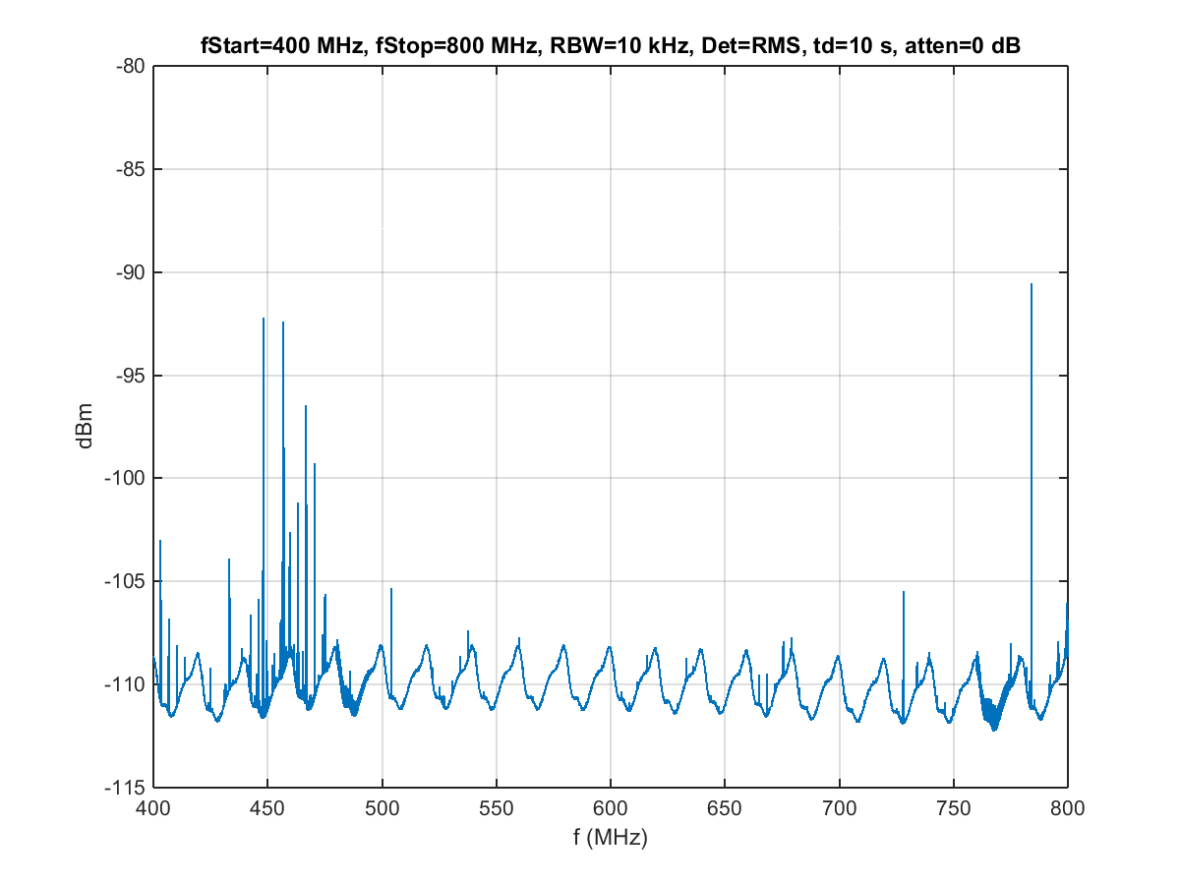
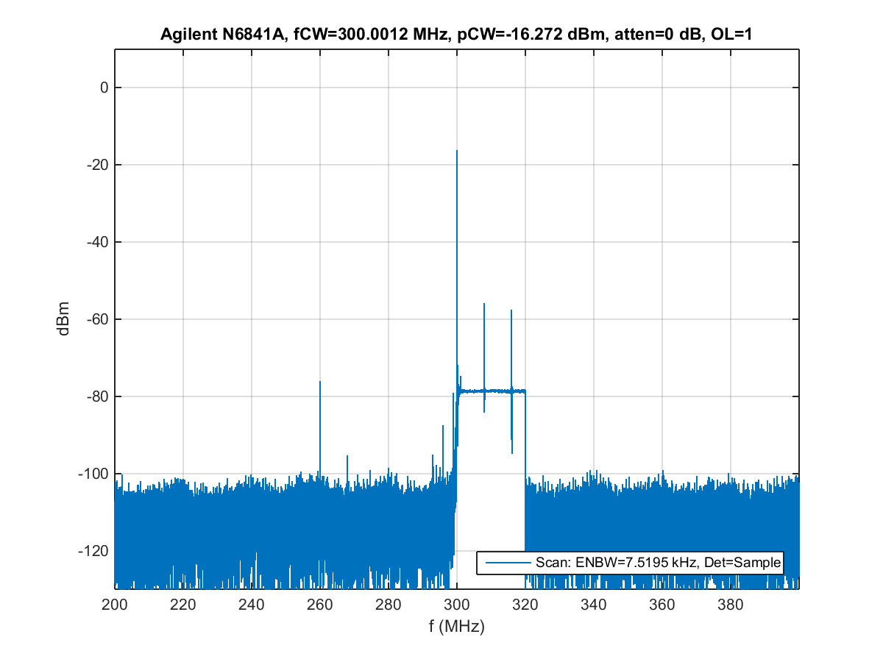
Example COTS Sensor
Test Results
DANL Test showing self-generated spurs
Overload Behavior

Slide 6
How Measurements are
Logged to Database
Three message types
System: RF specs, sensor ID, calibration data
Location: geolocation data, time
Data: detection scheme, frequency range, power spectra, …
Modes
Acquisition: periodically posts finite block of data
Streaming: continuously transmits measurements over a persistent, secure socket
{
"Ver": "1.0.12",
"Type": "Loc",
"SensorID": "101010101",
"SensorKey": 846859034,
"t": 987654321,
"Mobility": "Stationary",
"Lat": 40.0,
"Lon": -105.26,
"Alt": 1655,
"TimeZone": "America\Denver"
}
sample Location message

Slide 7
Spectrum Occupancy
Database
Repository of power spectra measurements
Threshold-based calculation of band occupancy
Distributed architecture: multi-site, multi-org
Access via web-based services
Visualization via a web browser application
Open source
Organization A
Organization B
Sensor
Sensor
Sensor
Sensor
Sensor
Sensor
Periodic public meta data
Web Server + Database
Web Server + Database
Web Browser
Web Browser

Slide 8

FY16 Project Deliverables
Release 1 year of 3.5 GHz data measured near Norfolk and San Diego
Deploy 6 x 3.5 GHz Sensors at coastlines of U.S. littoral waters
Acquire Authority to Operate NTIA MSOD and make available online for NTIA/OSM
Assist NOAA in acquiring a 1695 – 1710 MHz monitoring solution at and around their MetSat ground stations
Continue to evaluate and test new sensing technologies
MSOD

Slide 9
Contact Information and References
Michael Cotton, mcotton@its.bldrdoc.gov, 303-497-7346
Souryal, et al., “Real-Time Centralized Spectrum Monitoring: Feasibility, Architecture, and Latency," in Proc. IEEE DySPAN, Sep. 2015.
Wepman, et al., “RF Sensors for Spectrum Monitoring Applications: Fundamentals and RF Performance Test Plan,” NTIA Technical Report TR-15-519, Aug. 2015.
Cotton, et al., “An Overview of the NTIA/NIST Spectrum Monitoring Pilot Program,” IEEE International Workshop on Smart Spectrum, New Orleans, Mar. 9, 2015.
Cotton and Dalke, “Spectrum Occupancy Measurements of the 3550-3650 MHz Maritime Radar Band Near San Diego,” NTIA Report TR-14-500, Jan 2014.

