Slide 1
NI Platform for Spectrum Monitoring Systems
Abhay Samant
Section Manager, RF and Wireless Communications

Slide 2
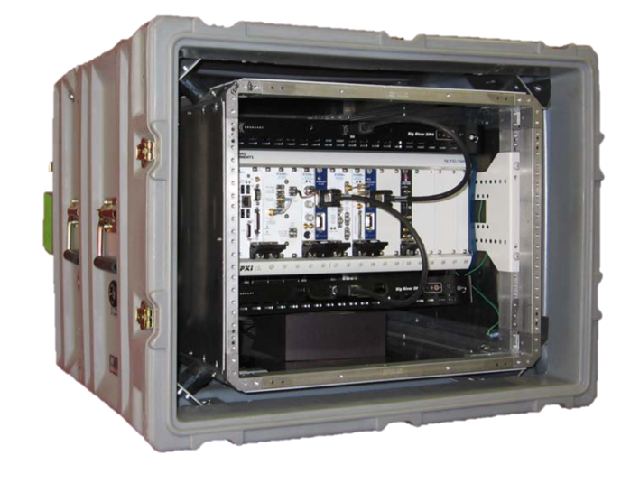
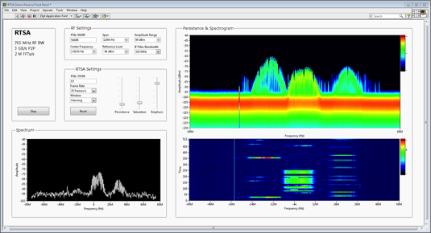
Spectrum Monitoring System Considerations
Receiver Performance
Scan Rate
Preselection & Dynamic Range
Linearity (SHI and TOI)
Noise Figure / Sensitivity
Signal Processing
Modulation/Signal Recognition
Digital downconversion/channelization
Filtering and windowing functions
System Completion
Transportable (SWAP)
Graphical display
Data storage and playback
Multi-channel and multi-system synchronization and GPS time stamping

Slide 3
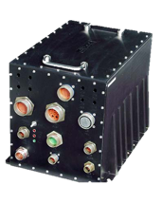
Elements of a Spectrum Monitoring System
1 to N Radio Front Ends
Multi-Processor Architecture
System Completion
Tx
Rx
CPU
GPU
Mechanicals
Tx
Rx
Data Bus
Data Bus
Tx
Rx
FPGA
DSP
Tx
Rx
Storage
Hardware is Commoditized
Software is the Hard Part!!!
Storage is Commoditized

Slide 4
Why is Software So Important?
Multi-Processor Architecture
Signal processing algorithms evolve
quickly in response to new threats
Software must scale across multiple hardware platforms
and technology readiness
levels (TRL’s)
CPU
GPU
Security paramount –
andIP in the FPGA is
often the most secure
Wider bandwidths require
sophisticated software to
handle intense signal
processing
FPGA
DSP
Software is the Hard Part!!!

Slide 5
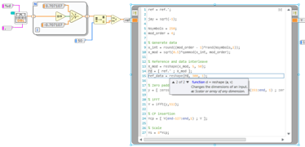
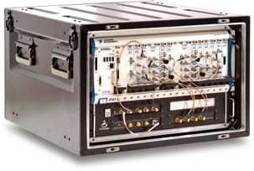
NI’s Platform-Based Approach to Spectrum Monitoring
NI’s Software Integrates all Aspects of System Design
Hardware Integration
Algorithm Development
System Completion
Integrated support for wide range NI RF hardware
Deployment platforms from highly-portable to high-performance
Deep LabVIEW signal processing libraries
RFNoC and GNU radio toolchain support
C, C++, .M, and VHDL integration
An ecosystem of partners and developers
Better usability with native GUI and built-in remote access
Hardware synchronization and data storage
Tx
Rx
CPU
GPU
Mechanicals
Tx
Rx
Data Bus
Data Bus
Tx
Rx
FPGA
DSP
Tx
Rx
Storage

Slide 6
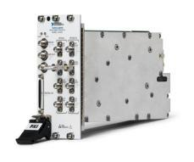
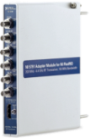
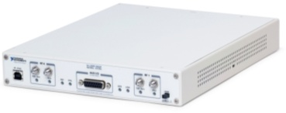
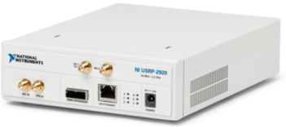
Scalable Platform for RF and Wireless Communication
Common LabVIEW Graphical System Design Software
mmWave Transceiver
High Performance
VSA
Software Designed
Instrumentation
mmWave
2 GHz BW 76 GHz Fc
Performance
High Performance RF and Baseband Transceivers
High Performance
SDR Prototyping
VSA
765 MHz BW 26.5 GHz Fc
Host Based
SDR Prototyping
VST
200 MHz BW 6 GHz Fc
FlexRIO
200 MHz BW 4.4 GHz Fc
Maximum SFDR of 117 dB
(1 Hz BW) at 20 GHz
USRP RIO
160 MHz BW 6 GHz Fc
USRP 20 MHz BW 6 GHz Fc
Price

Slide 7
Benefits of LabVIEW for Spectrum Monitoring
Tx
Rx
CPU
GPU
Radio Front Ends
Tx
Rx
System Completion
Tx
Rx
FPGA
DSP
Tx
Rx
Get up and running quickly with broad range of example programs
Maximize hardware performance with advanced driver API’s
Wide range of receivers w/ user-programmable FPGAs
Quickly develop FPGA software using LabVIEW
Fast prototyping using broad range of existing signal processing IP
Easily Integrate IP from various languages including: C, C++, G, .m, and VHDL
Control systems remotely using remote access technologies
Stream massive signal bandwidth to hard disk
Leverage ecosystem of more than 100,000 LabVIEW developers and partners

Slide 8
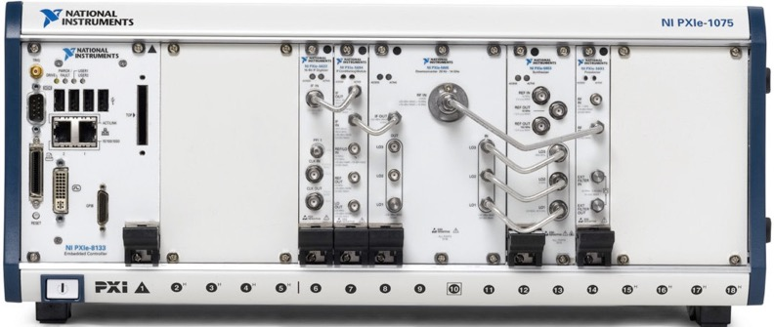
PXIe-5667 System (7 GHz)
Characteristics | PXIe-5667 | ITU Handbook
Frequency Range | 20 Hz - 3.6 GHz 20 Hz - 7.0 GHz | 20 MHz – 3 GHz
Preselection | Sub-octave Filters | Sub-octave Filters
Noise Figure | 12 dB < 3 GHz 14 dB < 7 GHz | 12 dB
Second Harmonic Intercept | >+80 dBm | +40 dBm
IP3 | >+17 dBm | +10 dBm
Phase Noise @ 10 kHz | > -129 dBc/Hz | -100 dBc/Hz
Scan Rate | 30 GHz/sec | --
PXIe-5694
Bank of Selectible IF Roofing Filters
PXIe-5693
Bank of Selectable RF Bandpass Filters
Note: PXIe-5667 is based on 14 GHz PXIe-5665 – but front end filters limit max frequency to 7 GHz
PXIe-5667 is Fully Compliant to ITU Receiver Specifications
Notes:
Complete PXIe-5667 system.

Slide 9
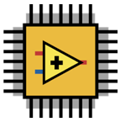
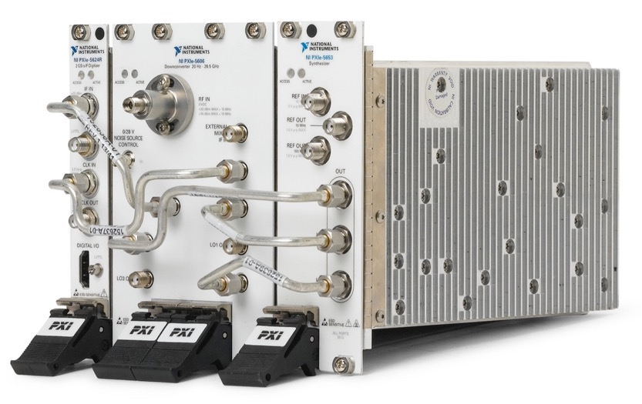
NI PXIe 26.5 GHz Vector Signal Analyzer
Specifications
Frequency Range | 20 Hz to 26.5 GHz
Analysis BW | 320 MHz below 3.6 GHz 765 MHz above 3.6 GHz
Phase Noise (typ, @10 kHz offset) | -129 dBc/Hz @ 1 GHz
Nom RMS Noise Floor (without pre-amp*) | < -155 dBm/Hz (1 GHz) < -145 dBm/Hz (26 GHz)
TOI | > +20 dBm (20 Hz to 26 GHz)
Flexibility | Kintex-7 410T FPGA Programmable w/ LabVIEW
No. of Slots | 7
*Noise floor at 1 GHz is -165 dBm/Hz with pre-amp engaged
Add Heavenly

Slide 10
Ettus Research USRP Family
 | Bus B2xx | Embedded E3xx | Networked N2xx | High Performance X3xx
Frequency (Hz) | 70 M – 6 G | 70 M – 6 G | DC-30M & 10M–6G | DC-30M & 10M–6G
Bandwidth | 56MHz (32 MHz in 2x2) | 56MHz (32 MHz in 2x2) | 40 MHz | 160 MHz
Channels | 2 Tx, 2 Rx | 2 Tx, 2 Rx w/ filter banks | 1 Tx, 1Rx | 2 Tx, 2 Rx
RF Performance | Good | Good | Better | Best
Architecture | Integrated RF | Integrated RF | RF Daughterboard | RF Daughterboards
Communication | USB | Embedded | 1GbE | 10GbE or PCIe
MIMO Capability | 2x2 | 2x2 | Up to 2x2 | 2x2 to 256x256
LabVIEW Support | Yes | No | Yes | Yes
NI Version | USRP-290x | None | USRP-292x USRP-293x | USRP-294x USRP295x
Open S/W Ecosystem | GNU Radio C++ MatLab Xilinx ISE | GNU Radio C++ Xilinx Vivado C Coder HDL Coder | GNU Radio C++ MatLab Xilinx ISE | GNU Radio C++ MatLab Xilinx Vivado Simulink C Coder HDL Coder

Slide 11
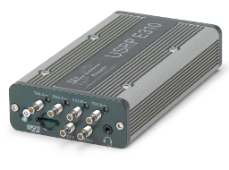
USRP E-Series Overview
Specs
Frequency Range: 70MHz - 6 GHz, 10dBm power output
2x2 MIMO standard configuration
~ 50 MHz BW / channel
Xilinx Zynq-7020
ARM Dual-Core Cortex A9 @ 667MHz
1GB Processor RAM
512 MB FPGA RAM
120x90x50 mm, 375g
3-9 W
Applications
Mobile Network research
Network testbeds
Small, portable, low cost spectrum monitor
Small UAVs
Handheld universal communicator
Features
I/O: GigE, Audio in/out, USB 2.0 Host, GPS In
Micro SD memory card slot
Invensys MPU-9150A 10-axis IMU
3-axis MEMs Gyro, Accelerometer & Magnetometer
Barometric Altimeter
U-BLOX AMY6-M GPS Receiver
Derivatives
Waterproof - IP67
4 Rx to TDOA/DF Applications
OEM/Unboxed
Battery

Slide 12
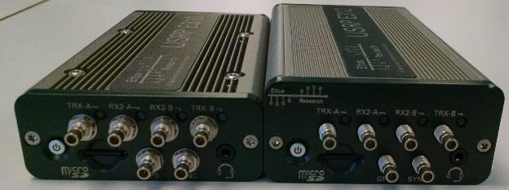
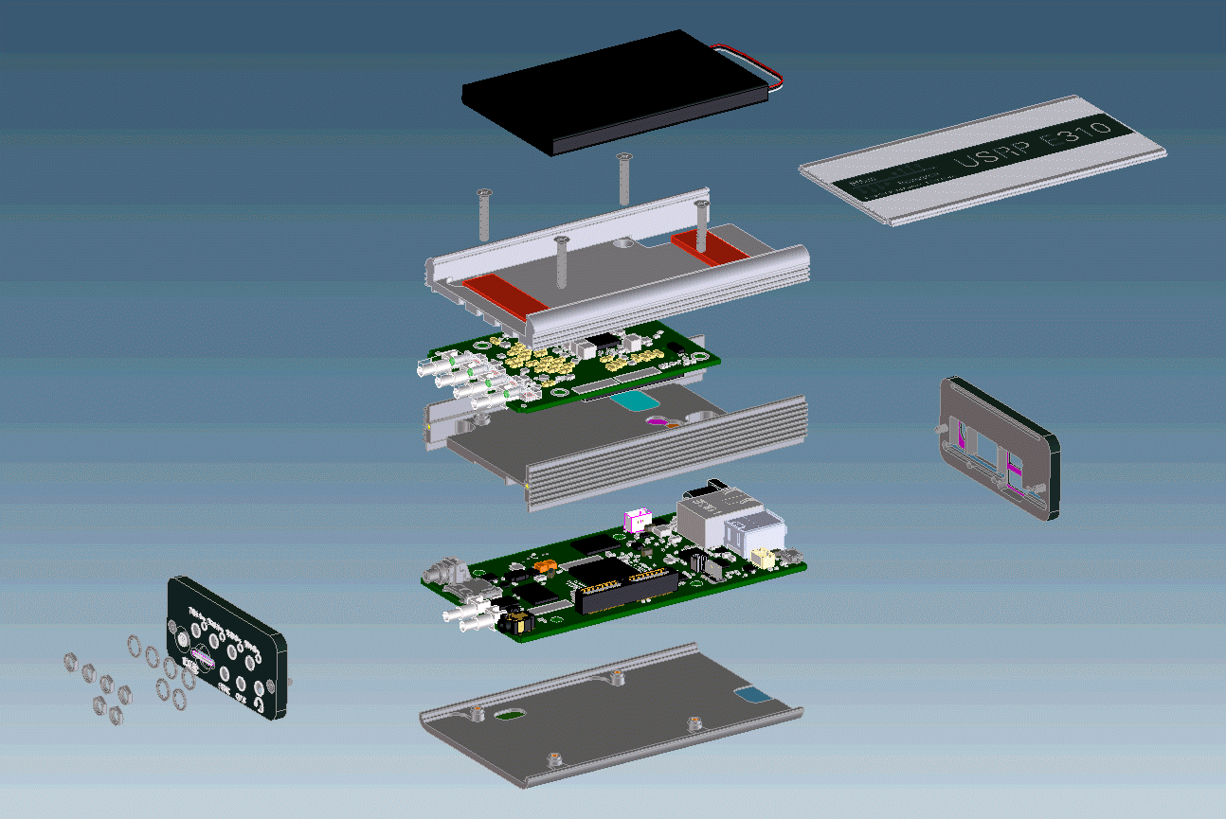
E312 Battery
Battery life powered down ~160hr
Battery life on idle ~5:30hr
Battery life on full load (1x1 TX/RX @5GHz, 1Mhz, 100%) ~2:20hr
Battery life on full load (2x2 TX/RX @5GHz, 1Mhz, 100%) ~1:45hr
Battery charge time to full ~2:00hr

Slide 13
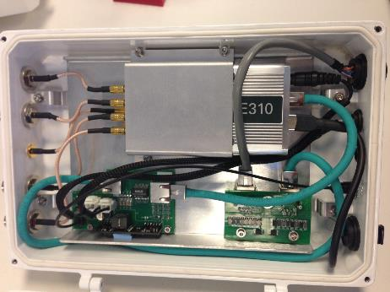
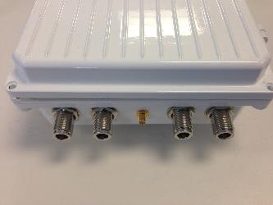
E313 IP67 Enclosure
Power Over Ethernet
(POE) DC-DC
Lightning Protection
E310 or E312 Thermally Connected to Enclosure

Slide 14
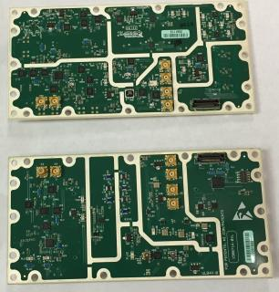
High Sensitivity Dual Rx X-Series Daughterboard
Q2 2016
Designed for regular monitoring and/or to gather wireless signal intelligence data
Provides spectrum measurements from 10 MHz to 6 GHz
Unlike existing Ettus Research direct conversion daughter-boards, will have two receive channels and a super-heterodyne front end which will deliver residual spurious performance better than -100 dBm.
Target Applications:
Direction Finding
Spectrum Monitoring
SIGINT/COMINT/ELINT

Slide 15
Roadmap
Tx
Rx
CPU
GPU
Radio Front Ends
Tx
Rx
System Completion
Tx
Rx
FPGA
DSP
Tx
Rx
Wider bandwidth
Higher Frequencies
Signal Conditioning
Multi-channel synchronization
Seamless support for heterogeneous compute nodes
Latency
Streaming
System Level abstraction
Deployment
Data storage
Software for data analytics and insight
Foster open ecosystem

Slide 16
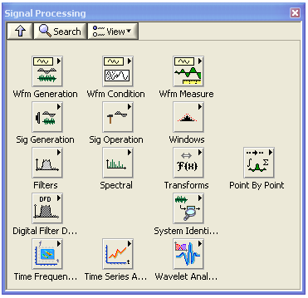
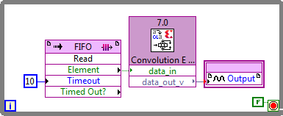
Signal Processing with LabVIEW
DDCs / DUCs / Filtering / Channelization / Decimation
In-band power, adjacent-channel power, burst timing, BER, EVM, MER, ρ, and more
Advanced RF, spectral measurement, and modulation software
Custom modulation formats and channel coding and impairments
Wavelet and filter-bank design for short-duration signal characterization, noise reduction, and detrending
Time-frequency analysis -- analytical, graphical tools for signals with evolving frequency content
Time-series analysis -- statistical analysis for description, explanation, prediction, and control
Access Xilinx CORE Generator IP Libraries in LabVIEW FPGA
Notes:
National Instruments LabVIEW provides algorithms and functions designed specifically for analysis and signal processing. You can easily integrate these into deployed Signal Intelligence systems as well as systems to test receivers.

Slide 17
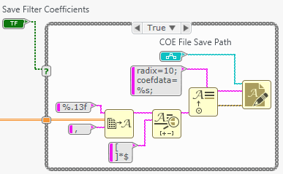
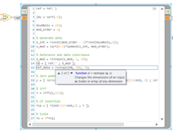
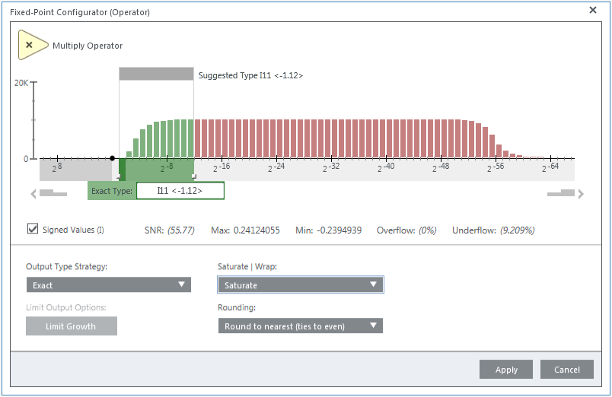
Benefits of LabVIEW for Signal Processing
New Signal Processing Tools in LabVIEW Communications
Easy integration of C & .m code
FPGA High-Level Synthesis
LabVIEW Communications has extensive and productive tools that allow you to create and reuse signal processing IP for multi-core processors and FPGAs – and do it faster!
FPGA programming through graphical high level synthesis (HLS) and IP containers for VHDL
Multirate Diagram with for more intuitive DSP algorithm design
Floating to fixed point conversion utilities
Import compiled C/C++ code and natively compile .m IP
Notes:
This slide needs to translate to benefits

Slide 18
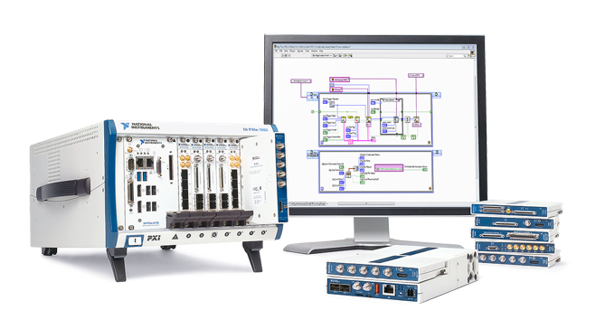
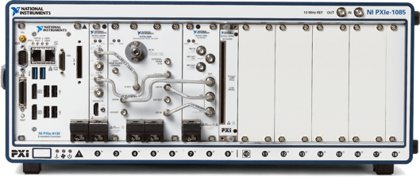
PXI Spectrum Monitoring Options
FlexRIO Receivers
PXI Vector Signal Analyzers
Lowest cost
PXI & embedded form factor
Direct conversion receivers up to 6 GHz
Highest performance
PXI form factor only
Heterodyne receivers up to 26.5 GHz

Slide 19
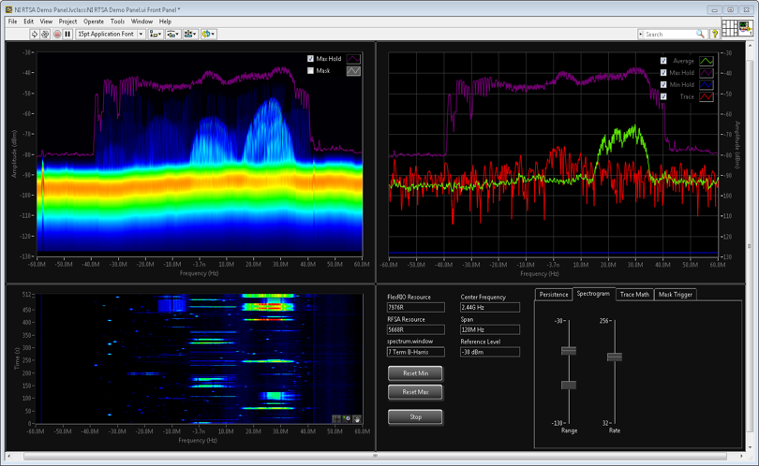
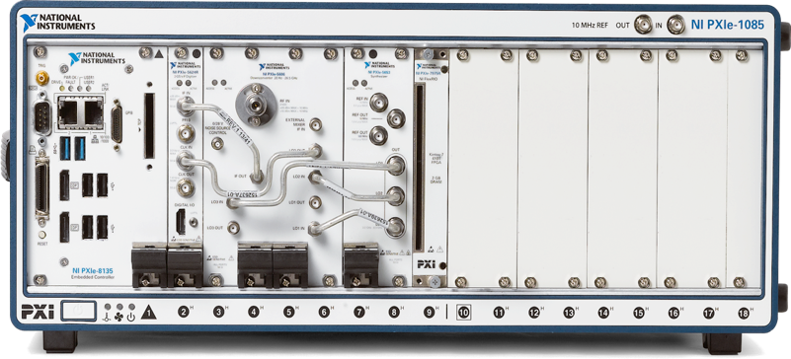
PXIe-5667 vs PXIe-5668R
Characteristics | PXIe-5667 | PXIe-5668R
Frequency Range | 20 Hz - 3.6 GHz 20 Hz - 7.0 GHz | 20 MHz – 26.5 GHz
Preselection | Sub-octave Filters | 50 MHz BW YTF
Noise Figure | 12 dB < 3 GHz 14 dB < 7 GHz | 5 dB* <10GHz 9 dB* < 20GHz
Second Harmonic Intercept | >+80 dBm | >+60 dBM
IP3 | >+17 dBm | >+20 dBm
Phase Noise @ 10 kHz | -129 dBc/Hz | -129 dBc/Hz
Scan Rate | 30 GHz/sec | > 30GHz/sec
Slots | 9 | 8*
PXIe-5668R can stream at full data rate (765 MHz) to FlexRIO (peer-to-peer) OR hard disk
LO and sample clocks of PXI VSA’s can be shared for multi-channel applications
*With PXIe-569x 26.5 GHz pre-amp, releasing Q2-2016
Notes:
Complete PXIe-5667 system.

Slide 20
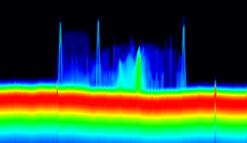
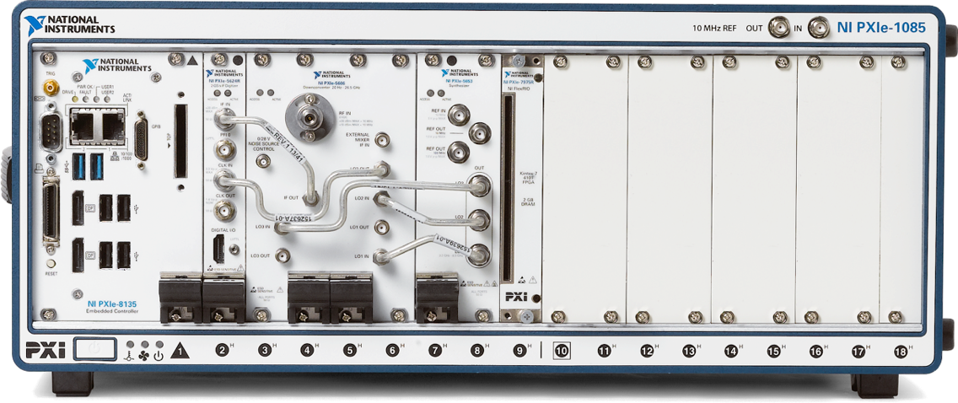
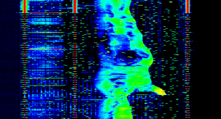
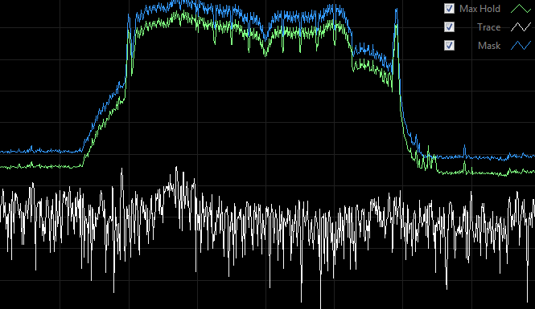
RTSA Application for PXIe-5668R
PXIe-7976R FlexRIO
FlexRIO FPGA Module
PXIe-5668R VSA
VSA
IQ Data
To Host
P2P
Persistence
Spectral Data
To Host
Spectrogram
To Host
Comparison with traditional RF signal analyzers
Product | Real-Time Bandwidth | Maximum Frequency | 100% POI
NI PXIe-5668R+7976R | 765 MHz | 26.5 GHz | 1.5 µs
Keysight UXA | 510 MHz | 26.5 GHz | 3.51 µs
R&S FSW | 160 MHz | 67 GHz | 1.87 µs
Tektronix RSA5000/RSA6000 | 165 MHz | 26.5 GHz | 3.7 µs
Triggers
Frequency Mask + Trace Math

Slide 21
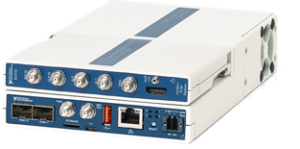
PXIe-5667 vs PXIe-5668R vs FlexRIO
PXI Form Factor
Characteristics | PXIe-5667 | PXIe-5668R | NI 5792R
Frequency Range | 20 Hz - 3.6 GHz 20 Hz - 7.0 GHz | 20 MHz – 26.5 GHz | 200 MHz to 4.4 GHz
Preselection | Sub-octave Filters | 50 MHz BW YTF | Selectable LPF
Noise Figure | 12 dB < 3 GHz 14 dB < 7 GHz | 5 dB* <10GHz 9 dB* < 20GHz | 10 dB < 3 GHz 14 dB < 4 GHz
Second Harmonic Intercept | >+80 dBm | >+60 dBM | -
IP3 | >+17 dBm | >+20 dBm | - 6 dBm
Phase Noise @ 10 kHz | -129 dBc/Hz | -129 dBc/Hz | -100 dBc/Hz
Scan Rate | 30 GHz/sec | > 30GHz/sec | -
Slots | 9 | 8* | 1
NI Controller for FlexRIO
*With PXIe-569x 26.5 GHz pre-amp, releasing Q2-2016
200 MHz BW
Notes:
Complete PXIe-5667 system.

Slide 22
FlexRIO Form Factor & Deployment Options
NI’s LabVIEW Software Environment
Prototype
Deploy
Features and Specifications
667MHz Dual-Core ARM A9 Processor
NI Linux Real-Time OS
uSD Storage, USB, and 1 GbE Connectivity
Optimized for size, weight, and power
1.75 x 5.5 x 9.2 inches
Features and Specifications
High-performance Xeon processors
Windows OS or NI Linux Real-Time OS
Up to 17 FlexRIO modules per system
High-performance RAID options
Notes:
Overall, the Controller for FlexRIO helps push down the deployment curve so you can take a platform based approach to design. Now you can design, prototype, and deploy your technology all on one platform. During design, LabVIEW enables you to quickly test out your algorithms. Prototyping on FlexRIO for PXI ensures that you have all the resources at your disposal to be successful with your PoC. The new Controller for FlexRIO brings the same FPGA and I/O technology to the form factor you need, better enabling you to productize or replicate systems.
The End.

Slide 23
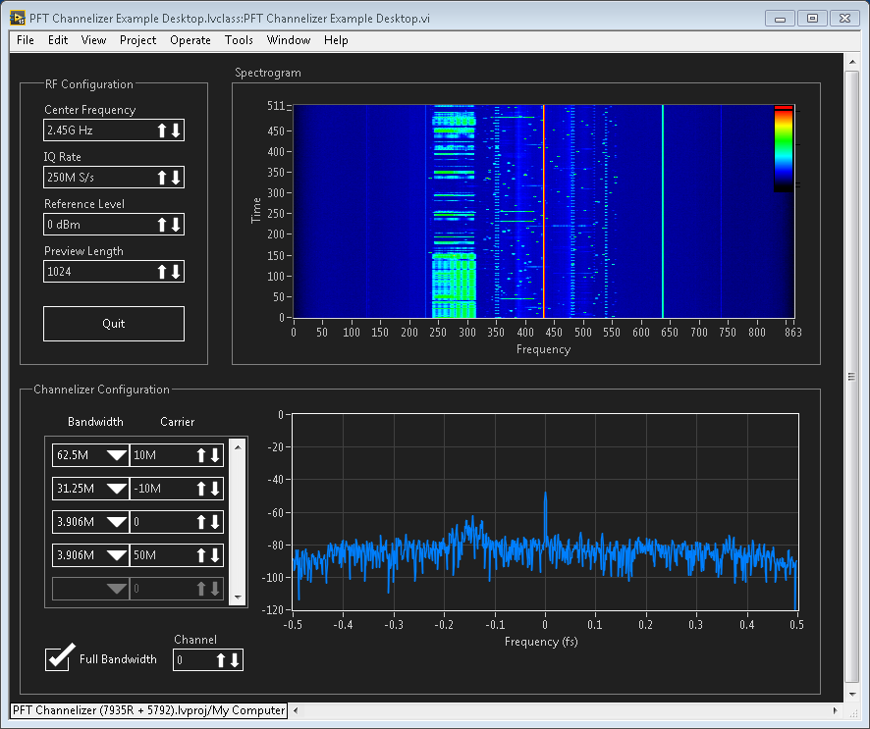
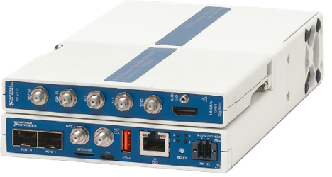
LabVIEW FPGA Channelizer Reference Application
Q2-2016
Pipelined Frequency Transform Channelizer
Continuous real-time operation
Up to 512 channels
Up to 100 MHz aggregate, contiguous bandwidth
Variable channel BW and center frequency
VITA-49 Radio Transport Protocol over 10 GbE UDP
Industry standard IQ data encapsulation
Desktop
PC
Controller for FlexRIO
1 GbE
Spectrogram
Configuration
Channel Power Spectrum
RT
DRAM
RF Receiver
NI 5792
FPGA
PFT Channelizer
DRAM Reordering
VITA-49 Packing
10 GbE UDP
10 GbE
Raw Channelized IQ Data
1 UDP port per channel
VITA-49 Packing
Notes:
Contacts: Jonathan Sass, Ryan Verret, Rob Bauer
Chances are you’ve seen the Real-Time Spectrum Analyzer reference application; now we are releasing a new reference application for spectrum monitoring with the Controller for FlexRIO. This reference application contains channelizer IP that is capable of scaling up to 512 channels and streaming VITA-49 structured data over 10 GbE.

Slide 24
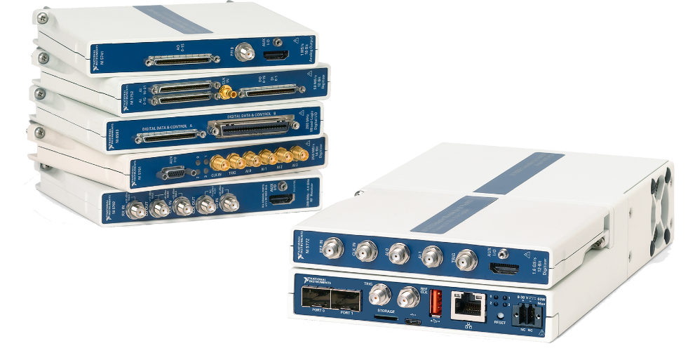
Controller for FlexRIO
Released
Program with LabVIEW
Decrease development time with a single development environment to target both FPGAs and Processors
Leverage High Performance I/O
Process Data on Powerful Xilinx FPGAs
Kintex-7 K410T w/ 2 GB DRAM
2 x SFP+ Ports for 2.5 GB/s of data streaming
Reference clock and trigger inputs for synchronization
Deploy your Solution
667MHz Dual-Core ARM A9 Processor
NI Linux Real-Time OS
uSD Storage, USB, and 1 GbE Connectivity
Optimized for size, weight, and power
1.75 x 5.5 x 9.2 inches
3GS/s AI
1Gb/s DIO
4.4GHz RF

Slide 25
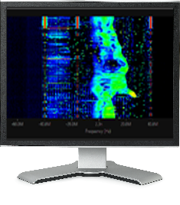
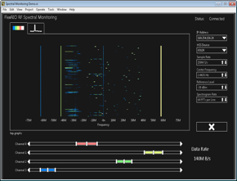
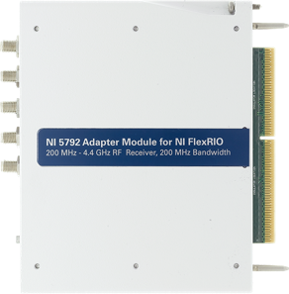
Monitoring Solution with Controller for FlexRIO
Remote Client
FPGA
Processor
NI 5792
Generate
Spectrogram
Compute FFT
DMA to Host
Write to Client
1 GbE
Read from Client
Configuration
200 MHz – 4.4 GHz
200 MHz BW
Channelizer
10 GbE Stream
Server
10 GbE UDP
Notes:
To start, we can meet the bandwidth requirements with our NI 5792 RF receiver adapter module, which has 200 MHz instantaneous bandwidth. The user interface part is pretty simple, we can compute the FFT and Spectrogram on the FPGA using functions that are a part of our Real-Time Spectrum Analyzer reference architecture (export controlled but available for order @ $0). The processor would just be responsible for streaming data over the network back to the host.
Now for logging the signals of interest to disk, we are producing 1 GB/s of data continuously. That would mean conventional storage is not an option and even a RAID drive would fill up quickly. If we can better isolate the signals we are actually interested in on the FPGA, then we can drastically reduce the amount of hard disk space needed. If we only need 5MHz of RF bandwidth, we could simply acquire at 6.25 MHz and log that data locally on a uSD card or stream it over the network. If we wanted more bandwidth though, or say multiple channels, we would want to use the high speed serial transceivers, each capable of streaming up to 1.25 Gigabytes per second. For now, let’s say that we need multiple channels of data. By channelizing the data on the FPGA, we discard any of the data that we aren’t interested in and stream the rest over fiber to a server using 10 GbE UDP.
Finally, we can send commands from the remote client to reconfigure the operations on the FPGA in real-time, choosing new channels, FFT averaging, or even reconfiguring the RF frontend on the adapter module.

Slide 26
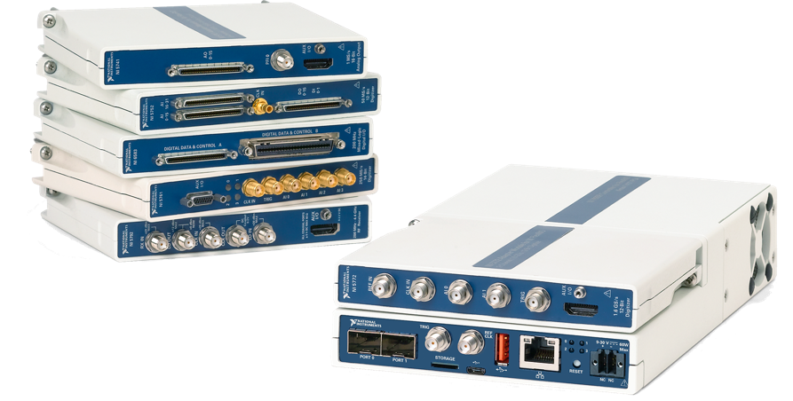
Controller for FlexRIO
Program with LabVIEW
Decrease development time with a single development environment to target both FPGAs and Processors
Leverage High Performance I/O
Process Data on Powerful Xilinx FPGAs
Kintex-7 K410T w/ 2 GB DRAM
2 x SFP+ Ports for 2.5 GB/s of data streaming
Reference clock and trigger inputs for synchronization
Deploy your Solution
667MHz Dual-Core ARM A9 Processor
NI Linux Real-Time OS
uSD Storage, USB, and 1 GbE Connectivity
Optimized for size, weight, and power
1.75 x 5.5 x 9.2 inches
3GS/s AI
1Gb/s DIO
4.4GHz RF

Slide 27
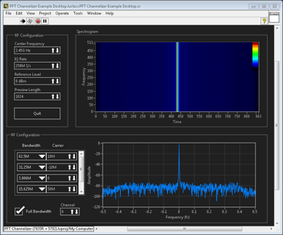
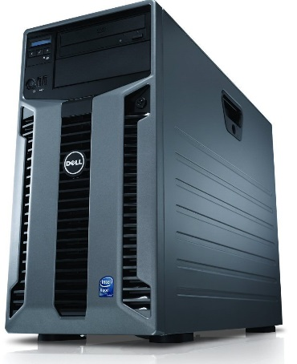
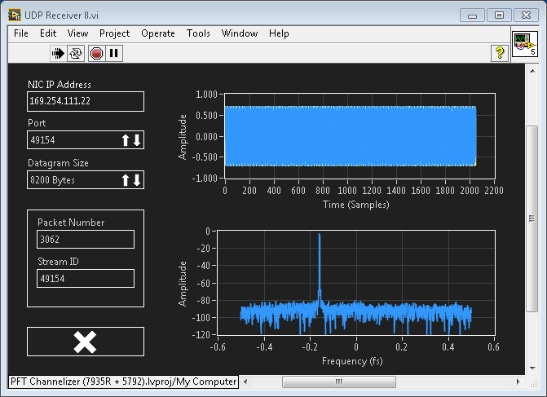
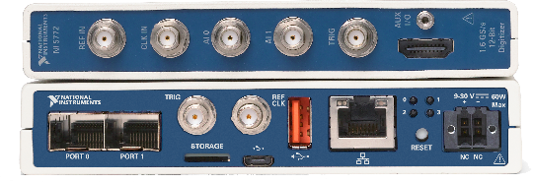
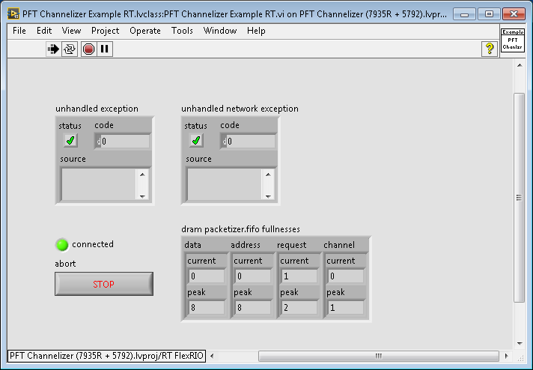
Example Overview
Remote Configuration
10 GbE UDP
I/Q Streaming
1 GbE
Configuration and Preview
I/Q Processing
Configuration Server

Slide 28
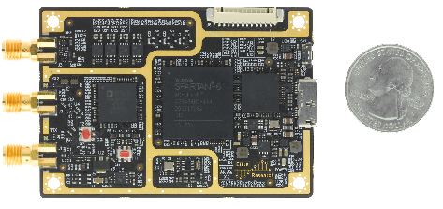
B200mini
Small form-factor SDR
1x1, 56MHz IBW
USB 3.0 mini-B, bus powered
Tx/Rx & Rx2 Antennas
Spartan 6 LX75
B200 driver
RefCLK/PPS Input
89 × 55 mm (3.5 × 2.17 in)
Enclosure (Optional)
Extended Temperature (Optional)
USB 3.0
Type B Mini Connector
USB 3.0
PHY
(FX3)
XILINX Spartan6 LX75
UHD Transport Control Time Sync
Analog Devices Integrated RFIC
AD-9364
TX_DSP_0
SMA
RFA TX/RX
TX_DSP_1
SMA
RFA RX
SMA
EXT_REF
System Clock & Timing

Slide 29
USRP E-Series Overview
Specs
Frequency Range: 70MHz - 6 GHz, 10dBm power output
2x2 MIMO standard configuration
~ 50 MHz BW / channel
Xilinx Zynq-7020
ARM Dual-Core Cortex A9 @ 667MHz
1GB Processor RAM
512 MB FPGA RAM
120x90x50 mm, 375g
3-9 W
Applications
Mobile Network research
Network testbeds
Small, portable, low cost spectrum monitor
Small UAVs
Handheld universal communicator
Features
I/O: GigE, Audio in/out, USB 2.0 Host, GPS In
Micro SD memory card slot
Invensys MPU-9150A 10-axis IMU
3-axis MEMs Gyro, Accelerometer & Magnetometer
Barometric Altimeter
U-BLOX AMY6-M GPS Receiver
Derivatives
Waterproof - IP67
4 Rx to TDOA/DF Applications
OEM/Unboxed
Battery

