Slide 1
A Broad View of Spectrum Measurements
NSF Spectrum Measurements Workshop
IIT, Chicago, IL
April 6, 2016
Dr. Preston Marshall
Principal Wireless Architect, Google Access
Chair, Wireless Innovation Forum
Spectrum Sharing Committee
pres@google.com

Slide 2
Spectrum Measurements Need to Extend beyond Observatory
Observation of spectrum occupancy important, but other types of spectrum measurement also important
Biggest obstacle to effective (dense) spectrum sharing is uncertainty in estimating least possible propagation loss
New opportunities for fundamental changes in our understanding of micro and nano-level propagation opening
  Now – Generic loss of specific scatter types from “Big Data” regression of millions of measurements
  Ultimate – Crowd-sourced, localized, building/locale specific measurements self reported by spectrum sharing devices

Slide 3
Real World Deployments can Achieve Much Greater Density
Google Micro-path Model Data
We have collected over 1,500,000 propagation points in dense/semi-dense environments
Data shown is for benign environment with low buildings in MTV
30 dB in r² is 2⁵ (32 times) in range, and 2¹⁰ (1,000 in density) impact
Plan to regress against Google Earth path analysis (buildings, trees, …)
Measured Path Loss
Free Space Estimate (L-R
Additional Scattering Loss
Lost Opportunity for Spectrum Sharing
From Google Ex-Parte filing on Feb 16, 2016

Slide 4
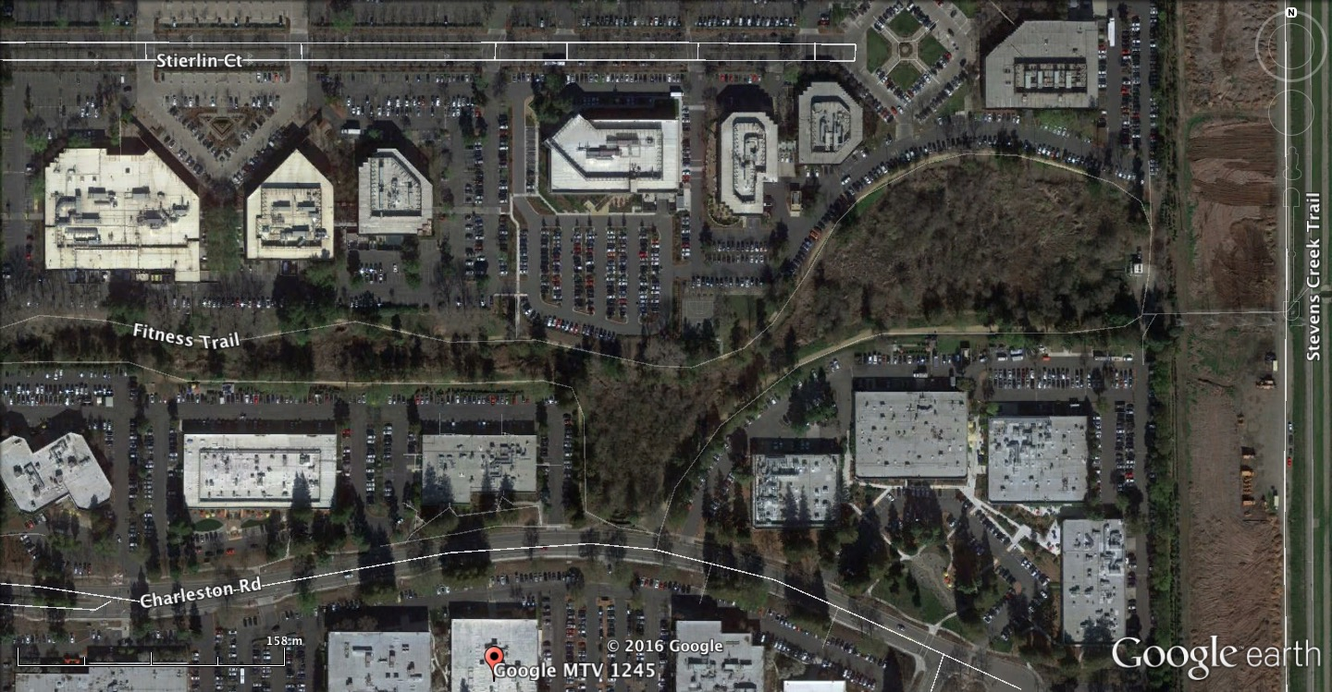
Micro and Nano Models
n meters through foliage in summer
For this building,
Learn Loss:
  Through interior wall
  Between Floors
  Through Exterior Wall
n meters through commercial space
Radio
2 building entry/exists
Micro-Model
Radio
Radio
Radio
Nano Model
Radio
Radio
Radio
3 Main Street
1 Main Street

Slide 5
We Would Like to See
Community Standards for:
  Archiving of Static Measurements (Observatory)
  Archiving of Path characteristics and Loss
  Requesting and self reporting by spectrum sharing devices (such as required by FCC 3.5 GHz regs)
  Embedded functionality in dedicated sensing devices
  Analytic tools to operate on all of the above
Multiple, independent collection and anaytic efforts to populate all of these

Slide 6
Thank You
Dr. Preston Marshall
Principal Wireless Architect
Google Access
pres@google.com

