Slide 1
Rohde & Schwarz USA, Inc.
NSF Workshop on Spectrum Measurements & Spectrum Management
Randy Neal
System Engineer
San Antonio, TX
randy.neal@rsa.rohde-schwarz.com
COMPANY CONFIDENTIAL

Slide 2
Introduction to the panelist
Randy Neal
System Engineer
San Antonio, TX
randy.neal@rsa.rohde-schwarz.com
COMPANY CONFIDENTIAL

Slide 3
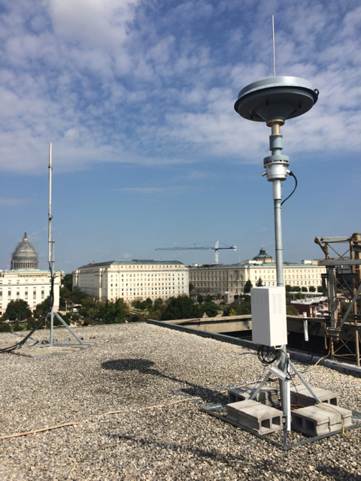
Overview
Importance of Receiver Sensitivity
Types of Measurements
Recordings
Direction Finding
Classification
COMPANY CONFIDENTIAL

Slide 4
Geolocation Technology Considerations Receiver Performance
Anyone who has looked at spectrum in the past years understands it can be bit of the “Wild West” when it comes to what transmitters are doing on air
Many more transmitters on air, and more closely spaced than ever before, and growing more by the day
Any good receiver system has to operate in this environment, and obtain results even for low level signals in the midst of higher power transmitters
COMPANY CONFIDENTIAL

Slide 5
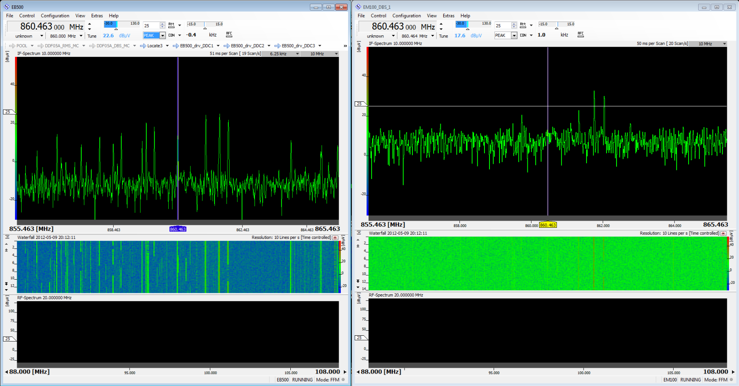
Geolocation Technology Considerations Receiver Performance: Preselection
The most prominent feature which separates a true receiver from a Spectrum Analyzer is a high performance front end preselection.
Preselection is a filter system used to block higher power out-of-band signals which would end of over-driving the detection circuits, or cause the receiving system to add attenuation to protect detection circuits, and therefore degrade sensitivity
COMPANY CONFIDENTIAL

Slide 6
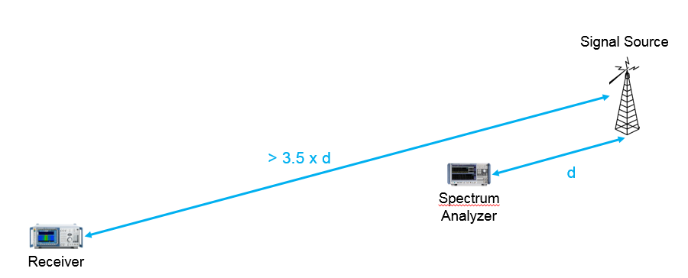
Geolocation Technology Considerations Receiver Performance
When the signal environment is challenging, you need to have a robust instrument for signal acquisition.
For example: a robust receiver in a dense or difficult signal environment can be 10 dB more sensitive than even a high performance spectrum analyzer
Receiver can therefore be almost 3.5 times further away from signal source!
Not only does it provide for better results (ie, system performance does not impact signal quality), but having a more robust receiving system can improve coverage range for measurements, therefore reducing overall number of sensors needed to cover a given geographic area
`
COMPANY CONFIDENTIAL

Slide 7
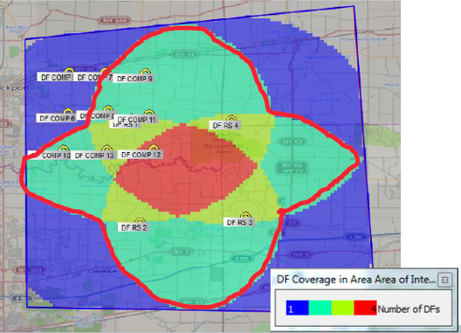
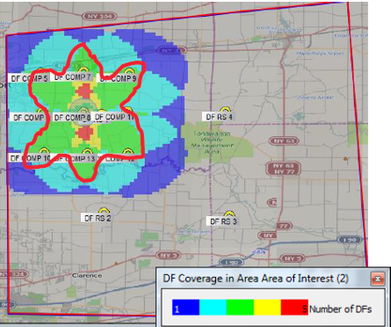
Geolocation Technology Considerations Deployment Economics
How does receiver performance impact deployment considerations
Some basic field testing between different grades of receiver hardware has shown more than 20 db of displayed SNR difference (same signal and setup conditions)
DF Coverage Results
5 W transmitter at 2 m height assumed, 10 meter RX antenna height
No terrain accounted for (i.e. flat ground, roughly 30 km square shown)
COMPANY CONFIDENTIAL

Slide 8
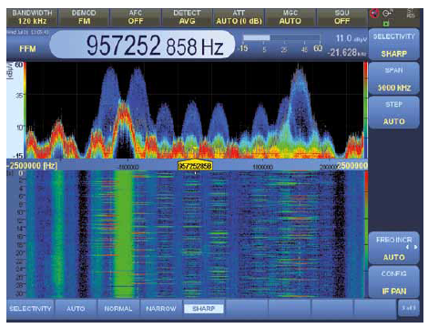
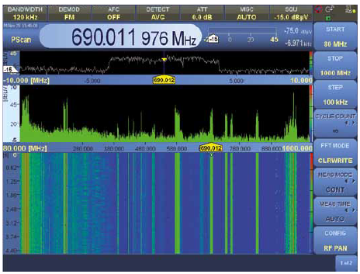
Measurements: Recording
Can you record? Record what?
System Independent Measurements (Field Strengths)
FFT data
IQ Data
Mission Data, Audio / Text, Classification Results
Dumb versus Intelligent Recording
DF Results
Geo-Locations
COMPANY CONFIDENTIAL

Slide 9
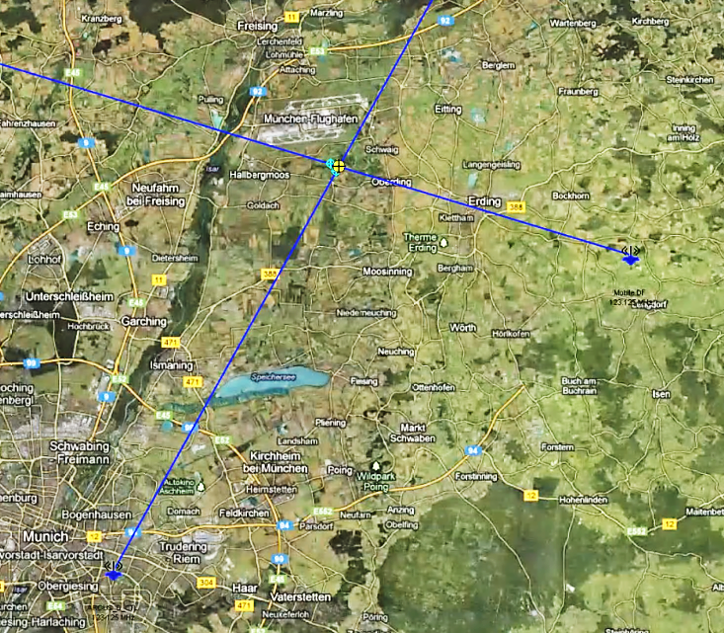
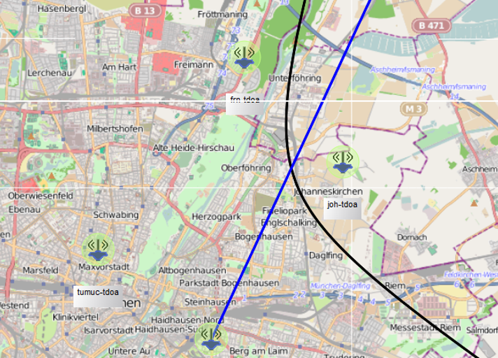
Measurements: Direction Finding
Automatic Lines of Bearing
Mobile application able to deal with multipath
Tipping of other measurements
Alarming and storing of Geolocations
COMPANY CONFIDENTIAL

Slide 10
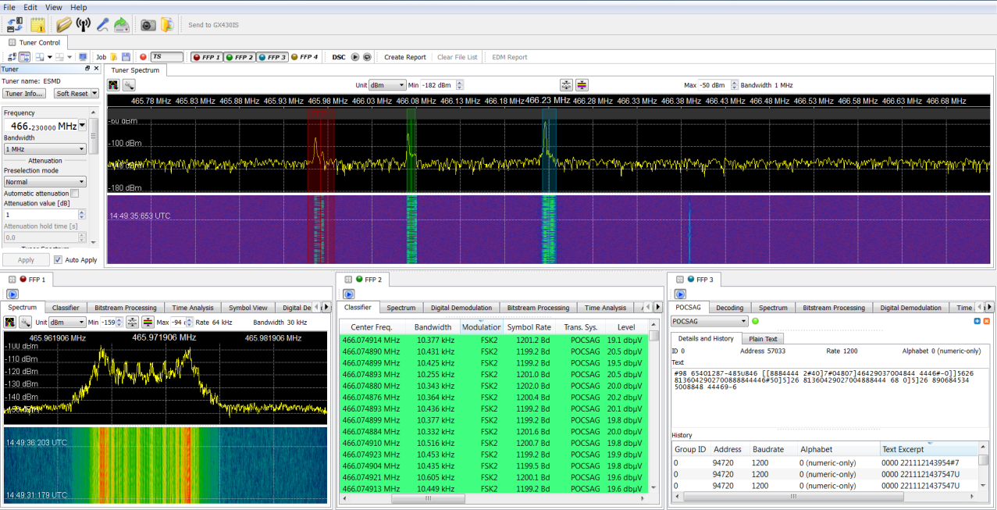
Measurements: Classification
Spurious Emissions are detrimental for Automatic Detection / Classification Systems
Use 2 types of ways to classify a signal
Conventional – measures signal parameters
Shape Detection – examines only spectral shape
COMPANY CONFIDENTIAL

Slide 11
Summary
Receiver specs should be considered for environment
One size does not fit all
Types of signals being detected need to be understood
Efficient and reproducible measurements and reporting structures are key
COMPANY CONFIDENTIAL

Slide 12
Questions?
COMPANY CONFIDENTIAL

