Slide 1
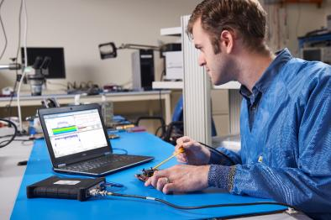
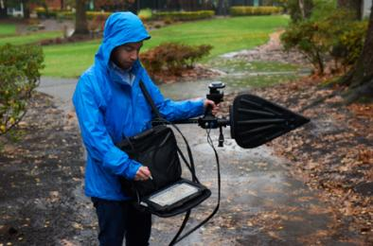
Trends in spectrum management
Crowded Spectrum
“Interference of things”
Need the answer, not the data for field operators
Need for remote acquisition and analysis elsewhere
Disaggregated collection
Budget constraints especially in developing countries
Transients matter
Intermittent signals can be the toughest to manage
Notes:
The biggest driver in wireless R&D at the movement is the Internet of Things. This is driving more and more consumer and industrial devices to require wireless capabilities.
With the explosion of wireless connected devices comes the potential for interference problems. There is an old saying from Spectrum Managers: the only reason you don’t think you have interference is because you haven’t looked. With more RF devices comes more issues for regulators of the spectrum to ensure licensed users remain free from issues. There is a risk that the Internet of Things becomes the Interference of Things, and to address that, Spectrum Managers will need a new breed of tools to help identify and locate these inherently hidden potential interferers.

Slide 2
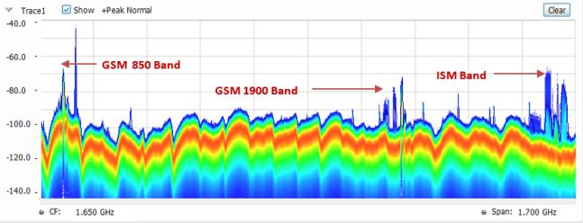
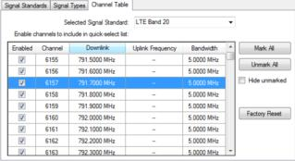
Scan
Channel tables help user easily set up instrument
DPX helps find signals of interest you can’t see with conventional spectrum analyzers
Instrument setup made easy
with Channel Table
Panorama Scan made with Swept DPX in
SignalVu-PC software
Notes:
Taking a closer look at how people use field spectrum analyzers: a large portion of managing the spectrum, whether you are a government employee for a regulatory agency, or work for an operator of a private communications system, you will need to start to look for interferers by looking at the whole spectrum. The expression used is “from DC to Daylight”, but most of the time it would be focused on areas of interest like the cellular band or some critical air traffic control radar/communications bands.
The new features with SignalVu-PC address this need well with Channel Tables based on many wireless and broadcast standards. This lets the user quickly set up the instrument and start taking measurements.
With DPX, you can see signals that other analyzers miss due to the fast update rates provided by modern PC’s. DPX means “Digital Phosphor Spectrum”, and was a term made by Tektronix when replacing some of the Analog scopes with Digital scopes. The problem was that even though Digital scopes were a real breakthrough, there was still some insight for engineers using the old Cathode Ray Tube screens. These Analog scopes with CRT displays showed a brighter trace for signals that happened more often, or a lighter trace for a rare event.
In the same way, DPX can show short duration signals of interest. In the past, these short duration events may not have been as much of a problem, but modern digital communications use busted signals. This means that if the interfering signals happen at the same time a burst is being transmitted, then it may cause a data packet to be lost, requiring re-transmission, and eventually slowing down the network (at best).
DPX with the RSA500 and SIgnalVu-PC is shown here to work over a 1.7 GHz span, and steps across in 40 MHz increments. This can be invaluable to reveal interfering signals that other analyzers miss. Any signal lasting at least 100 useconds has a 100% chance of being seen at full amplitude within each of the 40 MHz real time steps. This scanning of the spectrum can greatly improve the chances of seeing an interfering signal that would be missed by other spectrum analzyers.

Slide 3
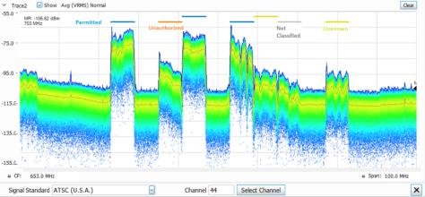
Classify
User defined Signal Survey to help detect what is different from expected
Quick signal compare with library of possible signals
Match signals of interest based on criteria
Bandwidth
Frequency bands
Signal type: TV broadcast, Cellular, WLAN
Signal Survey
Signal Identification of North American Digital TV signal
Notes:
The Signal Survey allows the user to establish zones of the spectrum & identify which of these are expected, unauthorized, or unknown. This can quickly help eliminate areas of the spectrum where no more time looking is required if the signals present can all be accounted for. This may be done over a wide frequency span.
The next step for any spectrum manger is that once they have discovered a signal of interest through scanning and staring at a more narrow bandwidth, they need to classify the signal of interest. New features avaible allow the user to compare the basic signal parameters: frequency, bandwidth, filter shape of the signal, to determine whether that is an expected signal or not. Staring at a signal of interest and classifying it as best as possible is important to give clues as to what the Spectrum Manager might be looking for.
For example, if there is an unauthorized signal of interest in the cellular band that looks like a broadcast signal, then it might be a small, illegal transmitter someone is using to transmit a signal where they don’t own the spectrum.

Slide 4
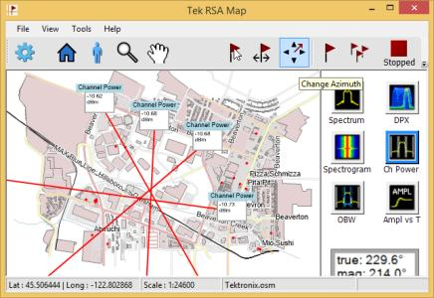
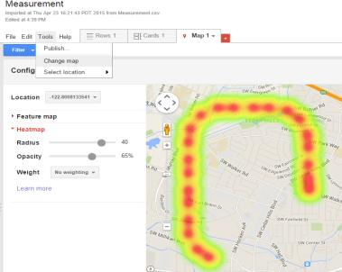
Locate
Integrate measurements with the map
Use smart antenna to easily plot results and determine direction of the signal of interest
Make results available for offline processing – heat maps
Available Smart Antenna with
internal electronic compass:
DF-A0047
Basic triangulation enabled with DF antenna,
SignalVu-PC features
Heat map enabled by results from RSA500
imported to Google Fusion Tables
Notes:
The next step is for the Spectrum Manager to locate the signal of interest. It is useful to have measurements integrated with a map when doing this step. The resulting measurements can also be taking with a “smart” direction finding antenna, then the azimuth line to the highest signal strength can be plotted on the map. If this is done several times across a large area, the Spectrum Manager can start to locate where the signal is transmitting from.
Indoors, the problem is more difficult. The issue is that the azimuth line to the highest signal strength isn’t always in the same direction as the transmitter of interest lies. There are many copies of the signal bouncing around inside an area, and these might not help to triangulate on the transmitter.
Another way is to use an omni-directional antenna and plot a heat map of the signal strength. This can be a useful way to find the signal of interest in a closed space.

Slide 5
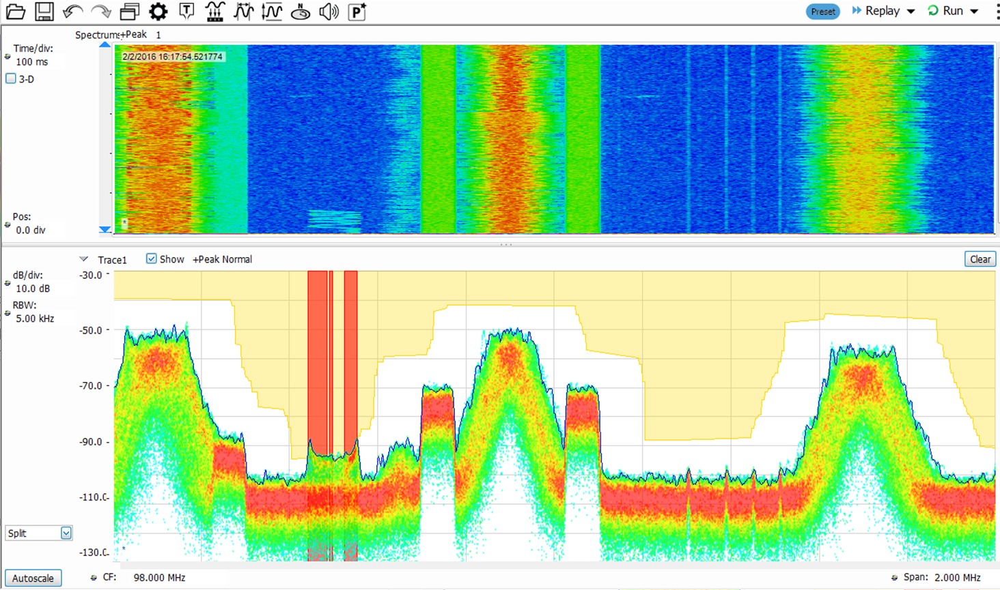
Record and Playback
Continuously capture all signals
Create a seamless recording of signal
Simplify common tasks:
Document a new radio link coming on line
Record an interfering signal for
later analysis
Record interfering signals in the field
Perform mask testing to pinpoint signals of interest and act on failures
Beep, stop, store picture, store data
Playback signals and events of interest
Add, change displays, settings

Slide 6
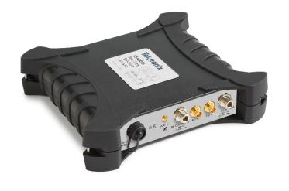
RSA500 Series Real Time Spectrum Analyzer
All-in-one field tool
Spectrum Management, Regulatory Monitoring
See signal compliance at a glance using industry’s best open signal database
Interference Hunting
Quickly discover co-channel interference and transients with DPX, direction finding, GPS mapping
Installation and Maintenance
Complete cable & antenna testing easily with DTF, VSWR
Field Ready
Take the weight out of your hands – carry a tablet, keep the instrument in your bag
Notes:
The RSA500 is the battery powered version with a rugged form factor. An open signal data base allows users to make custom tables to help users in the field quickly and simply set up the analyzer and search for interfering signals.
In the field, the RSA500 is an unmatched interference hunter with performance and application measurement displays not available in other analyzers. Finding co-channel interfering signals with the DPX display is important, then mapping and use of the integrated Direction Finding antenna helps to locate interfering signals of interest.
For operators of radio networks, it is also important to have a single tool to complete the job of installing and maintaining communications equipment. The RSA500 with SignalVu-PC offer new capabilities for Cable and Antenna measurements not found in previous Tektronix field spectrum analyzers.
The form factor is surprisingly helpful because now the user only needs to carry a tablet PC, while the instrument can stay in a backpack or the supplied shoulder case. This can increase the amount of time the field operator can use the instrument without fatigue.

Slide 7
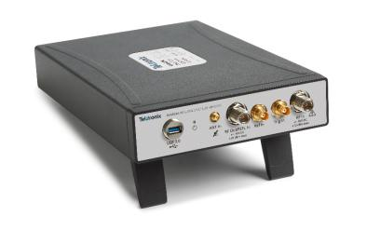
RSA600A Series Real Time Spectrum Analyzer
Essential Lab Tool for wireless test
R&D
Powerful debug tools like DPX and Domain correlation
Address today & tomorrow’s most popular wideband signals with 40 MHz bandwidth
Design Validation
Complete support for popular IoT wireless standards
Manufacturing Test
Measurement speed, performance in the lab and automated testing
Notes:
In the lab, it is important to have a spectrum analyzer with enough performance satisfy challenging RF device specs. The RSA600 fits in well in the lab with powerful RF specs for R&D, Validation, and even Manufacturing Testing of wireless devices.

Slide 8
One Software Package
RF Analysis for all Tektronix instruments
Notes:
Tektronix has been pursuing a strategy of extending signal analysis software to multiple platforms. This allows a common user interface, and helps get more new features to more products in less time.
Last year, we introduced Wireless LAN or Wi-Fi analysis capabilities on the MDO4000B with a PC using SignalVu-PC. This year we just added support for Bluetooth. We plan to have a steady cadence of new SW releases, and the exciting part about this is all these new capabilities will be available on SignalVu Software and any platform that supports it. So the current and future features will be on the RSA5000, the RSA6000, all Tektronix’ Windows based Oscilloscopes, the MDO4000B when controlled by SignalVu-PC software, and any future platforms we may launch. This also means that all of these analysis platforms will have the same look and feel when using them for RF measurements with the SignalVu software.

Slide 9
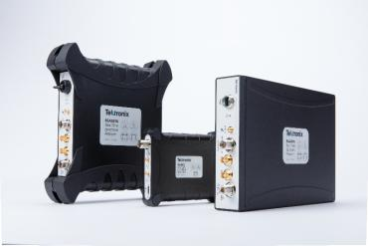
Summary
USB Spectrum analyzer family
Expanding USB Spectrum Analyzer offering
RSA500A Series for Field RF
RSA600A Series for Wireless Lab Applications
RSA306B for General Purpose Applications
Software for spectrum management
Mapping
Recording
Classification

Slide 10
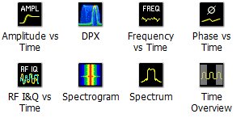
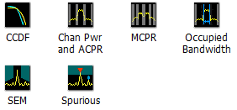
SignalVu-PC Software
SignalVu-PC still offers 17 measurements standard in the free version
New standard features include
Improved User Interface
Standards-based channel navigation database
Tracking generator application
UI enhancements for tablets
Node Locked and Floating Licenses available
New capabilities offered
Signal Classification Database
VSWR/Return Loss, distance-to-fault, cable attenuation (shipping Q2 2016)
Mapping and Signal Strength (Updated with Smart Antenna support)
LTE Field Analysis with BTS ID
Improved signal mapping and geolocation features
Measurements with free software
Notes:
The base version of SignalVu-PC is free software that can be downloaded from Tek.com. With this launch, we have updated the user interface to give higher contrast to some of the controls, and more touch screen friendly.
The optional features are all SW and increase the capabilities of the with features for the field (Signal Classification, Mapping/Signal Strength), and features for both the lab and the field (record/playback, cable and antenna test measurements: VSWR, Return Loss, and Distance to Fault).

Slide 11
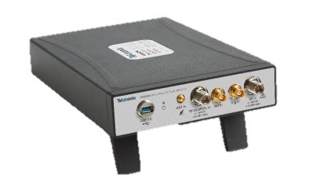
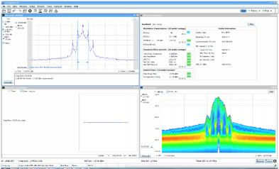
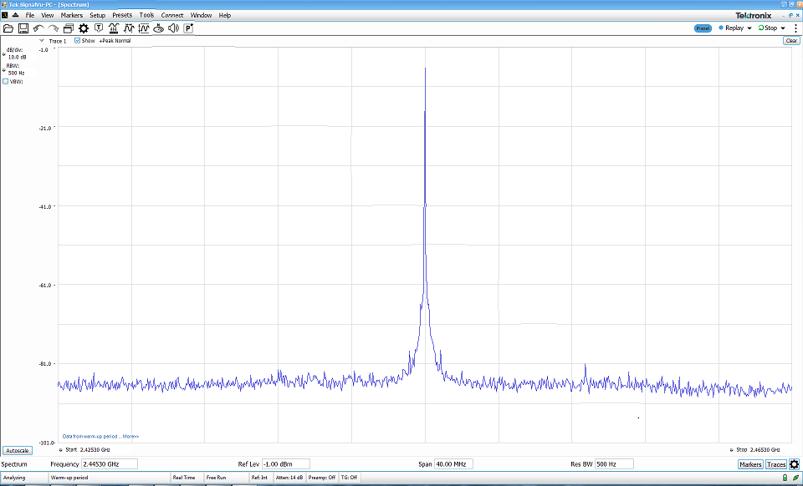
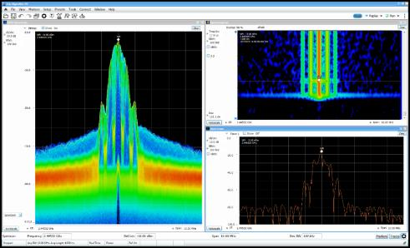
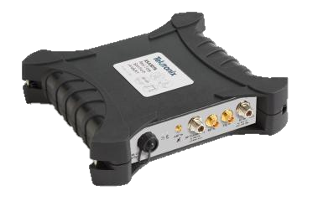
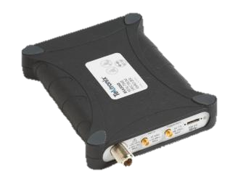
From Basic RF to Advanced Analysis
Three platforms, one customizable software
Traditional Spectrum Analyzer Functionality
17 Automated Measurements
Lowest Price
Real-time Measurements
Vector Signal Analysis
Spectrum Masks
Compliance Testing
Mapping and Signal Survey
Full Functionality at a Low Price
Notes:
From a basic (but important) Spectrum Analyzer measurement to complex, application specific measurement tasks like mapping signal strength RF wireless coverage or characterizing Bluetooth device for compliance to the SIG (Special Interest Group) with RF parametric tests, SignalVu-PC is a great tool.
All of our USB Spectrum Analyzer are powered by the same software. You don’t need to compromise application features when going to a lower cost analyzer. This means that all of the Tektronix spectrum analyzers can measure basic spectrum, perform wireless standards measurements, make pulsed signal measurements, or record and playback long duration signals of interest.
With SignalVu-PC software powering the USB Spectrum Analyzers, you are getting full functionality at a low price.

